Slide 1
AASE Conference Presentation Proposal FAQs

Slide 2
Pick Topic
Academic Support
Bar Exam
DEI
Professional Dev.

Slide 3
Pick Format
Interactive Workshop
Lesson in a Box
Panel Discussion
Group Discussion
Other Idea

Slide 4

Pick Timeslot
5-minute poster
nearly unlimited
20-minute mini
seeking 2 to 6
45-minute full
seeking 8 to 24
75-minute plenary
seeking 1 or 2

Slide 5
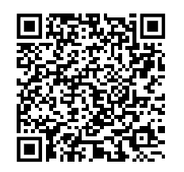
Proposal Form – Due Jan 12, 2026

Slide 6
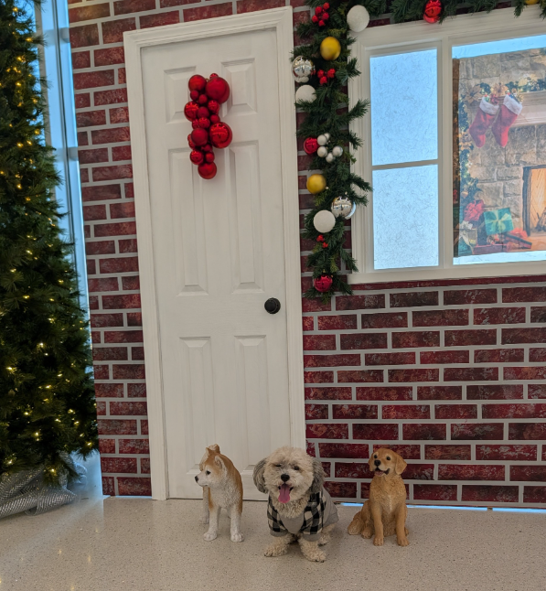
Final Remarks
We are here for you. We are happy to:
- answer your questions
- brainstorm with you
- review your draft and offer feedback
Happy Winter Break!

