Slide 1



Telling a Better Story
Making the Heart & Mind Connection with Data
July 2023

Slide 2

Proverb

Slide 3
3 R’s
Making the Heart Mind Connection
Rethink your connection with data
Revise your reports
Retell your story
Notes:
There are many ways to make the heart and mind connection.
These 3 R’s are a way to conceptualize the rebalancing of the heart and mind story to increase the impact of the message:
First - Reshape your connection with data – know what data you need to improve your internal operations and enhance your external reporting
Second - Revise your reports so that current and future funders and stakeholders can see your value
Retell your story with data, so that the heart and mind connection is made.
These 3 R’s will frame our discussion
NEXT SLIDE

Slide 4

Making the Heart Mind Connection
Rethink your Connection with Data
Photo by Marcus Winkler

Slide 5
Program Reports
Build on Data You Have
Population: Our organization serves X number of youth/year
Demographics: Youth are ages 1-25, with x% gender, race, ethnicity, etc.
Program Outcomes: Placement, permanency, well-being, stronger families
Services & Care Coordination: Type & number of services-case management, safety management, foster home recruitment/licensing,

Slide 6
Rethinking
Your Connection with Data
Value Driven
Data to Inform & Transform
Organizational Awareness
Actionable Data
Outcomes of Interest

Slide 7
Organizational Awareness
Improving Operations & Outcomes
Improves Decision Making Process
Helps You Understand Your Program
Enables staff to access and share information easily
Helps identify areas for improvement
Enables real time monitoring of progress and performance

Slide 8
Outcomes of Interest
Program Reports
Case management, placement, utilization management, visitation, transportation
Foster Home recruitment and licensing
Foster Home and Group Home payments
Adoption promotion, recruitment, and support
Training for case managers, foster/adoptive parents, and other child welfare staff
Services to children and families such as safety management, family support
Prevention services
In-Home & Out of Home Services, EBPs
Safety, Permanency, Well-Being, Strengthening Families

Slide 9

Useful, Actionable Data to Inform and Transform
Access - Timely and appropriate
Quality of Services & Operations
Coordinate Services with other agencies
Engagement & Satisfaction of youth & families
Outcomes for youth & families that show positive trends
Cost of services and overhead

Slide 10
Value Driven
Quality/Outcome
Cost
VALUE

Slide 11
Impact Driven
Build on Data You Have
VALUE
Are you efficient in gathering data and producing reports for funders?
Do you measure the outcomes associated with your services
Do you measure overall service impact and cost?
Can you produce reports that make the HEART & MIND Connections for stakeholders and funders?

Slide 12

Making the Heart Mind Connection
Revise your Reports

Slide 13
Data Sources & Report Tools
Software for Foster Care/Social Services
EXCEL spreadsheets
Tableau/Crystal Reports/Accounting
Other

Slide 14
Heart & Mind Stories
The Enterprise Reports
Program Reports (External)
Management & Cost Reports
(Internal)
Quality & Outcome Reports
Heart & Mind Reports (“Enterprise” )

Slide 15
Reshaping Data Management
Implement
Discovery
Your Organization
Redesign
Design
Develop

Slide 16
Build or Buy
“Enterprise-Wide”
Identify key internal leaders to design the project & Create an Action Timeline
Conduct a Data Scan of Care management systems, spreadsheets Tableau/Crystal, Invoices/Claims, etc.
Build a Data Warehouse
Roll it out to internal leaders, do training, and use the reports
Identify metrics that matter for the heart/mind connection, required reports, KPI’s, assessments, etc.
Visual Depiction of Data - Dashboards, Tables, Charts & Reports

Slide 17

Making the Heart Mind Connection
Retell your Story
Photo by Etienne Giradet

Slide 18
Storytelling - the Best Marketing
Communication
Service
Brand
History
Youth Needs
Trust
Experience

Slide 19
Recap
Changing the Data Focus
Value Driven
Data to Inform & Transform
Organizational Awareness
Actionable Data
Outcomes of Interest

Slide 20
Rebalance
Heart & Mind Story
Impact Driven: List 3 outcomes that you think are most impactful for Youth/Families
Organizational Awareness: List 3 areas/functions in which the organization could do a better job
Data to Inform & Transform: List 3 reports you would like to have to inform and transform your organization
Competition: List 3 outstanding competitors & what makes them different from your organization
Value & Impact Driven: List 3 messages/ideas you want funders &/or the community to know about your organization

Slide 21
Rethink, Revise, Retell
Heart & Mind Story
Define the Need
  How should our story change to be more competitive?
  What are the elements of a solid Heart Mind Connection?
  Review data currently collected & decide what new “Enterprise-wide” data & reports are needed
Develop an Action Plan
  Communicate with staff that change is underway
  Engage your team & Identify Champions & Resources
  Decide to Build or Buy
  Generate urgency with timelines & tracking of each action step
Communicate the Heart Mind Story to your staff, stakeholders and payers/funders.

Slide 22
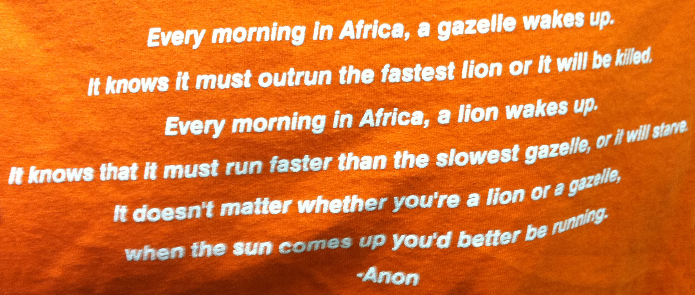
Proverb

Slide 23

Thank You
  Ann Boughtin MS, MPA
  615-498-4398
  aboughin@gmail.com

