Slide 1



FCC EQUITY, INCLUSION AND DISPROPORTIONALITY CAFE
Michael Bryant, Chief Operating Officer-Embrace Families
Esther Jacobo, Director- Citrus Family Care Network
Michelle Samuels, Director of Training-Citrus Family Care Network
Florida Coalition for Children 2023 Annual Conference

Slide 2

Objectives
Recap 2021 and 2022 Café's
Where Are We Now
Panel CEO's NE Region
Developing the Statewide Toolkit

Slide 3
Group Agreements
Everyone is open to share in the discussion
Everyone is respectful of each other
Everyone is solution focused
Everyone is Engaged and objective
What are some additional agreements we should have?

Slide 4

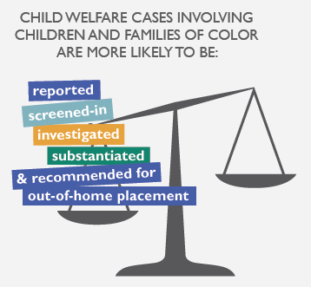
Why Are We Addressing
Equity Inclusion and Disproportionality(EID)?
Every child, youth, and family deserves effective supports and services to meet their unique needs.
Children of color are disproportionately represented in the United States foster care system.
In most states, including Florida, there are higher proportions of African American/Black and American Indian children in foster care than in the general child population.
Source: National Council of Juvenile and Family Court Judges
Source: National Child Welfare Workforce Institute

Slide 5

DCF Goals of Child Welfare Services
The prevention of separation of children from their families.
The protection of children alleged to be abuse, neglected, or abandoned including
provision of emergency and long-term alternate living arrangements.
The reunification of families who have had children placed with relatives or in foster homes or institutions.
The establishment of permanent living arrangements for children who cannot be reunited with their families or when reunification would not be in the best interest of the child.
The transition to self-sufficiency for older children who continue to be in foster care as
adolescents.
The preparation of young adults that exit foster care at age 18 to make the transition to self-sufficiency as adults.

Slide 6
Community-Based Care
Approach
Bring DCF Child Welfare Services Goals to the level of each community.
Increase local community ownership of service delivery design
Meant to Increase
Accountability
Resource Development
System Performance

Slide 7

Definitions
Racial Equity: Racial identity no longer predicts how someone will fare in the child welfare system related to assessment, service quality, or opportunities.
Disproportionality: The level at which groups of children are present in the child welfare system at higher or lower percentages or rates than in the general child population.
Disparity: The unequal outcomes of one racial or ethnic group as compared to outcomes for another racial/ethnic group

Slide 8

Disproportionality Data
Guided By Data

Slide 9
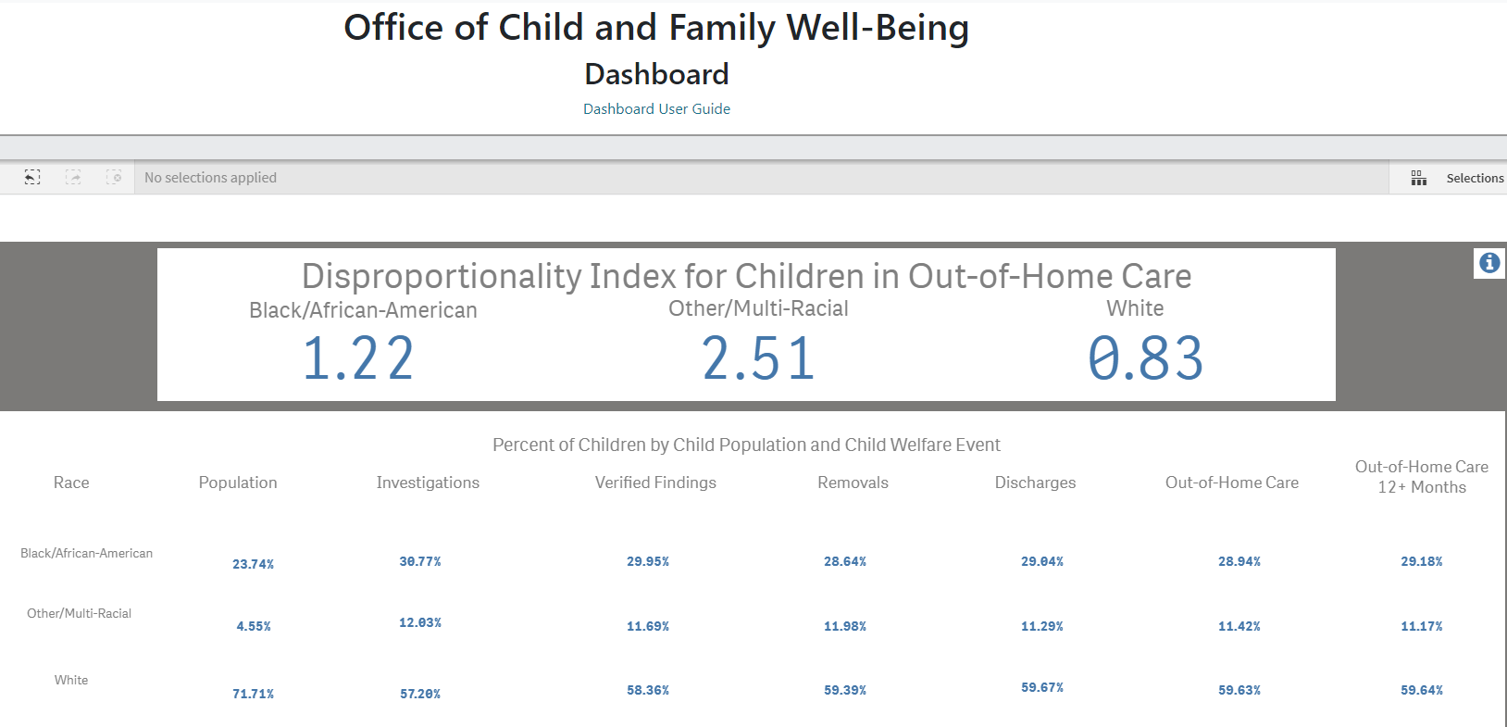
State of Florida Disproportionality Data
Data Source: Florida Department of Children and Families Office of Child and Family Wellbeing Dashboard
https://myflfamilies.com/service-programs/child-welfare/dashboard/

Slide 10
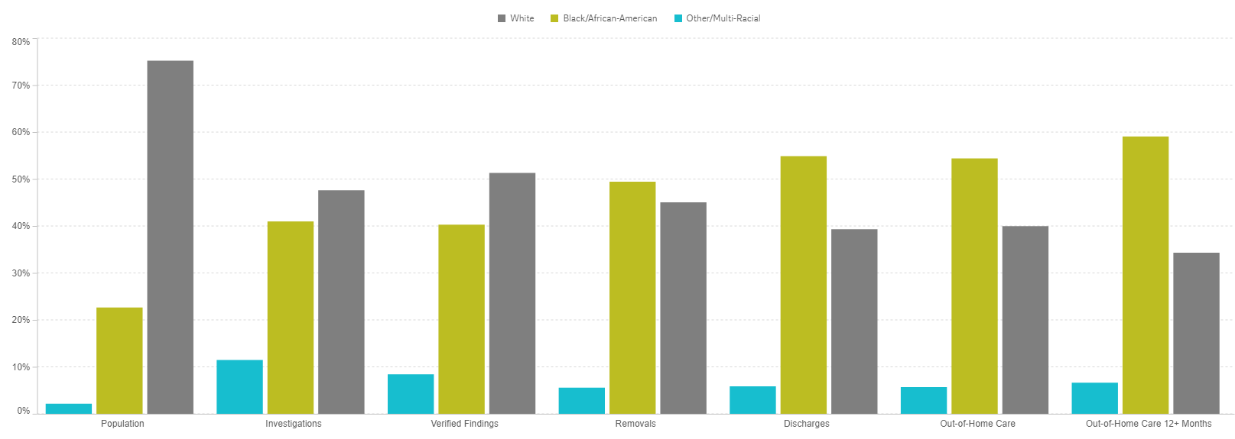
Circuit 11 Miami-Dade Disproportionality Data FY19-20
Miami-Dade Circuit 11 Data FY 19-20
Black Children Make Up:
23% of the child population
41% of Investigation
40% Verified Findings
49% Removals
54% OHC Placements
59% OHC 12+ months
Data Source: Florida Department of Children and Families Office of Child and Family Wellbeing Dashboard
https://myflfamilies.com/service-programs/child-welfare/dashboard/

Slide 11
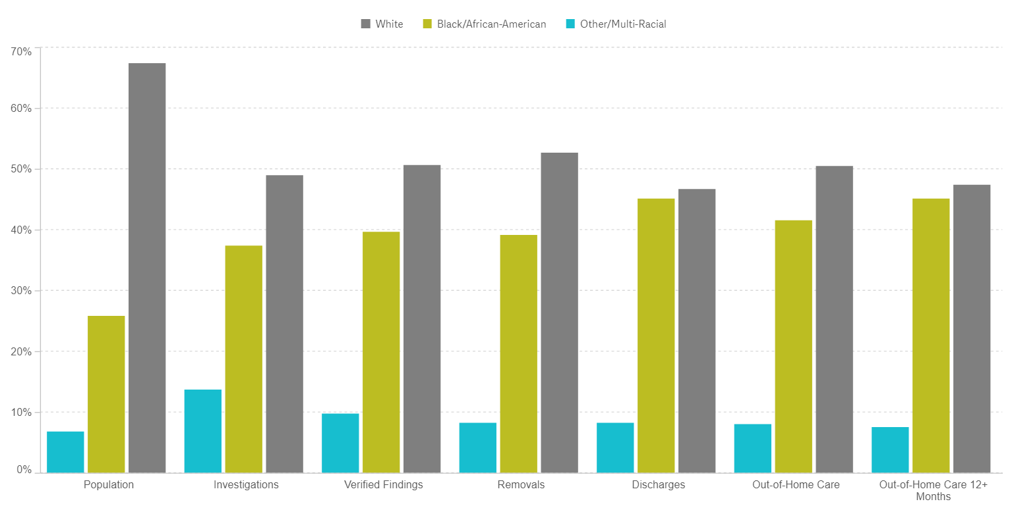
Circuit 9 Orange and Osceola County Disproportionality Data FY20-21
Data Source: Florida Department of Children and Families Office of Child and Family Wellbeing Dashboard
https://myflfamilies.com/service-programs/child-welfare/dashboard/

Slide 12
FCC EID Café 2021/2022
Recap

Slide 13
Recommendations
Youth Voice
Recommendations:
  Take purposeful steps to build trust with youth.
    Take them seriously
    Have them be messengers to other kids and youth in care that your organization can be trusted and will be respectful of them and their views.
  Ensure Youth Councils have a voice in advocacy work in Tallahassee and Washington, DC.
  Have youth be part of the procurement process for youth related services.
  Provide training for staff interacting with youth on how to have difficult/sensitive conversations, including use of non-violent language to improve communication.
Youth Councils
Recommendations:
  Have youth actively participate in the formation of the Youth Councils
  Youth residing in group homes may be a good starting point for forming a youth council.
  Forming Youth Councils that are similar to Family Advisory Councils that provide a consistent voice that is representative of the community.
  Have Youth Councils be standing committees of the board of directors
Access to Services and Resources
Recommendations:
  This is not just an issue for CBC Lead Agencies, other system of care and community partners need to get involved and buy in (i.e., law enforcement, education, Managing Entities, libraries).
  Create heat maps utilizing data from different sources (i.e., education, law enforcement, Medicaid eligibility, removals) to determine areas of greatest need and use as a road map to form community partnerships/ create community buy in.
  Establish coordinated discussions with leadership and direct care staff, and leadership and youth through forums to identify areas of need/gaps in accessing resources.
  Make purposeful efforts to identify, connect with, and share information (possibly including providing training to CPIs, case managers and therapists) about services available to youth and families.

Slide 14
Recommendations Cont’d
Assembling & Utilizing Data
Recommendations:
  Organizations can reach out to Casey to get local data for their community
  Know your audience: Reframe the data to show different members/components of the system of care what it means and how it affects them.
  Improve data collection across the state and ensure consistency in data collection to track changes over time.
Abuse Reports & Removals
Mandated reporter training and address implicit biases
  Since many reports come from educational settings, consider looking at data on education bias to determine if children of color are more likely to be labeled as aggressive as compared to their peers.
  What abuse reporting criteria is in place and how is that connected to removals.
Look at CPI data as CPIs make the decisions on removals in most cases.
Staff & Hiring
Hiring: Utilize blind resumes and conduct group interviews with blind resumes.
Collect internal data on staff demographics to ensure staff make up reflects the community and the population served. This should also apply to foster parents. Then, look at that data with an REI lens.
Provide training/surveys on implicit bias.

Slide 15
2023 EID Café Approach
Region by Region Approach with Support from the FCC SIRT EID Committee

Slide 16
Panel Discussion- NE Region

Slide 17
Toolkit

Slide 18
FCC SIRT EID
Subcommittee

Slide 19
Next Steps

Slide 20
Thank You For Participating

