Slide 1
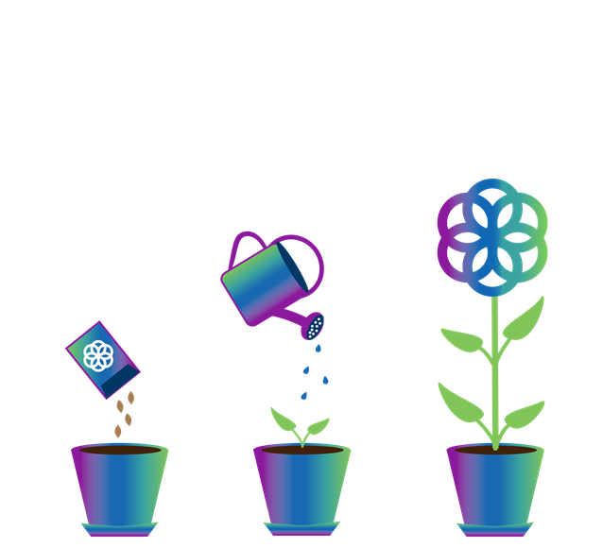

Together
ing
The Florida Institute for Child Welfare’s Approach to Innovative Workforce Programming
Kristina Finch, Associate Director
Florida Institute for Child Welfare
Lisa Magruder, Director
Florida Institute for Child Welfare
Florida Coalition for Children 23rd Annual Conference
July 18, 2023
Notes:
Welcome everyone and thanks for joining us today.
INTRODUCTIONS
The GROW Center began two short years ago and, in that time, we’ve made great collaborative strides toward the development of programs to support workers throughout the life of their career – from students considering entering the field to new workers to established leaders.
Today, we’ll be providing status updates on our three major programs, and acknowledging the partnerships that have made them possible.
If you joined us last year at FCC, you’ll see some significant updates. If you didn’t join us last year or are otherwise unfamiliar with the GROW Center, we’ll be providing a bit of 101/refresher so you are up to speed.

Slide 2


The GROW Center Defined
GREATER RESILIENCE OF THE WORKFORCE
The Institute’s GROW Center houses each of the Institute-related components of Senate Bill 1326 and creates a dynamic through-line from classroom to casework to retain workers who grow, competently, into leaders at all levels of the workforce.
The GROW Center is the umbrella under which all the Institute's professional advancement offerings are created, and all management and administrative tasks, curriculum development, and coordination of activities are conducted.
Notes:
So what is the GROW center?

Slide 3
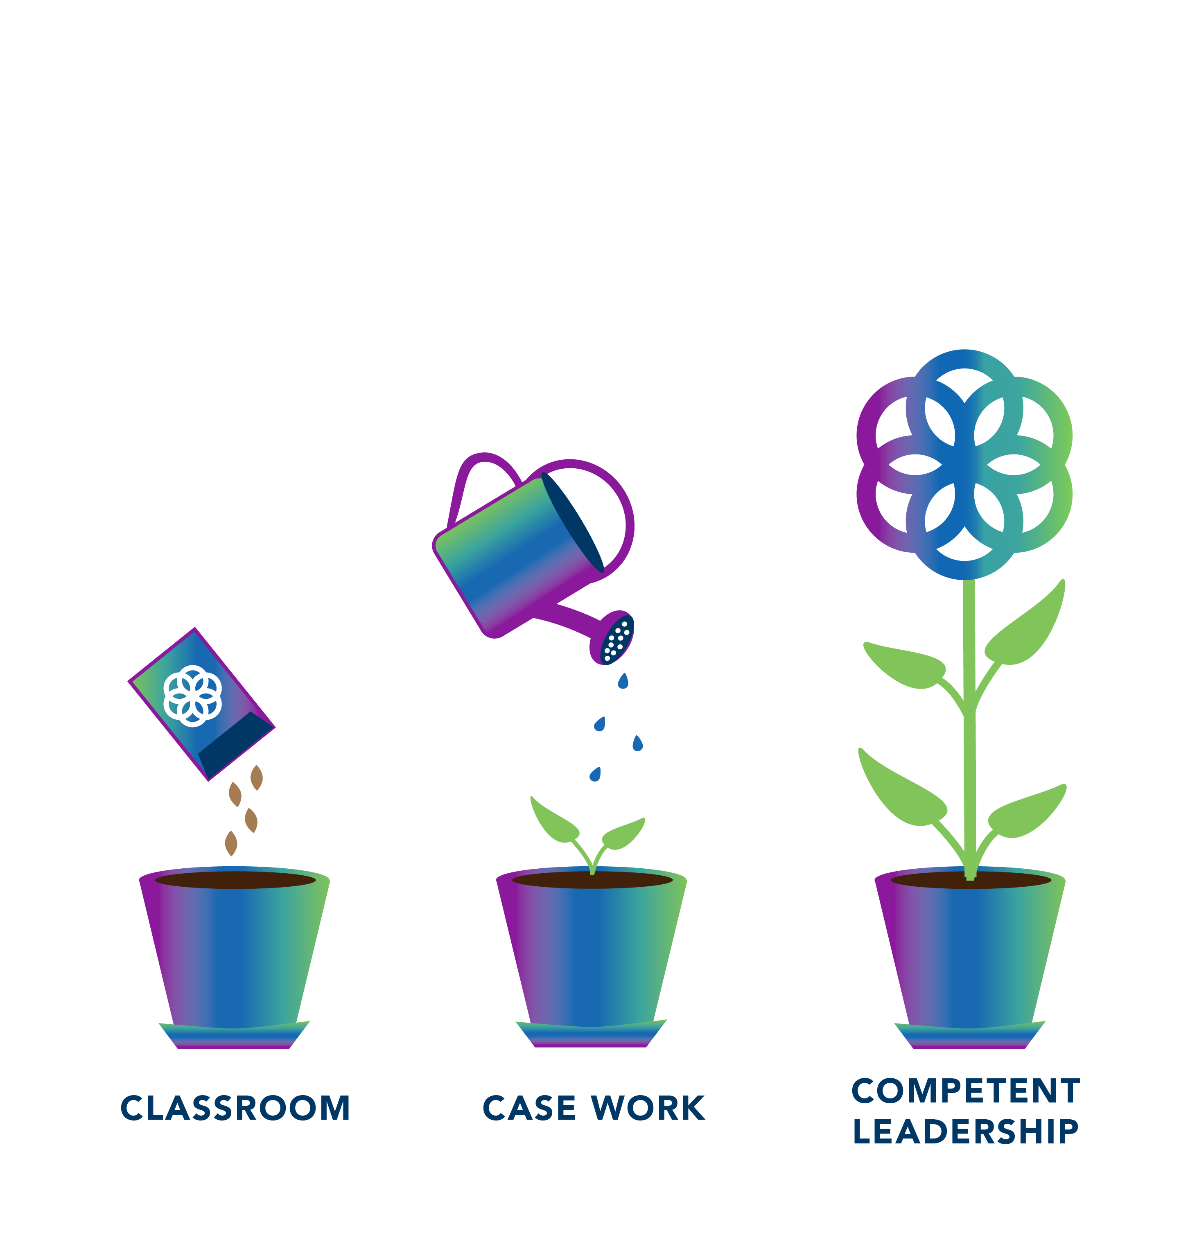
Our Goal
To create a continuum of learning opportunities and ongoing support for college students, recently trained personnel, and middle and upper management positions working in child welfare agencies to enhance learning and build capacity towards meaningful and systemic change within the statewide child welfare workforce.
Notes:
Preparing and supporting Florida’s child welfare workforce from classroom to case work to competent leadership. It really is creating a through-line, making sure that the child welfare workforce is equipped with individuals who possess the skills necessary for success.

Slide 4
What is a “thriving” workforce?
Increased Stability in the CW Workforce
Competent Leaders Embedded in All Organizational Levels
Improved System Partnerships
Enhanced Workforce Capacity to Cultivate Ongoing Well-Being Support
Notes:
What is our ultimate goal – the impact we want the GROW Center to have? A thriving workforce.
A thriving CW workforce is one that positively impacts outcomes for children and families and shows evidence of overall enhancement in job/career satisfaction and effective interorganizational partnerships led by experienced, collaborative, and competent leaders.
The GROW Center activities lie within each of these circles - and in the various “in betweens”. Each of our programmatic offerings are being created and delivered with these long-term outcomes in mind.

Slide 5
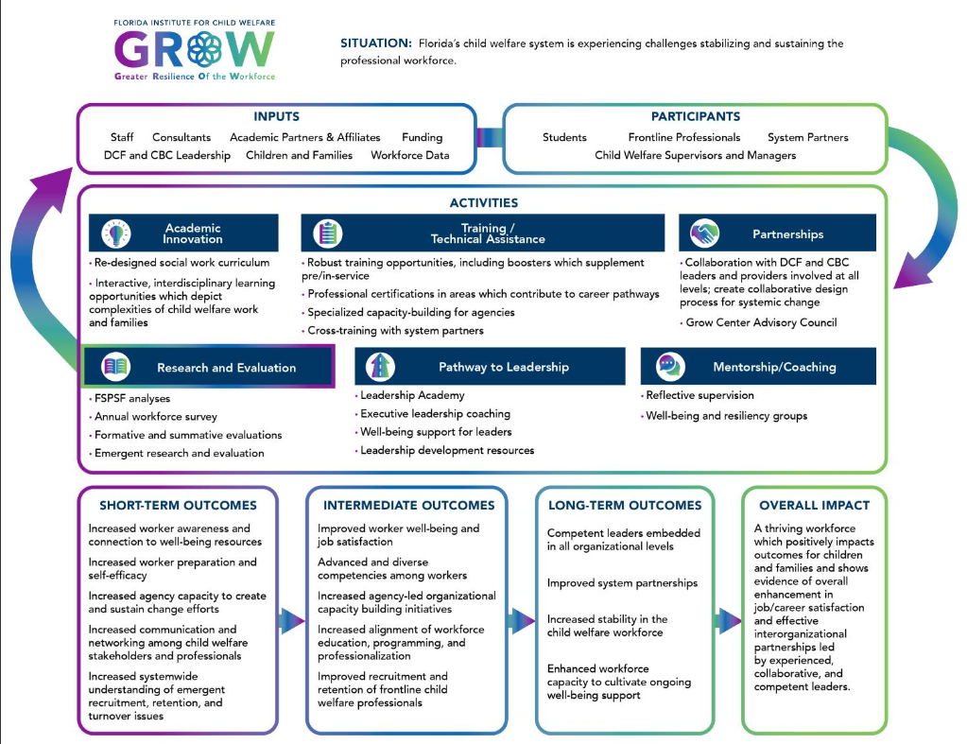
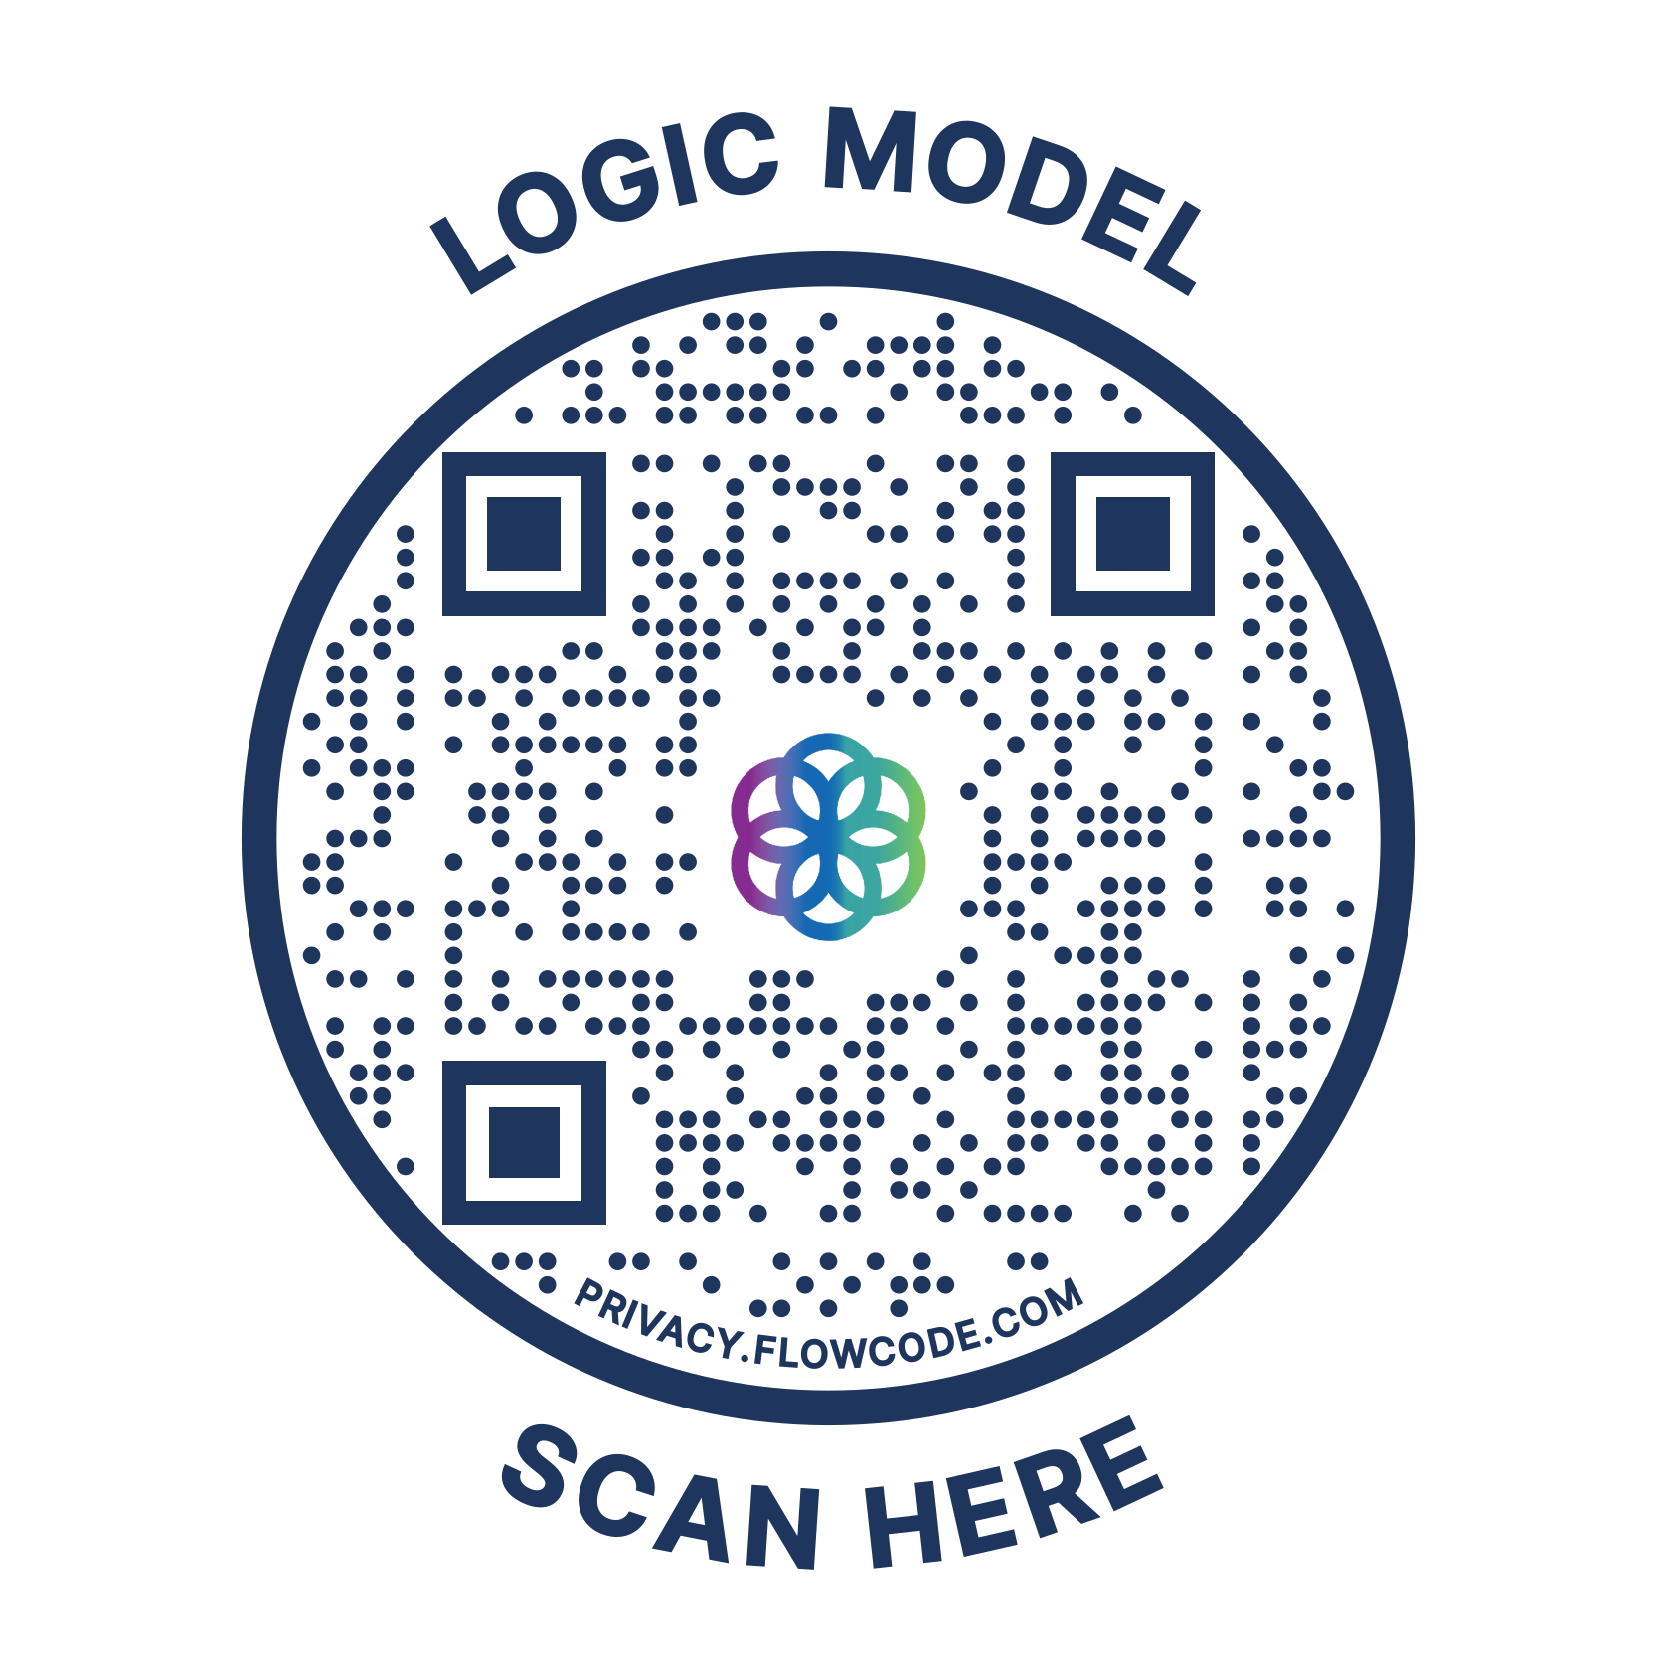
Scan for a Closer Look at the Logic Model!
Notes:
We won’t go in depth into all aspects of our logic model. Although we consider this to be a living document, it is our north star as we chart a course toward that thriving workforce. Importantly, we acknowledge one are on piece of a large, complex system. This is where the inputs and participants you see listed here are so crucial.

Slide 6
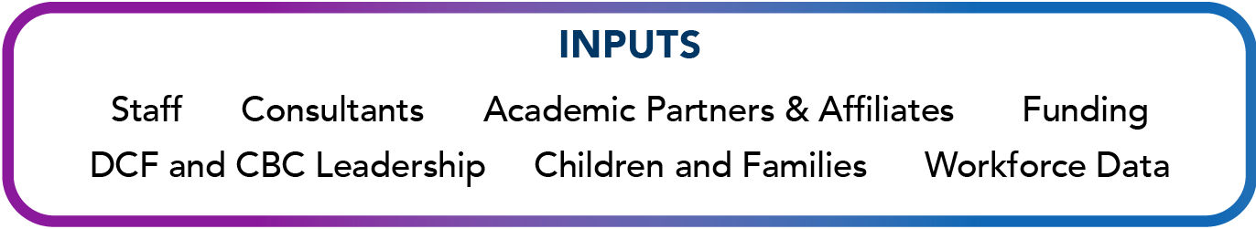

Helping us
Notes:
Our inputs are the things that are needed to make the GROW Center go. Of course, we need our funding and our staff, but we also need the input, feedback, and buy-in from lots of other stakeholders (like you!) as well as data to inform our work. As we go through this presentation, I encourage you to think about specific activities where you see yourself – we need champions all over Florida.
Our participants are our primary targets of intervention. As Kristina shared earlier, our legislative mandate necessarily means students, frontline professionals, child welfare supervisors and managers, and system partners are included as those we are trying to reach through GROW Center programming. Similarly, if your role is listed here, we want you to know about us. Everything isn’t for everyone, but the goal is to have SOMETHING for everyone.

Slide 7






Our Partnerships
Supporting the exploration, development, implementation, and enhancement of our child welfare workforce focused interventions.
Notes:
The Institute is grateful for its ongoing and new partnerships. We are currently partnering with Case Management and DCF organizations throughout the state as well as University affiliates from universities across the state to support the exploration, development, implementation and enhancement of our child welfare workforce focused interventions.

Slide 8
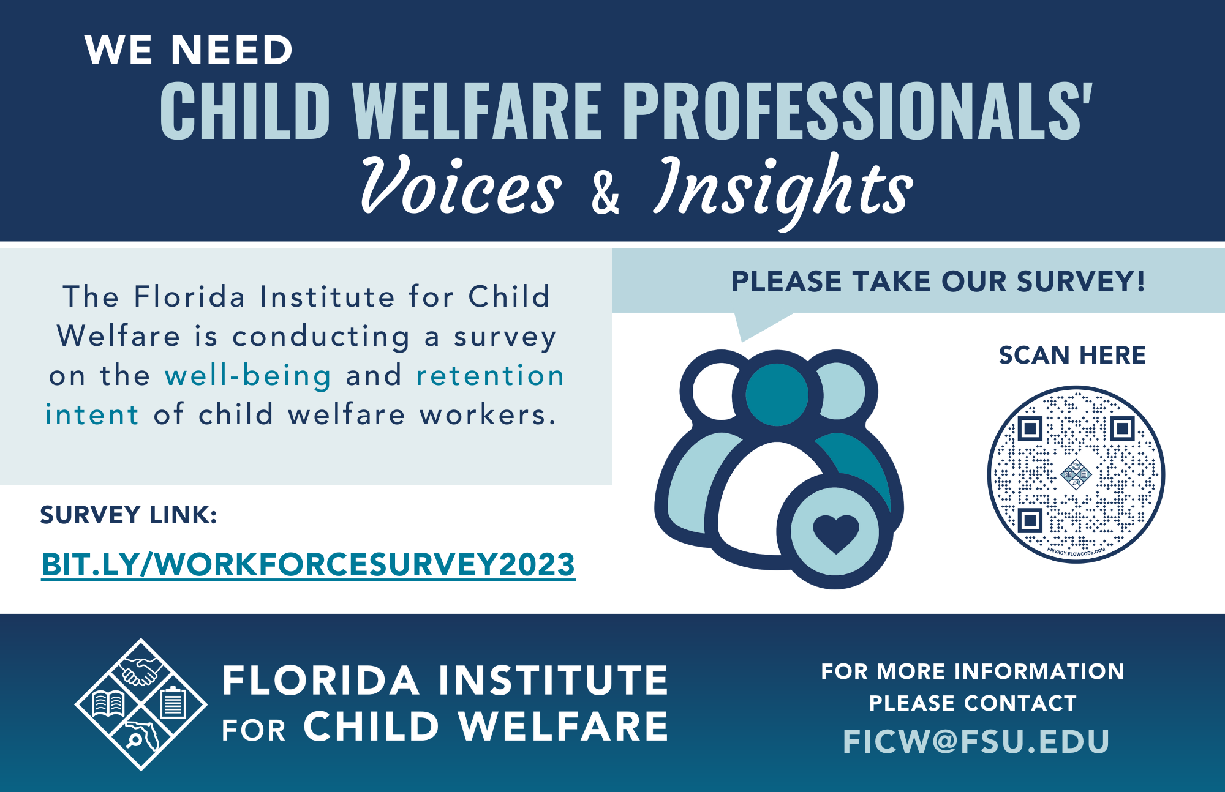
Notes:
WORKFORCE STUDY PLUG #1
Now, we’re going to talk to you about our three major GROW initiatives – what are they, where are they, and who’s working with us on them.

Slide 9



How do we achieve our intended outcomes?
3 STRATEGIC INITIATIVES
Notes:
AI: The enhancement of the BSW and MSW curricula led by the FSU College of Social Work in collaboration other university affiliates is the initial focus of the GROW Center’s academic innovation agenda, followed by a strategic expansion of the exposure to child welfare and support and given to students identifying an interest in the field.
ALIGN is a learning community that offers holistic support for child welfare professionals and advancement opportunities throughout their career. Within ALIGN, we have two primary programs: the ALIGN learning portal and MyALIGN.
The goal of the AWE Initiative is to enhance workforce well-being through specialized leadership development and adaptive technical assistance at the organizational level.
Let’s breakdown each of these in more detail.

Slide 10
The enhancement to the BSW and MSW curricula, initially led by the FSU College of Social Work in collaboration with other university affiliates, is the initial focus of the GROW Center’s Academic Innovation agenda.
The College is developing robust curriculum assets in the form of experiential learning and state of the art virtual technologies to expose students to the field of child welfare in a realistic and supportive manner and educate them more effectively, about the complexities of the field.
Moreover, an interprofessional collaboration will provide students enrolled in various disciplines an opportunity to engage in an interdisciplinary course, and in interactive workshops and simulation/immersion events focused on trauma and child welfare issues faced by families in the State of Florida.
Notes:
To truly professionalize the child welfare workforce, students in social work and other academic programs should not only be better prepared both in the knowledge gained but also have a better understanding of the complexities of working with child welfare-involved families.
ACADEMIC INNOVATION WILL:
redesign the future of learning in social work education through innovative, experiential learning, and state of the art virtual technologies.
successfully prepare and train students to address the complex and diverse needs of youth and families in everyday practice.
develop and implement innovative, promising, and tested teaching methodologies that facilitate active student engagement and reflection in the classroom.
facilitate the development of resilient, engaged, lifelong learners who are prepared to enter social work practice.
3 pilot courses selected
Identification of necessary skills for success in the field identified by Field Educators
Facilitation of (PBL and CBL) Training Workshops for Faculty at CSW
Problem-Based Learning (PBL) Activities & Assessments development for selected courses
Child Welfare Case Booklet development
Identification & inclusion of key interdisciplinary (College of Law, Criminology, and Medicine) partners

Slide 11
Current Status
Innovative curriculum assets and pedological enhancements have been implemented in 6 courses at FSU and 1 course at USF.
AI has identified early adopters from other colleges and schools of social work and are currently preparing faculty from those programs to implement the assets developed by the AI project.
An initial immersion event for students was facilitated by the FSU College of Social Work with faculty and students present from various disciplines.
An interprofessional workgroup comprised of faculty from six different academic units developed course content for an interprofessional course: “Working with Families: An Interprofessional Perspective.”
Notes:
Innovative curriculum assets include: videos, written cases, and assessments. USF course, PHC 6550 Child Health and Development
The FSU courses are: SOW 4615/5614 Family Violence, SOW 4702/5712 Substance Use and Misuse, and SOW 5308 Social Work Practice (online). The FSU CSW instructor for the SOW 5308 Social Work Practice (online) also taught the course in the fall with the PBL/CBL content. The USF course is PHC 6550 Child Health and Development. Data collection for the summer 2023 courses is underway. Pre-test data have been collected. Post-test data will be collected at the end of the semester.
Interprofessional course

Slide 12
Key Partnerships to Date
Consultants/Contracts
Zero Abuse Project
Terry Wolfer, Ph.D., MSW (University of South Carolina)
Academic Partners and Affiliates
Florida State University
Social Work
Medicine
Nursing
Early Childhood Education
Communication Science and Disorders
Criminology
Law
Early Adopters
Florida A&M University
Florida Atlantic University
Florida Gulf Coast University
Saint Leo University
University of South Florida
University of West Florida
Notes:
Other FSU partners include the Center for Civic Engagement and the Film School

Slide 13
What’s next for Academic Innovation?
Project WAKEUP will transition to FICW in 2024
Hiring programmatic and evaluation leads for all academic innovation projects
Development of career mapping resources
Brief survey of students in relevant disciplines
Capacity-building through training and asset development
Statewide dissemination of Project WAKE UP materials
Notes:
Student survey: what is their interest in a career in CW? What do they see as pros? Cons? I think we need to launch this at FSU soon, but should expand to other schools; could include items related to licensure; recruitment

Slide 14
The ALIGN community will offer many opportunities for the child welfare professional to take courses, learn about relevant issues, and gain experience in problem solving to become more confident in their approach and feel supported throughout their learning pathway. The ALIGN team also engages in exploration of new innovations to enhance the way we prepare workers.
The ALIGN Learning Portal is designed to support employees, the GROW Center facilitates Advanced Certification (AdCerts) courses, learning tracks, trainings, and webinars through the portal.
An additional component of the ALIGN initiative, MyALIGN aims to support the child welfare professional by establishing a digital platform to create a state-wide connected and supported child welfare community equipped with resources, assessments, coaching, and networking opportunities.
Notes:
ALIGN is a learning community that offers comprehensive support for child welfare professionals and advancement opportunities throughout their career. Engaging with ALIGN will provide opportunities to Advance, Learn, Innovate, Grow, and Network with other child welfare colleagues statewide. Joining this community includes support through training and onboarding, specialization pathways through Advanced Certification courses (AdCert), as well as ongoing mentoring and coaching.

Slide 15






How do our programmatic activities connect to our intended outcomes?
Networking & Peer Support
Varied Professional Development
Coaching & Guided Reflection
Learning Management System
Advanced Certification Courses
Digital Platform
How will ALIGN impact you and your organization?
Increase worker awareness and connection to well-being resources
Increase worker preparation and self-efficacy
Increase agency capacity to create and sustain change efforts
Increase communication and networking among child welfare stakeholders and professionals
Increase systemwide understanding of emergent recruitment, retention, and turnover issues
Notes:
Here you’ll see the short and intermediate outcomes we’ve set out to achieve through our activities we are engaged in through the ALIGN initiative. We are creating:
Learning Management System
Strength, Trauma, and Resiliency Studies AdCert
Understanding Substance Use Disorder in Family Systems AdCert
MyALIGN Platform
Pre-Service Curriculum Overhaul
Human Trafficking Training Development for Case Managers & Foster Parents

Slide 16

The first cohort for the STARS advanced certification course (AdCerts) has completed. 27 of 31 participants completed all coursework and have been awarded certificates. Participants received access to a coach, peer networking opportunities, online assets, and participated in facilitated sessions with content experts.
The ALIGN Learning portal is finalizing the launch of additional AdCerts focusing on substance use and domestic violence. Learning tracks focusing on infant mental health, non-violent communication, neurodiversity, and substances are also forthcoming.
The ALIGN project is supporting the Department in its revamp of the preservice experience for PIs and Case Managers through the implementation of virtual reality training, the development of quality training offerings, the development of the MyALIGN platform, and evaluation activities.
The MyALIGN platform is being piloted and beta-tested with select cohorts of preservice employees at DCF and a CBC. Full launch of the platform is expected to occur in the Spring of 2024.
Current Status

Slide 17
Key Partnerships to Date
Consultants/Contracts
eCare Vault
Academic Partners and Affiliates
Florida State University
CFC
IFVS
CPEIP
Agencies
Northwest Florida Health Network

Slide 18
What’s next for ALIGN?
Additional learning tracks:
Nonviolent communication
Infant mental health
Neurodiversity
Substances
Resource development exploration for MyALIGN
Inventories of:
Peer support programs
Supervisor training and support programs
Alignment of resource materials with preservice curriculum
Development of a community directory of local resources
External coaching resources for platform users

Slide 19

AdCerts | Dates to Remember
Support of Substance Use (SOS) Interventions in Family Systems
Cohort 1 Applications: Open now!
Course begins: August 28, 2023
Strategies for Addressing Family Violence and Enhancing Resilience (SAFER)
Cohort 1 Applications: September 2023
Course begins: October 23, 2023
Strength, Trauma, and Resilience Studies (STARS)
Cohort 2 Applications: January 2024
Course begins: February 2024

Slide 20
The Alliance for Workforce Enhancement (AWE) is an opportunity for specialized capacity building for Florida’s child welfare system.
Through a 3-year partnership, selected AWE sites have tailored technical assistance that includes: a comprehensive assessment, co-creation of a plan to address a challenge identified through assessment, guided implementation activities, project evaluation, and sustainability planning.
These tailored growth opportunities are supported by well-being and resiliency activities and leadership development training.
Notes:
Florida’s child welfare system has experienced persistent challenges within their organizations which range from training, onboarding, burnout, and turnover. In response, the Institute has created the Alliance for Workforce Enhancement (AWE), an opportunity for specialized capacity building for Florida’s child welfare system. Through a 3-year partnership, selected AWE sites will have an organizational assessment, tailored technical assistance, and leadership development. This includes Comprehensive assessment to determine organizational strengths and challenges, co-creation of a plan to address a challenge identified through assessment, guided implementation activities, project evaluation, and sustainability planning. These tailored growth opportunities are supported by well-being and resiliency activities and leadership development training.
Site One (Leon County Service Center) has been launched
Organizational Health Assessment has been completed
Wellbeing Consultant scheduled to begin on working with site one in June
Site Two identified – kickoff meetings scheduled for July
Co-creation of a plan for the Leadership Academy roll out in partnership with the National Child Welfare Workforce Institute, Leadership Academy Consultants underway

Slide 21





How do our programmatic activities connect to our intended outcomes?
Organizational Assessment
Guided Change Implementation Activities
Leadership Development
Project Evaluation
Sustainability Planning
Increased organizational leadership understanding of factors impacting the organization's health
Increased organizational readiness for change
Increased worker connection to well-being resources
Improved processes and outcomes relative to the selected change plan initiative
Improved worker well-being
Increased leadership preparation and self-efficacy
How will AWE impact you and your organization?
Notes:
Short-term:
Increased organizational leadership understanding of factors impacting the organization's health
Increased organizational readiness for change
Increased worker connection to well-being resources
Intermediate:
Improved processes and outcomes relative to the selected change plan initiative
Improved worker well-being Increased leadership preparation and self-efficacy

Slide 22

The AWE project has kicked off 2 pilot sites at the DCF Leon County Service Center and Partnership for Strong Families.
Pilot Site #1’s (DCF) leadership academy cohort has completed 3/5 in person classroom sessions. Training sessions have occurred on-site at the Florida Institute for Child Welfare. The cohort has identified the area of change that they will be leading. The strategy team has vetted all change ideas for feasibility and relevance. A crucial component of the Academy is the 1-on-1 coaching. Leaders have been paired with a coach and are actively engaged to help further support their learning, professional growth and contributions to the site’s change initiative.
Pilot Site #2 (PSF) has completed 5 months of strategic planning alongside the Alliance for Workforce Enhancement Team. This site has also identified a 14-leader cohort to engage in the yearlong AWE Leadership Academy. There are 14 coaches who have been assigned to work with each member of the academy throughout the year. Utilizing their organizational health assessment (AWE-Inventory), the strategy teams have identified their change initiatives, specific to both the lead agency and case management organizations.
Current Status

Slide 23
Key Partnerships to Date
Consultants/Contracts
Center for Black Well-Being
Academic Partners and Affiliates
FSU College of Social Work
Alia Innovations
Coaches
Butler Institute
National Child Welfare Workforce Institute
Agencies
Leon County Service Center
Partnership for Strong Families
System Partners
Florida Certification Board

Slide 24
What’s next for AWE?
Standardized Application Process for Subsequent AWE Sites
Evaluation from the 2 initial pilot sites will inform the final design of the program and onboarding of subsequent sites
Applications for additional sites expected to open in Summer 2024
Procurement of Consultation Partners
Focused on enabling the AWE project team with providing expert consultation services to support AWE sites and their successful implementation of their organization-wide change initiatives
Notes:
Current consultation topics include: Data Analytics and Cultivating a Results Oriented Accountability System:
We recognize the importance of creating a result oriented and data driven child welfare organization. We are interested in partnering with an organization to implement initiatives that train and promote various methodologies, analytic tools, building internal capacity for Six Sigma, and more.
2. Workflow Strategies:
We recognize the importance of equipping child welfare professionals with the most effective tools to execute their jobs. Often for new professionals, there is a significant need for training and adapting to the rapid flow of work, balancing priorities and organizing time. We are interested in partnering with an organization to implement initiatives that not only train professionals on improving workflow through techniques of time management and prioritization, but an organization that promotes internal capacity building and sustainability.
3. Communication and Team Building:
We recognize the importance of teams finding trust within each other and understanding broad changes to their system. Child welfare organizations are motivated to create changes and shifts and also find it challenging to communicate the changes and rationale to their varying teams. We are interested in partnering with an organization to implement initiatives that focus on creation of clear communication protocols and ongoing strategies for how to build cohesion among team members.
4. Organizational Culture Shifts towards Physical and Psychological Safety:
We recognize the importance of psychological safety in creating an environment where employees feel comfortable taking risks and sharing ideas. Additionally, we know that our frontline professionals are put at physical risk at times in their work and we also want to create sustainability and formal procedures in the event that an incident occurs. We are interested in partnering with your organization to implement initiatives that foster psychological safety, physical safety and drive sustainable organizational culture shifts.
5. Enhancement of Site-Specific Training Implementation and Onboarding:
We recognize the importance of training and support for new professionals in the child welfare field. We are interested in working with an organization to provide consultation on training schedules, onboarding policies and procedures and offer recommendations and partnership towards improving those processes.

Slide 25


The GROW Center Advisory Committee’s mission is to contribute to the transformation of the child welfare system in the state of Florida by providing informed guidance, professional expertise, stakeholder experience, and advice to GROW Center staff; serve as a bridge between GROW Center initiatives and child welfare professionals and organizations; and advocate for GROW Center initiatives throughout the state of Florida.
Notes:
Applications have closed for the 23-24 FY. We are proud to have 20 members representing all regions in Florida and comprised of both Department, University, and CBC affiliated committee members.

Slide 26






Serve as eyes and ears on-the-ground in Florida regarding child welfare system
Gain a thorough understanding of GROW Center initiatives
Work on committee projects, outreach, and support in between meetings
Provide programmatic input and advice on emergent problems
Leverage networks to increase awareness of and participation in GROW Center initiatives
Notes:
Prepare for and participate in 4-6 GCAC meetings per year, including reviewing agendas, background materials, and draft minutes
Familiarize yourself with the GROW Center’s initiatives, including AI, AWE, and ALIGN
Provide programmatic input and advice on emergent problems to the GROW Center staff
Serve as eyes and ears on-the-ground in Florida regarding child welfare system needs as well as generate ideas for future GROW Center’s programs and initiatives
Represent the GROW Center’s programs and initiatives in the community
Review and score submitted proposals in response to a formal solicitation
Leverage your networks to increase awareness of and participation in GROW Center initiatives
Advocate for increasing the visibility of the GROW Center’s programs and initiatives
Serve as ambassadors to the media, conveying previously approved information about GROW Center activities and successes to media outlets to increase the visibility and/or engagement with services in the broader community
Exhibit willingness to provide feedback to GROW Center staff on organizational initiatives and activities
Brainstorm possible outlets (organizations and individuals) who might benefit directly from participating in GROW Center initiatives
Offer specialized expertise based on your specific experience, training, and perspectives
Work on committee projects, outreach, and support in between meetings
Communicate, as needed, with other Advisory Committee members and GROW Center staff

Slide 27
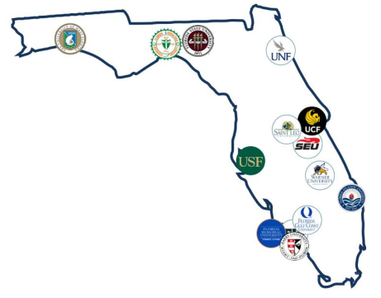
Affiliate Network
The Institute created a faculty affiliate network by assembling a cadre of social work researchers who share this dedication from the 14 public and private universities offering Council on Social Work Education accredited degrees in social work. The Institute expanded the faculty affiliate network to include research affiliates who have expertise in areas related to the vulnerabilities of at-risk families.
For more information, please visit:
https://ficw.fsu.edu/Partnerships/Affiliates
Notes:
Our affiliates

Slide 28
Research Collaborations
Agency | Project
FLITE Center | Evaluation of FLITE Center, HOPE Court Evaluation
Follow the Love | Relational Permanency Intervention Pilot
Children’s Home Society | CaseAim Evaluation, Inventory of Post-Adoption Clinical Supports
Kids Central, Inc. & DCF | Kinship Navigator Program Evaluation
Foster and Adoptive Parent Association | Foster Parent Survey
Heartland for Children | Sexual Safety Evaluation
Office of Family Courts | Early Childhood Court Evaluation
DCF | Human Trafficking Screening Tool Validation
Notes:
These are some of our recent and current projects. A number of others run by our affiliates who have made connections with agencies across the state.
Other collaborators outside of Florida – University of Kentucky, University at Buffalo

Slide 29
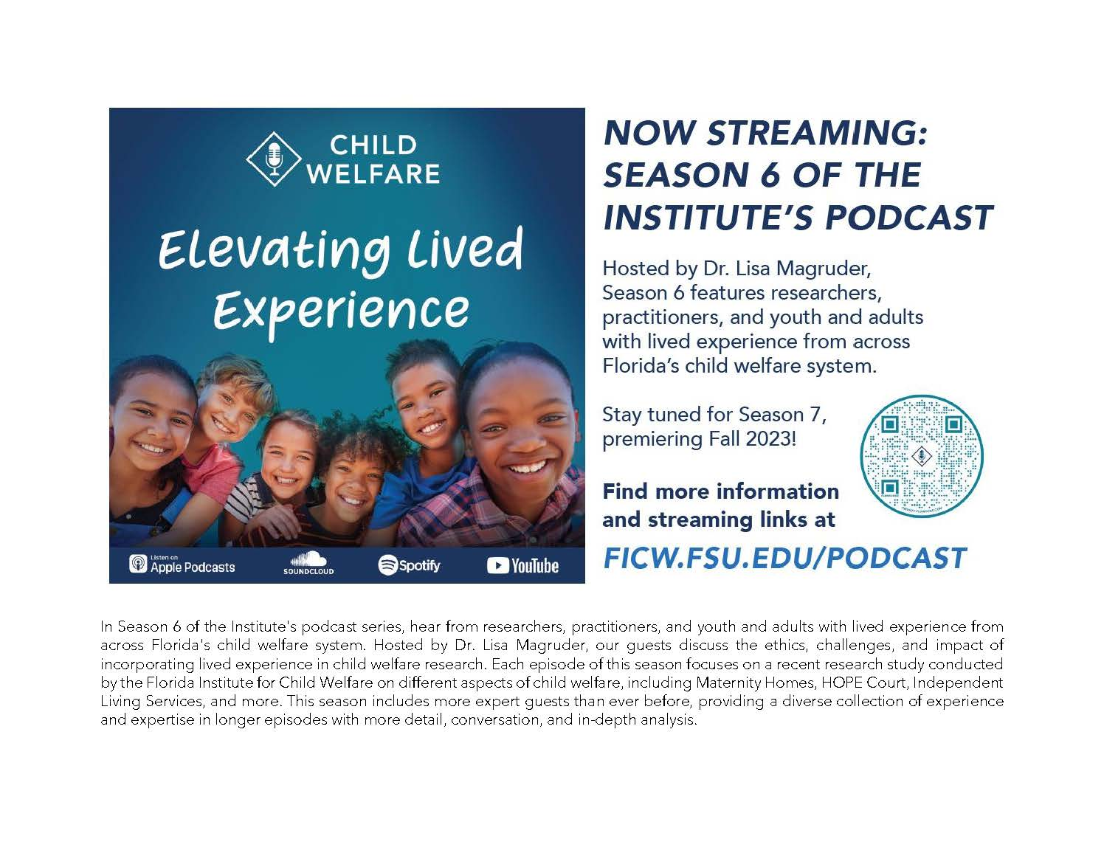
Notes:
Lived experience on FICW team
Lived experience on projects - paid consultants to be part of team, requesting affiliate projects include lived voice (e.g., advisory boards, project personnel, consultants)
Compensation (nod to podcast)
Actively working to broaden network for parents

Slide 30
to hear
We
want
from you!
Check out the GROW Center Advisory Committee Webpage.
Let us know what topics you would like to see explored.
Apply for the annual Priority Research Award.
Serve on an exploration focus group.
Serve as an evaluator for upcoming projects and share your knowledge and expertise to help us make impactful development decisions.
Sign up for updates on the Institute’s website!

Slide 31
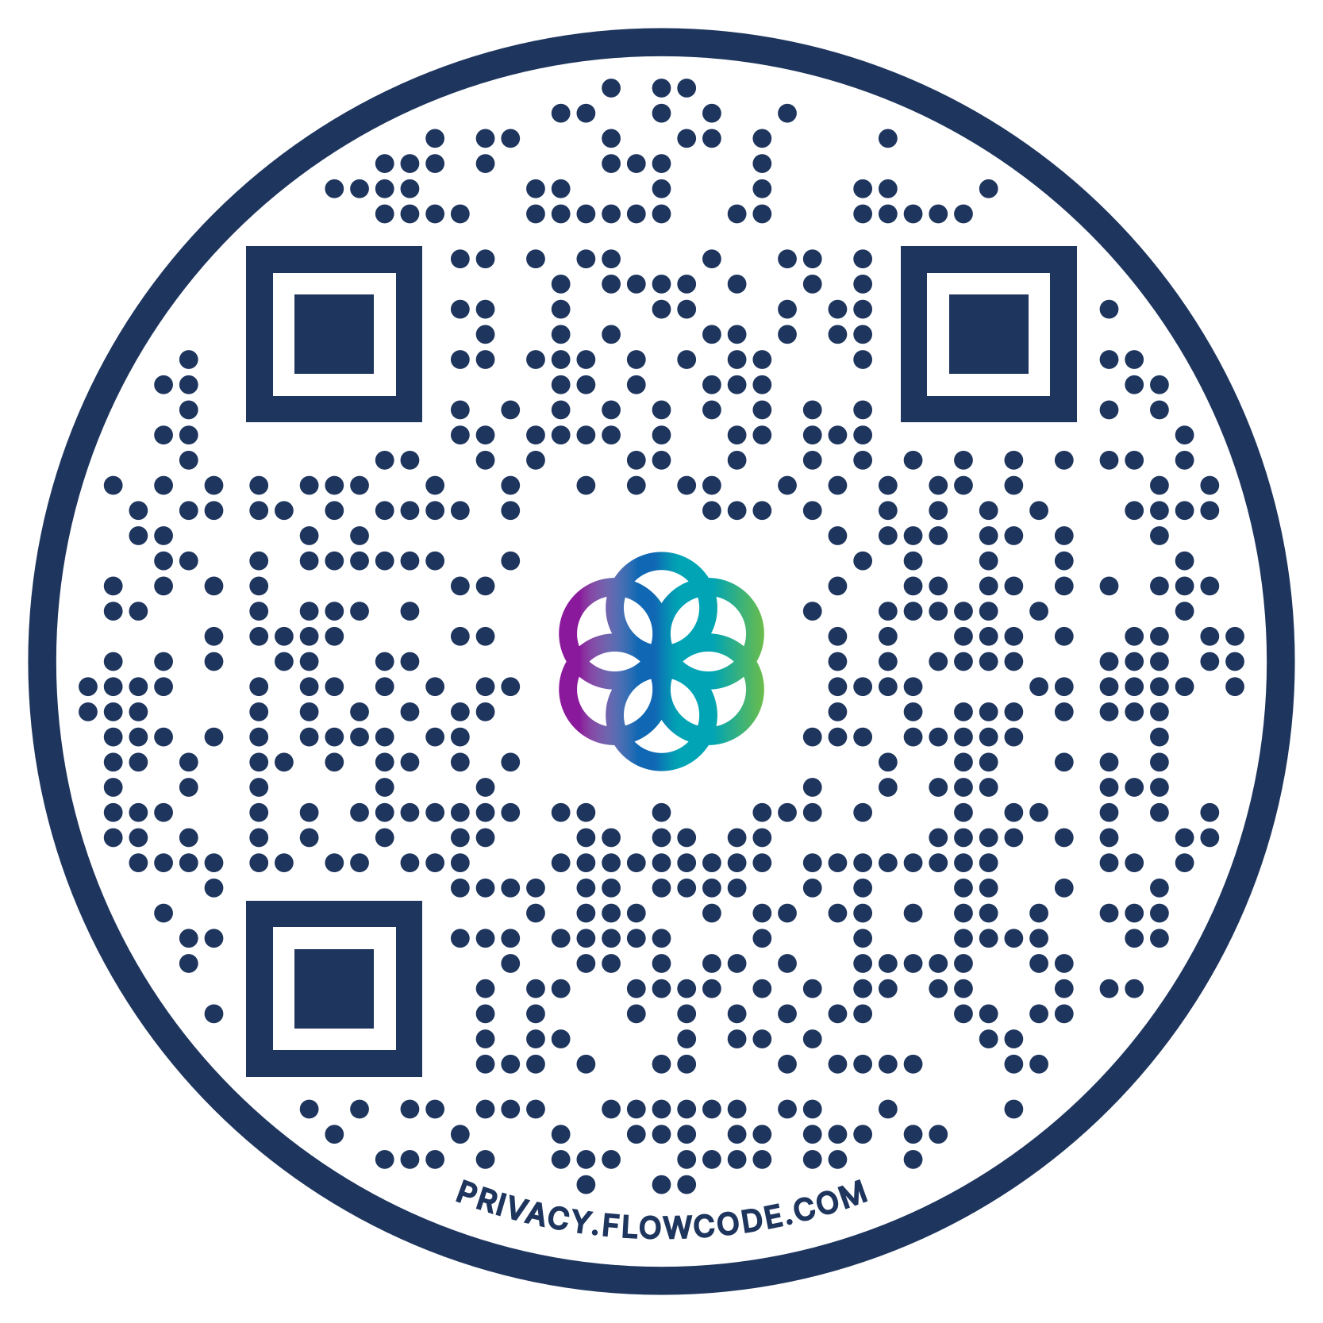

Questions?
Want more info?
Scan to check out our website.

