Slide 1
Family First prevention services act (ffpsa)
Implementation
Department of Children and Families
Office of Child Welfare

Slide 2

Family first prevention service act
The family first prevention service act (FFPSA) was passed into law on February 9,2018 as part of the bipartisan budget act
Emphasizes the use of evidence-based services to prevent children from entering foster care
Limits the use of federal funding when placing children in settings that are not licensed foster homes
https://www.congress.gov/bill/115th-congress/house-bill/1892

Slide 3
Part 1 – prevention activities under title IV – E
Allows the use of the Title IV-E funds for the following services to prevent the placement of children and youth into the foster care system.
        In-home parent skill-based programs,
        Mental health services, and
        Substance abuse prevention and treatment services
Title IV-E funds can only be used in this capacity for 12 months for children who are “candidates for foster care” and for pregnant or parenting foster youth.
The act further clarifies that children and youth under the guardianship of a kin caregiver are also eligible for these funds.

Slide 4

Part IV. Ensuring the necessity of a placement that is not in a foster family home
Places a limit of two weeks on federal payments for placements that are NOT one of the following licensed setting type:
  A licensed foster family home
  A licensed residential family-based treatment facility for substance abuse
  A supervised setting where the child may live independently if the child is 18 years or older
  A specialized setting providing prenatal, post-partum or parenting supports
  A setting providing high-quality residential and supportive services to children who are victims of, or at risk of human trafficking, or
  A qualified residential treatment program (QRTP)
Effective October 1, 2021

Slide 5
Prevention plan and services
Development & Implementation
Department of Children and Families
Office of Child Welfare

Slide 6
Florida’s family first prevention plan
March 30, 2023: State FFPSA Plan Approved
  Florida’s Public Assistance Cost Allocation Plan Pending Approval – Upon approval claiming for EBPs effective going back to 10/1/2021
Plan Components
  Child and Family Eligibility for IVE Prevention Services
  Service Description and Oversight
  Evaluation
  Monitoring Child Safety
  Workforce Training and Support
  Continuous Quality Improvement
Implementation Status
  Publish CFOP 170-1 Chapter 17
  FSFN Adoption and Placement Module
  Training to the CBC on policy and FSFN
  Fidelity
  Ongoing Implementation of Programs
  https://www2.myflfamilies.com/service-programs/child-welfare/kids/publications/

Slide 7
Selected prevention programs
Florida’s title IVE prevention program five-year plan includes the following nine well-supported services:
  Healthy Families America (HFA)
  Nurse Family Partnership (NFP)
  Parents as Teachers (PAT)
  Homebuilders
  Parent Child Interaction Therapy (PCIT)
  Brief Strategic Family Therapy (BSFT)
  Functional Family Therapy (FFT)
  Multisystemic Therapy (MST)
  Motivational Interviewing
Seeded EBP: Refocusing the Modern Family (Application Behavior Basics) & CARES (National Center for Innovation & Excellence)

Slide 8
Candidate for foster care
Can remain safely in their home or kinship placement with evidence-based prevention services
Child and youth formally assessed through community engagement or Florida Abuse Hotline reporting to be at imminent risk of entering foster care, AND
Note: A child or youth may be at imminent risk of entering foster care based on alleged maltreatment
and/or circumstances and characteristics of the family unit, individual parents, and/or children that may
affect the parent’s or guardian’s ability to safely care for and nurture their children in their own home.

Slide 9

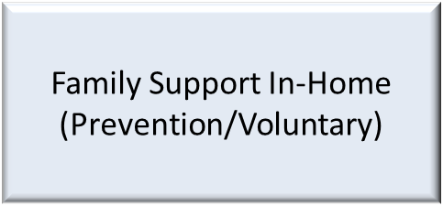
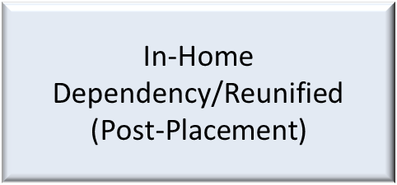
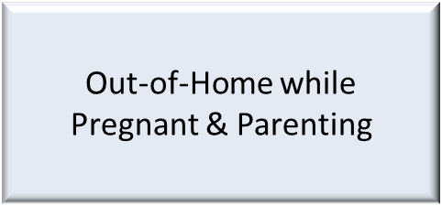
Four primary candidacy populations
There are four primary candidacy populations that are eligible under the Title IV – E Prevention Service.
Adoption

Slide 10
Placement alignment
Department of Children and Families
Office of Child Welfare

Slide 11
Placement continuum of care
SIPP Engagement
Short Term Residential
Respite
Specialization
Specialized Therapeutic Group Homes and Qualified Residential Treatment Programs
Foster Home Capacity and Supports
At-Risk for Sex Trafficking Homes
Dually Served and Coordination with Department of Juvenile Justice and Agency for Persons with Disabilities

Slide 12
Next Steps
Train the Trainer Sessions July and August
      Supervisors, trainers or staff designated by the Lead Agency in Case Management, Prevention, Provider, Finance, Placement and Services Team Members
    Direct Training Sessions July and August
      Audience: Regional Licensing and Finance/Rev Max/Placement and Service Entry Team Members
PACAP Approval (allows claiming to begin – in process)
Fidelity and Continuous Quality Improvement Ongoing Development
Evidence Based Programs Implementation and Sustainability
5. Placement Continuum of Care and Capacity Building

Slide 13
Q & A
Department of Children and Families
Office of Child Welfare

Slide 14
Expanding EBP Capacity (FFPSA)
July, 2023

Slide 15
2022 FCC Café Recommendations
Identify EBPs that are program-wide vs. those based on individual therapists to reduce impact of turnover.
Scale and track capacity of prevention and diversion.
Reduce state requirements that exceed federal requirements.
Increase capacity for primary prevention services that can be supported by FFPSA (not client specific).

Slide 16
Challenges with building capacity
Bill Medicaid 1st (4E last)
Not a financially sustainable business model
Rates Medicaid don’t support therapist salary and service requirements of EBPs
  Salaries $38K-40K (high turnover affects fidelity)
  Too many activities uncovered (staffings, collateral contacts, family education, on call, de-escalation calls, siblings, additional assessments and fidelity reviews required)
Service documentation required by Medicaid (along with EBP documentation requirements) takes too much time off task, affects fidelity
Even with increased rate (MST) as an ILOS (after 1 year, no provider billed)

Slide 17
Q: How to expand EBPs in Florida?
A: Build a sustainable business model
Blending and Braiding workgroup (July, 2021-present)
Members:
Providers & Lead Agencies
State agencies: DCF (OCFWB, SAMH), DJJ, AHCA, Medicaid HMOs
EBP developers

Slide 18
Recap work to date
Braided funding model (Medicaid/Non-Medicaid)
  Expected: 44% (Medicaid/non-Medicaid); Actual: 27%-30% (Medicaid)
Pilot: BSFT (Heartland for Children), deep dive
Challenges with braided model (administratively heavy providers),
  Providers seeking out one funder/payer with less documentation requirements than Medicaid (i.e. foundation grant, local grants)
Workgroup recommendations:
  Focus on ILOS (bundled rate)
  Reduce red tape (excessive service doc; focus on EBP documentation)
  Work on a blended model (DCF-OCFWB/SAMH, DJJ, AHCA) to fund slots
  Consider longer term strategy to add EBPs as “covered services”

Slide 19
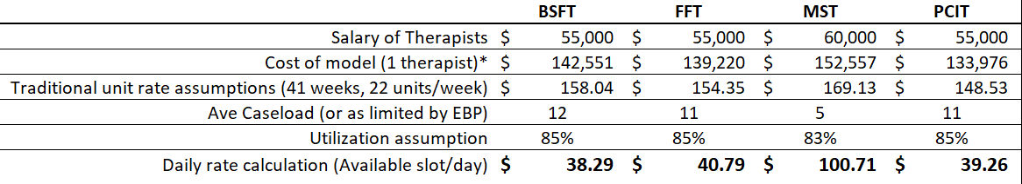
Example of bundled rate

Slide 20
Expanding QRTP Capacity (FFPSA)
July, 2023

Slide 21
Outlined below is a chart delineating possible solutions and strategies to build
placement capacity for complex youth in Florida.
BUILDING QRTP CAPACITY FOR HIGH NEED YOUTH IN FLORIDA
SOLUTION | RECOMMENDATIONS | IMPACT | STATE ACTION NEEDED | UPDATE 2023
LICENSE QRTP THRU DCF, NOT AHCA | Similar to BHOS, keep licensing function at DCF and establish a bundled clinical overlay rate for reimbursement through Medicaid. Focus on QRTP federal requirements without adding more regulations. Allow other state agencies such as APD and AHCA, to obtain a QRTP credential from the Department, and make all licensed RTC sites presumptively eligible and credentialed as QRTPs. | Increased capacity (providers more willing if DCF licenses beds) | DCF and AHCA policy and rule change. | DCF amended rule 65C-46.0211 to allow for a dual track for QRTP licensure. Following the legislative session 2023, DCF released the draft guidelines for a DCF licensed QRTP. The draft rules are currently under review for public comments. The amended rules follow the guidelines from the federal FFPSA in an effort to keep regulatory standards at a manageable level and to attract additional QRTP providers.
REDUCE ADMINISTRATIE MONITORING | Require DCF, AHCA, CBC and Medicaid HMO to conduct joint monitoring rather than 4 separate administrative monitoring visits. Allow providers who are accredited to be monitored once every three years. This is consistent with s. 402.7306 monitoring requirements. | Reduced agency costs, reduce provider costs and less duplication in reviews | Interagency Agreement(AHCA, DCF) and mandated in contracts with CBCs. | Progress in this area has been minimal. Consider whether this topic should be revisited and addressed in the coming year given that some QRTP’s, At-Risk, Maternity and Safe Houses are operating without a contract from the lead agency in their area (particularly for those that operate a statewide catchment area).
ADVOCATE FOR ADEQUATED CLINICAL RATE FOR QRTP (AMCA/MEDICAID) | Work with AHCA to develop a rate to support the difference clinical needs of the high needs youth population. | Better optimization of available revenue streams. | Request AHCA to increase rate for STGH. Develop a rate for specialty population QRTP programs to need the clinical needs for the specified group. | Currently room and board rates are set (including QRTP) according to a utilization standard and expenses demonstrated on the DCF Template. The reimbursement rate for the clinical services offered by a QRTP remains static at the STGH rate offered by AHCA. This has been identified as a barrier in the past and continues to be a potential barrier.

Slide 22
SOLUTION | RECOMMENDATIONS | IMPACT | STATE ACTION NEEDED | UPDATE 2023
ADDRESS POLICY BARRIER (IMD) | Most providers expressed wanting to keep census low (4-6), but many have multiple dwellings on a campus, opening them up to IMD rules for sites with >12 beds. Replicate language used for STGH for QRTP license to allow multiple dwellings on a campus (as long as 12 beds or less per domicile). | Increased capacity (more campus programs will apply as QRTPs) | Amend FAC to allowing multiple QRTP dwellings on campus (to bypass IMD rule), similar to STGH | DCF has made allowance to have multiple QRTP’s which are individually licensed on a campus setting. However, that is a workaround to address short term needs. A long term fix is needed at the federal level. A small group of Florida providers have been working with Representative Castor and Congressman Bilirakis to carry a bill that would fix QRTP on a long term and national level.
REINFORCE CAPACITY BUILDING THROUGH CONTRACTS | Allow CBCs to contract with providers for “available capacity” vs utilization, allow for multi-year contracts and retained earnings/net income (for the purposes of recouping start-up costs not covered by FFTA or other sources, may need to readdress “sub-recipients”, if FFTA funds are not available. Do not restrict availability FFTA funds to only the original providers who expressed interest. | Increased capacity (more providers will apply because less financial risks and disruption to existing clients) | Contracting authority (DCF), amend contracts with CBCs to explicitly allow request AHCA to increase rate for STGH. Develop a rate for specialty population QRTP programs to need the clinical needs for the specified groups. | A small FCC workgroup is meeting to address rate structure, reimbursement and startup costs. The final recommendations will be provided to DCF.
POLICY (EMPTYING BEDS) | If license were to stay under AHCA, allow for a waiver so providers do not have to empty beds to be licensed. |  | If not specified in code, could be letter of agreement | Currently room and board rates are set (including QRTP) according to a utilization standard and expenses demonstrated on the DCF Template. The reimbursement rate for the clinical services offered by a QRTP remains static at the STGH rate offered by AHCA. This has been identified as a barrier in the past and continues to be a potential barrier.

Slide 23
Restructure QRTP’s To Better Serve Children with Complex Needs
Specialty QRTP Homes:
Develop homes designated for populations of children that are known to have unmet needs. Those specialty providers/homes will develop expertise in serving the children with quality care/services and have available capacity to meet local and statewide demands. The categories/groupings that have been identified include:
Children who have a developmental disorder
Children who are at-risk of becoming involved with DJJ, those currently involved in the DJJ system and children who have been in and out of the DJJ system
Children with challenging behavioral disorders, particularly those that are ineligible for traditional mental health services (STGH QRTP)
Children who are sexually reactive
Children with medical issues that require greater than routine care and have co-occurring behavioral issues

Slide 24
Qualified Residential Treatment Program
STGH/QRTP CREDENTIAL Status
Currently, there are five credentialed QRTP providers with 50 beds operating in the state.
The Department continues to work to implement changes to the QRTP/Qualified Evaluator process established in HB 893.
For FY 2021-2022, over 26% of the money spent on children placed in residential treatment centers licensed by AHCA was Title IV-E reimbursable.
Notes:
$8,031,381 total cost for placement
$2,134,260 reimbursable

Slide 25





Florida’s Out-of-Home Placement Array
545 Beds
1,755 Beds
Residential Treatment Programs
1,069 beds
Specialized Programs
Specialized Therapeutic Group (AHCA) Credentialed as a QRTP (DCF)
5 licensed facilities/50 beds
Specialized Therapeutic Group Homes (AHCA)
7 facilities/68 beds
Statewide In-Patient Psychiatric (AHCA)
11 facilities/427 beds
16,164 Beds
Transitional Programs
Wilderness Camps
1 provider / 70 beds
Maternity Homes
13 providers/ 134 licensed beds
At Risk for Sex Trafficking
156 providers/ 1523 licensed beds
Safe Houses
6 providers/33 licensed beds
7,838 Beds
Foster Homes
Residential
Group Care
21 providers / 348 beds
Emergency Runaway Shelter
24 providers / 401 beds
Emergency Shelter
17 providers/ 266 beds
Traditional Homes
7 providers/ 54 beds
Level I
4,463 children
3,914 providers
Level II
4,943 providers
10,402 beds
Level III
21 providers
37 beds
Level IV
398 providers
812 beds
Level V
186 providers
461 beds
Relative/ Non-Relative
Relative Caregiver
5,790 children
3,781 providers*
Non-relative Caregiver
2,048 children
1,468 providers*
Notes:
Data sources as of 8-9-2022
Placement
Non-Rel
Rel
Data Source #1077 for 7-31-2022 as of 8-9-2022
Level
One
Two
Three
Four
Five
Data Source #1268 for 7-31-2022 as of 8-9-2022
Placement
Residential Group
Emergency
Wilderness
Maternity
At Risk for Sex Trafficking
Safe House
Data Source #1268 for 7-31-2022 as of 8-9-2022
Notes
Combined Residential Group and Traditional
Residential
Traditional
At Risk. Should Sex Trafficking be included in the Title?

Slide 26
Visioning Exercise
If we were wildly successful, what would this look like in 5 years?
What recommendations do we have to move this forward in the coming year?

Slide 27
Additional Resources/Links:

