Slide 1



Connecting Students to Pathways
for Academic Success
Florida Coalition for Children Annual Conference
July 17, 2023

Slide 2



Presenters
Dr. Steve J. Rios
Senior Director
Positive Pathways
Jasmine Moore
Associate Director
Positive Pathways
Devin Floyd
Program Director
Educate Tomorrow

Slide 3
Topics
The Need: Students Speak
Florida’s Trailblazing Policies and Programs
Overview of Positive Pathways
OPPAGA Report
Powerful Partnerships
Support for Youth Experiencing Housing Insecurity
Discussion

Slide 4
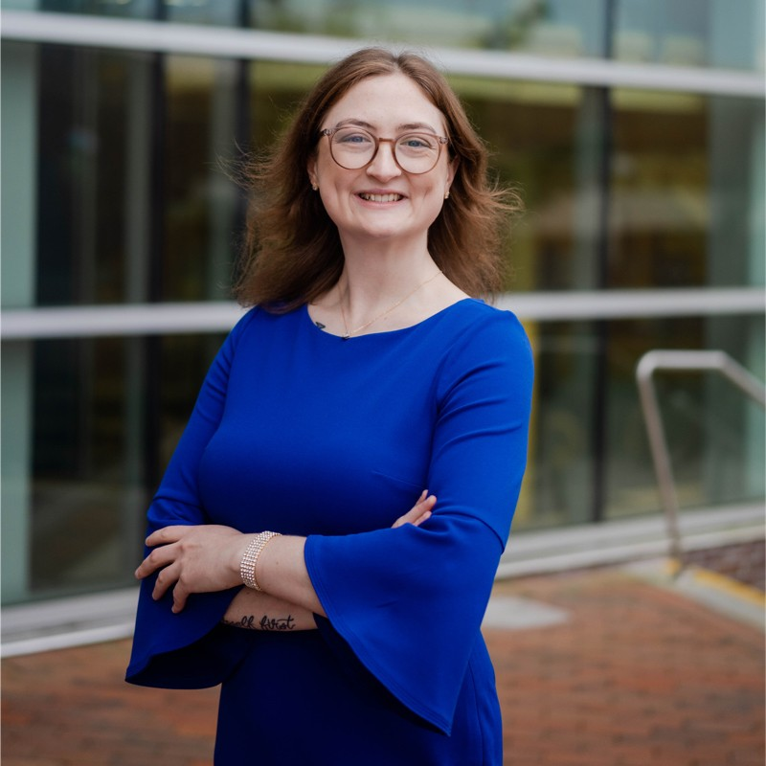

The Need: Students Speak

Slide 5
Audience Participation
Please share one thing that either of the students spoke about that resonated with you.

Slide 6
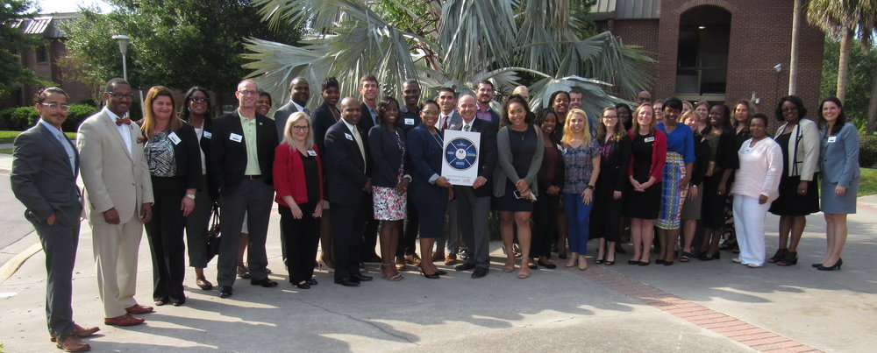
Overview of Positive Pathways Program

Slide 7
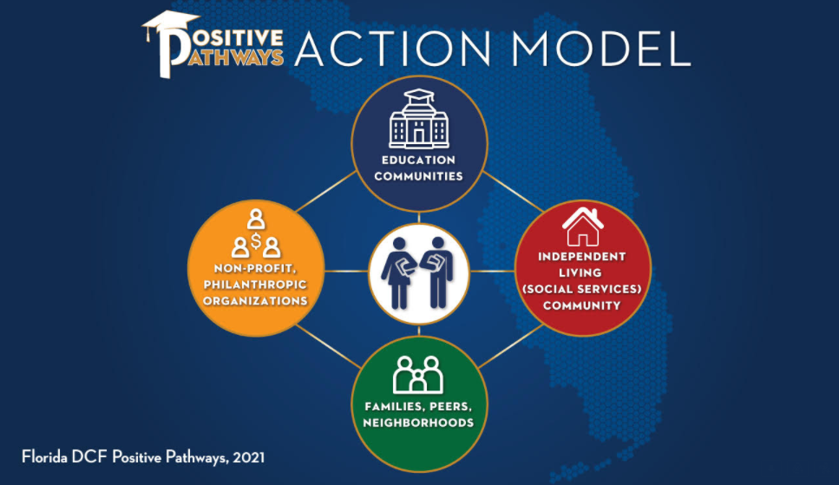





Slide 8


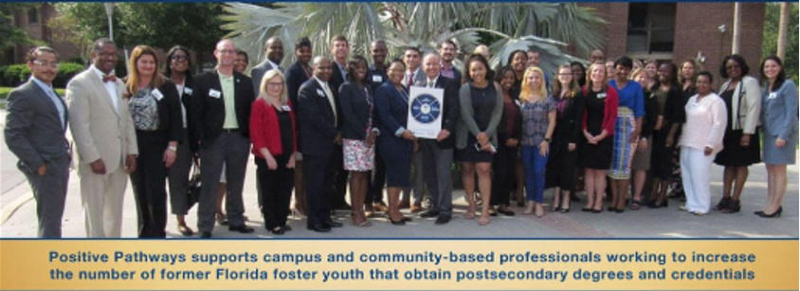


Highlights
Created in 2016 and funded by the Florida Department of Children and Families (DCF), in response to a Florida law requiring collaboration between DCF and the Florida Department of Education
Dramatic increase in number of students from foster care using tuition and fee exemption
Unique state-level program aimed at increasing post-secondary educational success among college students who lived in foster care in Florida
Administered by Educate Tomorrow, a statewide non-profit organization
Maintains and expands a network of members
Began as Florida Reach, a volunteer statewide network

Slide 9




Purpose and Benefits
Monthly network calls
Targeted professional development
Extensive and consistent networking opportunities
Daily access to immediate technical support
Small group support (College Connection)
Updated resources and directory of campus-based and community-based liaisons
Purpose
To develop and support a statewide network of informed and empathetic, and dedicated education and child welfare professionals to support students from foster care and homeless settings through their journeys to post-secondary completion.

Slide 10

Florida’s Trailblazing Policies and Programs

Slide 11


Tuition Waivers for Youth Who
Have Experienced Foster Care
The State of Florida provides tuition and fee exemptions, to eligible students, through age 28.
The waiver is authorized at state public universities, public colleges, and technical colleges.
Fee exemptions may be available to a student who:
  He or she is, or was at the time of reaching 18 years of age, in out-of-home care.
  He or she was adopted from the Department of Children and Families after May 5, 1997.
  He or she is, or was at the time of reaching 18 years of age, placed in the custody of a relative or non-relative under s. 39.5085, s. 39.6221, or s. 39.6225, F.S.
  He or she was reunited with his or her parents after spending at least 18 months in out-of-home care after reaching 14 years of age, including a reunification pursuant to s. 39.8155, F.S.
Note: The exemption remains valid until the student reaches 28 years of age. See § 1009.25(1)(c), (d), Fla. Stat. For questions regarding eligibility or how to obtain a tuition and fee exemption form, CF-FSP 5220, contact your local Community Based Care Lead Agency or call Florida’s Independent Living Resource Center, operated by daniel, at 1-844-ILYOUTH (844-459-6884).

Slide 12
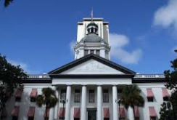
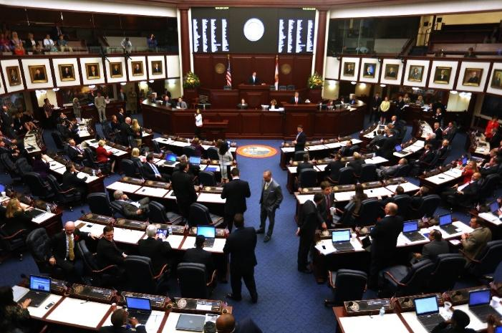




Legal Context
The Florida Legislature mandated, beginning in 2014, that DCF collaborate with the State University System, the Florida College System, and the Florida Department of Education to help eligible youth transition to and through postsecondary educational settings.
Chapter 409.1452: Addresses the need for a comprehensive support structure in the academic arena to assist young adults who have been or remain in the foster care system
Notes:
In 2014, the Florida legislature directed the Florida Department of Children and Families (DCF) to work collaboratively with the Florida Department of Education, the Florida College System, and the State University System Board of Governors to “help address the need for a comprehensive support structure in the academic arena to assist young adults who have been or remain in the foster care system.” (409.1452, F.S.)

Slide 13

Legislative Foundation
409.1452, 2022
The department shall collaborate with the State University System, the Florida College System, and the Department of Education to address the need for a comprehensive support structure in the academic arena to assist children and young adults who have been or remain in the foster care system in making the transition from a structured care system into an independent living setting.
(1)(a) Each school district program, Florida College System institution, or state university at which a student is exempt from the payment of tuition and fees under s. 1009.25 must have, at a minimum, a knowledgeable, accessible, and responsive employee who acts as a liaison and provides assistance to those students who are exempt from the payment of tuition and fees to assist in resolving any problems related to such exemption. The liaisons shall provide such students with on-campus support and must be employees of the program, institution, or university.
A school district program, Florida College System institution, or state university may also provide campus coaching services and other support to a student who is exempt from the payment of tuition and fees under s. 1009.25 to promote his or her successful completion of postsecondary education and transition to independent living.

Slide 14

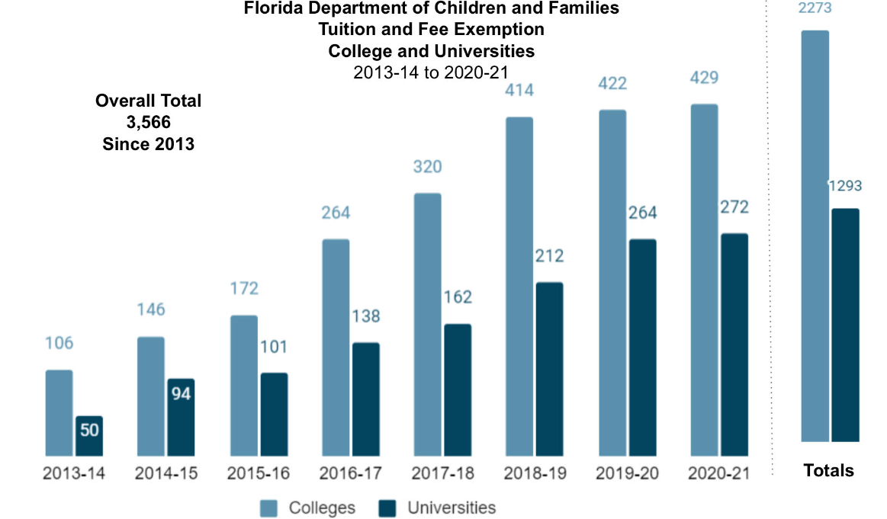
Positive Impact of Our Work

Slide 15














Slide 16
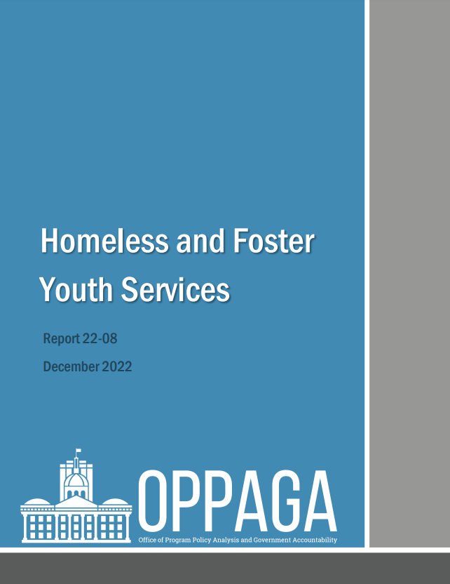
Homeless and Foster Youth Services Report (December 2022)
Mandated by Florida Legislature last year
Examines effectiveness of local school districts’ delivery of benefits and services required under the federal McKinney-Vento Homeless Assistance Act
Examines services provided by campus liaisons to foster youth enrolled in state colleges and universities
Academic outcomes of these students (Positive Pathways members)
Notes:
Steve

Slide 17
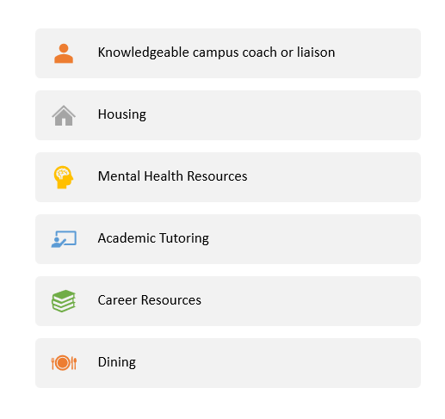
Campus-based Services
Students with the tuition waiver have access to several resources to support their
holistic development and transition to adulthood.
Notes:
Steve

Slide 18
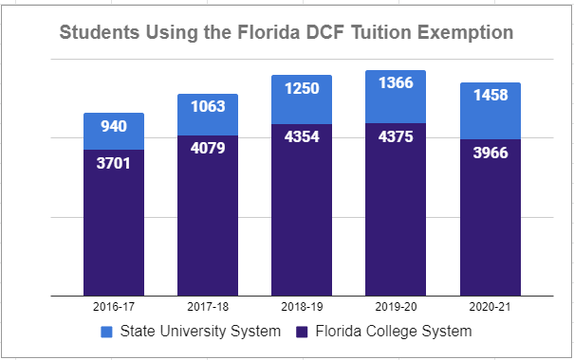


Use of Tuition Exemption
Notes:
Steve

Slide 19
Completion Rates
489 students received a waiver beginning in either 2013-14 or 2014-15.
  244 (50%) finished a bachelor's degree during the review period
25% completed the degree in four years and
40% completed the degree in six years (Far better than the six-year graduation rate of 27% for US first-generation students in general) Source: Center for First Generation Student Success
210 students transferred from a state college to an SUS institution
  57% of them completed a bachelor’s degree (compared to 63% among ALL students at public institutions nationwide
Overall, these numbers are far better than the 3% and 11% consistently relayed in documents around the country
Notes:
Steve

Slide 20
Completion Rates
OPPAGA analyzed FCS data of 4,065 students and found that 732 (18%) of the students completed a degree during the review period, with 11% completing a degree within three years. Another 243 (6%) completed a certificate program.
Notes:
Steve

Slide 21
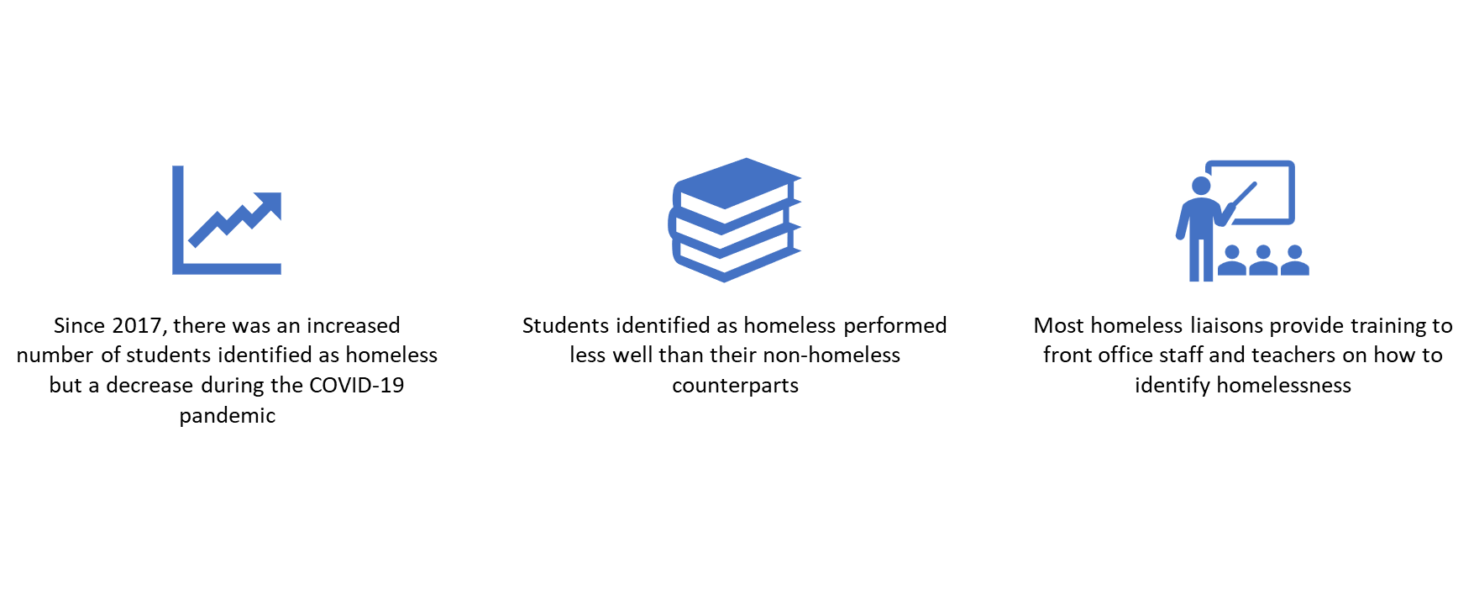
Major Findings: Homeless Students in K-12
Notes:
Jasmine

Slide 22

OPPAGA Recommendations: K-12 Liaisons & Homeless Youth
Receive training on trauma informed care for school district liaisons and other educational staff
Require school districts to check the residency status of students at least once per school year
Require school districts to provide periodic training to all staff who interact with students
Notes:
Jasmine

Slide 23
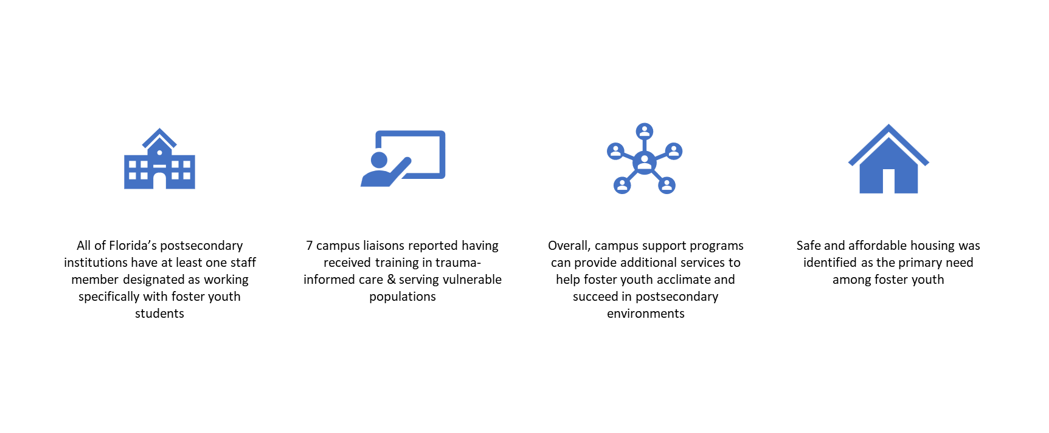
Major Findings: Foster Youth & Postsecondary Institutions

Slide 24

OPPAGA Recommendations: Postsecondary Education & Foster Youth
Regularly generate a list of foster youth who are newly eligible for the tuition waivers
Create a system that institutions can use to verify students’ tuition waiver eligibility
Increase the age at which students lose eligibility for the foster-care related tuition waivers
Modify statute to specify the training requirements for liaisons
Prioritize housing for foster youth students on their campuses
Notes:
Jasmine

Slide 25

Powerful Partnerships

Slide 26



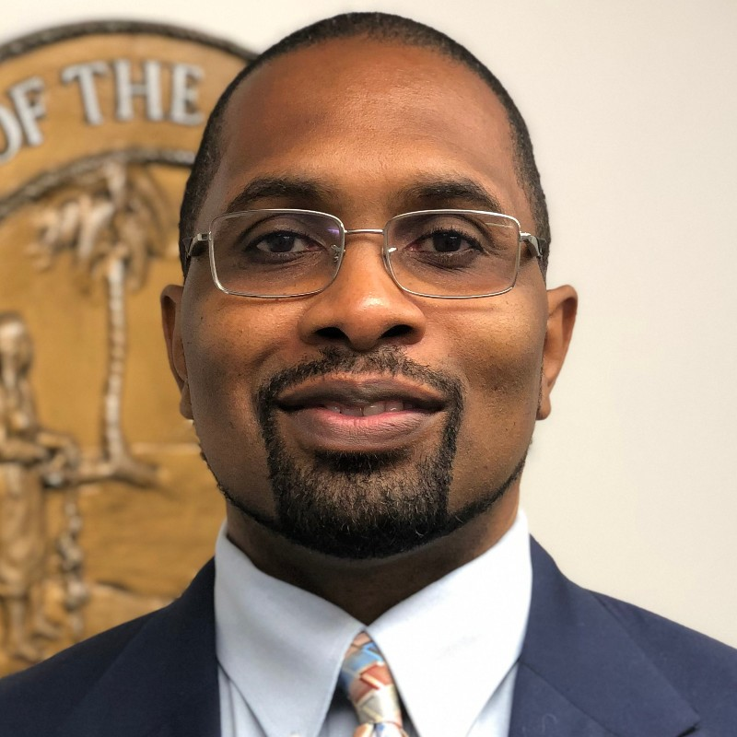

Powerful Partnerships
Calvin
Martin
GAL

Slide 27
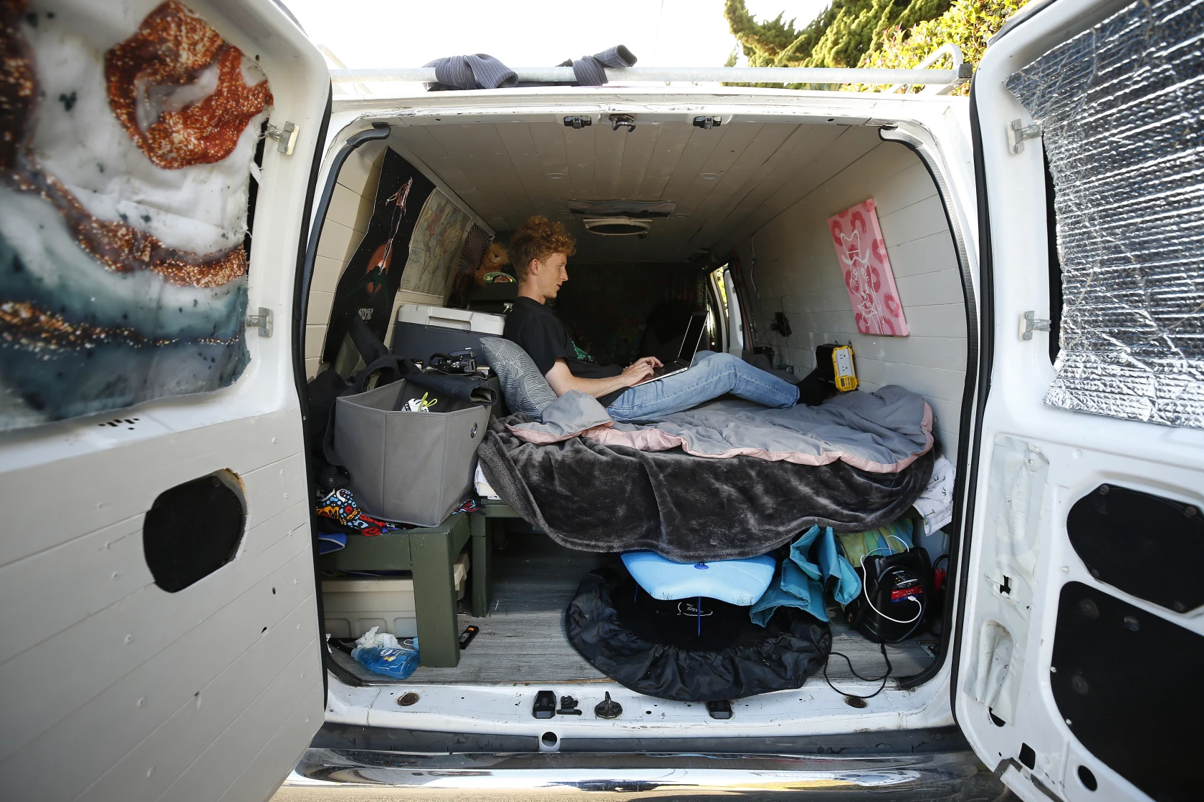
Student Experiencing Housing Insecurity

Slide 28



Number of Homeless Students Statewide
2020-21
63,946
Number of 12th-Grade Homeless Students Statewide
2020-21
4,784
(2,100 UHY)
Number of Students Using Homeless Waiver in Florida College System Colleges
2020-21
723
Number of Students Using Homeless Waiver in
State Universities
2021-22
344
Sources: Florida Department of Education, Florida Board of Governors, Florida College System

Slide 29




Homeless Exemption
The 2021 Florida Statutes (1009.25)
Exempt from the payment of tuition and fees, including lab fees, at.
school district that provides workforce education programs
Florida College System institution
Public state university:
Definition:
- Student who lacks a fixed, regular, and adequate nighttime residence
or
- whose primary nighttime residence is a public
or
- private shelter designed to provide temporary residence, a public or private transitional living program, or a public or private place not designed for, or ordinarily used as, a regular sleeping accommodation for human beings.
Notes:
PESS provides a monthly stipend of $1256, for youth who turned 18 in licensed care, to secure housing, utilities, and assist with the cost of living while attending postsecondary or vocational school, until age 23
Requirements for Participation:
Age 18-22;
Spent 6 months in care prior to turning 18 in care, or adopted or placed in guardianship over the age of 16 after spending 6 of the most recent 12 months in licensed care;
Completed high school diploma or equivalent;
Enrolled full time (9 credit hours) in Bright Futures eligible post-secondary or vocational school
If the student's school is NOT a Florida Bright Futures-eligible School, then they're NOT eligible for PESS; however, the student may be eligible to receive ETV funding

Slide 30
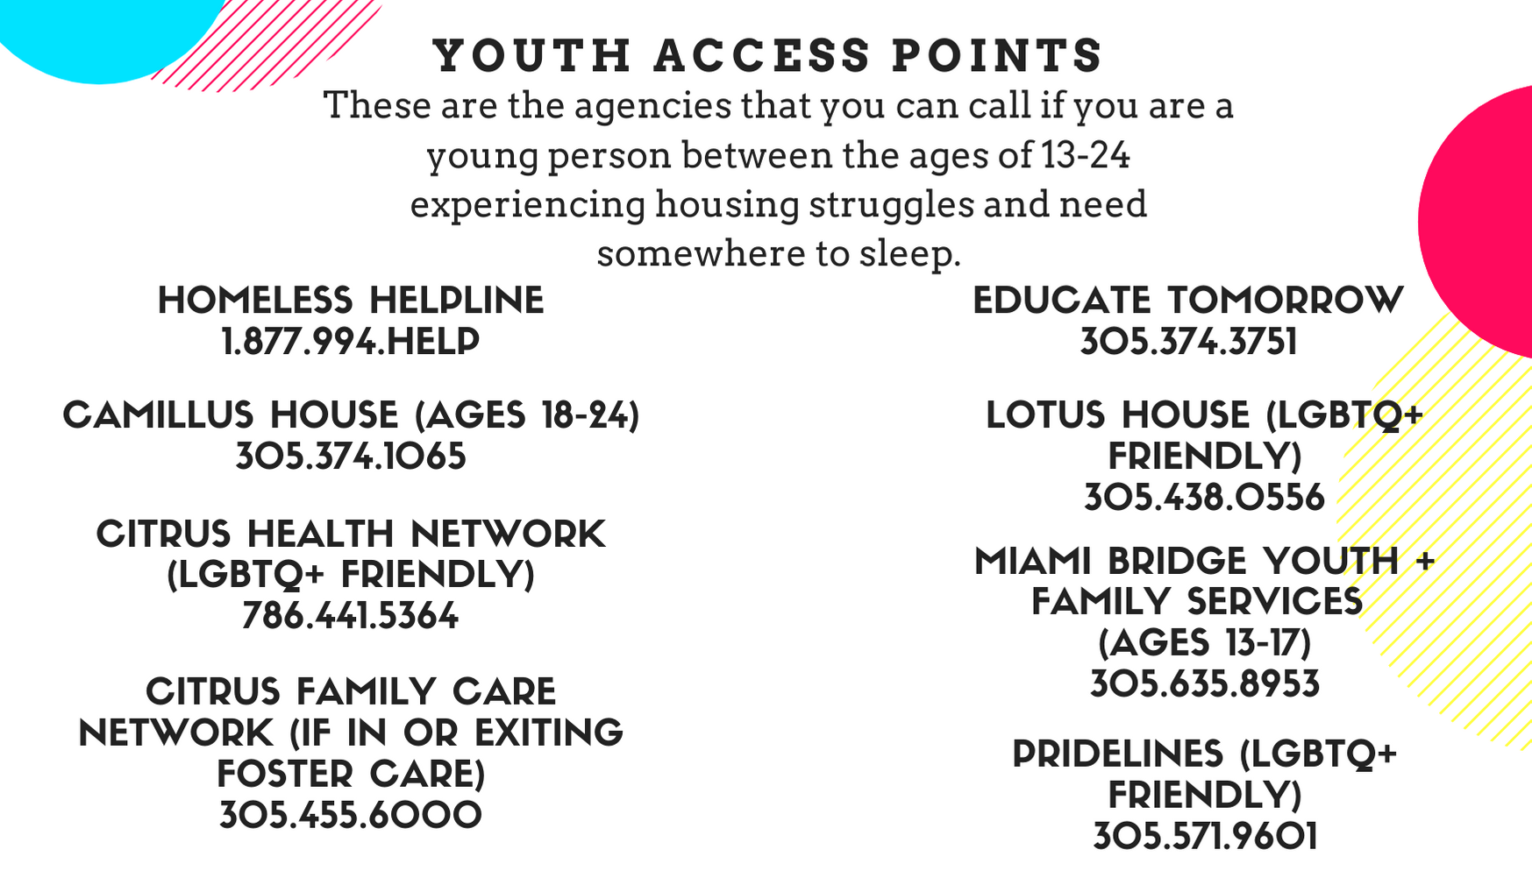

Youth Access Points (YAPs)
What is a Youth Access Point?
Youth Housing
  Camillus
  Chapman
  Miami Bridge
What is a Homeless Verification Letter?
  Project UPSTART waiver and fees
How do we ensure access and support beyond housing placement?
  Join Educate Tomorrow!
Notes:
Devin

Slide 31
Care Coordination, Educate Tomorrow Approach
Types of Support We Provide
Academics - MDCPS, AOK Scholars, Miami Dade College, FIU, nsoro
Legal - Lawyers for Children America, Americans for Immigrant Justice
Housing - Casa Valentina, Chapman Partnership, Lotus House, The HOMY Collective & Youth Access Points, Citrus FUP Vouchers
Emergency Funding - Family Stabilization Funds, DCF Specific Funding
Special Needs - Disabilities Independence Group, The Early Learning Coalition, Regis House, Thriving Minds
How We Provide Support
In Person & Online Workshops - Life Skills Training, Lunch & Learns, Virtual Resource Center
One on One Sessions - Trust & Confidentiality
Mentoring - Support System of peers and empathetic, knowledgeable adults
Care Coordination - Identifying the needs, then coordinating resources
Meet students where they are - Community spaces, i.e. library
Notes:
Critical Mobile Unit
Andrea

Slide 32
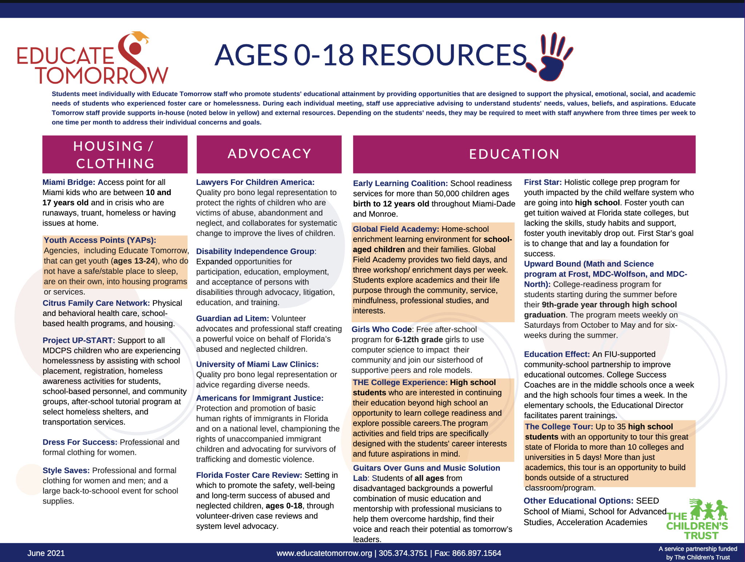
Notes:
Janessa

Slide 33
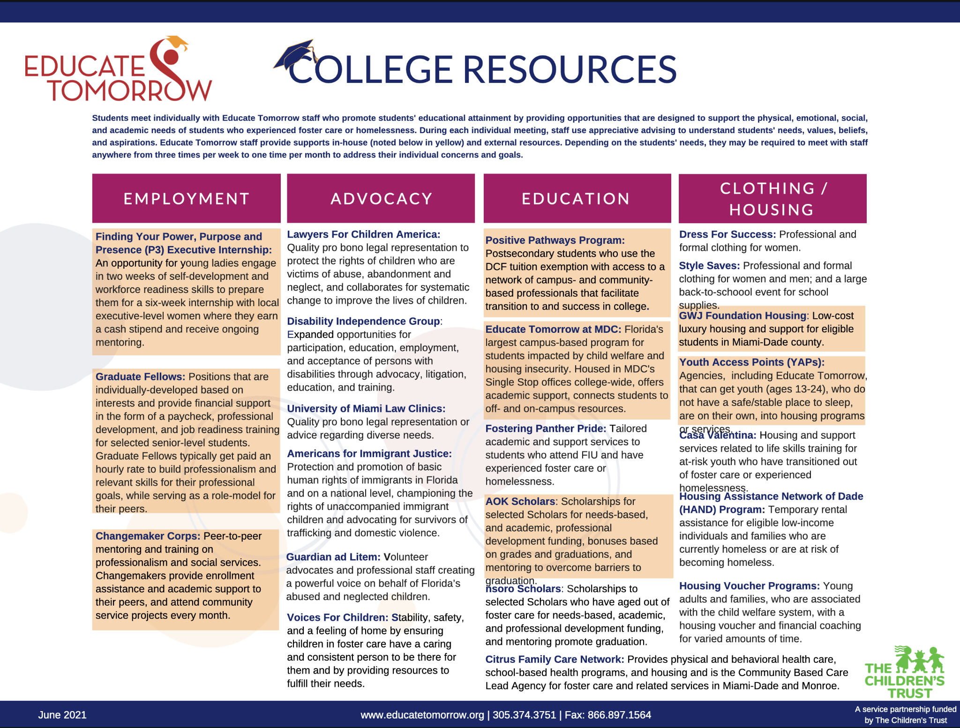
Notes:
Janessa

Slide 34

Action Plan

Slide 35
Action Plan
Step 1: Determine and Define Need
Step 2: Identify Existing Resources
Step 3: Build Trust
Step 4: Engage for Action
Step 5: Assess Results

Slide 36

Questions & Answers

Slide 37
How to Reach Us
Dr. Steve J. Rios
Senior Director
Pathways@EducateTomorrow.org
Jasmine Moore
Associate Director
Jasmine@EducateTomorrow.org
Devin Floyd
Program Director
Devin@EducateTomorrow.org

