Slide 1
Addressing the Trauma of a Removal
Beverly Jean-Jacques, Ph. D.
Director of Prevention Services
Citrus Family Care Network
Aymee Prieto, LMHC
Transitional Trauma Therapist
Citrus Health Network

Slide 2
Objectives
Provide
An overview of the background and need for trauma-responsive initiatives.
Review
The trauma of removal and its impact.
Discuss
Innovations that reduce trauma for children and families with dependency cases, especially during child removal.
Examine
Strategies that promote trauma-informed practices during a removal.

Slide 3
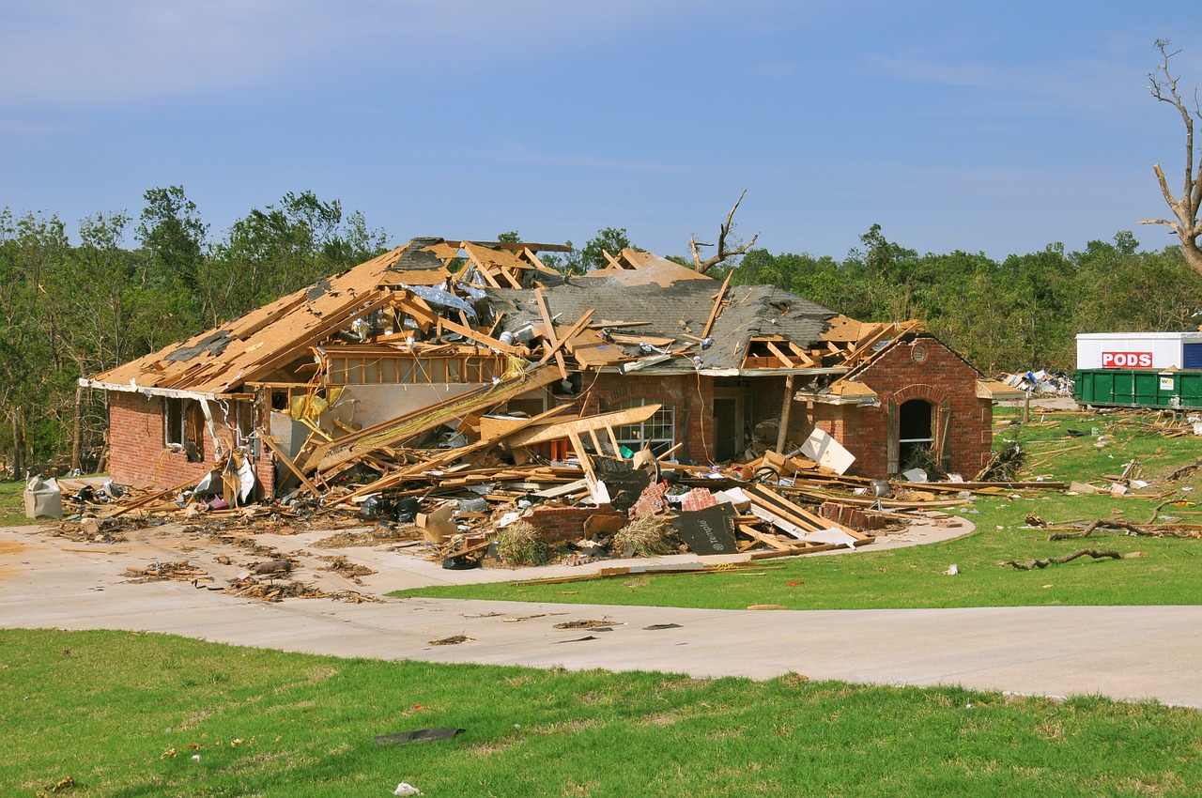
What is Trauma?
  “Trauma is an emotional response to a terrible event like an accident, rape, or natural disaster.”
  ~American
  Psychological Association

Slide 4
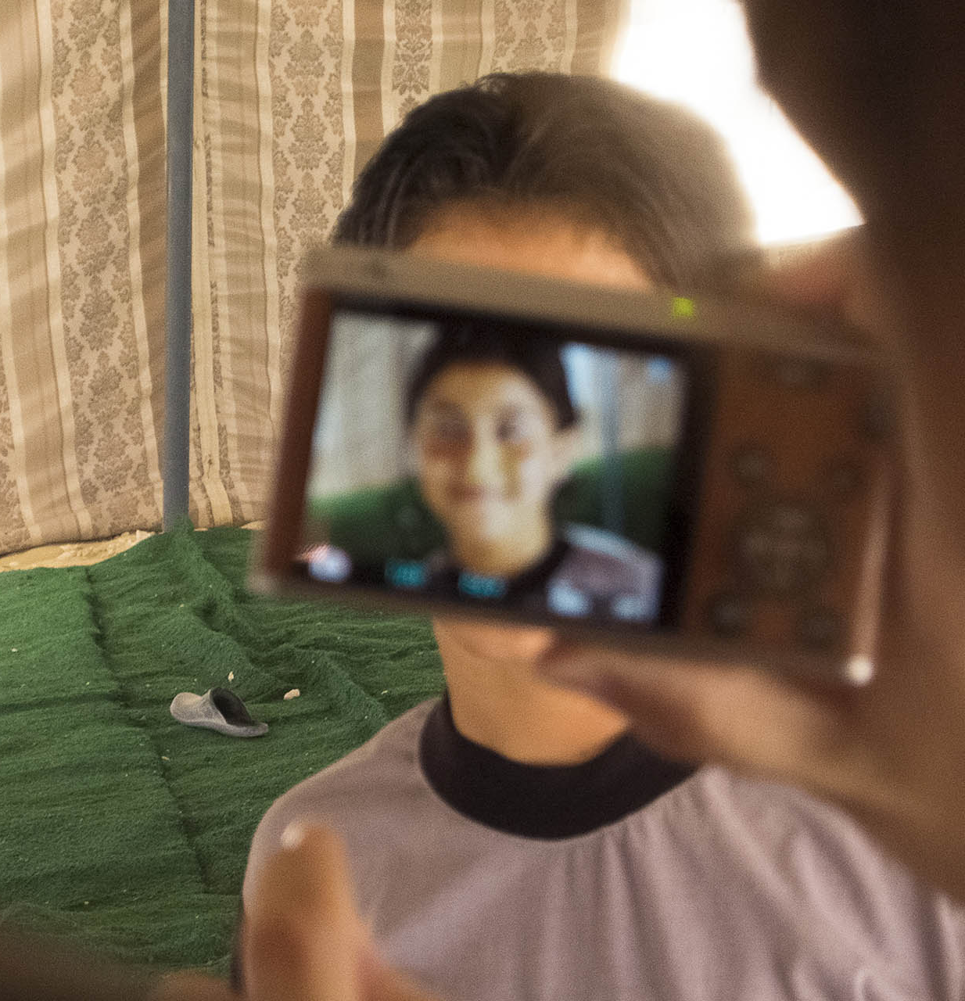
Considerations through a Trauma Lens
    Trauma Intensity and Frequency
    Single, repeated, or sustained?
    Time to process the experience?
    Number of losses?
    Nature of the Trauma
    Was the trauma unexpected?
    Was it intentional?
    Was it experienced directly or indirectly?
    What happened since the trauma?
    Cultural meaning of the trauma?

Slide 5
The Impacts of Trauma
Individual
(Child, Parent)
Group
(CPI, CM)
Trauma
Community/Mass
(Neighborhood)

Slide 6
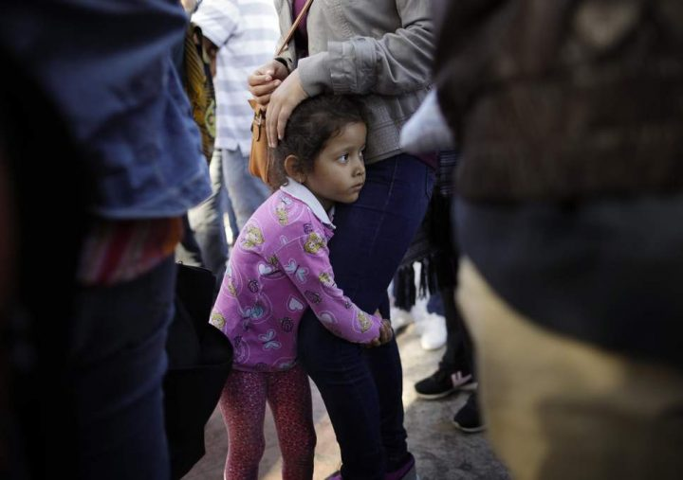
Removal

Slide 7

Trauma of Separation (Part 1)
Children of the System pt 1.mp4
Full Episode: “Children of the System” (Ep. 405) | Our America with Lisa Ling | OWN – YouTube

Slide 8
Reflection Time
Have you ever been involved in a removal?
Have you had to explain to children why they were being removed?
What impact do you think a removal has on the family unit?

Slide 9

“Where are you taking me?”
Child
Anger
Sadness
Guilt
Confusion
Fear
Out-of-Home
Relative/Non-Relative Placement
Licensed Care

Slide 10
Taken
Taken into foster care, through the eyes of a child.mp4

Slide 11
Developmental Trauma
Specific events occurring within a given developmental stage
Adverse Childhood Experiences (ACEs) influence development, physical and mental health.
ACEs are often not single events and occur as multiple experiences for most individuals

Slide 12

Impact of Trauma on Emotions
Most survivors of trauma exhibit immediate reactions
  Emotional
    Difficulty identifying & regulating
    Numbing
      Help by teaching new coping skills and how to tolerate distressing emotions:
        mindfulness practices
        cognitive reframing
        cognitive processing
        trauma-specific desensitization approaches
        exposure therapy
        eye movement desensitization and reprocessing

Slide 13

Impact of Trauma on Physiology
Some may present initially with physical symptoms
  Physical
    Somatic complaints
      Help by referring for medical evaluation
        There may be specific conditions that require medical attention.
      Help (beyond medication) by implementing:
        good sleep
        hygiene practices
        cognitive rehearsals of nightmares
        relaxation strategies
        nutrition

Slide 14

Impact of Trauma on Physiology
  Physical (cont.):
      Brain changes
      Elevated brain arousals
      Help by telling the child:
        What is happening
        What will happen next
        That their siblings are safe
      Help by providing:
        Nurturing
        Emotional safety
        Comforting sensory experiences

Slide 15

Impact of Trauma on Cognition
Beck’s cognitive triad model (1979)
  Cognitive
    World view
      “The world is a dangerous place.”
      “People cannot be trusted.”
    Self-view
      “I am incompetent.”
      “I am damaged.”
    Future view
      “Things will never be the same.”
      “It’s hopeless.”

Slide 16
Impact of Trauma on Cognition
  Cognitive (cont.):
    Triggers and Flashbacks
    Dissociation, Depersonalization, Derealization
      Fixed or glazed eyes
      Sudden flattening of affect
      Long periods of silence
    Help:
      Focus on the here and now with grounding techniques
      Distinguish between what is happening now and what happened in the past
      Normalize the reactions as common traumatic stress reactions
      Understand why flashbacks and triggers occur and how to manage or prevent them

Slide 17

Impact of Trauma on Behaviors
  Behavioral
    People engage in behaviors to manage the aftereffects, the intensity of emotions, or the distressing aspects of the trauma
        Help by
          Learning how to manage triggers, memories, and emotions without avoidance-desensitization
          Screening for self-harm/suicide risk
          Teaching coping skills
          Creating a plan of safety with the person (e.g., create a safety card that person can carry with them)

Slide 18
System-Oriented Trauma
“Re-traumatization is reliving stress reactions experienced as a result of a traumatic event when faced with a new, similar incident.” ~SAMHSA
Challenging or discounting reports of abuse or traumatic events
Minimizing, discrediting, or ignoring child’s response
Failure to provide adequate security and safety
Notes:
https://store.samhsa.gov/sites/default/files/d7/priv/sma17-5047.pdf

Slide 19
Reflection Time
What role do you play in managing Re-traumatization?
How can you minimize (or eliminate) Re-traumatization while doing your work?
How can you increase awareness of your own impact on a removal?

Slide 20
Need for Early & Immediate Intervention During Removals
Children’s Reception and Intake Base (CRIB)
Transitional Trauma Therapist (TTT)
Explaining the removal to the child
Explaining the process and players to come into the child’s life
Promoting, teaching, and activating coping skills

Slide 21
“What is this Place?”
CRIB locations provide a welcoming, safe, child-friendly, and -focused environment designed to meet a child’s immediate needs and mitigate the trauma of being removed from the home.
CRIB services are available to assist CPI during the removal process as a joint response in the community (as early as requested by DCF).

Slide 22
“What’s in Here?”
Food
Activities (Toys, Board games, books)
Television
Beds
Recreation Area
Showers
Support Staff

Slide 23

CRIB Central:
Creative Safe Spaces for Play

Slide 24
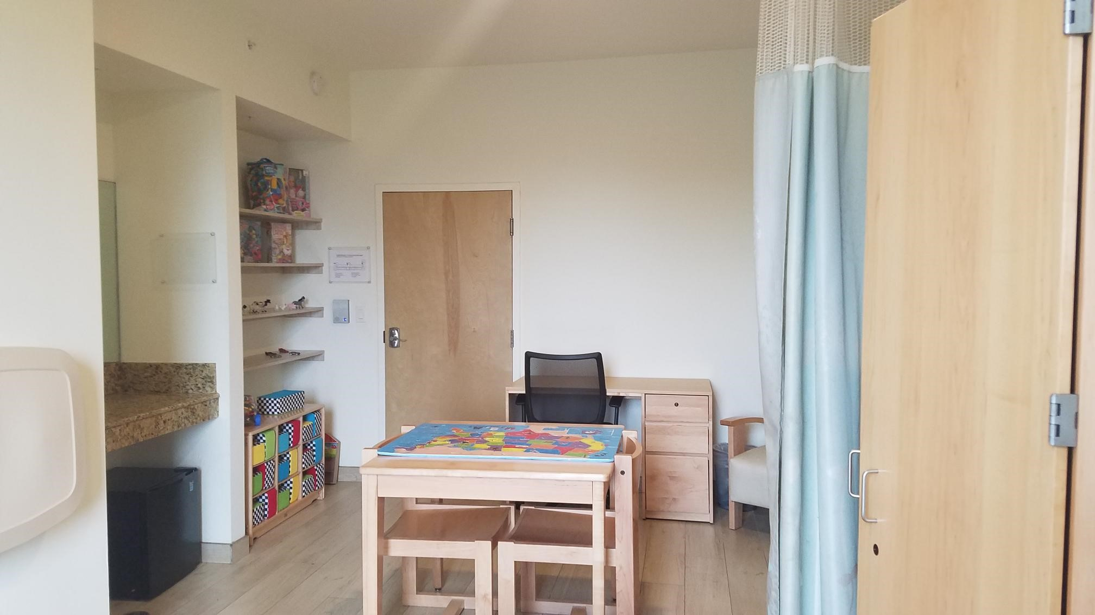
CRIB Central:
Main Room

Slide 25

Safe Space for Infants & Toddlers

Slide 26

Comfortable Area for
Children to Rest

Slide 27

“Who are you?”
Transitional Trauma Therapist (TTT)- CRIB clinicians engage children and families during removal and provide brief therapeutic support as a child is displaced.
Behavioral Health Technician (BHT)- Support staff that address the child’s immediate basic needs from hygiene to nutrition while providing comfort and security.

Slide 28

“What does it mean to be a TTT?”
Transitional Trauma Therapist
Master’s Level Clinician
Provide Clinical Services:
Interventions to children and/or caregivers to mitigate the trauma of removals
De-escalation and crisis stabilization
Psychoeducation and brief therapeutic support
Provide Support
Brief Useful Resources & Supportive Talks (BURST)
Critical Incident Debriefing

Slide 29

“What does a TTT do?”
Team Approach (TTT / BHT)
Immediate Engagement
Screening Triage / Recommendations
Comfort Calls for Biological Parent
Placement Planning Call for Licensed Foster Parent
Telephonic Supportive Services for Relative/Non-relative

Slide 30

“What Else?”
Overlay services
While child is awaiting therapeutic services
Special circumstances
Assisting investigators and/or case managers in announcing difficult news, de-escalating, and other types of transitions.

Slide 31
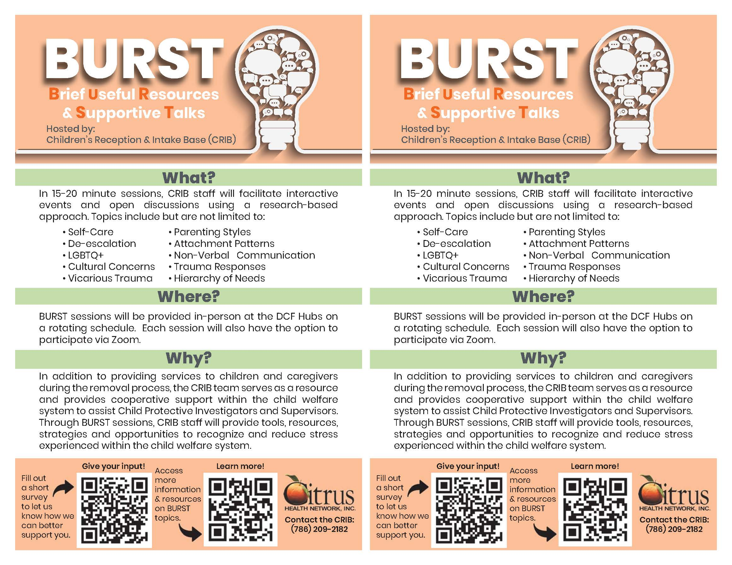
Notes:
For the workforce:
Brief Useful Resources and Supportive Talks (BURST)
Self Care
De-escalation
Communication
Breaking the News
Critical Incident Debriefing

Slide 32

“What’s a BHT?”
Behavior Health Technician
Meets child’s immediate basic needs (food, hygiene)
Engages with child by reading books or playing games
Provides comfort and support to child
Ensures child’s safety and security
Helps child prepare a duffle bag for placement

Slide 33

CRIB Data Collection Efforts
Conversations with child about the reasons for the removal
Explain to child placement logistics
Collaborate with child on identifying coping skills and supports

Slide 34
Trauma of Separation (Part 2)
Children of the System pt 2.mp4
Full Episode: “Children of the System” (Ep. 405) | Our America with Lisa Ling | OWN – YouTube

Slide 35
Key Strategies
Awareness
Attention
Response

Slide 36
Awareness
Understanding
Different trauma responses
Mindful
Of your own biases
Belief
That your words and actions matter

Slide 37
Attention
Attending
To the person’s experience (including behavioral and emotional reactions)
Listening
For the specific triggers that seem to be driving the person’s reactions
Empathize
With their pain and struggle

Slide 38
Response
Respond
With consistency
Develop
Individual coping plan in anticipation of triggers
Validate
The person’s experience

Slide 39
Ongoing Strategies for Best Practices
Promoting Kinship Care
Assist relative/ non-relative families with the support needed to stabilize the initial placement of children
Permanency efforts
Family Finders
Continuity of Care
Coordination of Services
Quality Parenting Initiative
(65% statewide target for kinship care)

Slide 40
“It isn’t just what happened to you that determines your future – it’s how you’ve come to make sense of your life that matters most.”
Dr Seigel, Neurobiology Expert and Psychiatrist.

Slide 41
Reflection Time
What is a change you can make in your current practice?
What is one thing that you learned today?

Slide 42

Questions for Presenters

