Slide 1

Yes, EDB and All Honors Classes
Effective Approaches for the Difficult High Potential Kids on Your Caseload
Notes:
A little larger on the Copyright line .. Definitely larger, bold contact and underline email address
.. THROUGHOUT – I know there was an exeter rush on getting these out for the 1st AMAZING class:
Now that there is some time, it may sound petty but sitting through the sessions I thing the following would help.
Spacing on slides, using te entire slide - Consistent bulleting - Font sizing and bolding - other comments along the way
— THE SLIDES WORKED, THEY WERE WELL RECEIVED, THE CONTENT WAS GREAT, LOOKING FORWARD TO SESSEION 1B

Slide 2
How would these children have fared in foster care/PESS/ Independent Living?
This child was four years old before he could speak and seven before he could read.
This child did poorly in grade school. He was caught attaching a flaming lantern to a kite and trapping a mouse in a contraption that he made.
This child’s teachers told him he was “too stupid” to learn anything. Because of this, his mother had to home school him.
This person got a job in a dry goods store when he was 21. But his employers would not let him wait on a customer because he "Didn't have enough sense."
A newspaper editor fired this person when they were a young adult because he had "No good ideas"
This teen flunked out of college.
Notes:
Maybe more spaces between loans and bullets or hyphens

Slide 3
How would they fare in foster care/PESS/ Independent Living?
7 This person was kicked out of the navy, as, "Unfit for service"
8 This person was rated as mediocre in chemistry despite telling his
family about his strong desire to be a chemist when he grew up.
9 This child was taken to a psychologist because she could not pay
attention in school.
10 This child failed the sixth grade and had to take a math class over
three times just pass.
11 This child infuriated his teachers and they expelled him when he was
12 years old. They blamed him for not finishing his homework and his
lack of concentration.
Notes:
Maybe more spaces between loans and bullets or hyphens

Slide 4
We don’t know what we don’t know
Albert Einstein was four years old before he could speak and seven before he could read.
Isaac Newton did poorly in grade school. One of his most practical adolescent inventions was a mill, which mechanically ground wheat into flour via mouse power.
When Thomas Edison as in elementary school he was labeled "addled" by a school administrator,
F.W.Woolworth got a job in a dry goods store when he was 21. But his employers would not let him wait on a customer because he "Didn't have enough sense."
A newspaper editor fired Walt Disney because he had "No good ideas"
Leo Tolstoy flunked out of college.
Notes:
A little larger on the Copyright line .. Definitely larger, bold contact and underline email address
.. THROUGHOUT – I know there was an exeter rush on getting these out for the 1st AMAZING class:
Now that there is some time, it may sound petty but sitting through the sessions I thing the following would help.
Spacing on slides, using te entire slide - Consistent bulleting - Font sizing and bolding - other comments along the way
— THE SLIDES WORKED, THEY WERE WELL RECEIVED, THE CONTENT WAS GREAT, LOOKING FORWARD TO SESSEION 1B

Slide 5
We don’t know what we don’t know
7. Admiral Richard E. Byrd had been retired from the navy, as, "Unfit for
service" Until he flew over both poles.
8. Louis Pasteur was rated as mediocre in chemistry when he attended
the Royal College. He went on to invent pasteurization and the rabies
vaccine.
9. Gillian Lynn was taken to a psychologist because she could not pay
attention and was underperforming in school. She famously
choreographed Cats and Phantom of the Opera
10. Winston Churchill failed the sixth grade and wrote at length of his
disdain
of the subject.
11. F. Scott Fitzgerald, who most likely had dyslexia, infuriated his teachers
in school. He went on to write The Great Gatsby and Tender is the Night.
Notes:
A little larger on the Copyright line .. Definitely larger, bold contact and underline email address
.. THROUGHOUT – I know there was an exeter rush on getting these out for the 1st AMAZING class:
Now that there is some time, it may sound petty but sitting through the sessions I thing the following would help.
Spacing on slides, using te entire slide - Consistent bulleting - Font sizing and bolding - other comments along the way
— THE SLIDES WORKED, THEY WERE WELL RECEIVED, THE CONTENT WAS GREAT, LOOKING FORWARD TO SESSEION 1B

Slide 6


DISCUSSION
If we are being honest with ourselves, what has our formal training taught us about children who are neurodivergent, exceptionally intelligent or ‘outside of the box” thinkers?
Notes:
Placement instability for kids with these traits, end up in offices waiting for placement. We don’t have stats on the actual #s but the social workers involved in their care notice. There is a crisis in FL right now - not enough foster families and too many kids. Some even end up sleeping in cars waiting for placement.

Slide 7
In her doctoral dissertation, A Population Ignored: Foster Parents’ Perceptions of Giftedness and Its Role In the Experiences of Youth in Foster Care, Dr. Alissa Cress of Purdue University , found no trainings for foster parents, case managers or child welfare professionals, that explicitly taught attendees about the behavioral considerations and/or needs of gifted and talented students anywhere in the country.

Slide 8

What is intelligence?
American Psychological Association (APA) defines intelligence as how “individuals differ from one another in their ability to understand complex ideas, to adapt efficiently to the environment, to learn from experience and to engage in forms of reasoning to overcome obstacles by taking thought.”
No judgement - like height or eye color.
Notes:
Maybe more spaces between loans and bullets or hyphens

Slide 9
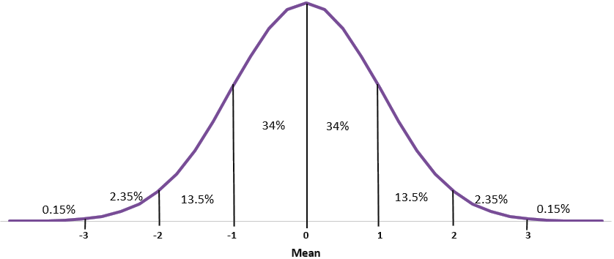
Normal Distribution of IQ
115-129 Mildly GIfted
130-144 Moderately Gifted
145-159 High Gifted
160+ Profoundly Gifted
Notes:
Bolding of text in box

Slide 10
What is giftedness
“Giftedness is asynchronous development in which advanced cognitive abilities and heightened intensity combine to create inner experiences and awareness that are qualitatively different from the norm. This asynchrony increases with higher intellectual capacity. The uniqueness of the gifted renders them particularly vulnerable and requires modifications in parenting, teaching, and counseling in order for them to develop optimally.”
The Columbus Group in 1991

Slide 11
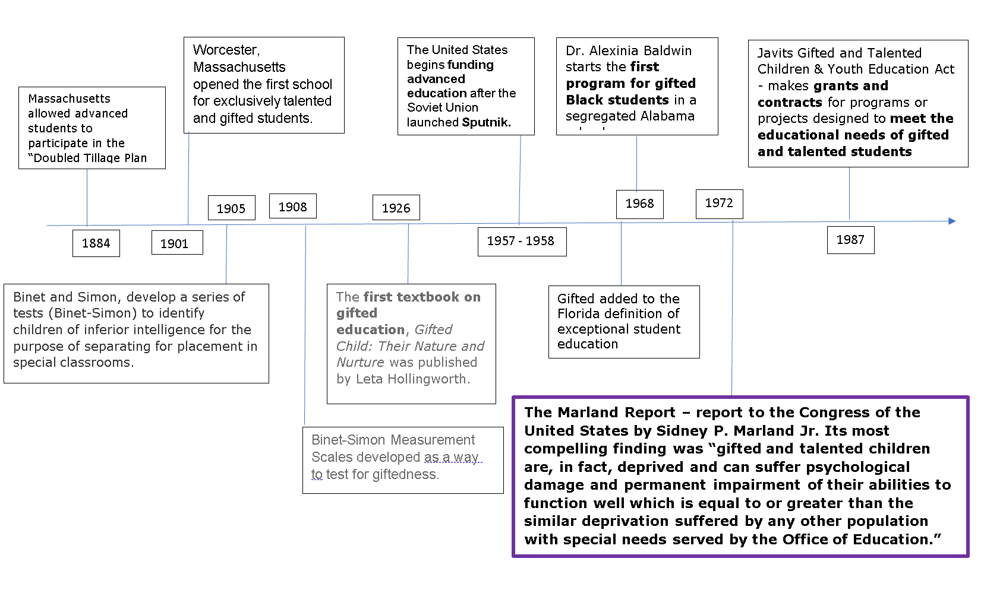
History of Gifted Education in the US
Notes:
Fewer boxes - possible Marland separate slide
it got lost in classroom

Slide 12
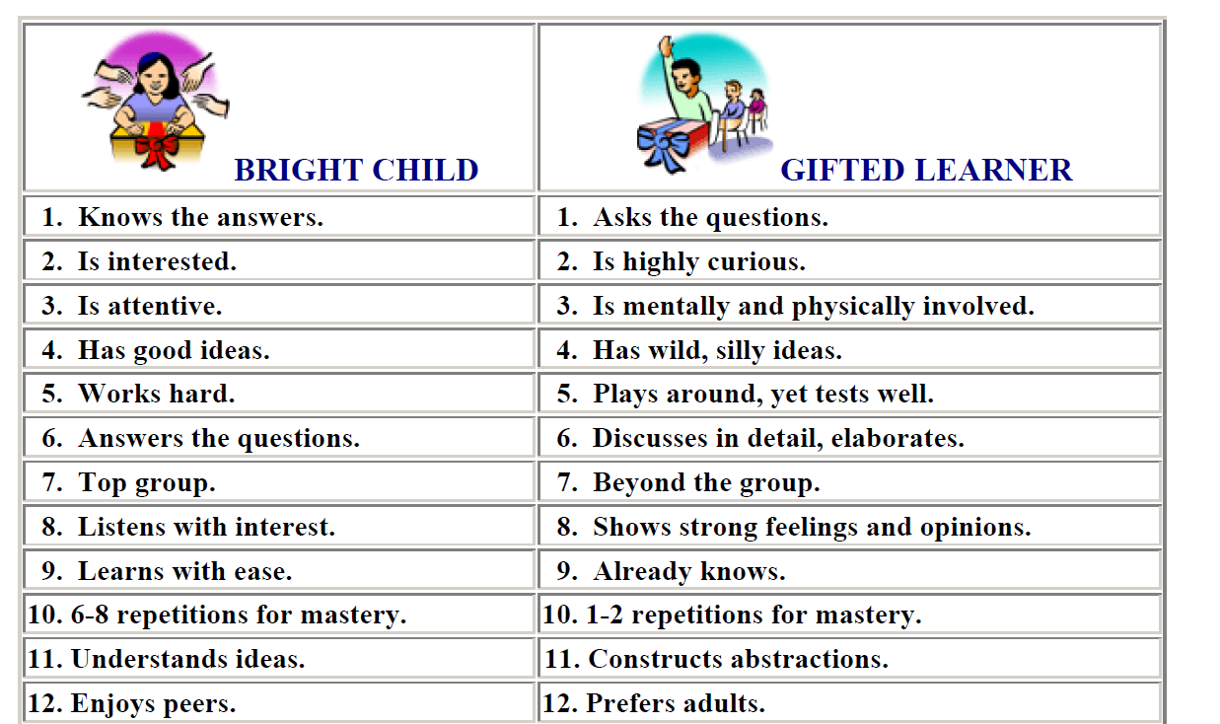
Misconceptions about “smart kids”
Notes:
Maybe more spaces between loans and bullets or hyphens

Slide 13
Behaviors consistent with high-intelligence that can present in challenging ways
Underachievement
Tantrums
Struggles with social skills
Boredom
Anxiety
Asynchronous development
Perfectionism
Strong Sense of Justice
Black and White thinking
Executive functioning
Unkind use of sarcasm and humor
Notes:
Underline Additional behaviours can be: And bold it

Slide 14
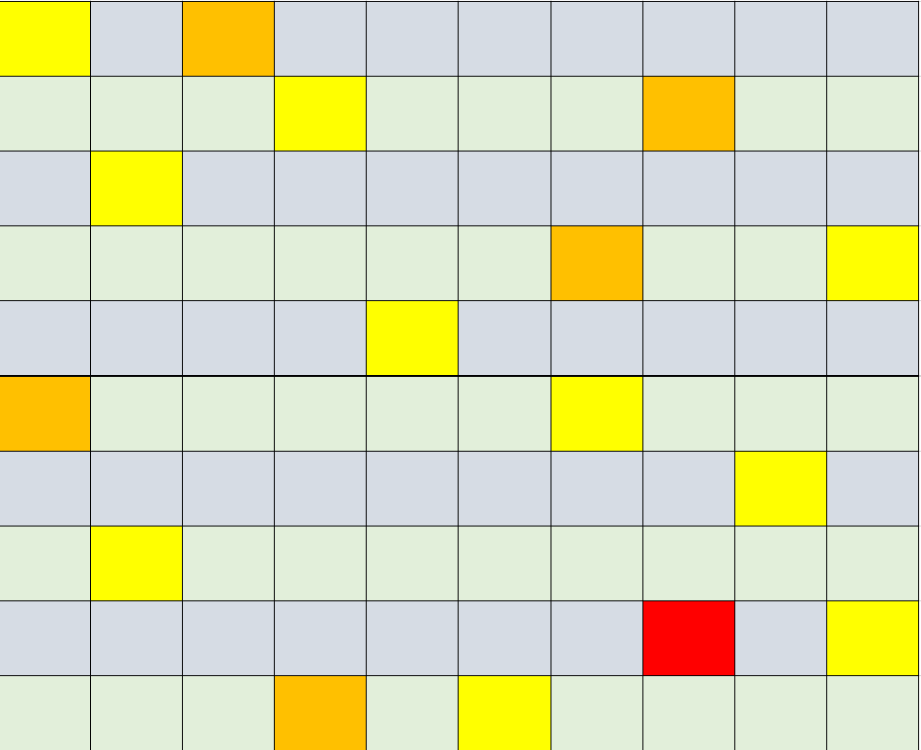
Estimated number of gifted and talented in Florida’s foster care system
The Florida Foster care system has approximately 25,000 children.
Approx. 2,500 children who have needs associated with high cognitive abilities or about 37 high intelligence foster children per county just in foster care
Around 250 profoundly gifted children in foster care or around 3 per county
Notes:
Same

Slide 15
Many gifted and talented children (and adults) are being misdiagnosed by psychologists, psychiatrists, pediatricians, and other health care professionals. The most common misdiagnoses are: Attention Deficit Hyperactivity Disorder (ADHD), Oppositional Defiant Disorder (OD), Obsessive Compulsive Disorder (OCD), and Mood Disorders such as Cyclothymic Disorder, Dysthymic Disorder, Depression, and Bi-Polar Disorder. These common misdiagnoses stem from an ignorance among professionals about specific social and emotional characteristics of gifted children which are then mistakenly assumed by these professionals to be signs of pathology.
Misdiagnosis and Dual Diagnosis of Gifted Children by James T. Webb, Edward R. Amend, Nadia E. Webb, Jean Goerss, Paul Beljan, & F. Richard Olenchak.

Slide 16
Underachievement
Boredom often transforms into underachievement, and an overall disinterest in academics.
Underachievement may not reveal itself until students are in an environment in which they are being appropriately challenged
Discrepancies in scores.
Academic engagement is not relevant to the “real world” or useful to their current lives.
Notes:
same

Slide 17
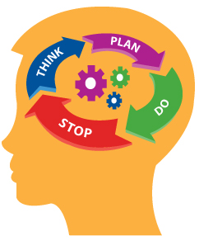
Executive Functioning
Mental processes that enable us to plan, focus attention, remember instructions, and do multiple tasks successfully
Resistance to an activity means we need to inquire more
Mistakes are an opportunity for learning
“Time blindness”, “flow” or “tunnel vision”
Impact of Trauma
Notes:
Rearrange the list with the short lines 1st and move the image up and make it larger

Slide 18
Other dimensions of giftedness
Overexcitabilities / Intensities
Multipotentiality
Asynchrony
Twice-Exceptional
Notes:
Spacing

Slide 19
Extracurricular Activities are a MUST
Options can vary widely - sports, music, performing arts, clubs, foreign languages
Many children have no idea about all of the options that are out there or what they might like
Subject matter specific mentors
Allow for release of pent-up energy, feelings trapped in the body, frustration,
Cheetahs got to cheetah!
Notes:
Same

Slide 20
Sports: An excellent example
How we nurture athletic talent, is an excellent example of how we can and should support gifted needs
“Play-up” - ability grouping, not just age grouping
Specialized training and gear
Travel to compete against others who excel in the same area

Slide 21
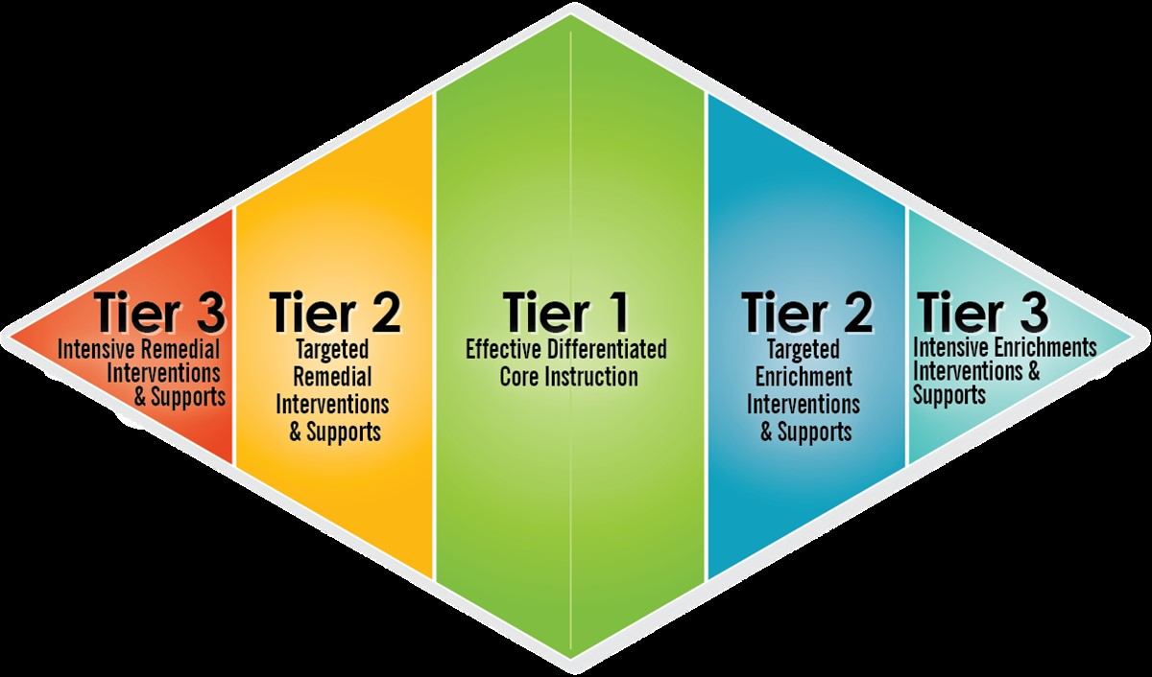

Slide 22
Tips for working with these youth
Check your ego at the door
Earn their respect
Be willing to explain why….a lot!
Don’t be intimidated
Do not have expectations of them being good at everything
Respect their periods of frustration
Be aware of your bias
Notes:
A little larger on the Copyright line .. Definitely larger, bold contact and underline email address
.. THROUGHOUT – I know there was an exeter rush on getting these out for the 1st AMAZING class:
Now that there is some time, it may sound petty but sitting through the sessions I thing the following would help.
Spacing on slides, using te entire slide - Consistent bulleting - Font sizing and bolding - other comments along the way
— THE SLIDES WORKED, THEY WERE WELL RECEIVED, THE CONTENT WAS GREAT, LOOKING FORWARD TO SESSEION 1B

Slide 23
No matter where the youth goes, these needs go with them
They don’t stop having these needs when they get kicked out of a home
They don’t stop having these needs when they get kicked out of daycare
They don’t stop having these needs when they get arrested
They don’t stop having these needs and abilities when they go to a lockdown facility
They don’t stop having these needs and abilities if they are involved in commercial sex work.

Slide 24
Preparing these youth for the future
College / Post-secondary exposure should start in middle school
College readiness in their freshman year
Opportunities to participate in rigorous classes even with poor grades
Ample career Pathway Exposure
Follow/attend Positive Pathways an attend their training sessions and conferences
Notes:
A little larger on the Copyright line .. Definitely larger, bold contact and underline email address
.. THROUGHOUT – I know there was an exeter rush on getting these out for the 1st AMAZING class:
Now that there is some time, it may sound petty but sitting through the sessions I thing the following would help.
Spacing on slides, using te entire slide - Consistent bulleting - Font sizing and bolding - other comments along the way
— THE SLIDES WORKED, THEY WERE WELL RECEIVED, THE CONTENT WAS GREAT, LOOKING FORWARD TO SESSEION 1B

Slide 25
Improving education and graduation outcomes
Advocacy for testing and identification through the school system
Ensure education records are complete and provide to each new school
Meet with the child to get information about past school experience. Share learned information at ESSA staffings
Ensure the child’s case management file includes up to date graduation requirement completions

Slide 26
National Advocacy and Information
NAGC - conferences and the publication “Gifted Child Quarterly, Parenting for High Potential”
SENG - conferences and the publication “SENG Journal: Exploring the Psychology of Giftedness”
Florida Gifted Network
Notes:
Spacing

Slide 27
Talent Search and Development Programs
Johns Hopkins University Center For Talented Youth
University of Denver - Rocky Mountain Talent Search - Center For Bright Kids
Purdue University Gifted Education Research and Resource Institute (GER2I)
Notes:
Same .. Use the entire slide

Slide 28
Online Resources
Hoagies Gifted Education Page
Davidson Institute
Child Mind Institute
Renzulli Learning
Beast Academy - an online rigorous math program for elementary aged children
Science Friday
Mensa for Kids
Dabrowski Center

Slide 29
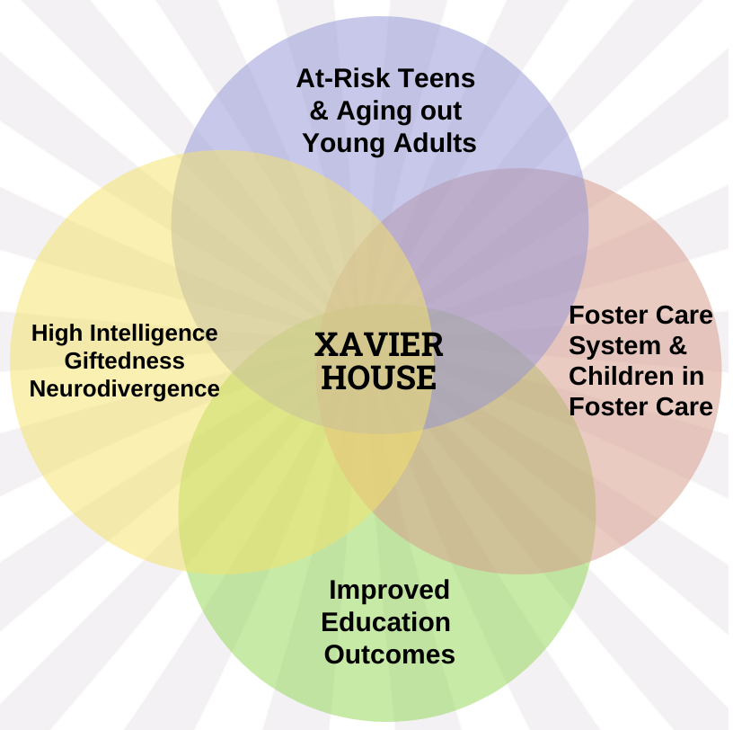
Foster group home for high potential youth in the foster care system
Will serve youth ages 14 to 17
Notes:
Many efforts in all these areas, but nothing like Xavier House to address the challenges for the kids that intersect in this diagram. We will reach all these areas.

Slide 30
Notes:
A little larger on the Copyright line .. Definitely larger, bold contact and underline email address

Slide 31
Thank You!
Yvette R. Robinson M. A. Ed.
Phone: 352-426-7600
Email: yvette.robinson@xavierhouse.org
Xavierhouse.org

