Slide 1

Recent Trends in Child Welfare Financing
2023 Florida Coalition for Children Conference
Kristina Rosinsky, Child Trends
July 18, 2023

Slide 2
Pop Quiz!
1. What is the largest federal funding stream used by child welfare agencies?
Title IV-E of the Social Security Act
Medicaid
Temporary Assistance for Needy Families (TANF)
Title IV-B of the Social Security Act

Slide 3
Pop Quiz!
1. What is the largest federal funding stream used by child welfare agencies?
Title IV-E of the Social Security Act
Medicaid
Temporary Assistance for Needy Families (TANF)
Title IV-B of the Social Security Act

Slide 4
Pop Quiz!
2. True or false:
About half of child welfare agency expenditures are spent on out-of-home placements.

Slide 5
Pop Quiz!
2. True or false:
About half of child welfare agency expenditures are spent on out-of-home placements.

Slide 6
Pop Quiz!
3. After accounting for inflation, child welfare agency expenditures have _______ between 2010 and 2020.
Increased
Decreased
Stayed the same

Slide 7
Pop Quiz!
3. After accounting for inflation, child welfare agency expenditures have _______ between 2010 and 2020.
Increased
Decreased
Stayed the same

Slide 8
Pop Quiz!
4. Which of these funding sources is the most flexible for child welfare agencies?
Title IV-E of the Social Security Act
Social Services Block Grant (SSBG)
Medicaid
Title IV-B of the Social Security Act

Slide 9
Pop Quiz!
4. Which of these funding sources is the most flexible for child welfare agencies?
Title IV-E of the Social Security Act
Social Services Block Grant (SSBG)
Medicaid
Title IV-B of the Social Security Act

Slide 10
Pop Quiz!
5. True or false:
Most states finance child welfare in similar ways and have similar expenditure trends.

Slide 11
Pop Quiz!
5. True or false:
Most states finance child welfare in similar ways and have similar expenditure trends.

Slide 12
Today’s Agenda
Overview of various funding streams
Spending trends
State funding profiles
Use of funds
Early impacts of the pandemic
  Innovative approaches and strategies for moving forward

Slide 13
Overview of the Child Welfare Financing Survey
Documents the sources and amounts of spending by child welfare agencies across the U.S.
46 states (including DC and Puerto Rico) participated in the SFY 2020 survey*
Survey collected data on states’ expenditures on child welfare activities for state fiscal year 2020
*Georgia, Hawai’i, Idaho, North Dakota, Washington, and West Virginia were unable to respond.

Slide 14
Major child welfare funding sources
State and local funds
Federal
        Title IV-E of the Social Security Act
      Title IV-B of the Social Security Act
      Medicaid
      Social Services Block Grant (SSBG)
      Temporary Assistance for Needy Families (TANF)
      Other federal funding streams
      Other funds (e.g., third-party income sources, third-party in-kind contributions, and private dollars)
Dedicated
Non-dedicated

Slide 15
Major child welfare funding sources
Federal funds

Slide 16
Major child welfare funding sources
Title IV-E of the Social Security Act can be used for foster care, adoption, guardianship, prevention services, transition supports for eligible children/youth, and child welfare workforce training.
Federal funds

Slide 17
Brief note on the Family First Act
The data being presented today are from SFY 2020, representing the very early days of Family First Act implementation.
Family First allows Title IV-E to be used for prevention services, with limitations.
Before Family First, many states had Title IV-E waivers that allowed them to use Title IV-E for prevention (among other services/activities not traditionally eligible under Title IV-E).
Between SFY 2018 and 2020, Title IV-E expenditures increased by 5% nationally. Waiver spending decreased significantly; foster care program spending increased significantly.

Slide 18
Major child welfare funding sources
Temporary Assistance for Needy Families (TANF) is a source of flexible funding for supporting child welfare activities.
Federal funds

Slide 19
Major child welfare funding sources
The Social Services Block Grant (SSBG) is a source of flexible funding to promote self-sufficiency, prevent or remedy child maltreatment, reduce inappropriate use of institutional care, and more.
Federal funds

Slide 20
Major child welfare funding sources
Medicaid provides health coverage and services, including clinical behavioral health services, to low-income individuals.
Federal funds

Slide 21
Major child welfare funding sources
Title IV-B of the Social Security Act can be used for the prevention of maltreatment, family preservation, family reunification, services for foster and adopted children, training for child welfare professionals, and adoption promotion activities.
Federal funds

Slide 22
Major child welfare funding sources
States may use other federal funding streams to fund child welfare activities, such as the Child Abuse Prevention and Treatment Act (CAPTA), the Adoption Opportunities Program, and more.
Federal funds

Slide 23
Major child welfare funding sources
Other sources include private dollars, third-party in-kind contributions, and third-party income used as offsets (like Social Security and child support).
Federal funds

Slide 24
Total child welfare agency expenditures have held steady over the past decade
Change in total child welfare agency expenditures, SFYs 2010–2020 (31 states)
US Total:
$31.4 billion
in SFY 2020

Slide 25
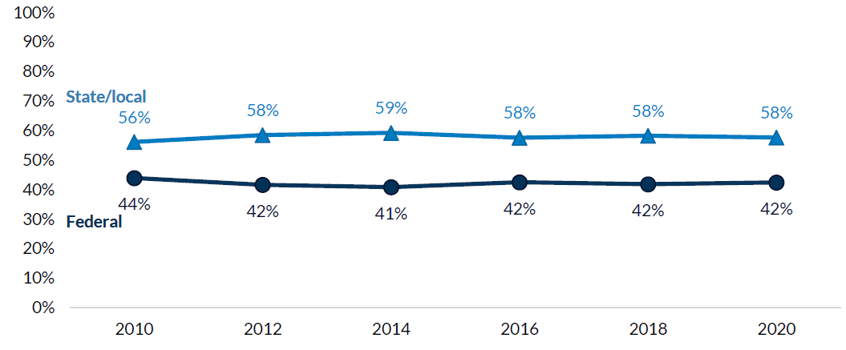
State/local sources make up a larger percentage of total child welfare agency expenditures than federal sources

Slide 26
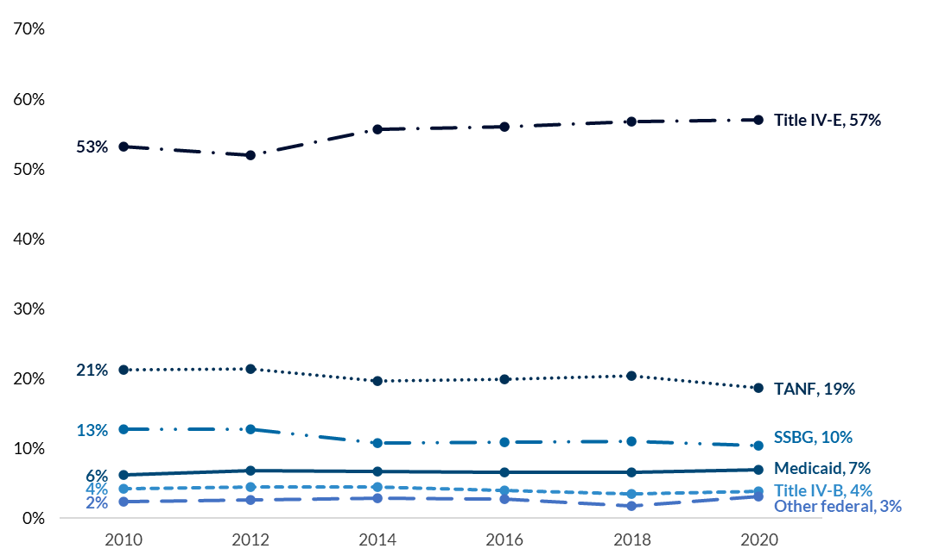
Proportion of total federal expenditures from each major federal source, SFYs 2010–2020 (38 states)

Slide 27
Child welfare agency expenditure trends and financing sources vary greatly among states
Top increases and decreases in total child welfare agency spending, SFYs 2018-2020
70% of states reported an increase
30% of states reported a decrease
FL experienced a 3% increase

Slide 28
Child welfare agency expenditure trends and financing sources vary greatly among states (continued)
Federal
State & local
28

Slide 29
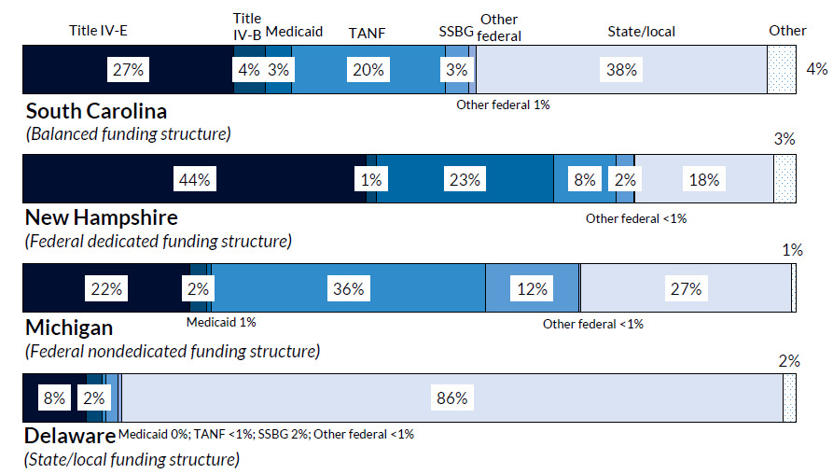
Key Finding #2: Child welfare agency expenditure trends and financing sources vary greatly among states
29

Slide 30
Reasons for state-level variation
Ability to meet match requirements
Characteristics of the children served by the child welfare agency
Competition from other agencies
Federal funding stream requirements

Slide 31
Child welfare agencies used nearly half of all federal and state/local expenditures to finance the costs of out-of-home placements, with smaller proportions spent on other services
Proportion of total expenditures on categories of services

Slide 32
Less child welfare agency prevention spending is focused on financial supports, substance abuse and mental health services than on other preventive services
Percentage of child welfare agency prevention expenditures on various prevention service categories
Federal
State/local
Parent skill-based programs
Caseworker visits/administration
Substance abuse prevention & treatment
Mental health treatment
Financial supports
Other services

Slide 33
Diving deeper into FL’s data
Get your phone or computer!
Google: “Child Welfare Financing Survey 2020”
Scroll down and find “Individual state profiles”
Open Florida’s factsheet
You can also find factsheets from prior years on this webpage
Find a partner and discuss:
  What data surprises you? Why?
  What questions come to mind as you review these data?
  Who can you talk to in your state to get answers to your questions?

Slide 34
Early impacts of pandemic
Latest survey data is from SFY 2020, which includes the very beginning of the pandemic
The pandemic resulted in an influx of federal funds to states and additional flexibilities for states that could have impacted SFY 2020 expenditures
  Families First Coronavirus Response Act
  Coronavirus Aid, Relief, and Economic Security (CARES) Act
  The Supporting Foster Youth and Families Through the Pandemic Act

Slide 35
Early impacts of pandemic on expenditures
Increases due to increased payments to foster parents and other providers; PPE and technology; increased length of stays; sick leave and emergency staffing; quarantining children; supporting older youth; new initiatives done with federal relief funding
Decreases due to less travel; decreased foster care population; fewer community-based services

Slide 36
Early impacts of pandemic on Family First implementation
22% of states indicated the pandemic delayed implementation of the Family First Act
Delays were caused by:
  government shutdowns and the transition to telecommuting
  the need to redistribute resources to focus on the immediate pandemic-related needs of children and families
  focusing on keeping residential programs open rather than on becoming Qualified Residential Treatment Programs (QRTPs)
  courts being overwhelmed with backlogs, resulting in the court system not being able to provide necessary judicial findings for QRTP settings
  prevention program providers struggling to stay open and retain staff, resulting in delayed roll out of evidence-based programs

Slide 37
Innovative Approaches and Strategies for Moving Forward

Slide 38
Colorado
Incorporate rules into the funding model that incentivize desired practices and outcomes
Have a dedicated fund for prevention

Slide 39
New York
Open-ended uncapped fund for prevention services
  Designed to incentivize local investment in prevention services
  State pays 62%, locality pays 38%
  Contributed to a significant decline in the foster care population, from 37,000 in 2002 to 16,000 in 2018
  Represented a $3.4 billion investment of state/local funds between SFYs 2019-2021
  Complemented by a capped reimbursement for foster care
Sources: https://ocfs.ny.gov/main/sppd/family-first.php & https://ocfs.ny.gov/main/sppd/docs/FFPSA-Prevention-Plan-2022-07-29.pdf

Slide 40
Strategies for moving forward
Taking a child/family-focused approach, rather than an agency-focused approach
Fiscal mapping
Cost modeling
Innovative funding strategies
Check out the Children’s Funding Project!
https://www.childrensfundingproject.org

Slide 41
Small Group Discussion
What are some steps you can take to increase the amount of funding available or change how funding is used to improve outcomes for children and families?

Slide 42
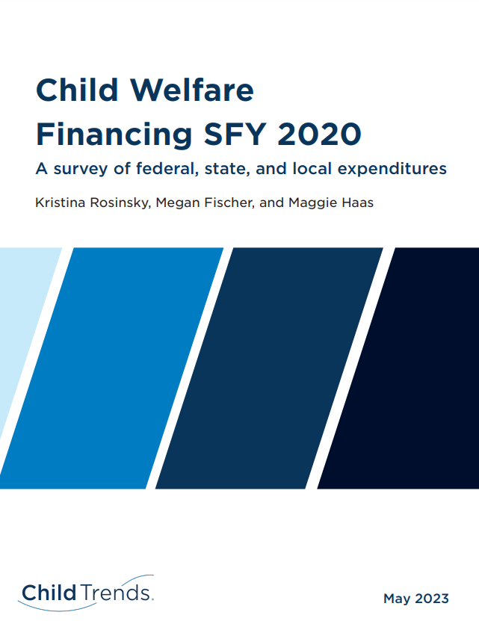
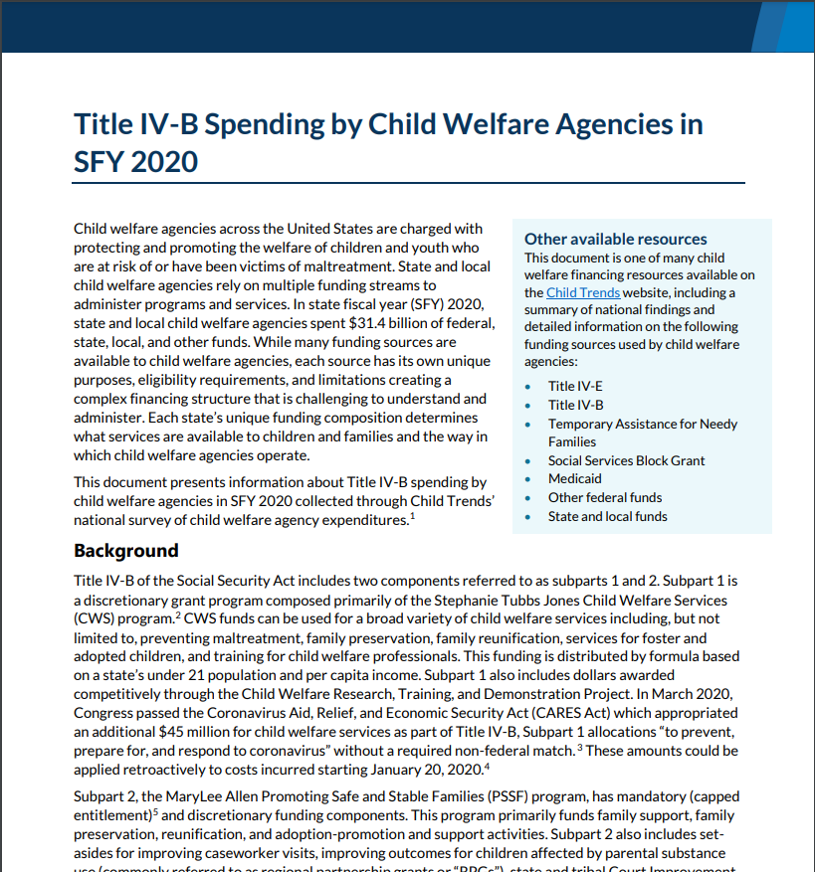
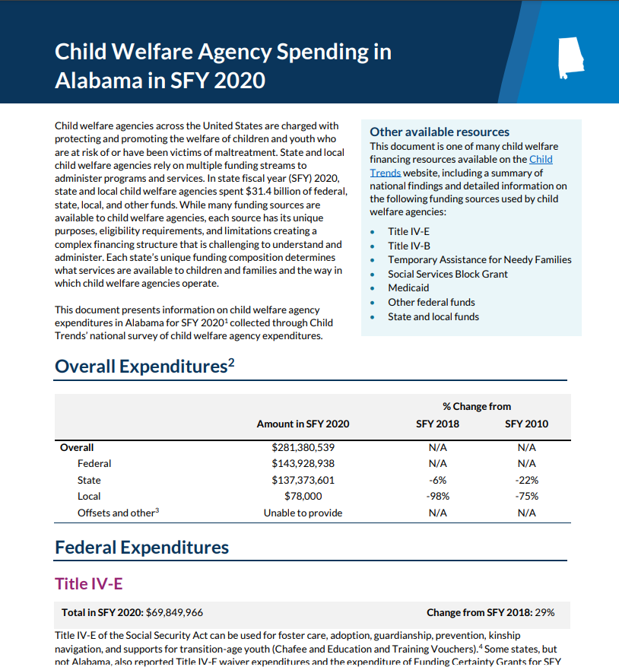
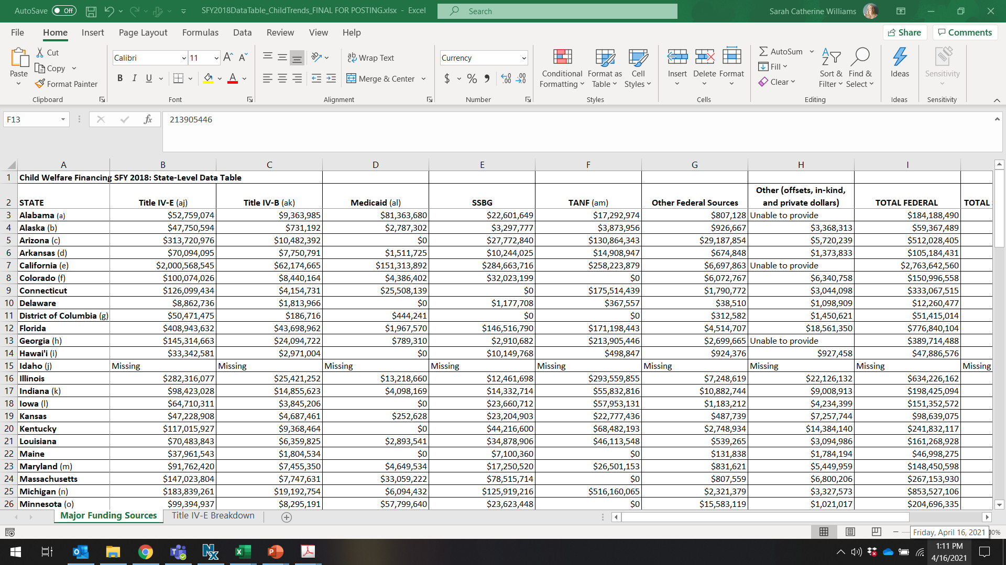
https://www.childtrends.org/publications/child-welfare-financing-survey-sfy2020

Slide 43
Thank you!
Kristina Rosinsky
krosinsky@childtrends.org

