Slide 1

Youth Engagement Community Cafe
Dr. Elizabeth Wynter
Foster Youth Voice Whisperer
Delgadina “Dina” Santos
Youth Advocacy Specialist, Selfless Love Foundation
Notes:
Dina’s Part-
Hello everyone, my name is dina santos. My pro-nouns are they/them and I am selfless love foundation’s youth advocacy specialist.

Slide 2
What has been accomplished to date?
Indicators of forward motion and progress
1. Foster Youth Voice Month – Awareness Campaign Growing!!
35 States participated in Foster Youth Voice Month in 2022. Florida was able to secure a governor's proclamation along with 5 other national partners.
2. Chafee Division X
41 youth leaders involved in OVI drafted and signed a letter to Secretary Harris that resulted in additional payments going directly to the hands of youth across the state!
3. Support and training for OVI Network of Youth Councils!!
OVI increased funding for 17 councils throughout the state of Florida and provide in-person and virtual training options to prepare youth for opportunities to share their experience and advocate for change.

Slide 3
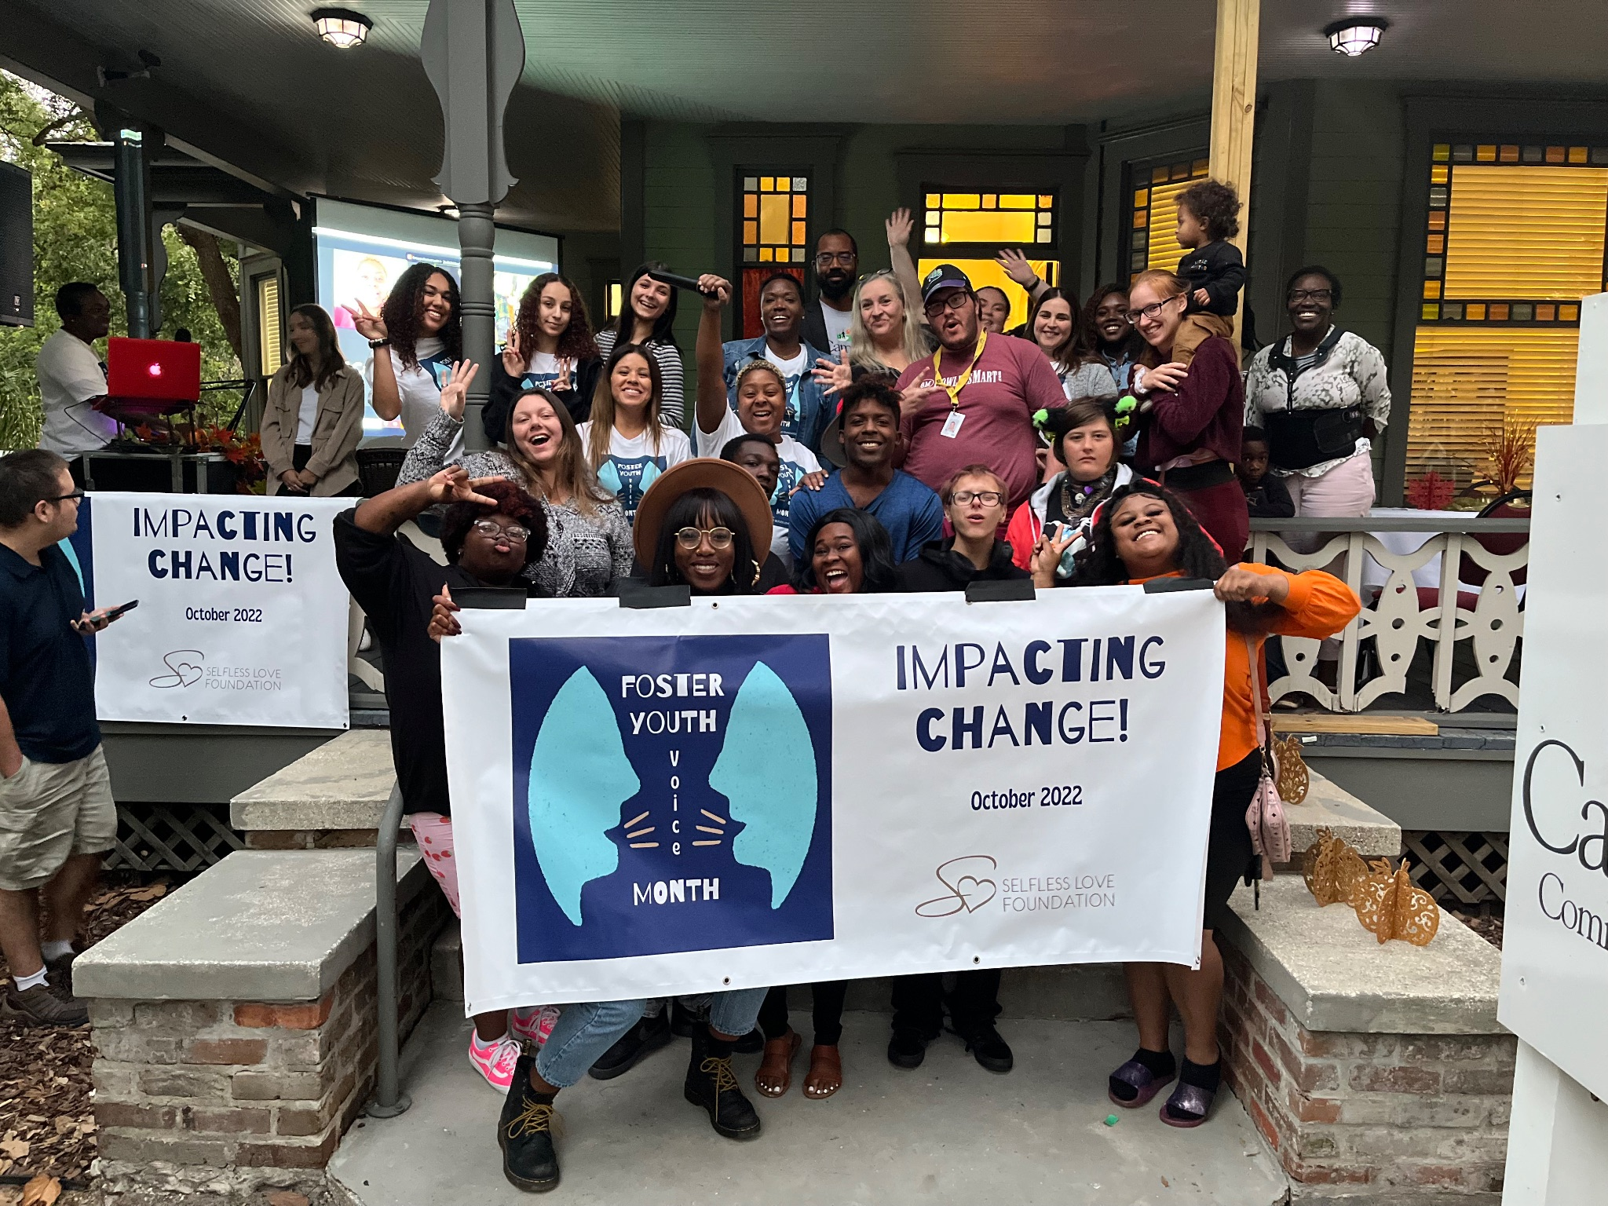
What has been accomplished to date to move the needle for youth?
Changing Perceptions
Foster Youth Voice Month
Youth Whisperer Blogs
Dream Tank Competition
Notes:
Dina’s notes:
Selfless Love’s Dreamtank competition is a life changing experience for the youth who get to be involved in it. speak to experiences and positive skills i acquired due to opportunities I got to participate in as a dreamtank contestant was rally in tally. Networking enhanced my ability in trainings and we got fantastic feedback on how engaging we are.

Slide 4
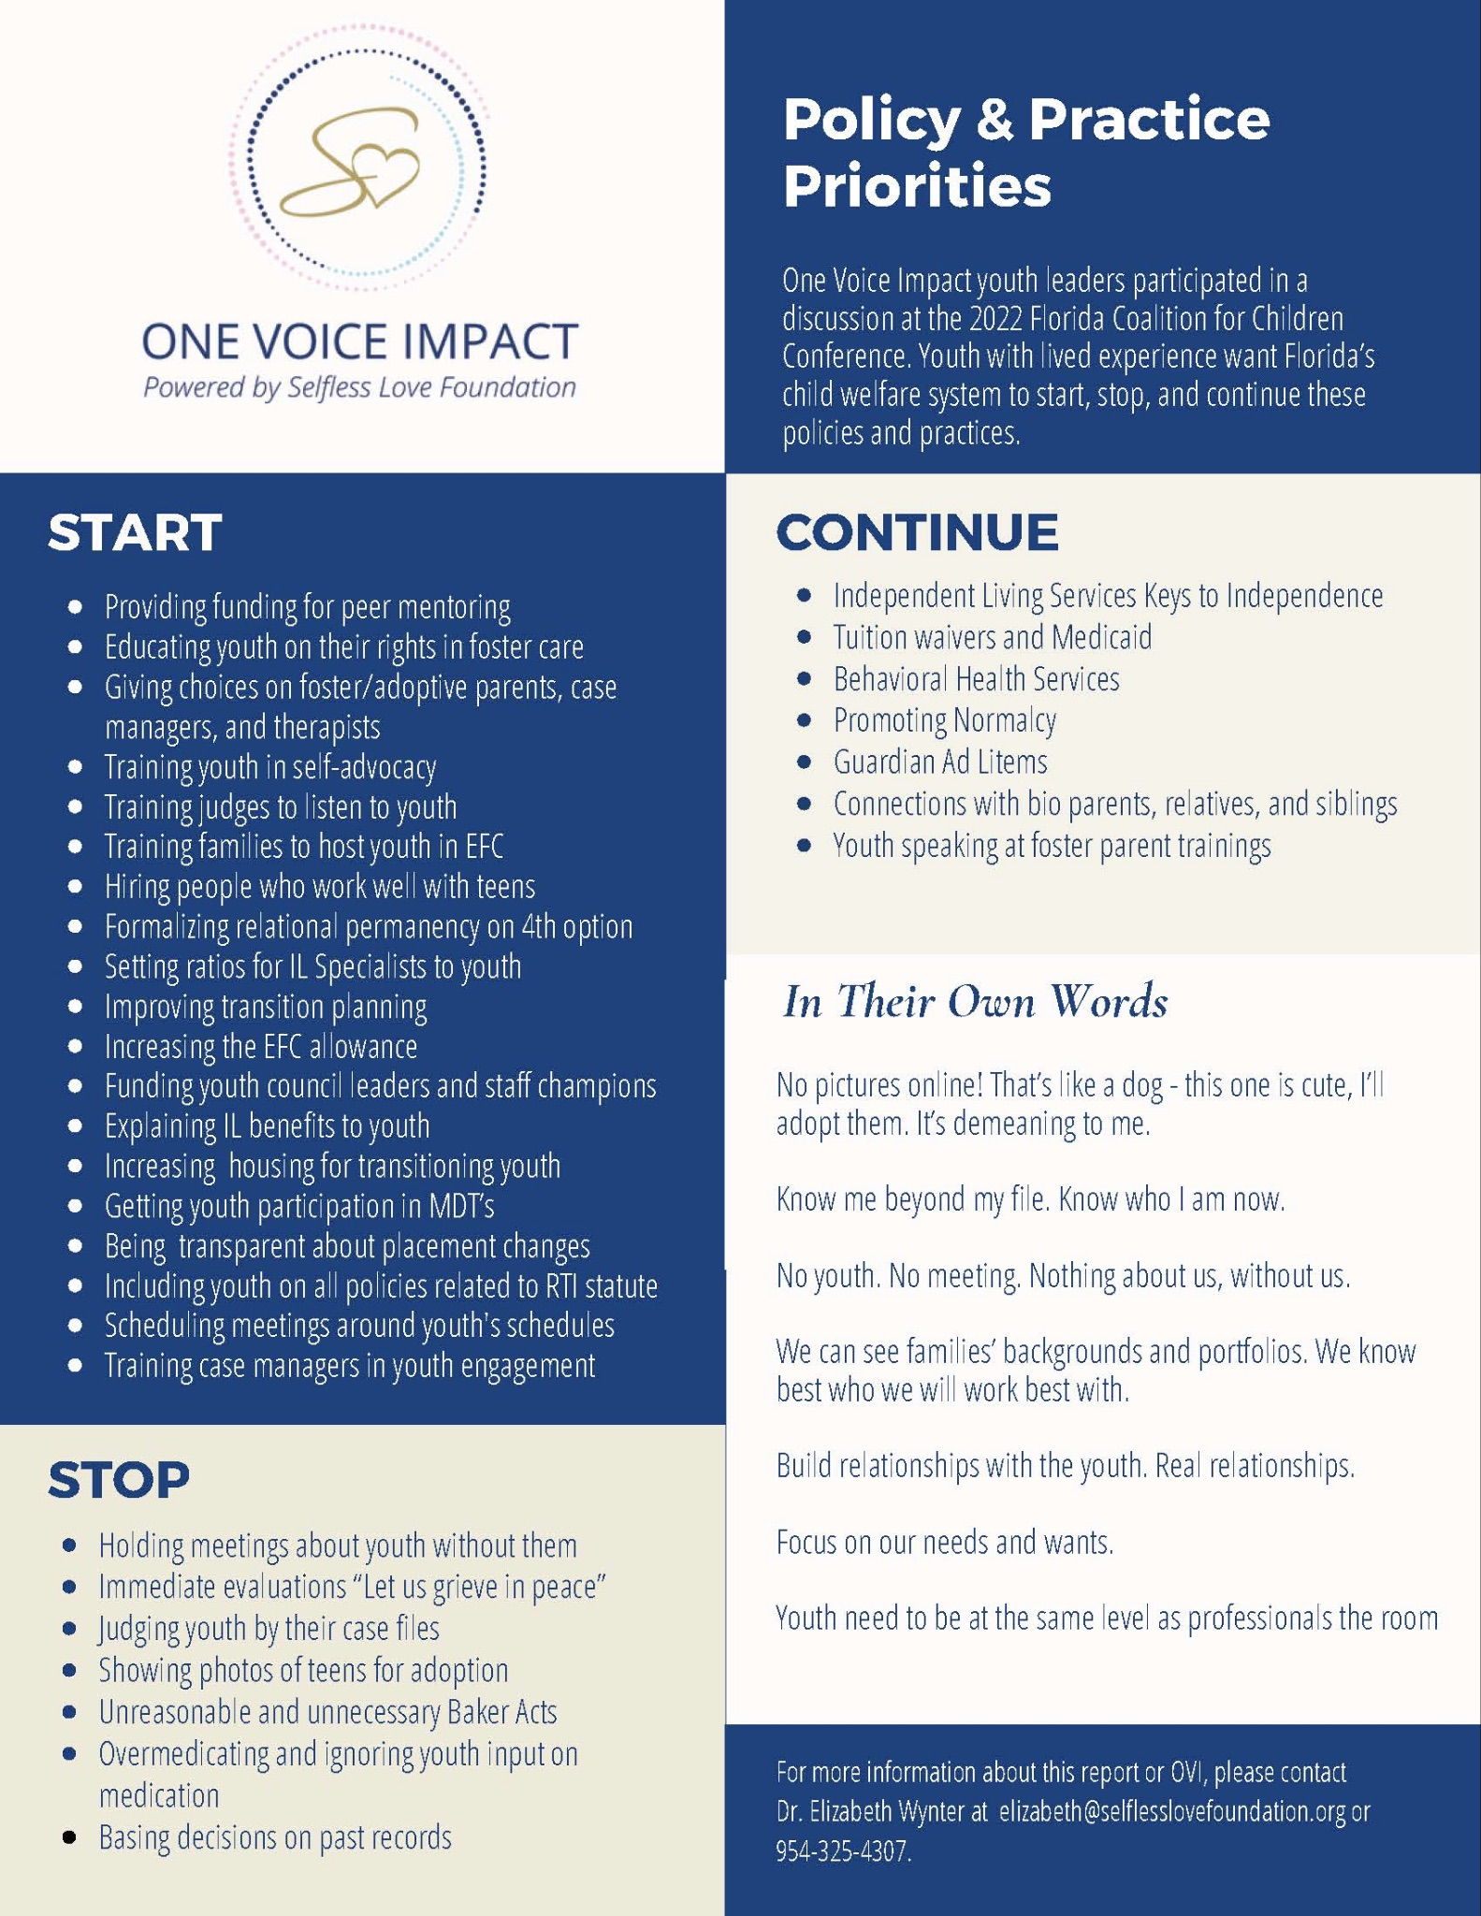
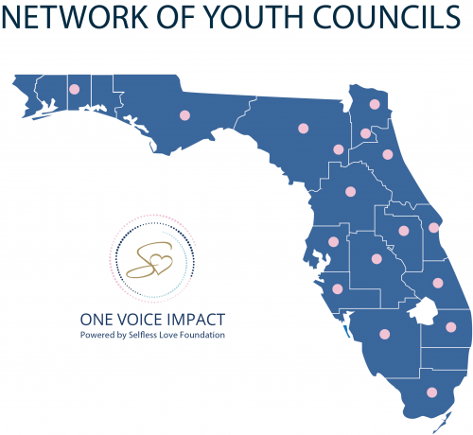
What has been accomplished to date to move the needle for youth?
Youth Voice & Youth Councils
Youth Thrive
Advocacy Team Manual
Legislative Training
Notes:
dina’s notes:
I am an active member of our advocacy team, we represent our peers engaged in the one voice impact network with statewide advocacy wether through FCC or meetings with legislators. Our goal is to advocate for change identified by my peers in the child welfare system and foster care. it was impactful for me that these legislators listened to the concerns myself and my peers identified that needs to be addressed. I felt listened to and as if my opinion was valued. I got to briefly meet with senator Rouson who is with the committee of children, family and elder affairs who showed a lot of support around my comments around race equity and inclusion during a committee meeting, I really appreciated knowing that there was support given to me about those topics.

Slide 5

What has been accomplished to date to move the needle for youth?
Independent Living Outcome Data
OPPAGA Memo
FL Youth Experiences Study (YES) study
PESS Self-Sufficiency Assessment

Slide 6
OPPAGA: A Review of IL Programs in Florida
1) Consistency in IL services- youth in the Extended Foster Care program receive financial assistance along with case manager services. Youth want the same level of services in the Post-Secondary Education program.
2) Pathway to Self-Sufficiency- youth want an assessment that evaluates if they are on track to become self-sufficient when services end.
3) Permanent Connections- Youth leaving care without obtaining legal permanency want the child welfare system to ensure that they have a supportive adult to guide them through the transition to adulthood.

Slide 7
OPPAGA: A Review of IL Programs in Florida
4) Competency for IL Specialists – youth want the case managers that they work with to be specifically trained to serve this population of young people.
5) Implementation of a Standardized Life Skills Curriculum- youth want a consistent, comprehensive, evidence-informed life skills curriculum implemented across the state.

Slide 8
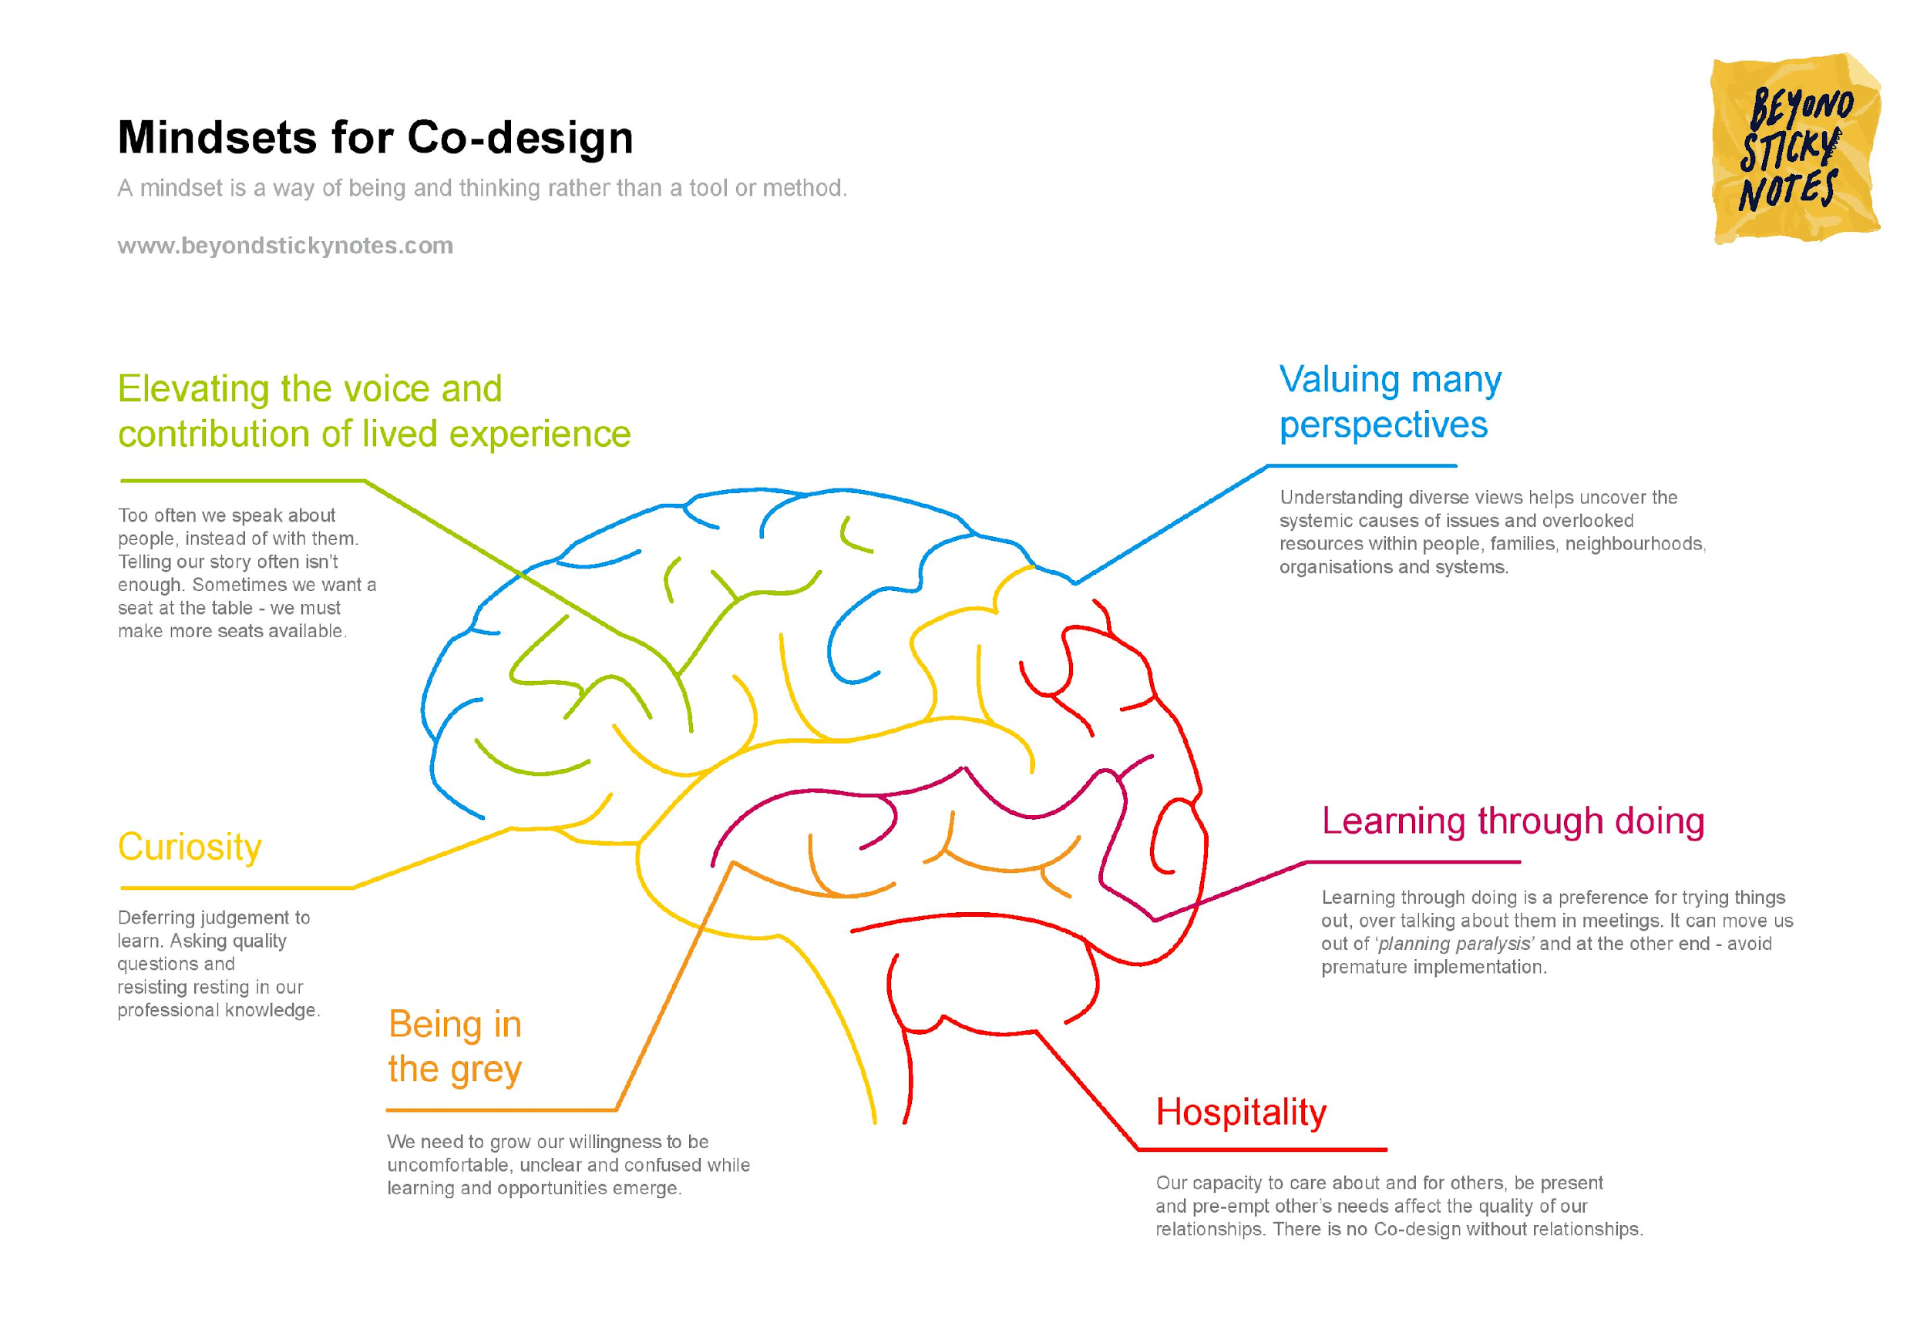
Co-design to work better together
Co-design is about working with the people who are closest to the solutions, prioritising relationships,
being honest, making sure people feel welcome, using creative tools and building capability. Co-design
uses inclusive convening and facilitation.

Slide 9
Embracing change for co-design
From | To
Making decisions for people with lived experience | Making decisions with people with lived experience
Valuing professional expertise above all | Valuing professional and lived experience equally
Seeing marginalised people as a burden | Seeing marginalised people as resilient, creative and capable
Colonising, heteronormative and ableist systems | Compassionate systems that see and respond to dimensions of difference
Believing that resources are scarce to make change | Seeing an abundance of experience, ideas and energy for change
Focusing on ‘consumer’ councils and committees | Embedding participation in everyday practice
Rushing to solutions | Slowing down to listen, connect and learn
Notes:
To make co-design a reality, we need systems, organisations and communities to embrace the
leadership and contributions of people with lived experience. Doing that requires different ways of
thinking and being, which are missing from many teams, organisations and systems.

Slide 10
Questions to consider
Where we are as a state regarding the topic of the respective Café?
Florida’s child welfare system should ensure that youth have a voice in decisions that impact their lives (e.g. attend court hearings, placement staffings, permanency planning, transition planning, etc.)

Slide 11
Questions to consider
2. What is the collective vision for the future regarding the topic?
Young people involved in the foster care system must be empowered to make decisions, given the dignity of risk and safe space to grieve losses, and offered opportunities for self-discovery and connection.

Slide 12
Questions to consider
3. What can I do to help realize the vision?
What can my organization do to support the vision?
What can the child welfare system do to support the vision?

Slide 13
Questions

