Slide 1
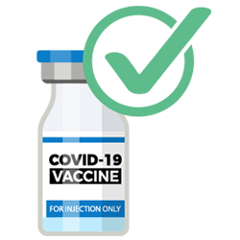
COVID-19 Booster Doses in Skilled Nursing Facilities
Joe Coyle, MPH
Director, Bureau of Infectious Disease Prevention
Michigan Department of Health and Human Services
12/8/2021

Slide 2

Outline
State of the Pandemic in Michigan
COVID-19 Booster Recommendations and Eligible Populations
Skilled Nursing Facility Booster Data in NHSN

Slide 3
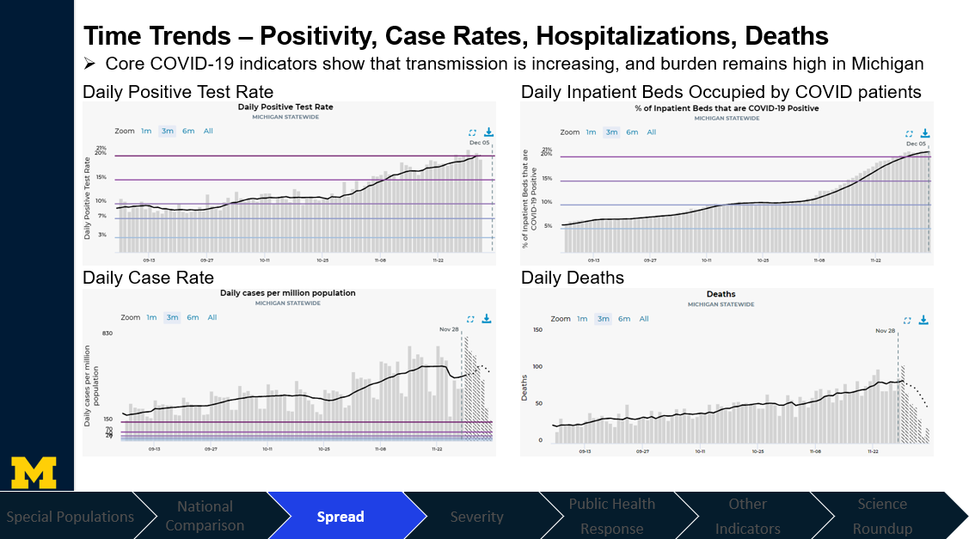

Slide 4
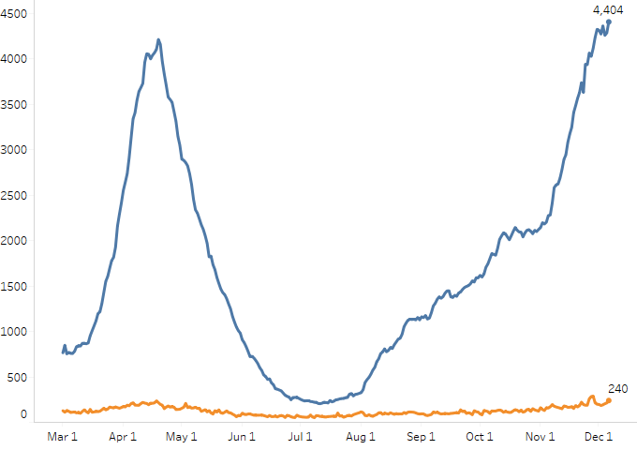
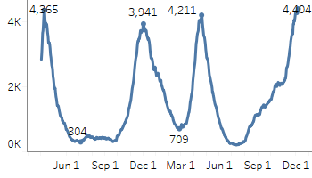
Statewide Hospitalization Trends: Total COVID+ Census
The COVID+ census in hospitals has increased by 4% in the past week (previous week was 13% growth).
The current wave’s hospitalizations are now at the highest point since the beginning of the pandemic.
Hospitalization Trends 3/1/2021 – 12/6/2021
Confirmed Positive & Persons Under Investigation (PUI)
Confirmed Positive
Hospitalized COVID Positive Long Term Trend (beginning March 2020)
PUI

Slide 5
Average and total new deaths, by age group
Daily COVID-19 deaths in confirmed and probable cases per million by age group (7 day rolling average)
Total COVID-19 deaths in confirmed and probable cases by age group (past 30 days, ending 11/29/2021)
0-19
40-49
70-79
20% of deaths below age sixty
20-29
50-59
80+
30-39
60-69
Total
0-19
20-29
30-39
40-49
50-59
60-69
70-79
80+
Through 12/6, the 7-day avg. death rate is more than 70 daily deaths per million people for those over the age of 80
In the past 30 days, the proportion of deaths among those over 60 is steady
Note: Death information sourced from MDHHS and reflects date of death of confirmed and probable cases.
Source: MDHHS – Michigan Disease Surveillance System (MDSS)
Special Populations
National Comparison
Spread
Severity
Public Health
Response
Other
Indicators
Science
Roundup

Slide 6
MICHIGAN SNF COVID-19 CASE TREND

Slide 7
Opportunities for Boosters

Slide 8
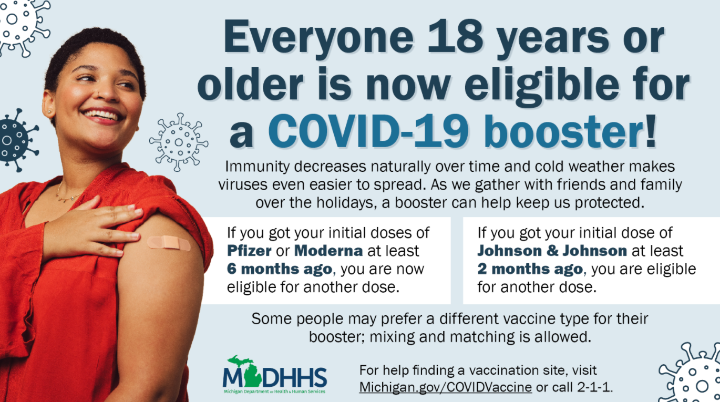

Slide 9
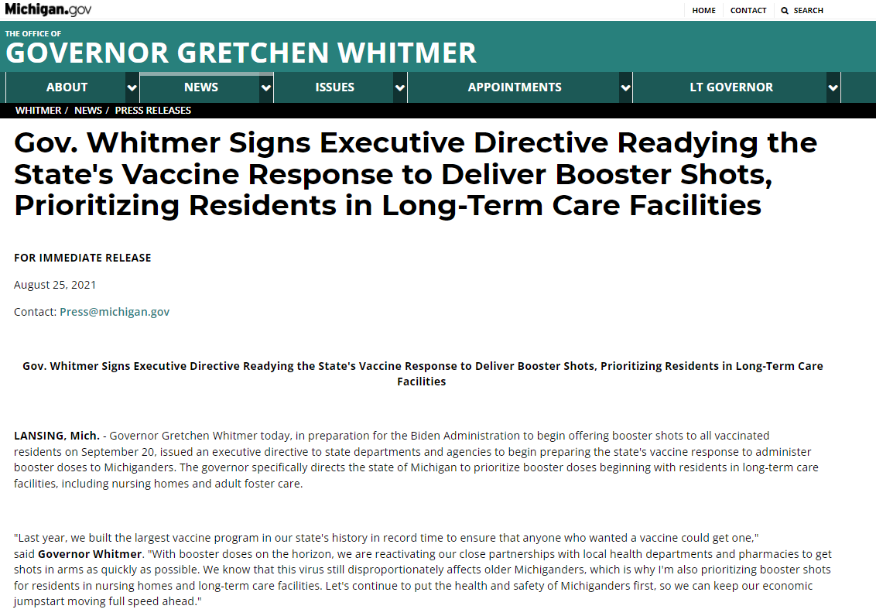
https://www.michigan.gov/whitmer/0,9309,7-387-90499_90640-566953--,00.html

Slide 10
MDHHS Activities and Goals
Monitoring data to identify trends and gaps in booster administration
Reaching out to facilities to confirm data is accurate
Reaching out to facilities that have lower booster administration coverage
Providing direct assistance to skilled nursing facilities, if needed, to identify vaccination partners to hold on-site vaccination clinics
Goal: Offer COVID-19 booster to every eligible nursing home resident by the end of the calendar year

Slide 11
NHSN Booster Data Quality
The only real way for MDHHS to monitor facility-specific booster administrations is to view the facility self-reported data through the NHSN
When examining those data we had questions about the accuracy of the information
Once we assure data quality, we can use the information through the NHSN to measure progress towards booster vaccination goals and use the facility-specific information to conduct more targeted outreach
  Are facilities correctly reporting the number of residents eligible for a COVID-19 booster?
  Are facilities correctly reporting the number of residents that received a COVID-19 booster?

Slide 12
Weekly Summary of SNF Resident Vaccination and Booster Eligibility/Coverage
Week Ending | Facilities Reporting | Total Resident Census | % of Facilities Reporting | Number of Residents Fully Vaccinated | % of Residents Fully Vaccinated | Cumulative Residents Eligible for Booster | Cumulative Residents with a Booster Received | % of Eligible Residents with Booster Received
10/10/2021 | 441 | 33519 | 100.0% | 28088 | 83.8% | 7040 | 434 | 6.2%
10/17/2021 | 439 | 33368 | 99.5% | 28023 | 84.0% | 7441 | 520 | 7.0%
10/24/2021 | 438 | 33361 | 99.3% | 28059 | 84.1% | 10862 | 865 | 8.0%
10/31/2021 | 437 | 33428 | 99.1% | 28207 | 84.4% | 15915 | 1482 | 9.3%
11/7/2021 | 439 | 33547 | 99.5% | 28301 | 84.4% | 18337 | 3496 | 19.1%
11/14/2021 | 437 | 33291 | 99.1% | 28114 | 84.4% | 20484 | 6282 | 30.7%
11/21/2021 | 440 | 33416 | 99.8% | 28402 | 85.0% | 21672 | 8695 | 40.1%
11/28/2021 | 434 | 32962 | 98.4% | 28021 | 85.0% | 21895 | 10256 | 46.8%
12/5/2021 (incomplete) | 285 | 22096 | 64.6% | 18841 | 85.3% | 15466 | 8558 | 55.3%

Slide 13
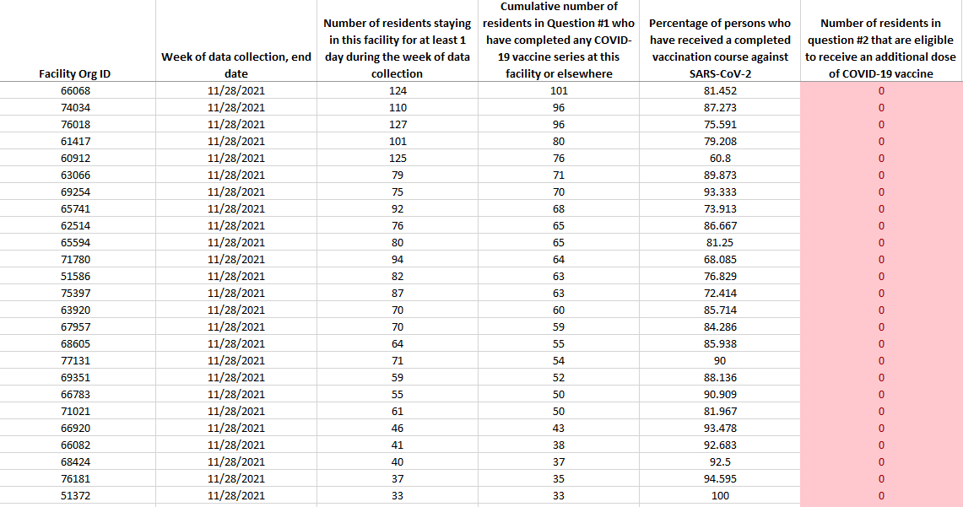
To give you a sense of what we are seeing….

Slide 14
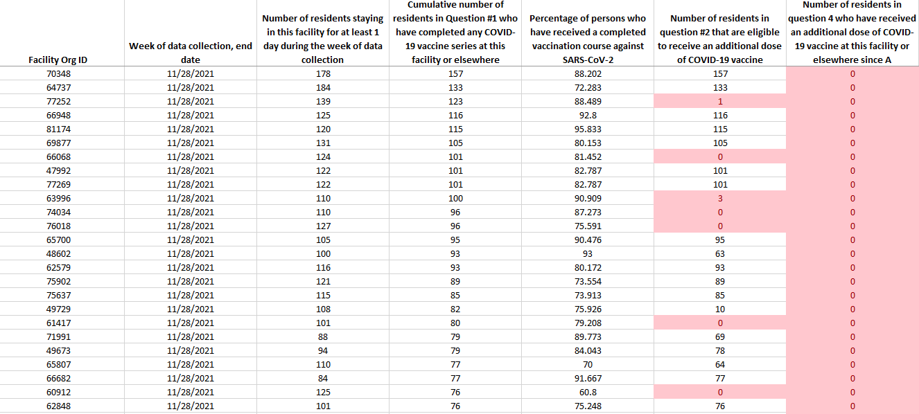
To give you a sense of what we are seeing….

Slide 15
MDHHS SNF Booster Data Validation Outreach
Within the last week MDHHS reached out 359 SNFs regarding their NHSN booster reporting
  Spoke with 236 facilities successfully (66%)
    Of those 89 (38%) reported having some NHSN data inaccuracies
    Of those 22 (9%) asked for assistance in setting up a COVID-19 vaccine clinic
MDHHS or the associations may continue to reach out to facilities (especially those for which we were unable to make contact with successfully)

Slide 16
Weekly Summary of SNF Resident Vaccination and Booster Eligibility/Coverage
Week Ending | Facilities Reporting | Total Resident Census | % of Facilities Reporting | Number of Residents Fully Vaccinated | % of Residents Fully Vaccinated | Cumulative Residents Eligible for Booster | Cumulative Residents with a Booster Received | % of Eligible Residents with Booster Received
10/10/2021 | 441 | 33519 | 100.0% | 28088 | 83.8% | 7040 | 434 | 6.2%
10/17/2021 | 439 | 33368 | 99.5% | 28023 | 84.0% | 7441 | 520 | 7.0%
10/24/2021 | 438 | 33361 | 99.3% | 28059 | 84.1% | 10862 | 865 | 8.0%
10/31/2021 | 437 | 33428 | 99.1% | 28207 | 84.4% | 15915 | 1482 | 9.3%
11/7/2021 | 439 | 33547 | 99.5% | 28301 | 84.4% | 18337 | 3496 | 19.1%
11/14/2021 | 437 | 33291 | 99.1% | 28114 | 84.4% | 20484 | 6282 | 30.7%
11/21/2021 | 440 | 33416 | 99.8% | 28402 | 85.0% | 21672 | 8695 | 40.1%
11/28/2021 | 434 | 32962 | 98.4% | 28021 | 85.0% | 21895 | 10256 | 46.8%
12/5/2021 (incomplete) | 285 | 22096 | 64.6% | 18841 | 85.3% | 15466 | 8558 | 55.3%

Slide 17
Please reach out to MDHHS should you need any assistance in providing an onsite vaccination clinic!
MDHHS-COVID-LongTermCare@Michigan.gov

Slide 18
Vaccination Opportunities Beyond Just Boosters

Slide 19
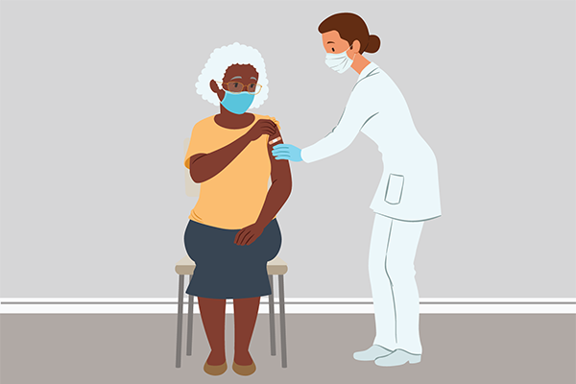
MDHHS-COVID-LongTermCare@Michigan.gov
It’s also not too late for unvaccinated folks to get their first dose!
Consider
Co-administering
Flu vaccine!

Slide 20
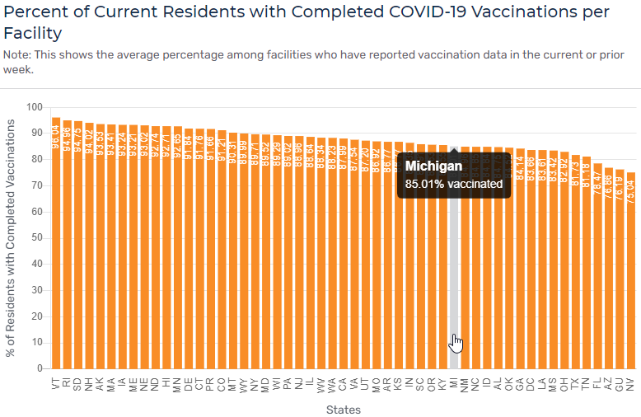
, Nursing Homes/Skilled Nursing Facilities
https://data.cms.gov/covid-19/covid-19-nursing-home-data
Special Populations
National Comparison
Spread
Severity
Public Health
Response
Other
Indicators
Science
Roundup

Slide 21
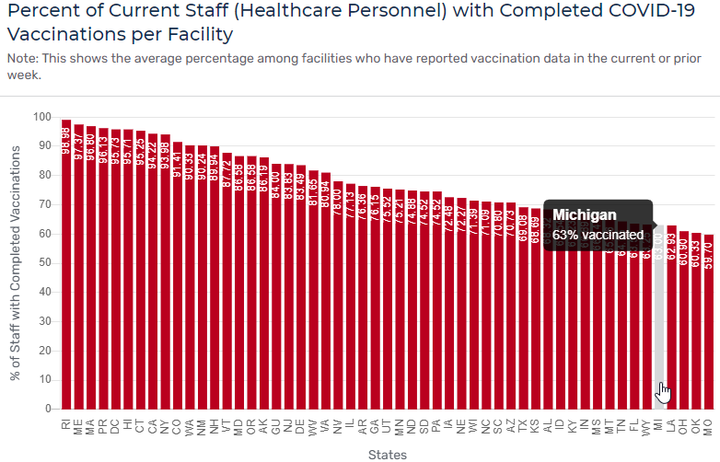
, Nursing Homes/Skilled Nursing Facilities
https://data.cms.gov/covid-19/covid-19-nursing-home-data
Special Populations
National Comparison
Spread
Severity
Public Health
Response
Other
Indicators
Science
Roundup

Slide 22
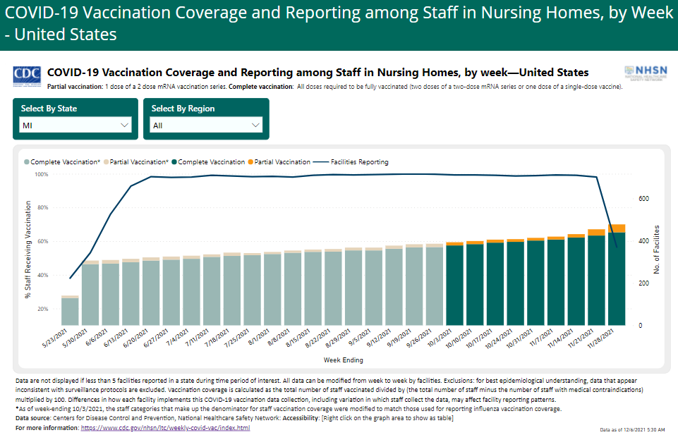
Michigan-specific trend in nursing/skilled nursing facility staff vaccination coverage
https://www.cdc.gov/nhsn/covid19/ltc-vaccination-dashboard.html
Special Populations
National Comparison
Spread
Severity
Public Health
Response
Other
Indicators
Science
Roundup

Slide 23
In Summary
COVID-19 remains a threat to Michigan, especially our most vulnerable populations
  Starting to see increases in cases and outbreaks in skilled nursing facilities
Booster doses can add to the existing protection of the fully vaccinated population, particularly the most vulnerable
Goal is to make sure every eligible resident is offered a booster dose by the end of the year
MDHHS is closely monitoring facility-specific booster administration data through the NHSN
You may expect to get a call from MDHHS or an association to discuss your facility’s data
  Please be aware this is just to help determine the accuracy of data and to help MDHHS focus outreach
We encourage any facility needing help with an on-site vaccination clinic to reach out to us at MDHHS-COVID-LongTermCare@Michigan.gov

