Slide 1


Safe and Calm
December 8, 2021

Slide 2

We will not hold our regular bi-weekly Safe and Calm Webinar on December 22.
Please watch for COVID member updates for any emergent communications.
Our next webinar will be held on January 5th.

Slide 3

2022 Member Awards
Call For Nominations
Open through January 13th
Only LeadingAge Michigan members in good standing, their employees and volunteers are eligible to win.
To submit a nomination, go to: surveymonkey.com/r/8C7SXLL
For more details go to: leadingagemi.org/page/2022MemberAwardsNom

Slide 4
Today’s Agenda
Vaccine data – Joseph Coyle: MDHHS Director of Infectious Disease Prevention
Advocacy – Dalton Herbel
Michigan Situation Update
Resources and Guidance
      CDC Updates
      COVID Relief Facilities
      Review of Testing Requirements

Slide 5
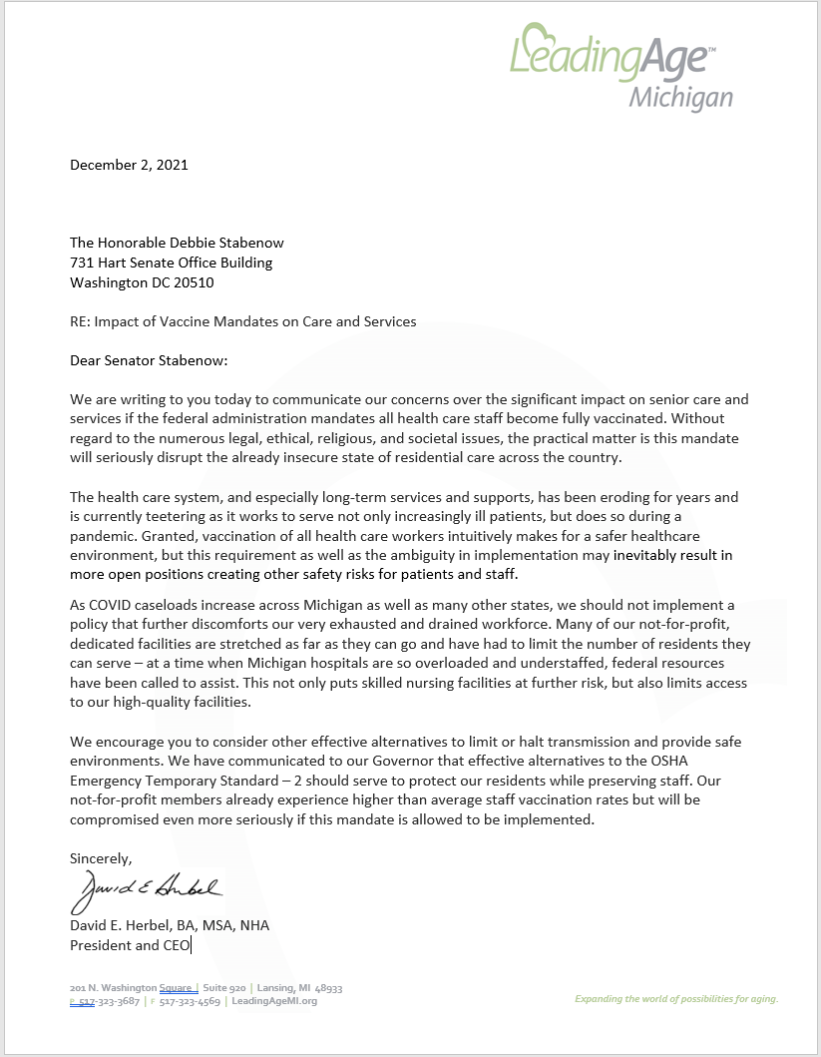
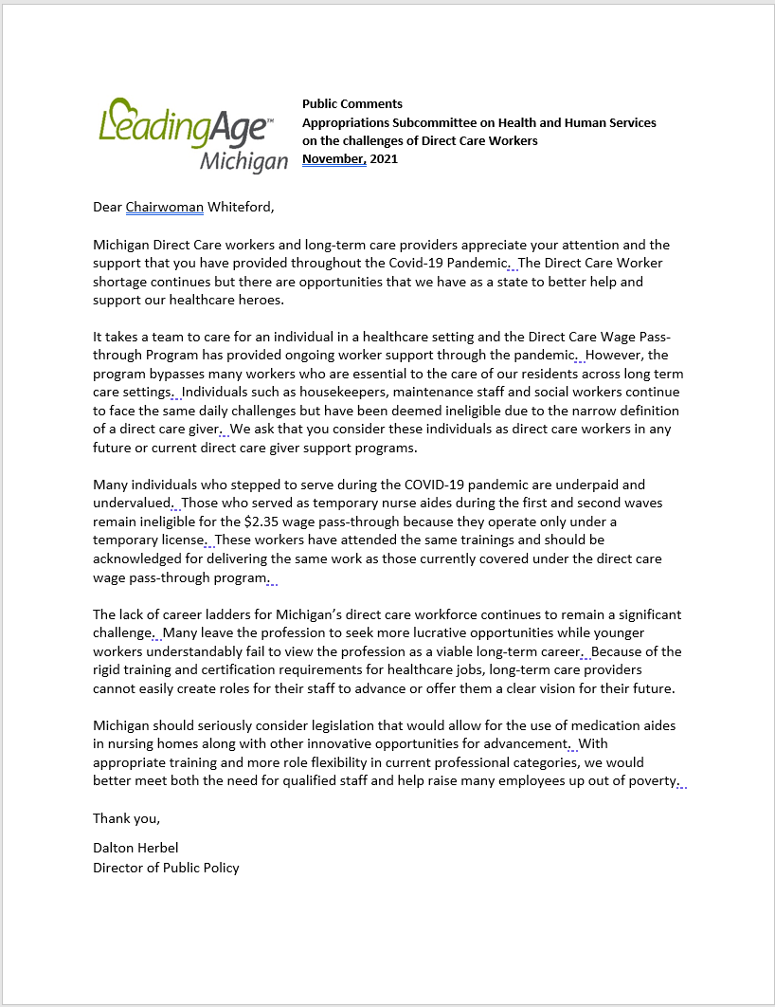
Workforce Advocacy

Slide 6
Community College RN Degrees HB (5556 – 5557)
Would allow community colleges to grant a bachelor of science in nursing should the community college meet and follow the same standards as a university.
  The community college cannot eliminate other healthcare related programs because of the implementation of 4-year nursing program.
LeadingAge and many other stakeholders have issued statements of support for the bills.
Reported out of Committee

Slide 7
Out of State License Reciprocity SB (796)
Would create an exception to the public health code's licensure requirement for a health professional for a health professional licensed in another state rendering medical care during a staffing shortage caused by a public health emergency. Assuming:
They would otherwise meet the licensure requirements
The Director of DHHS determined that control of the epidemic was necessary to protect public health.
Passed the Senate unanimously

Slide 8

Pause for Questions

Slide 9
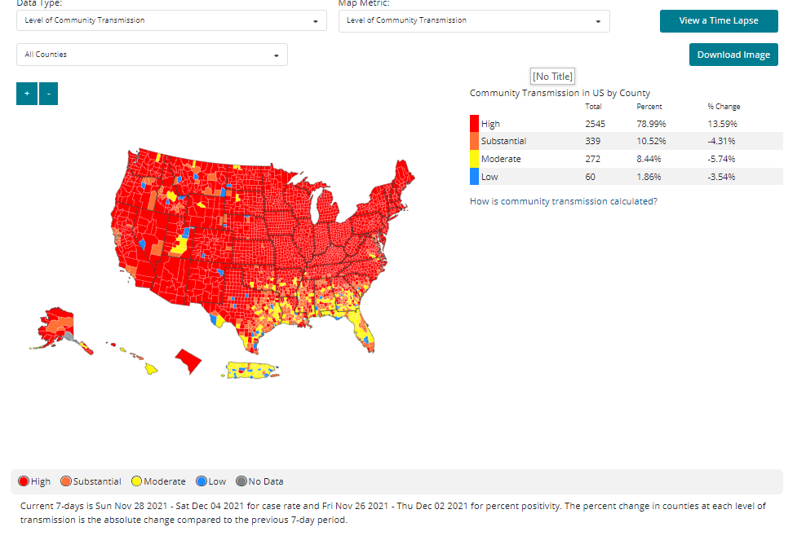
Michigan Situation Update

Slide 10
CDC County Level of Transmission 12/6/2021
Alcona | Berrien | Delta | Houghton | Kent | Manistee | Muskegon | Presque Isle | Washtenaw
Alger | Branch | Dickinson | Huron | Keweenaw | Marquette | Newaygo | Roscommon | Wayne
Allegan | Calhoun | Eaton | Ingham | Lake | Mason | Oakland | Saginaw | Wexford
Alpena | Cass | Emmet | Ionia | Lapeer | Mecosta | Oceana | St. Clair
Antrim | Charlevoix | Genessee | Iosco | Leelanau | Menominee | Ogemaw | St. Joseph
Arenac | Cheboyan | Gladwin | Iron | Lenawee | Midland | Ontonagon | Sanilac
Baraga | Chippewa | Gogebic | Isabella | Livingston | Missaukee | Osceola | Schoolcraft
Barry | Clare | G.Traverse | Jackson | Luce | Monroe | Oscoda | Shiawassee
Bay | Clinton | Gratiot | Kalamazoo | Mackinac | Montcalm | Otsego | Tuscola
Benzie | Crawford | Hillsdale | Kalkaska | Macomb | Montmorency | Ottawa | Van Buren
12/6/2021

Slide 11
Michigan County Level Of Transmission
CDC Covid Data Tracker

Slide 12
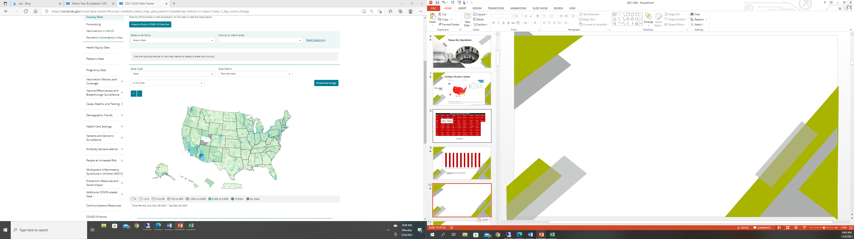
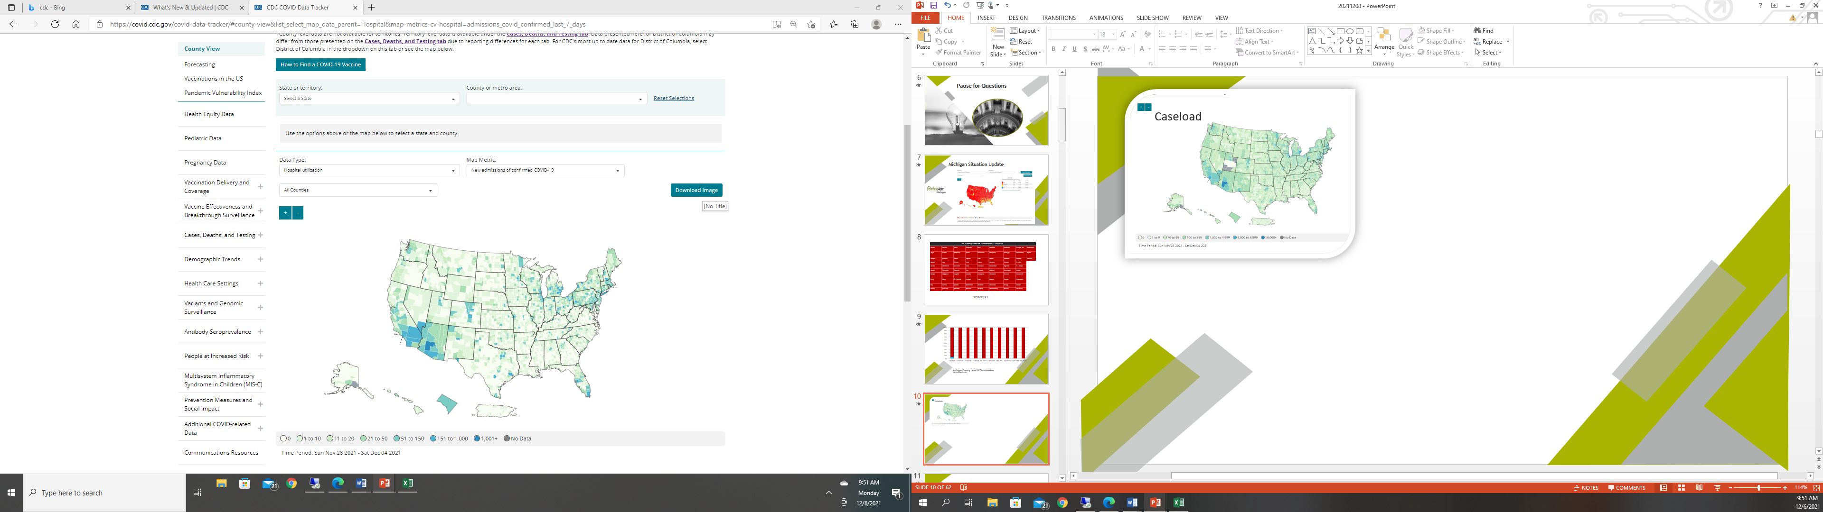
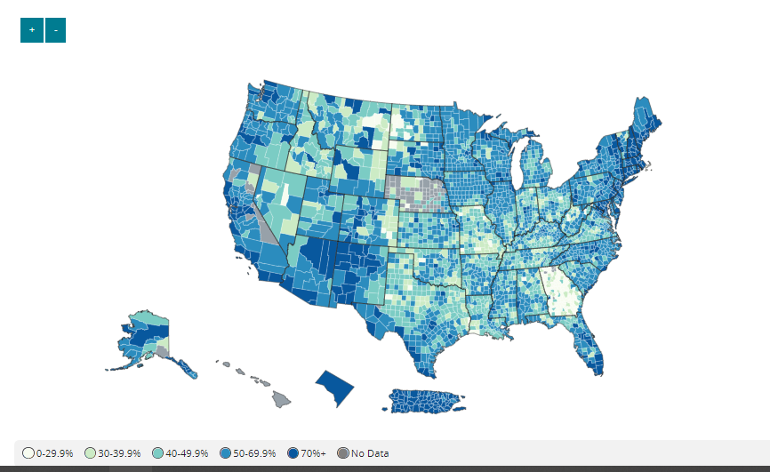
Caseload
Hospitalization
Vaccinations

Slide 18
11/30/2021 Reporting Date | SNF | HFA | AFC | Total | Total LTCF Cases | Total LTCF Deaths
New Resident Cases | 304 | 71 | 130 | 505
New Resident Deaths | 51 | 9 | 6 | 66
Cumulative Resident Cases | 21652 | 4315 | 3549 |  | 29516
Cumulative Resident Deaths | 4482 | 992 | 607 |  |  | 6081
Staff New Cases | 437 | 113 | 122 | 622
Staff New Deaths | 0 | 0 | 0 | 0
Cumulative Staff Cases | 20771 | 4982 | 3902 |  | 29655
Cumulative Staff Deaths | 55 | 9 | 22 |  |  | 86
 |  |  |  |  | 59171 | 6167

Slide 19
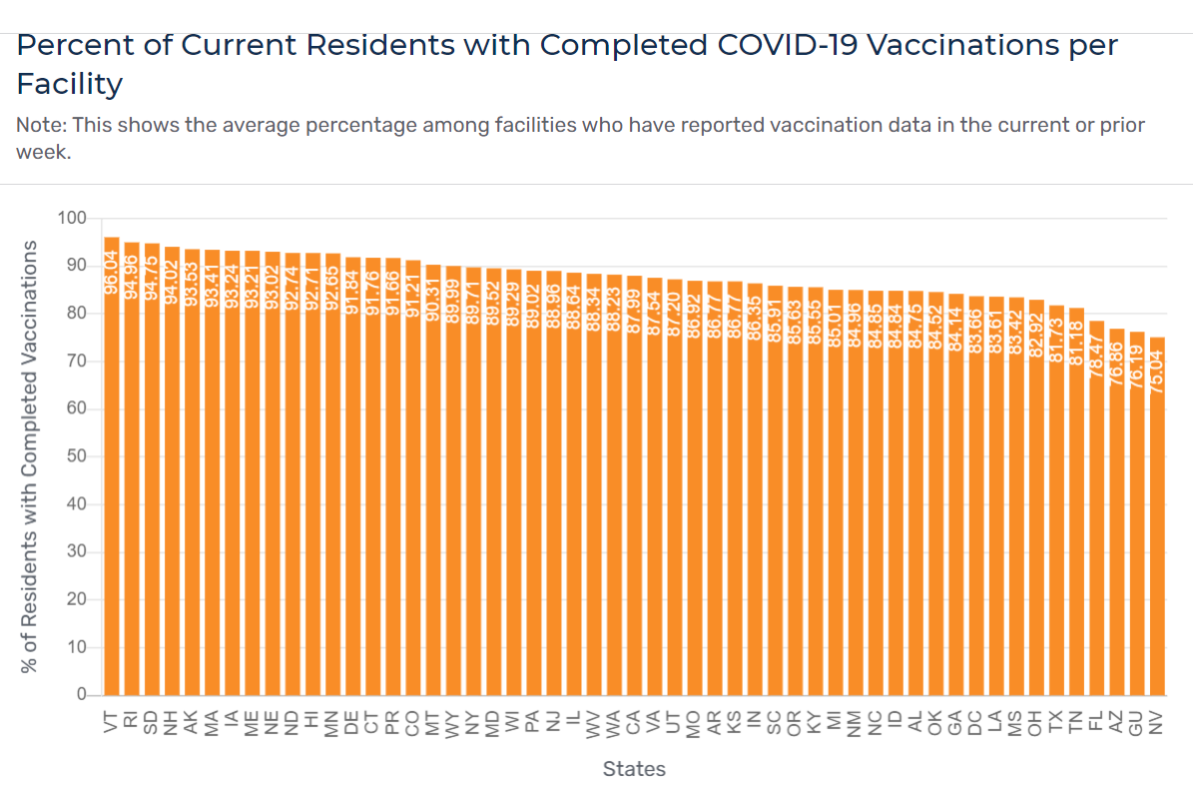
79.43% - 7/21
78.67% - 8/9
81.33% - 8/23
82.12% - 9/2
82.99% – 9/20
83.63% – 10/4
83.18% – 10/11
84.30% – 10/25
84.55% - 11/8
84.97% - 11/22
85.01% - 12/6
37th of 53

Slide 20
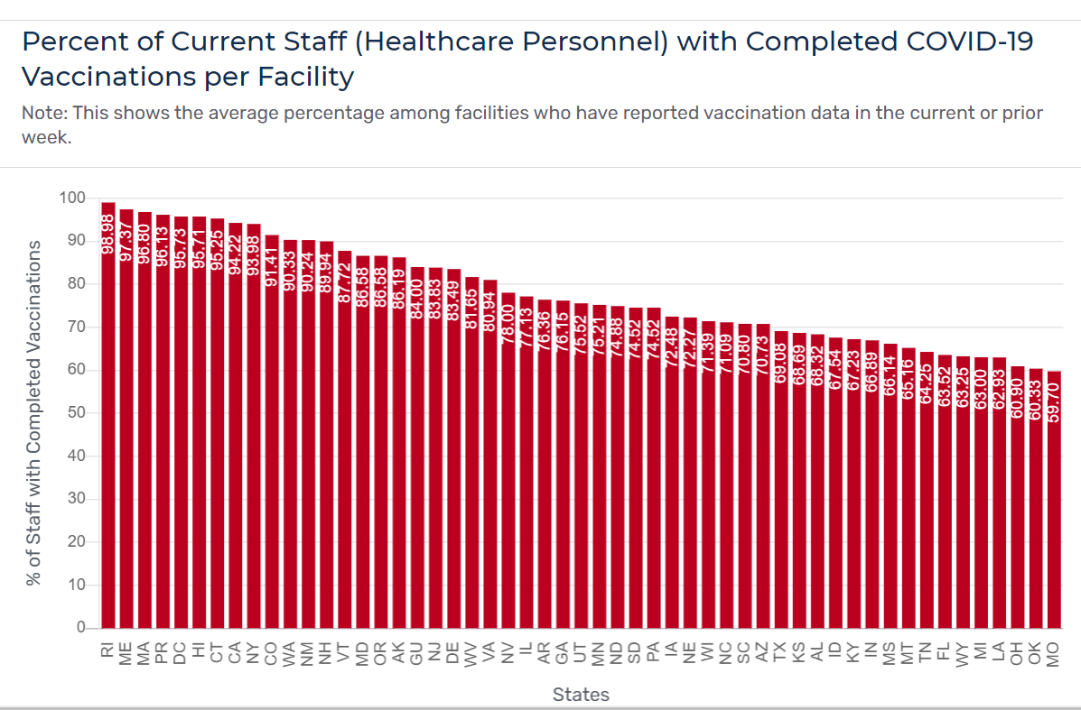
50.92% - 7/21
51.70% - 8/9
52.97% - 8/23
54.29% - 9/2
55.21% - 9/20
56.03% - 10/4
56.89% - 10/11
57.77% - 10/25
59.98% - 11/8
61.25% - 11/22
63.00 – 12/6
49th/53

Slide 21
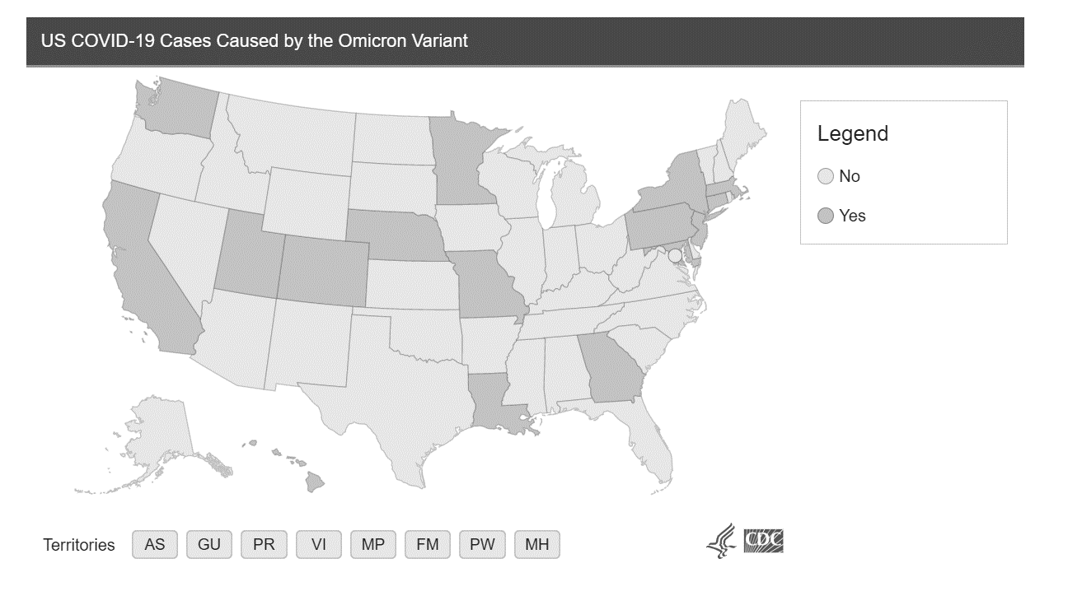
Omnicron Variant
CDC - Omicron Variant: What You Need to Know | CDC
First reported to WHO on 11/24/2021 – first US case 12/1/2021
Variant of Concern (some evidence of whether increased transmissibility, or more severe disease characterized by more hospitalizations or deaths, or reduced susceptibility to immunity – previous infection or vaccination, reduced effectiveness of treatments or vaccines
Likely spreads more easily than original virus (unclear about delta); unclear about severity of illness – may be less severe; vaccines are expected to work but breakthrough infections are likely; unclear if current treatments will be effective
Previous COVID infection may not stop Omicron

Slide 22

Resources and Guidance

Slide 23
Public Health Workers
Symptoms of Depression, Anxiety, Post-Traumatic Stress Disorder, and Suicidal Ideation Among State, Tribal, Local, and Territorial Public Health Workers During the COVID-19 Pandemic — United States, March–April 2021 | MMWR (cdc.gov) 12/3/2021
52.8% reported symptoms of at least one mental health condition in the past two weeks. More prevalent in workers who were unable to take time off or worked more than 41 hours in a week.
Identify and address work practices that contribute to stress and trauma
Encourage behaviors that promote mental health – build awareness of symptoms and coping strategies
Evaluate employee assistance programs
Focus more on building workplace cultures that promote wellness
Additional CDC Notes: Impact of Hospital Strain on Excess Deaths During the COVID-19 Pandemic — United States, July 2020–July 2021 | MMWR (cdc.gov) – ICU bed use at 75% capacity associated with additional 12,000 excess deaths two weeks later
100% capacity – 80,000 excess deaths two weeks later

Slide 24

Booster Recommendations
CDC Expands COVID-19 Booster Recommendations | CDC Online Newsroom | CDC
11/29/2021
All aged 18 and older recommended to have boosters six months after initial series (Pfizer and Moderna) and two months after J&J series
Emergence of Omicron reinforces need for vaccinations and boosters

Slide 25

Interactive Vaccine Module
Developed by Centers for Disease Control and Prevention in partnership with the U.S. Department of Veteran Affairs.
Whether in your office, hospital, or through a telehealth visit, building confidence in COVID-19 vaccination among your patients is critical to setting expectations, ensuring vaccine uptake, and helping protect our communities.
This interactive tool provides several scenarios and animated simulations of what these conversations could look like in real healthcare settings. To learn more, please visit: COVID-19 Vaccine Conversations Tool for Healthcare Professionals | CDC

Slide 26

Vaccine Booster Clinics
MDHHS driving booster clinics for nursing homes
Small HFAs/AFCs (12 or fewer beds)
  Work with AAAs and CILs to set up transportation to local pharmacies
  Larger HFAs/AFCs
    Request a clinic using the CDC contact form
    Work with local health department
    Contact AAA/CIL for assistance in connecting with local services
    After exhausting, can request MING assistance – event support request and send to mdhhs-localhealthservices@Michigan.gov – by February 28, 2022 (72 hours in advance)
  Facilities who still need assistance can reach out to MDHHS at MDHHS-COVID-LongTermCare@Michigan.gov

Slide 27
COVID Relief Facilities
Public Act 231 – requires nursing homes to be designated as either CRF or CRC to care for COVID positive
MDHHS has extended the 2022 CRF application deadline to December 10, 2021
The IPRAT Team drives decision-making; questions can be forwarded to MDHHS-IPRAT@Michigan.gov
Facilities who currently hold CRC status are not required to reapply at this time
Members who were previously approved as a CRF Tier 2 facility last year, and who have a current Tier 2 application submitted should have a virtual visit scheduled with LARA to complete the application. While waiting, the facility may continue to operate as a Tier 2 facility.
Visits should be completed soon to ensure that determination letters an be received before 12/31/2021
Facilities who have difficulties maintaining dedicated staffing should still apply for a Tier 1 application and then work with the IPRAT team on infection prevention strategies when staffing resources are a concern.
IPRAT desires to assist facilities in achieving Tier 1 status to provide for sheltering in place when residents are asymptomatic or only mildly ill. Staffing plans, workflow protocols, and infection prevention practices will be considered.

Slide 28
Project Firstline
View this week's video on the Spread of Respiratory Viruses (11:25) and join us Friday, December 10 at 9:00 a.m. for the live Q&A sessions where infection prevention experts will review main concepts from the video and address your questions.
Target Audience: All individuals working in Behavioral Health, Adult Foster Care and Homes for the Aged settings are encouraged to attend.
Registration Not Required
Join on your computer or mobile app
Click here to join the meeting
Or call in (audio only)
+1 248-509-0316,,210170545# United States, Pontiac
Phone Conference ID: 210 170 545#
Submit Questions
Having trouble accessing the video? Cut and paste https://youtu.be/Jzm-Gafn5lg into your internet browser.
Can't make the live event? A recording of the event will be available on our website after it airs.

Slide 29
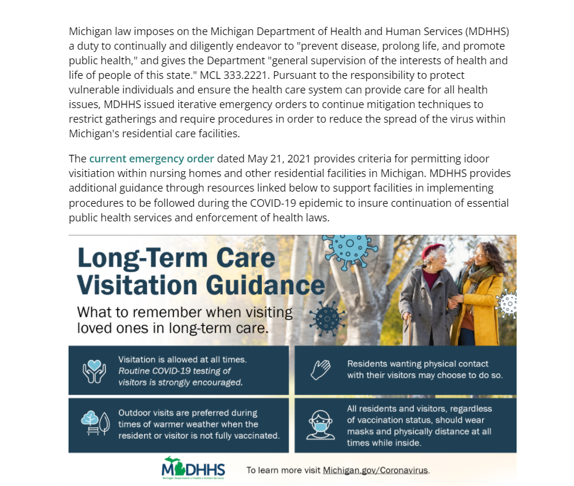
MDHHS Resources
Visitation
Residential_Care_Facilities_May_21_2021_Order_Guidance_updated_11_13_2021_741526_7.pdf (michigan.gov)
LTC_Visitation_Statement_wHeader_741528_7.pdf (michigan.gov) - 11/17/2021
https://www.cms.gov/files/document/qso-20-39-nh-revised.pdf
CMS is accepting CDC’s updated recommendations for screening individuals prior to entering a healthcare facility
“Active screening” requiring the presence of a live person is no longer required for entry into nursing homes or other healthcare settings. These settings now have the option to implement screening through electronic monitoring or other systems in which individuals self-report before entering the setting. Screening may be completed on-site or prior to arrival. The nursing home or healthcare setting must have a process in place to identify and properly manage any staff or visitors who meet any of the following criteria:
  A positive viral test for SARS-CoV-2
  Symptoms of COVID-19
  Meeting CDC criteria for quarantine or exclusion from work

Slide 30

Formal Response to Masking/Distancing
QSO 20-39-NH Revised issued on November 11 – conflicting information about masking/distancing
Masking and physical distancing should be maintained in areas of substantial to high transmission at all times.
Vaccinated residents can choose to unmask and may have physical contact if desired and aware of all potential risks.
Unvaccinated residents can choose to unmask and may have physical contact if desired and aware of all potential risks.
MDHHS – the safest practice for higher transmission areas is to mask and physically distance
CMS (12/3/2021) – the safest practice for higher transmission areas is to mask and physically distance

Slide 31
MDHHS Resources
Testing
Given the significant risk of COVID-19 outbreaks in long-term care facilities, MDHHS has issued an Emergency Order requiring that nursing facilities, homes for the aged, and adult foster care facilities licensed to care for 13 or more individuals conduct diagnostic testing in certain circumstances, to the best of their ability. Under the current testing order, revised October 12, 2021 facilities are required to follow testing guidance issued in CMS QSO 20-38-NH (revised).
Please see the following resources for more details and guidance on testing requirements, implementation, and reimbursement:
MDHHS Testing Implementation Guidance
Binax NOW COVID-19 Test Kit Training video
CareStart COVID-19 Test Kit Training video
MDHHS LTCF Testing - Financial Implications
LTCF Testing Reimbursement Form
Use the online Antigen Supply Request Form to request test supplies two weeks in advance of testing.
Use the online Antigen Reporting Form to report completion of individual tests.
Standing Order for Testing dated October 15, 2021

Slide 32
MDHHS Resources
Testing
Review of 10/12/2021 Memorandum on Testing
Skilled nursing facilities, homes for the aged and adult foster care facilities with 13 or more units
  Facilities must follow QSO 20-38-NH Revised
  Must test Any resident or staff members with COVID like symptoms or suspected exposure
  Conduct contact tracing to determine who to test following outbreak
    For confirmed positive individuals with symptoms, consider the exposure window to be 2 days prior to symptom onset
    For confirmed positive persons without symptoms, if exposure known the window should start two days following the exposure
    For confirmed positive persons without symptoms and exposure unknown, use two days prior to positive test (although it could be longer)
  Consider a broad based approach if cannot do contact tracing
  Conduct testing for all residents and staff potentially exposed regardless of vaccination status about two days after exposure and then again 5-7 days after exposure
  Conduct further testing if other cases are identified every 3-7 days until there are no new cases for 14 days

Slide 33
MDHHS Resources
Testing
Review of 10/12/2021 Memorandum on Testing
Routine testing of all unvaccinated staff based on CDC county levels of transmission
  Low transmission area – no testing recommended
  Moderate transmission area – testing once per week
  Substantial to High transmission area – testing twice per week
Facilities may consider testing in other scenarios, particularly for unvaccinated residents, staff or visitors – decisions to be made by the facility on a case by case basis
  Testing of all new or returning residents during intake unless tested in 72 hours prior
  Testing of all newly hired staff on their start date or within 72 hours prior
  Testing of asymptomatic residents who leave the facility frequently
  Testing of visitor to help facilitate visitation Visitor testing and vaccination can help prevent the spread of COVID-19 and facilities may ask about a visitors’ vaccination status, however, visitors 6 are not required to be tested or vaccinated (or show proof of such) as a condition of visitation.
  Testing of all visitors over the age of 13 prior to entry for indoor visitation – with the exception of visits at end of life
Asymptomatic persons recovering within three months of infection are exempted
MDHHS will continue to ship antigen testing supplies to SNFs, HFAs, AFCs
MDHHS will provide reimbursement for confirmatory molecular testing if not covered by insurance

Slide 34
LTC UPDATE December 2, 2021
Who can request testing supplies from MDHHS? – All SNF, HFA, AFC, ALF and Hospice facilities may request from the MDHHS.
Additional Testing Supplies Available: MDHHS is providing additional testing supplies to support testing for ALL residents, staff, and visitors of Long-Term Care facilities. MDHHS recommends offering testing to all individuals entering the facility as another layer of protection for one of our most vulnerable populations, especially as resident and staff cases of COVID-19 are increasing in AFC, HFA, and SNFs across the state.
Test Ordering: Testing must be done by using the Testing and Support Ordering Form.
Please allow up to two weeks for processing and shipment. Tests are typically shipped out within 1-4 days of the order being received, but please allow up to two weeks for shipment. If an outbreak is occurring and tests are needed immediately, this should be indicated on the ordering form and the request will be elevated.
Orders should be placed for no more than a 1-month supply at a time. There are testing supply constraints and the current supplies that MDHHS will be distributing have a shelf life of 4-5 months. To ensure tests are used and provided to all vulnerable populations’ requests must only be based on projected needs for the month.

Slide 35

OSHA Extends Comment Period for ETS - 2
45 day extension to the comment period for COVID vaccination and testing emergency temporary standard for employers with 100 or more employees.
Deadline pushed to January 19, 2022 to allow stakeholders time to review the ETS and collect information and data necessary for comment.
OSHA currently prohibited from implementing and enforcing the ETC with preliminary injunction in place until a further decision is made by the 6th Circuit Court of Appeals
.

Slide 36
1135 Waiver for Directors of Food/Nutrition
  Issued 11/26/2021
  Waives requirement that dietitians hired or contracted with prior to November 28, 2016 meet specified requirements by November 28, 2021
  Specialized education or training in food service management and safety resulting in an associate’s degree or higher in hospitality or food management,
  A bachelor level degree granted by a regionally accredited college or university
  A certified dietary manager
  Or certified food service manager
  Educational requirements range at a minimum 18 months to 4 years

Slide 37
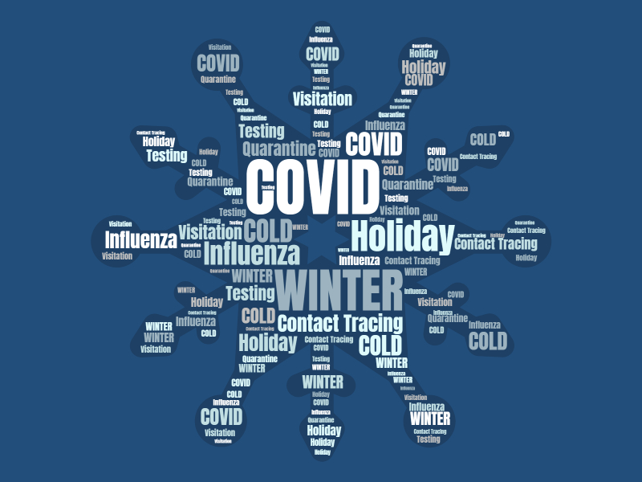
safeandcalm@leadingagemi.org
caitlin@leadingagemi.org
Dalton@leadingagemi.org
david@leadingagemi.org
Deanna@leadingagemi.org

