Slide 1
3D Elevation Program
Maryland Society of Surveyors
October 17, 2014
The National Map

Slide 2
3D Elevation Program (3DEP)
Topics
What is the 3DEP? – Overview and background:
  National Elevation Dataset
  National Enhanced Elevation Assessment
3DEP products and services
Data acquisition and inventory
Budget outlook
Resources

Slide 3
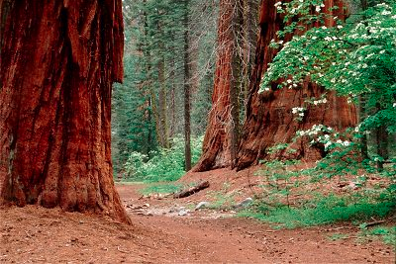
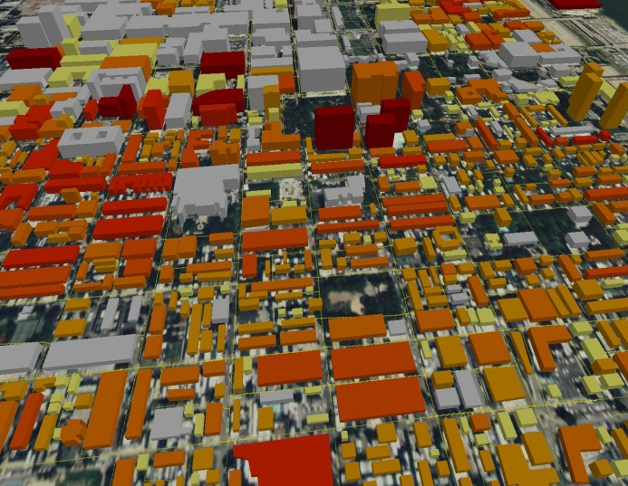
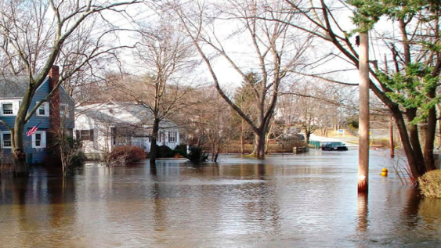
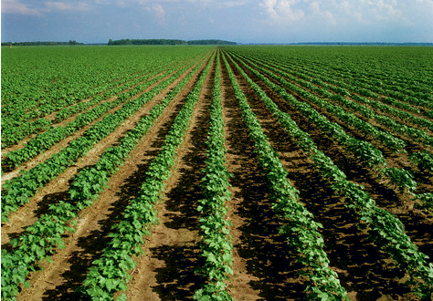
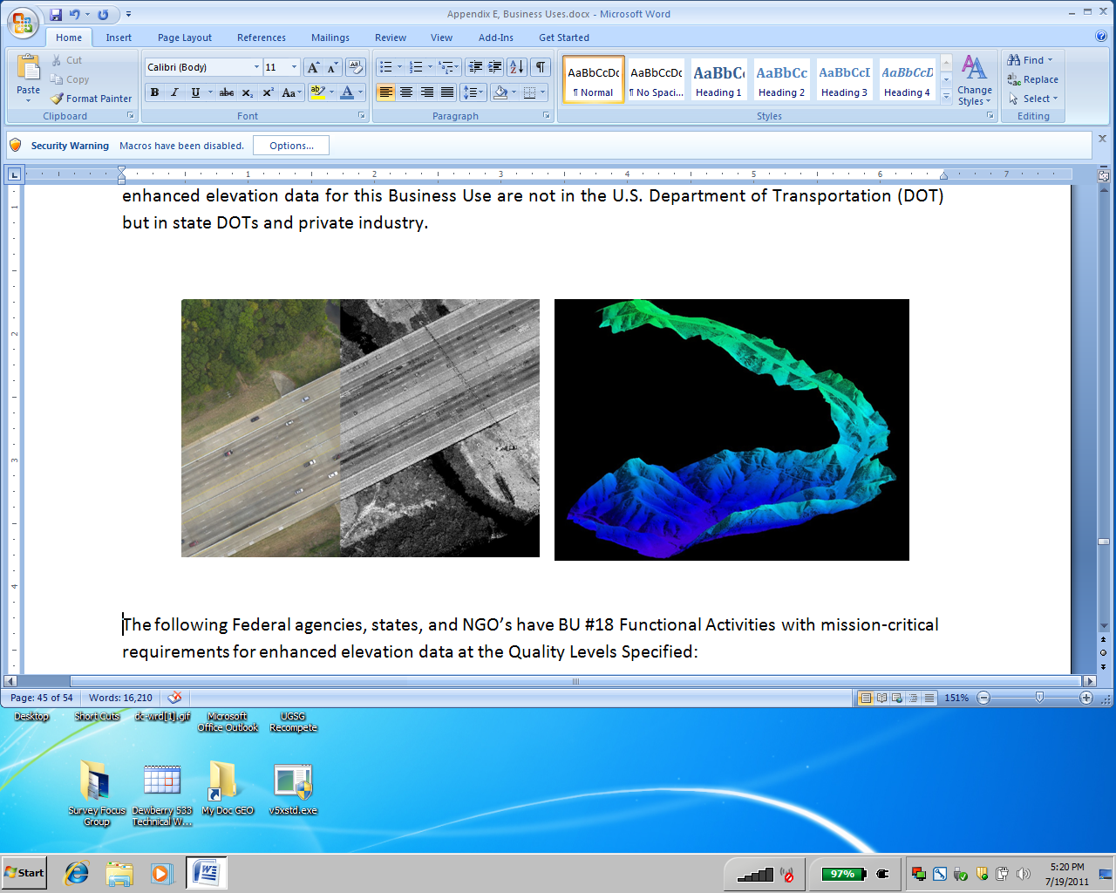
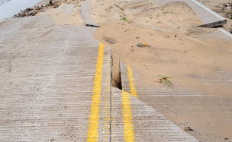
What is the 3D Elevation Program?
A call for action to…
Accelerate the acquisition of high quality light detection and ranging (lidar) data in the conterminous U.S. (CONUS), Hawaii, and the U.S. Territories; and interferometric synthetic aperture radar (ifsar) data in Alaska
Completely refresh the National Elevation Dataset (NED) with new lidar and ifsar elevation data products and services
Leverage collaboration among federal, states, local and tribal partners to systematically complete national 3D elevation data coverage in eight years
Raise governance to the executive level and build on the structure already in place at the operational level under the National Digital Elevation Program (NDEP)
Increase the overall investment in 3D elevation to $146 million annually to return more than $690 million annually in new benefits
Natural Resource Conservation
Infrastructure Management
Flood Risk Mitigation
Precision Farming
Land Navigation
and Safety
Geologic Resources and Hazards Mitigation

Slide 4
USGS Lead Agency for Terrestrial Elevation
Office of Management and Budget Circular A-16
For more than 15 years, the USGS has managed the National Elevation Dataset (NED) and coordinated acquisition through the National Digital Elevation Program (NDEP) on a project-by-project basis
We are at a point in the data lifecycle of defining the next generation national elevation program
Business
Requirements
Define
Inventory
Evaluate
Obtain
Access
Maintain
Use
Evaluate
Archive
Geospatial Data Lifecycle

Slide 5
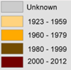
The National Elevation Dataset
5
Status
Current as of December, 2013

Slide 6
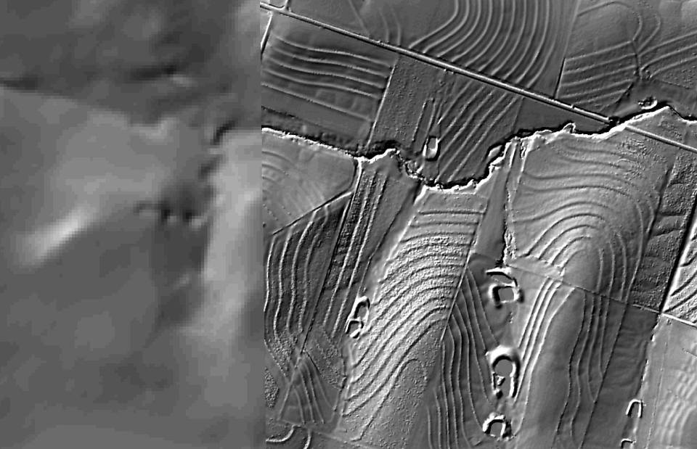
Lidar Improves Data Quality
6
Ten meter resolution
Two meter resolution
Courtesy of NRCS
Notes:
High-resolution LiDAR has captured the attention of conservation planners at the NRCS. The left panel depicts limited landscape detail available in the USGS traditional DEM, contrasted with the detailed farm field depiction on the right, using 2-meter LiDAR on the right. Both the farm terracing and water catchment areas are clearly visible. NRCS is able to utilize this data to provide farm planning assistance, often without site visits.

Slide 7
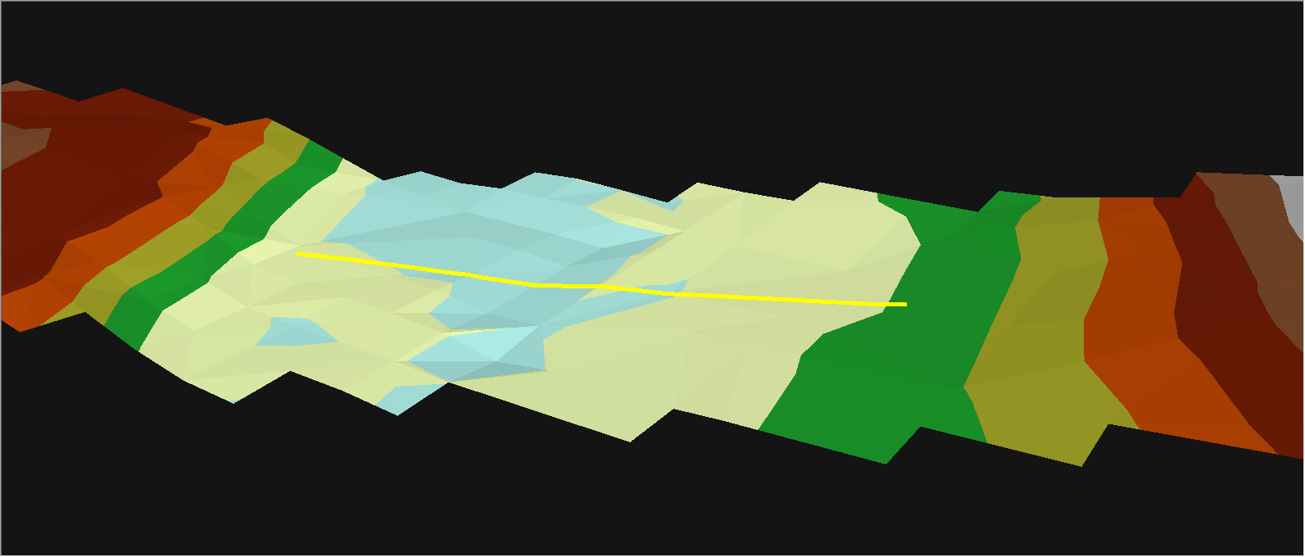
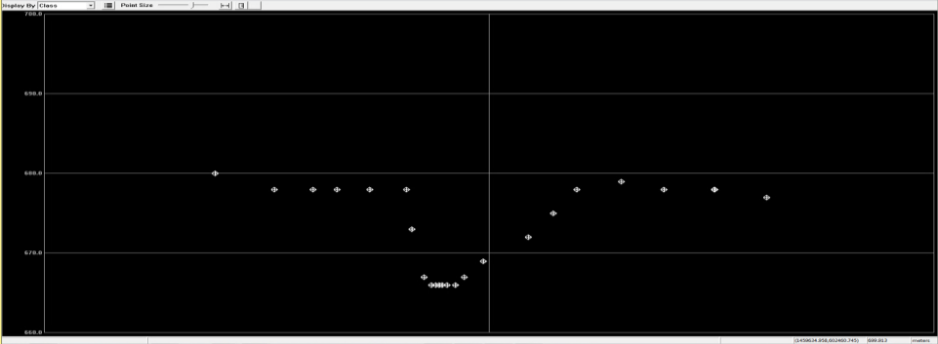
30 Meter Elevation Model
30m Profile
Actual Survey Elevations
Notes:
Here are a series of cross sections derived from different Digital Elevation Model resolutions, starting with the coarsest, which we used to describe in arc-seconds. Ahhhh those were the days.

Slide 8
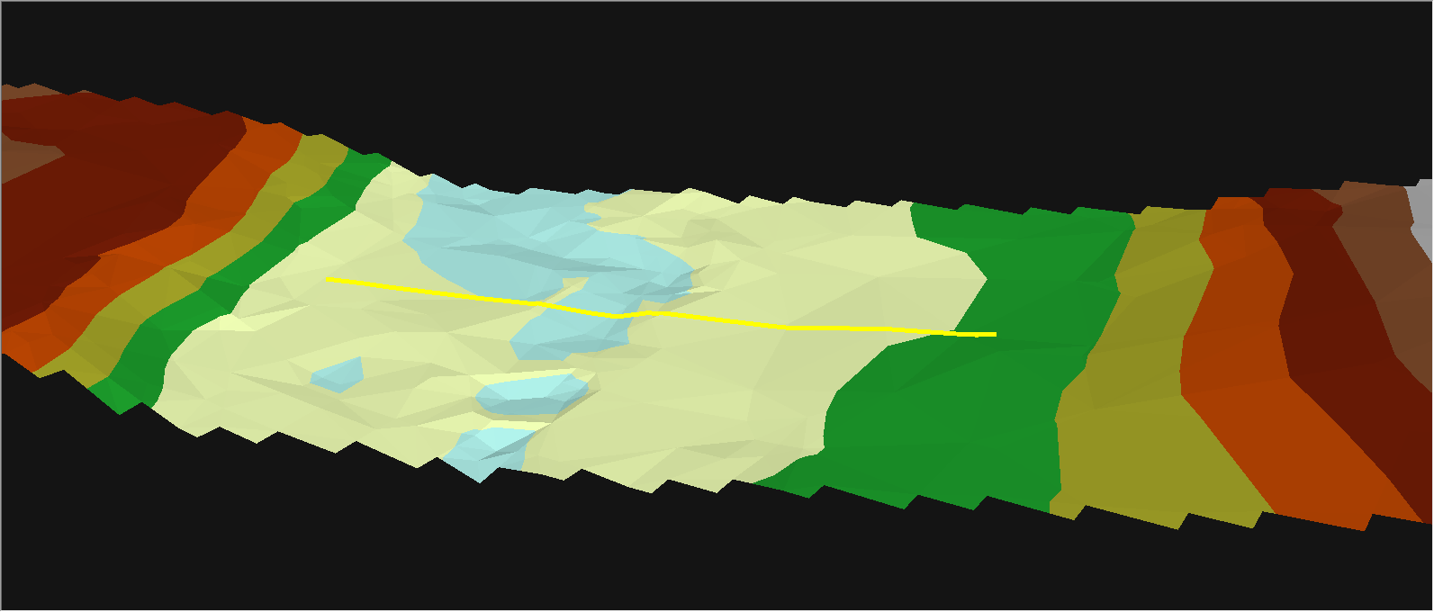
10 Meter Elevation Model
30m Profile
10m Profile
Actual Survey Elevations
Notes:
A noticeable improvement from 30-meter DEM, the 10-meter DEM is commensurate with the 1;24,000-scale map data now known as US Topo. US Topo does use lidar data to update contours.

Slide 9
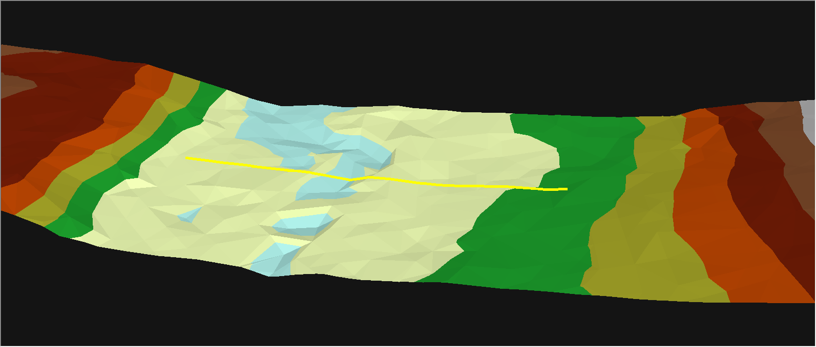
3 Meter Lidar Topography (2000-2005)
30m Profile
10m Profile
4m Profile
5 ½ Foot Vertical Error in Stream Bed Elevation
Actual Survey Elevations
Notes:
This graphic shows a typical Quality Level 3 lidar, with a normal 1 point per square meter point density. Earlier QL-3 data had less than 1 point/sq meter, particularly before the USGS draft lidar standard was published. The lidar draft standards were instrumental in advancing the expectations of both customers and contractors, and made review of data more quantitative.

Slide 10
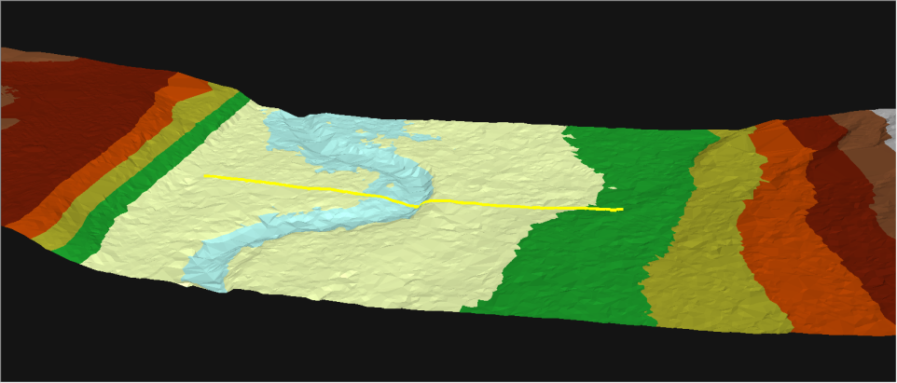
3DEP – Next Generation Flood Hazard Accuracy (2014)
30m Profile
10m Profile
4m Profile
3DEP Profile
Nearly mirrors existing high precision survey data.
Actual Survey Elevations
Notes:
This graphic shows Quality Level 2 lidar which has a point density standard of 2 points per square meter.

Slide 11
National Enhanced Elevation Assessment
At a Glance
Sponsored by the National Digital Elevation Program (NDEP) and funded by USGS, NGA,FEMA, NRCS and NOAA to:
      Document national requirements for lidar and ifsar data
      Estimate the benefits and costs of meeting these requirements
      Evaluate multiple national program scenarios considering data quality, update frequency, and geographic coverage to optimize benefits
    602 mission-critical activities that require enhanced elevation data were identified by:
      34 Federal agencies and 50 states
      A sampling of local governments, tribes, private and not‐for profit organizations
A national program has the potential to generate $1.2 billion to $13 billion in new benefits each year
Notes:
The National Enhanced Elevation Assessment (NEEA) was initiated in August of 2010 and completed in December of 2011. The project was sponsored by the National Digital Elevation Program member agencies. USGS conducted the assessment with assistance from Dewberry Inc. Project partners included NGA, FEMA, NRCS and NOAA.
The assessment documented 602 functional activities with requirements for enhanced elevation data. 34 Federal agencies; all 50 states and Territories; and select non-profit, industry, local governments, and tribes participated in the assessment. The assessment identified data quality, update frequency, geographic area requirements and expected benefits assuming that a need could be met by a national program. The functional activities were summarized into 27 business use categories.

Slide 12
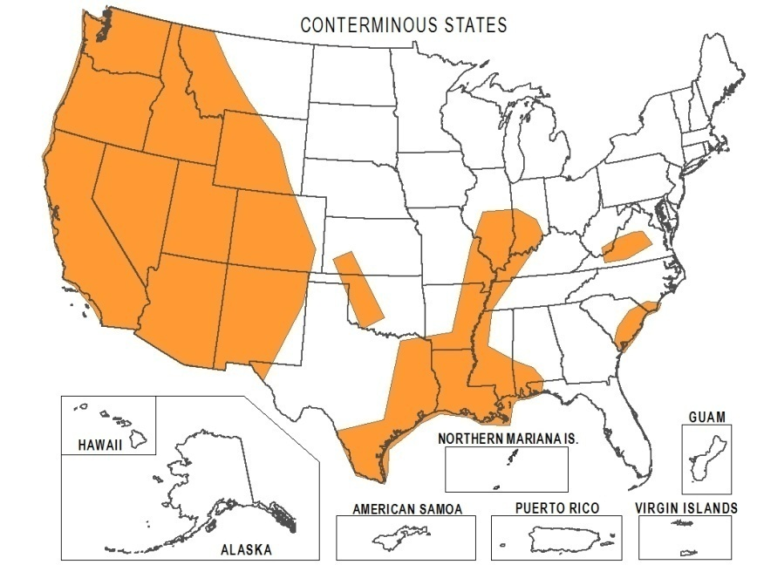
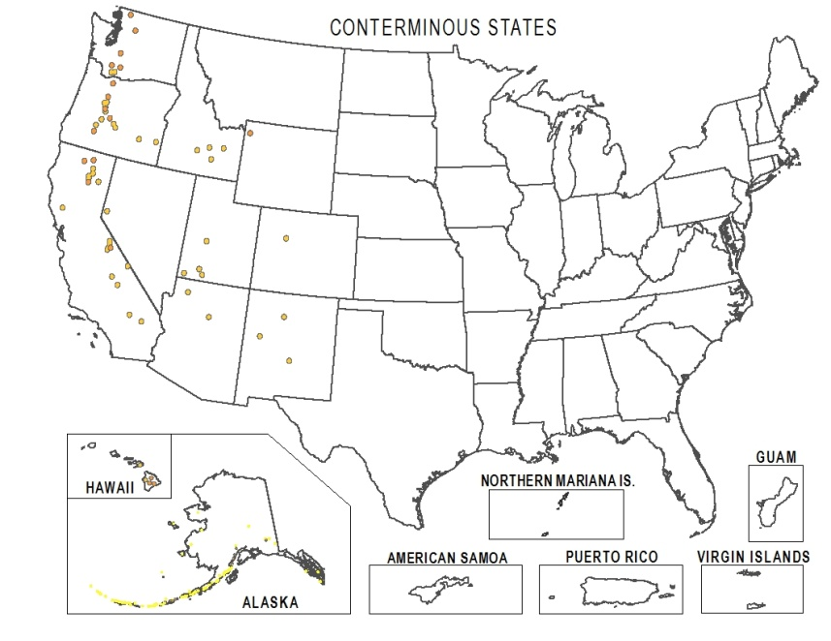
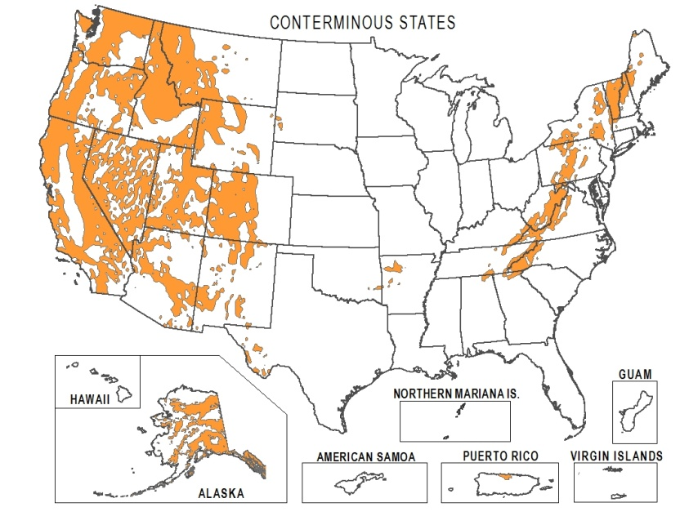
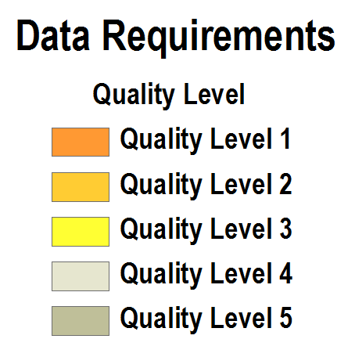
Example: USGS Geologic Resource Assessment
and Hazards Mitigation
Mission critical use: Identify areas,
level of activity and risk associated with earth hazards to reduce losses and increase public safety
Data requirement: Predominantly quality level 1
Update frequencies: 4-10 years
Expected combined benefits: $31.25M/year
Example applications:
Identify faults/landslides under thick vegetation
Enhance infrastructure engineering design
Estimate size, speed and effects of landslides
Create loss mitigation strategies
Provide maps and models to emergency planners
Seismic
Volcanos
Landslides
12
Notes:
READ-AHEAD BACKGROUND SLIDE
This set of three functional activities is one example of an agency requirement for quality level 1 LiDAR data to address the needs of geologic hazards. The expected benefit is $31.25 million per year for operational efficiencies and hazard loss reduction to citizens as a result of improved building/development codes and better planning to avoid hazard prone areas.
Other examples of business uses and associate activities include:
Agriculture and Precision Farming: optimizing yields and reducing harmful runoff by site-specific application of fertilizer and pesticides, optimizing farm practices.
Land Navigation and Safety: railroad grade safety and asset management, in-car navigation products and services, future intelligent navigation innovations to increase fuel efficiency.
Geologic Resource Assessment and Hazard Mitigation: detailed geologic mapping to understand and mitigate landslide, seismic and volcano risks to infrastructure and populations.
Natural Resource Conservation: conservation engineering, soils mapping, wetlands mapping and characterization, assessment of biological carbon stocks.
Infrastructure and Construction Management: military base and facility feasibility and planning, design and placement of infrastructure, transmission line vegetation management.
Flood Risk Management: flood risk analysis and flood plain mapping, emergency management, levee safety, flood forecasts, hydrologic and hydraulic modeling.

Slide 13
Benefits for Top Business Uses
 |  | Annual Benefits
Rank |  | Conservative | Potential
1 | Flood Risk Management | $295M | $502M
2 | Infrastructure and Construction Management | $206M | $942M
3 | Natural Resources Conservation | $159M | $335M
4 | Agriculture and Precision Farming | $122M | $2,011M
5 | Water Supply and Quality | $85M | $156M
6 | Wildfire Management, Planning and Response | $76M | $159M
7 | Geologic Resource Assessment and Hazard Mitigation | $52M | $1,067M
8 | Forest Resources Management | $44M | $62M
9 | River and Stream Resource Management | $38M | $87M
10 | Aviation Navigation and Safety | $35M | $56M
:
20 | Land Navigation and Safety | $0.2M | $7,125M
 | Total for all Business Uses (1 – 27) | $1.2B | $13B
Notes:
The functional activity benefits were aggregated into 27 business uses. This slide shows the top business uses ranked by the total benefits identified by assessment participants. When benefits were identified as a range, the conservative number represents the lower end of the range and the potential number represents the high end of the range. With the exception of the potential benefit of $7 billion associated with Land Navigation and Safety, all of the dollar benefits represent immediate needs. The land navigation benefit is realized from vehicle fuel reductions that can be achieved by intelligent vehicle navigation systems that could begin to appear in the market place as early as 2014.

Slide 14
National Program Recommendation
Multiple Scenarios Considered
Average annual costs: $146M
Average annual benefits: $690M
Average annual net benefits: $544M
Benefit Cost Ratio - 4.7:1
Total Benefits Satisfied: 58%
Recommended program (QL2) on an 8 year cycle
Highest quality level (QL1) on an annual cycle
QL3 on a 25 year cycle (closest to existing program)
Notes:
The recommended program would collect data at Quality Level 2 (one level above the level of current data quality) on an 8 year acquisition schedule. The program has the potential to address 58% of the benefits associated with the NEEA-identified requirements. The program recommendation includes “buy up” options for partner organizations to fund higher quality data.
BACKGROUND
Ten enhanced elevation data program scenarios were evaluated. The scenarios would each implement a national data collection strategy.
With the exception of the scenario of the highest quality (quality level 1) on an annual cycle (far left column on the chart above), all scenarios result in a positive benefit cost ratio.
However, not all of the scenarios significantly address the identified needs. While cost effective, the 13% scenario is most like the current (status quo) program. On the opposite end of the chart, the 98% scenario produces more costs than benefits. The recommended program is a mid-range option that provides QL2 nationally on an eight year cycle.
All scenarios include a recommendation to acquire Quality Level 5 (IfSAR) data in Alaska where cloud cover and remoteness preclude consideration for LiDAR over much of the state.

Slide 15
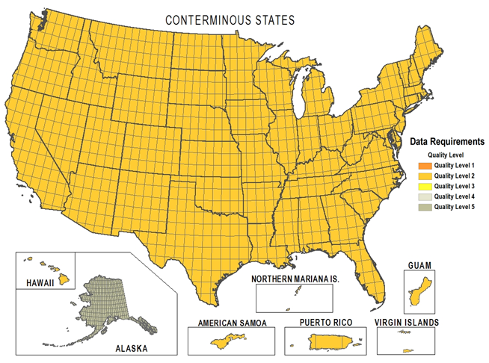
3D Elevation Program (3DEP)
Recommended Uniform Higher Quality
  QL2 lidar data for the conterminous United States, Hawaii, and the territories on an 8-year cycle (compared to QL3 commonly acquired to date)
  QL5 ifsar data for Alaska
  Lidar point cloud data and other products to be publically accessible
  Goal to be operational in early 2015
Quality Level | Source | Vertical Accuracy RMSEz | Nominal Pulse Spacing (NPS) | Nominal Pulse Density (NPD) | DEM Post Spacing
QL1 | Lidar | 10 cm | 0.35 m | 8 points/sq. meter | 1 meter
QL2 | Lidar | 10 cm | 0.7 m | 2 points/sq. meter | 1 meter
QL3 | Lidar | 20 cm | 2.0 m | 0.7 points/sq. meter | 3 meters
QL4 | Imagery | 139 cm | 5 m | 0.04 points/sq. meter | 5 meters
QL5 | Ifsar | 185 cm | 5 m | 0.04 points/sq. meter | 5 meters

Slide 16
3DEP Products and Services
Initial Products
Product | Planned Coverage on Release Date | Source(s) | Planned Product | Planned Availability and Product Release Dates
1 meter DEM | Partial Coverage U.S. and some Territories | Lidar | Tiles (TBD) by download | The National Map in January 2015 (new data) and TBD for pre-2014 data
5 meter DEM | Partial Alaska | Ifsar | Tiles (TBD) by download | Earth Explorer in October 2013, from The National Map in April 2014
1/9 arc-second DEM - legacy | Partial Coverage U.S. and some Territories | Lidar, Ifsar, Photogrammety | 15 min block by download | The National Map now
1/3 arc-second DEM | CONUS, HI, some Territories, partial Alaska | Lidar, Ifsar, Photogrammety | 1x1 degree block by download | The National Map now
1 arc-second DEM | CONUS, HI, AK and U.S. Territories | Lidar, Ifsar, Photogrammety | 1x1 degree block by download | The National Map now
2 arc-second DEM | Alaska | Lidar and Ifsar, Photogrammetry | 1x1 degree block by download | The National Map now
Elevation Point Query | CONUS, HI, some Territories, AK | 1/3 arc-second, 1 arc-second in AK | Application service | The National Map now
Hillshade | CONUS, HI, some Territories, AK | 1/3 arc-second, 1 arc-second in AK | Viewing service | The National Map now
5 to 120 foot Contours | CONUS, HI, some Territories, AK | 1/3 arc-second, 1 arc-second in AK | 1 degree block by download and viewing service | The National Map now
Notes:
Other lidar data that may become available at some point in the future are: breaklines, slope, aspect, intensity returns, possibly 24K contours. Lidar data is currently available from the Eastern Shore Regional GIS Consortium. Contact Erin Silva at elsilva@salisbury.edu
It should be noted that one product is not mentioned here that IS available, and that is metadata. ESRGC has all metadata for Maryland lidar.

Slide 17
3DEP Products and Services
Source Data
Source Data | Planned Coverage on Release Date | Source(s) | Planned Product | Planned Availability and Service Release Dates
Lidar Full Point Cloud - Unclassified | Partial Coverage – U.S. | Lidar – QL1, QL2, QL3 | Project areas by special request | EROS by special request now (pre-2014 data) NGTOC now (data acquired 2014 and later)
Lidar Full Point Cloud - Classified | Partial Coverage – U.S. | Lidar - QL1, QL2, QL3 | Project tiles by download | Earth Explorer now. The National Map in October 2014
Ifsar Digital Surface Model | Partial Coverage – Alaska | Ifsar – QL5 | Project tiles by download | Earth Explorer now, The National Map in January 2015
Orthorectified Ifsar Intensity Image | Partial Coverage – Alaska | Ifsar – QL5 | Project tiles by download | Earth Explorer now, The National Map in January 2015
Source resolution DEM | Partial Coverage U.S. and some Territories | Lidar, Ifsar | Project tiles by download | The National Map now (new data) and TBD for pre-2014 data
Notes:
Please note that I will not be covering details of the revision of USGS Lidar Base Specifications here today. That work is being ably done by USGS’s Karl Heidemann and others. It is expected that the release of the USGS LiDAR Base Specifications announced at the International Lidar Mapping Forum in February 2014 as version 1.1 may skip ahead to version 2.0, and is planned to be released later this fiscal year.

Slide 18
Specifications for 3DEP data
Version 1.1 to be completed in FY15 to define specifications for QL 0 data
Version 2.0 will be released in FY15 and will be the "total" 3DEP specification
  Horizontal Accuracy assessments (ASPRS Accuracy Standards)
  Revisions to reflect technological developments such as Geiger, Flash lidar
  Addition of vector features to support lidar data and derivatives
  Expanded hydrography feature collection
  Low Confidence polygons
  Incorporation of a GIS Data Dictionary
Vertical Reference System - North American Vertical Datum of 1988 (NAVD88); the geoid model used to convert between ellipsoid heights and orthometric heights shall be the latest hybrid geoid model of NGS, supporting the latest realization of NAD 83 (currently GEOID12A)

Slide 19
3DEP Data Acquisition
Broad Agency Announcement (BAA)
Implementation of a process where known priorities are broadcast to develop partnership opportunities for acquisition:
  Solicit agency priorities from NDEP agencies and state plans; obtain out-year plans and priorities where possible
  Analyze submitted priorities compared to baseline coverage in U.S. Interagency Elevation Inventory (USIEI) and prioritization criteria
  Develop joint priorities for new acquisition; review and approve plan among NDEP/3DEP agencies
  Issue BAA; review and accept proposals; implement data acquisition strategy; combination of USGS data acquisition, as well as partner acquisition
  Acquire and distribute data

Slide 20
Broad Agency Announcement
Status and Plans
This is the first BAA- We will adjust and adapt to improve the process
Improve BAA Support-
-Coordination: open 3DEP coordination meetings to be organized once or twice per year by state or region
-Develop Annual and Multi-year Plans: make known lidar requirements available online in the USIEI “Planned” status column
First BAA opened July 18, 2014. Closing soon
Notes:
The BAA replaces the coordination and partnership activities previously carried on by USGS Geospatial Liaisons and partners. The goal is to expand this activity to a national forum with nationally developed resources. USGS Geospatial Liaisons are to be role players in the state or regional 3DEP coordination meetings.

Slide 21
Broad Agency Announcement
https://www.fbo.gov Solicitation #G14PS00574
BAA AMENDMENT 4 TERMS AND CONDITIONS:
1. The due date for Stage 1 Pre-Proposals is hereby extended from 5:00 PM ET Friday, October 10, 2014 to 5:00 PM ET Thursday, October 23, 2014.
2. The due date for Stage 2 Proposals is hereby extended from 5:00 PM ET Friday, November 21, 2014 to 5:00 PM ET Wednesday, December 3, 2014.
3. Answers to questions and other associated documents will be posted in an upcoming amendment to the BAA as soon as available.
4. In the event posting of relevant documentation is delayed, due dates of Stage 1 Pre-Proposals and Stage 2 Proposals will be extended accordingly.
5. Questions are due NLT Wednesday, October 16, 2014 at 11AM ET.
END OF AMENDMENT 4

Slide 22
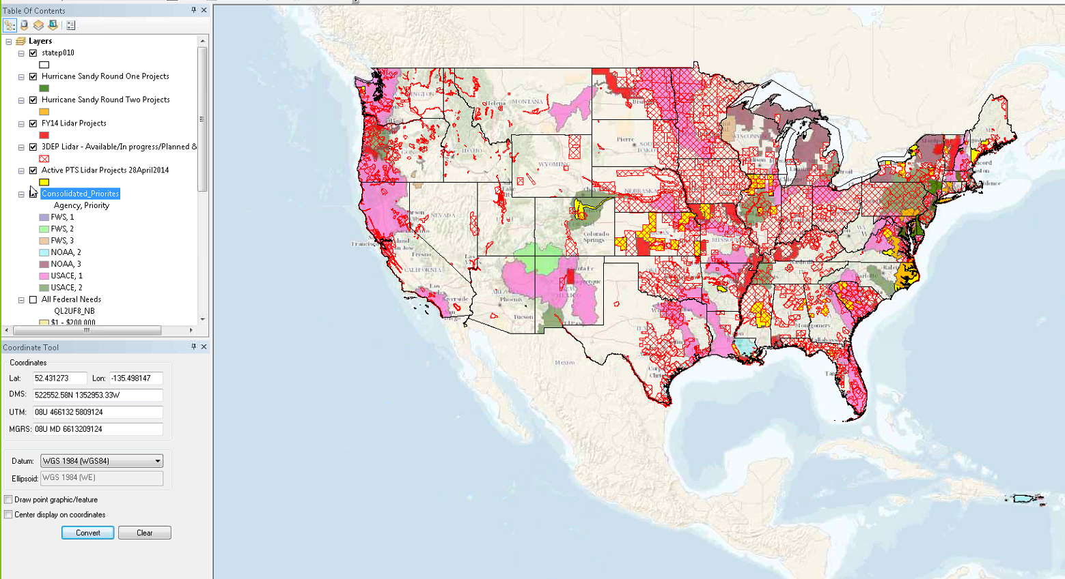
3DEP Data Acquisition

Slide 23
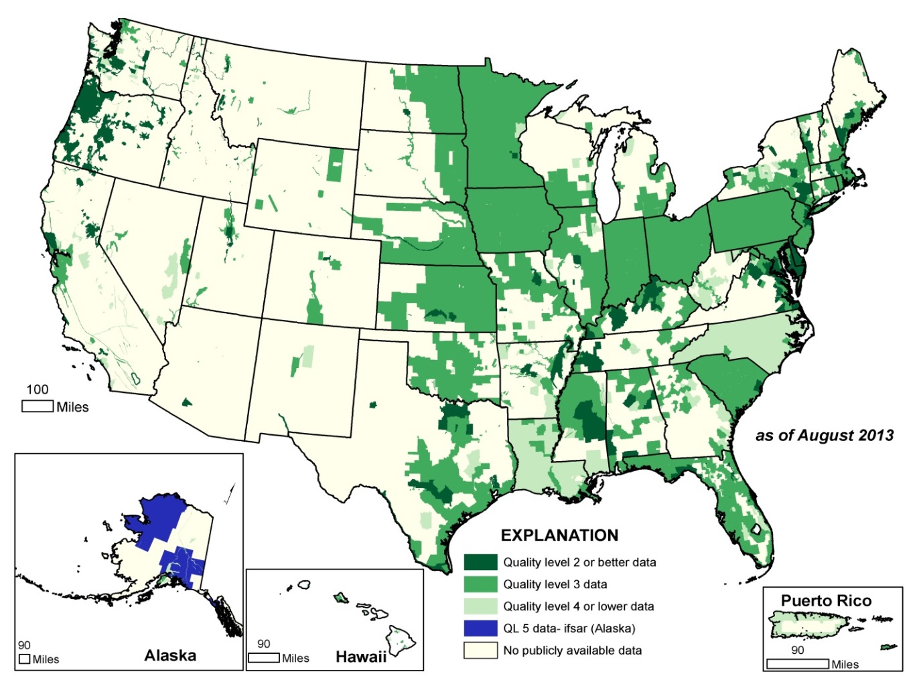
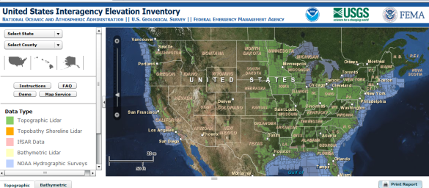
U.S. Interagency Elevation Inventory
23
2013 Status Map of Publically Available Lidar and Ifsar
Lidar: 38% of the lower 49 states has coverage
  Only 4 percent meets the 3DEP goal of QL2 or better
Ifsar: 43.5% of Alaska has coverage
  More than half the State needs ifsar data to complete the 3DEP goal for coverage
To view the inventory go to: www.csc.noaa.gov/inventory

Slide 24
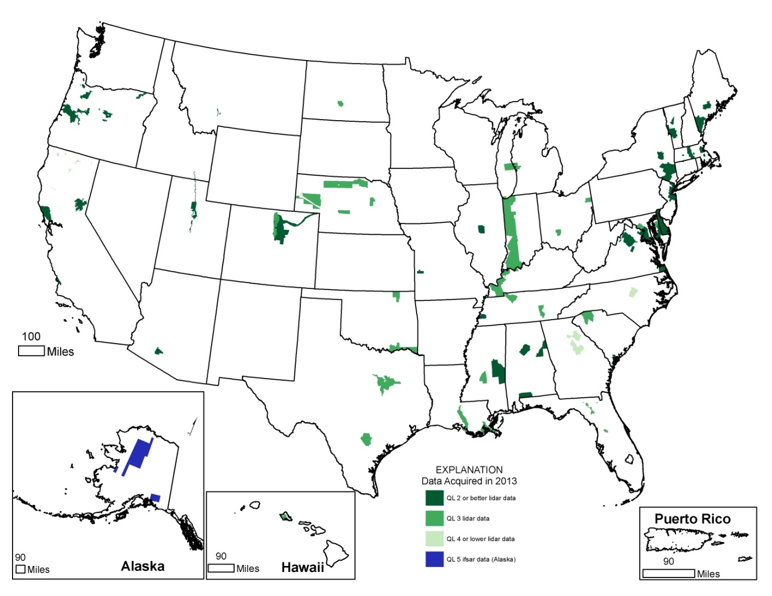
U.S. Interagency Elevation Inventory
24
http://coast.noaa.gov/digitalcoast/tools/inventory
Data Funded for Acquisition FY 13
6 % of the nation was acquired (includes all QLs)
Need to acquire 12% each year at QL2 or higher (QL5 in AK) to meet 3DEP national coverage goals

Slide 25
3DEP Budget Outlook
USGS Component
FY14 President’s Budget – USGS 3DEP increase of $9M plus $1M for Alaska ifsar; Omnibus resulted in $760K increase for Alaska and $1M in USGS Coastal Marine Geology for Coastal National Elevation Dataset
Endorsements – 3DEP was endorsed or received letters of budget support from:
  American Association of State Geologists (AASG)
  American Association of Photogrammetry and Remote Sensing (ASPRS)
  Association of State Floodplain Managers
  Coalition of Geospatial Organizations (COGO)
  Management Association of Private Photogrammetric Surveyors (MAPPS)
  National Geospatial Advisory Council (NGAC)
  National Society of Professional Surveyors (NSPS)
  National States Geographic Information Council (NSGIC)
FY15 President’s Budget – USGS 3DEP $5M, Alaska Mapping $236K, Ecosystems: Columbia River $350K and Puget Sound $450K
National Academy of Public Administration (NAPA) report - The November, 2013 report entitled “FEMA Flood Mapping: Enhancing Coordination to Maximize Performance” included the following recommendation:
  “The Office of Management and Budget should use the 3DEP implementation plan for nationwide elevation data collection to guide the development of the President’s annual budget request.”

Slide 26
3DEP Executive Forum
Governance and Executive Outreach
Purpose - to facilitate executive dialog and collaboration on strategies to implement and sustain 3DEP for the benefit of all its stakeholders
Leadership – Chair is Kevin Gallagher, USGS Associate Director for Core Science Systems
Objectives
  Monitor status, plans and coordination actions for 3DEP implementation
  Strategize on significant developments regarding elevation or related geospatial activities, for example, legislation, GAO studies, supplemental funding, etc.
  Share insights and develop strategies to communicate with industry and other stakeholder groups that could play a role in 3DEP funding
  Provide executive direction and input to NDEP as the operational coordinating body

Slide 27
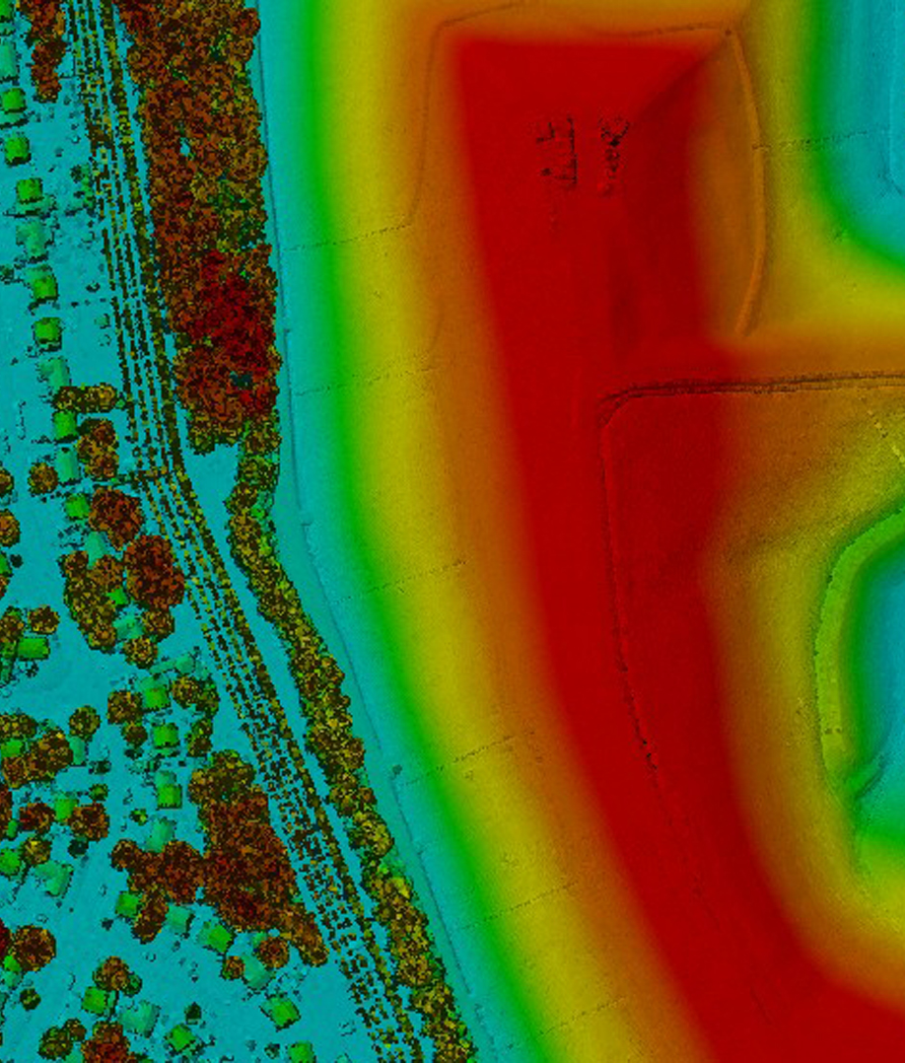
3DEP Implementation
Moving ahead
3DEP initiative plan – final DRAFT in peer review
System modernization milestones April, October and January 2015
3DEP Annual Report – in final stages of publication
3DEP official rollout – January, 2015

Slide 28
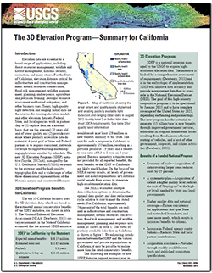
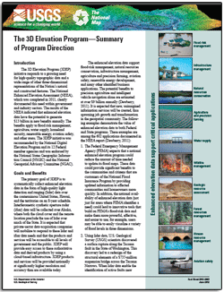
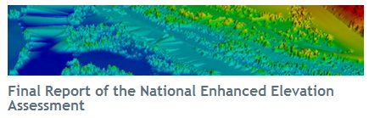
3DEP Resources
NEEA Report
3DEP webpage
USGS Fact Sheets
  NEEA at a glance
  3D Elevation Program
  State 3DEP Summaries
Resources in work
  Journal articles
  3DEP Plan
  3DEP Annual Report
http://nationalmap.gov/3DEP

Slide 29
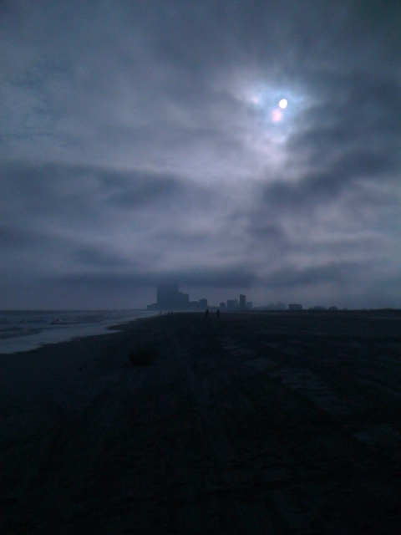
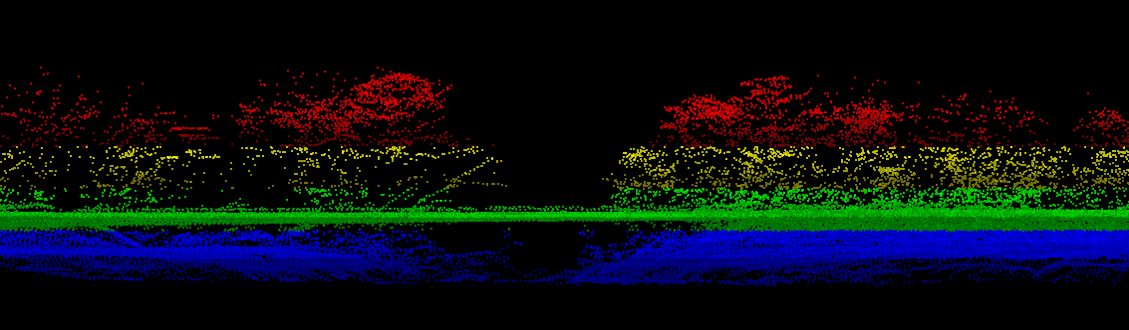
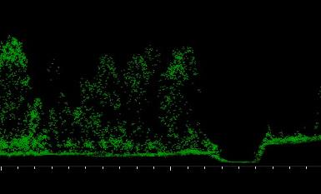
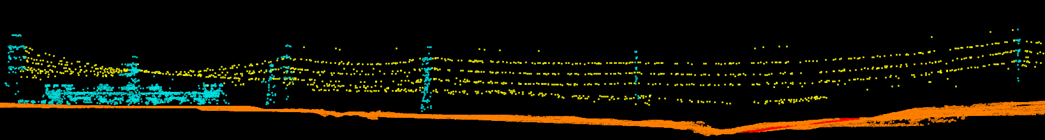
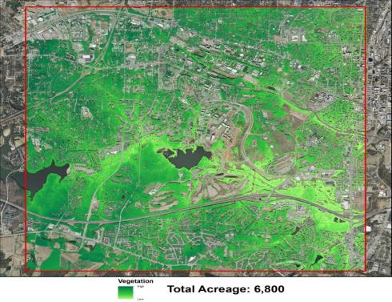
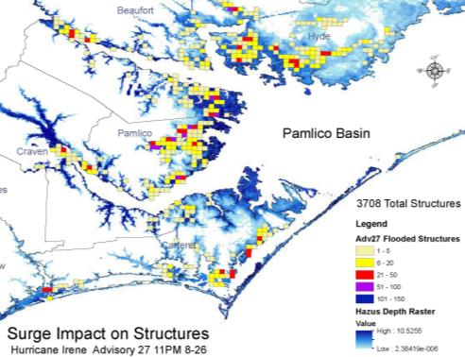
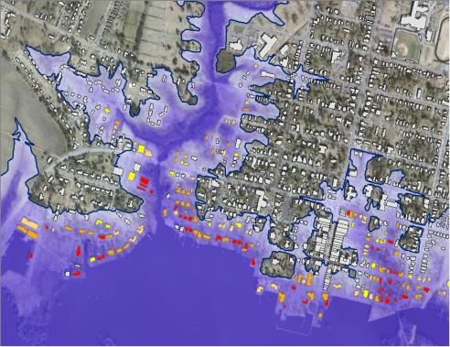
3DEP – Next Generation Business Value
Through the acquisition of new 3DEP topographic data, North Carolina will also be able to update and/or support the following areas:
      Storm Surge – Structure Impact
      Utility Management – Line Detection
      Transportation Design / Asset Management
      Vegetation / Forestry Management
      Hydrologic / Streambed Detection
      Wetland Identification
      Aviation Obstruction Assessment
      Precision / Efficient Farming
      Structure Delineation
High – Large Trees
Notes:
Infrastructure applications abound, Delaware Dept. of Natural Resources & Environmental Control has already estimated a loss of about 100 sq miles of land by 2100, and accompanying road miles are expected to be lost in those same areas. Using lidar generated shoreline data, this inundation can be forecast based on monitored rates of sea level rise and subsidence. This photo I snapped was taken 3 days before Hurricane Sandy struck here, Atlantic City, NJ. We knew it was coming, and the NJ GIS Conference ended the day after this picture was taken. As you may recall the then mayor contradicted State officials, and said it was safe for people to stay in their homes. For many areas in A.C. that was not good advice.

Slide 30
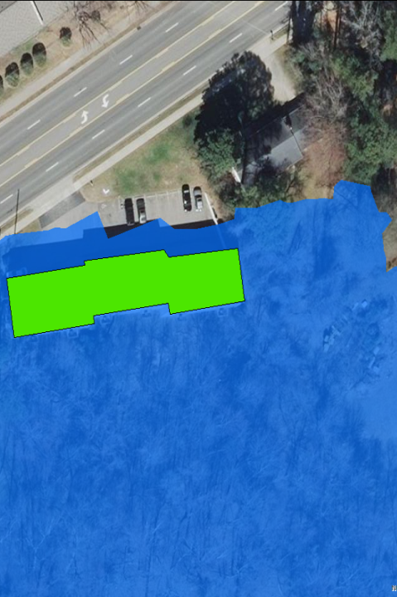
3DEP – Next Generation Letter of Map Amendments
  Elevation Certificate
    Costly to Property Owners ($500-$1,500)
    High Precision Survey Grade
  3DEP Support LOMA
    3DEP Derived Highest Adjacent Grade and Lowest Adjacent Grade
    Batch routine entire Counties
    Ac foot
    Petition FEMA to use 3DEP as alternative LOMA to remove properties when above the Base Flood Elevation
    Low to no Cost to Homeowner
BFE = 287.1 ft.
Quality Level | HAG Elev. (ft.) | HAG Delta (ft.) | In/Out of SFHA
Survey | 290.2 | n/a | OUT
30 Meter | 285.3 | 4.9 | In
10 Meter | 284.9 | 5.3 | In
3 Meter | 284.8 | 5.4 | In
3DEP | 289.9 | 0.3 | OUT
Notes:
This slide illustrates how 3DEP lidar can be used as a reliable tool to quickly review Elevation Certificates for permits or insurance purposes. Credit for this slide to the State of North Carolina

Slide 31
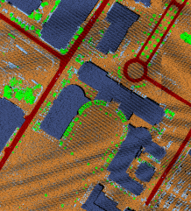
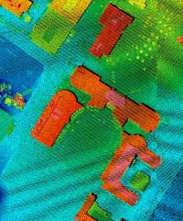
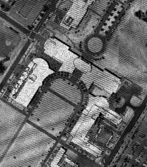
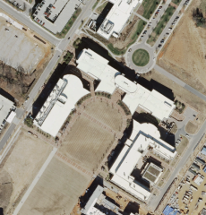
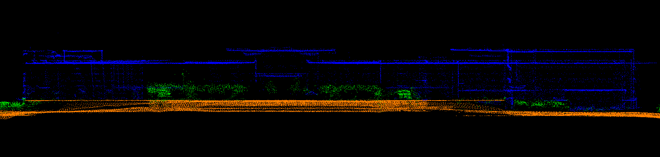
3DEP - Next Generation Building Footprint Extraction
Classification
Elevation
Intensity
Imagery
Profile
Notes:
It should be noted that best practice for automated building footprint generation is derived from QL-1 Lidar data which collects 8 points per square meter. QL-2 lidar combined with Marylands 6-inch pixel resolution orthoimagery would be an interesting experiment. FEMA Region 2 is mapping structures shoreline of the Q3 (100-year flood) line. Credit this slide to State of North Carolina.

Slide 32
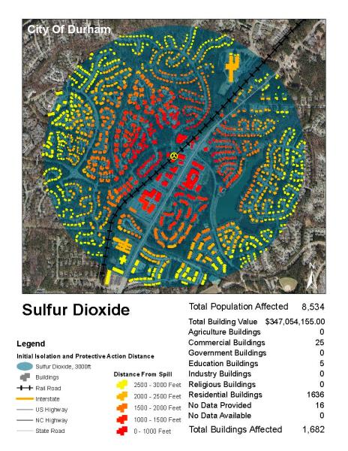
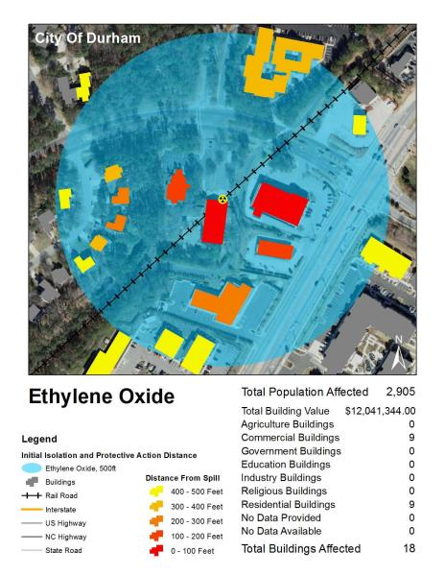
3DEP – Structure Impact Analysis from Hazards
Analyses Example

Slide 33
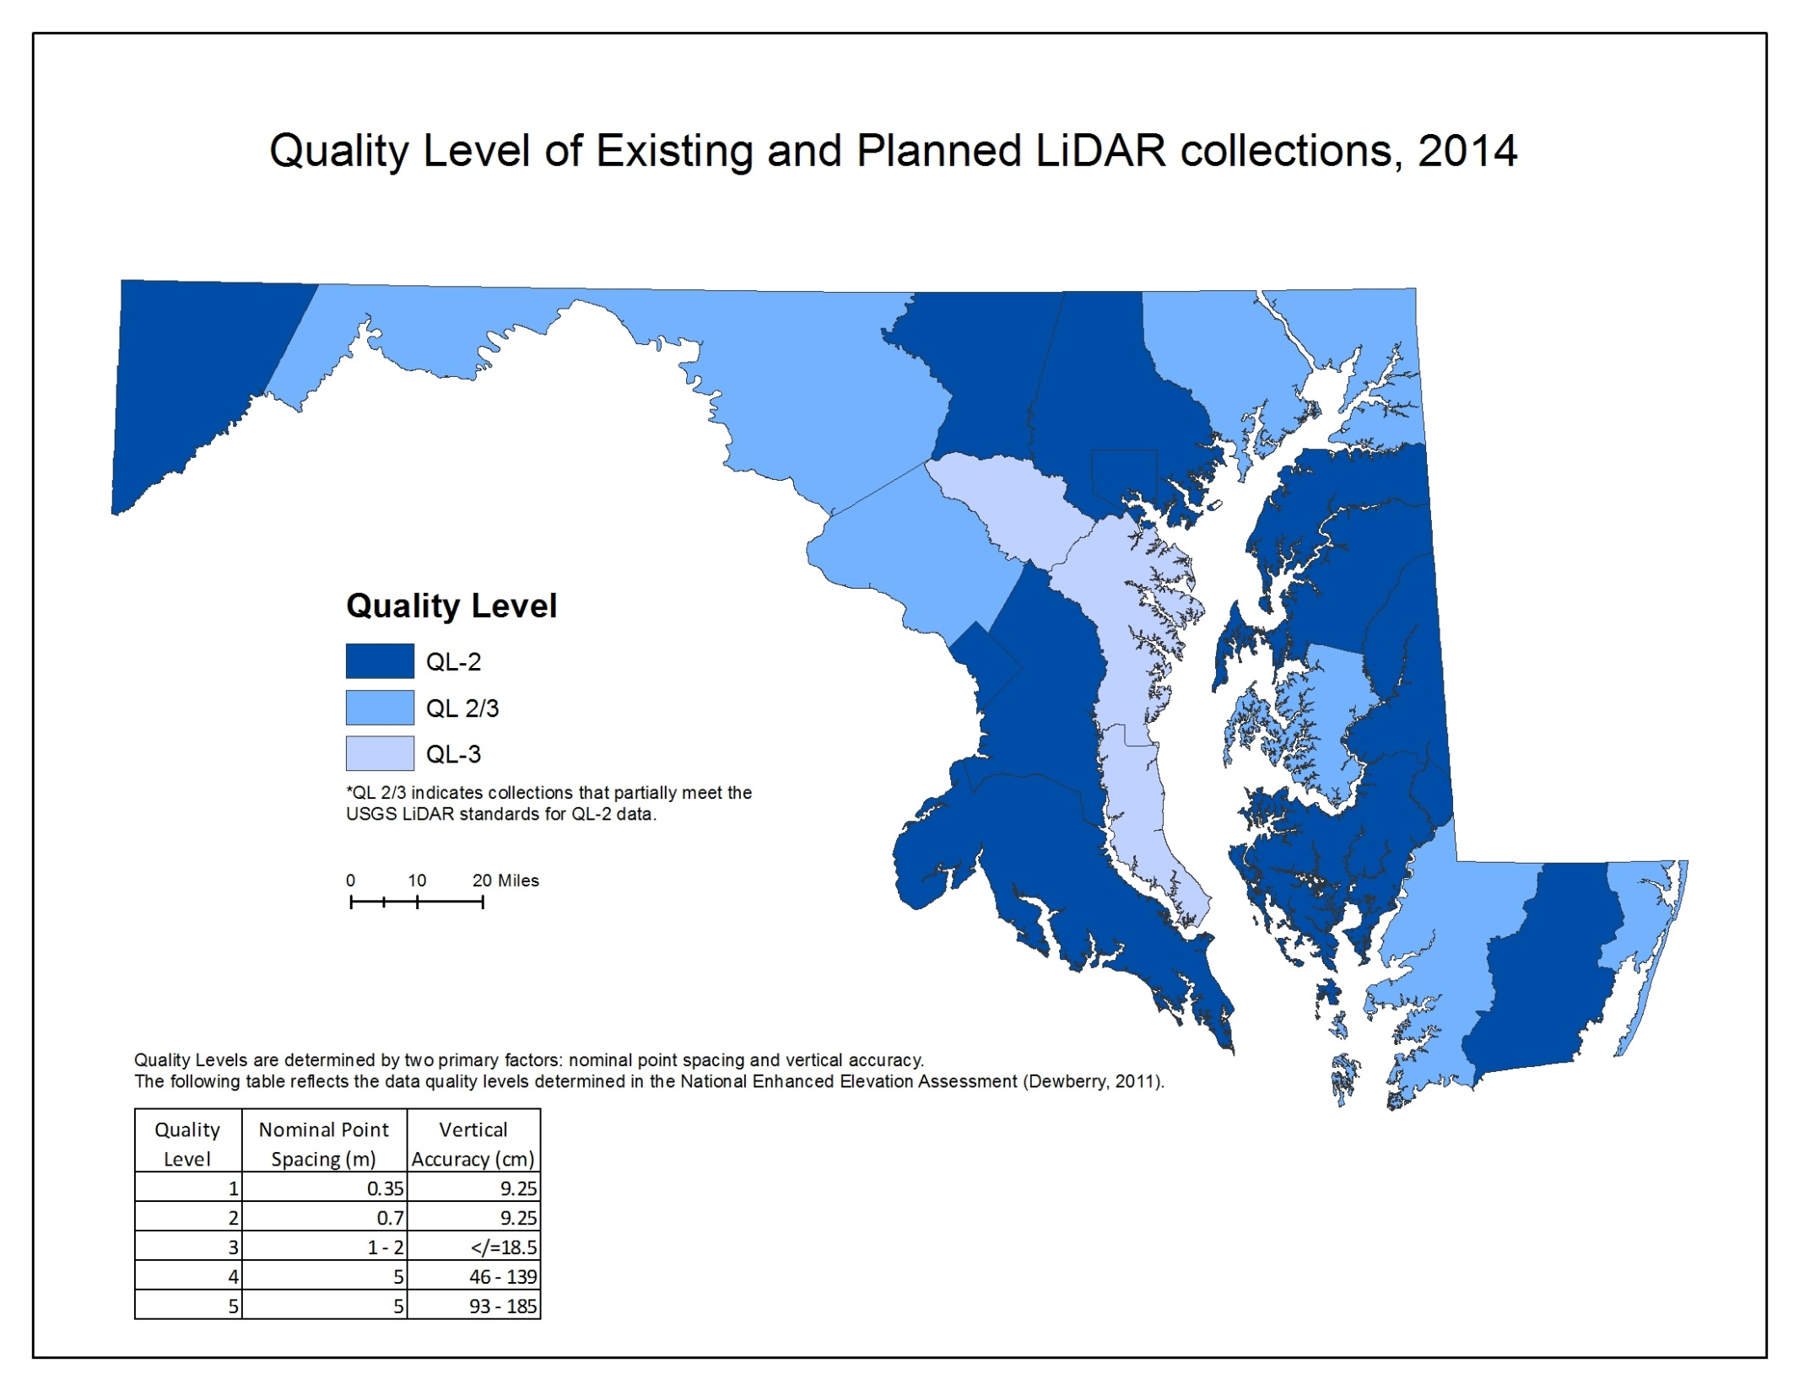
Notes:
Please note that Maryland’s lidar coverage is soon to be excellent, and coordination between local, state, and Federal agencies has been excellent. Note that Maryland has had a number of local government funded acquisitions in Montgomery, Baltimore, Harford, Cecil, Queen Anne’s, Howard, Anne Arundel, and Calvert Counties. FEMA funded the 2012 collection of Allegany, Washington, and parts of Frederick and Worcester counties, NRCS has funded most of Worcester, Wicomico, Somerset, Garrett, and the majority of Frederick counties. USGS has funded Dorchester, Caroline, Talbot, Kent, St. Mary’s, Charles, Prince George’s, Carroll, and the City of Baltimore. All Federal acquistions were contracted through USGS. Note many of these areas are to be collected this coming leaf-off season. Also note that Maryland has been in the transition phase from QL-3 specification to 3DEP QL-2 specs. Note that all Sandy Supplemental funding has been conducted as the beta test for QL-2 lidar collection, with tide coordination.

Slide 34
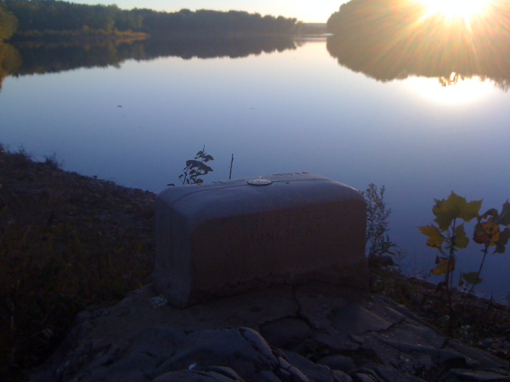
End Point
Questions-Discussion-Dialogue are Welcome rbarlow@usgs.gov 703-648-5189

