Slide 1




Maryland Society
of Surveyors
100% Member National Society
of Professional Surveyors

Slide 2
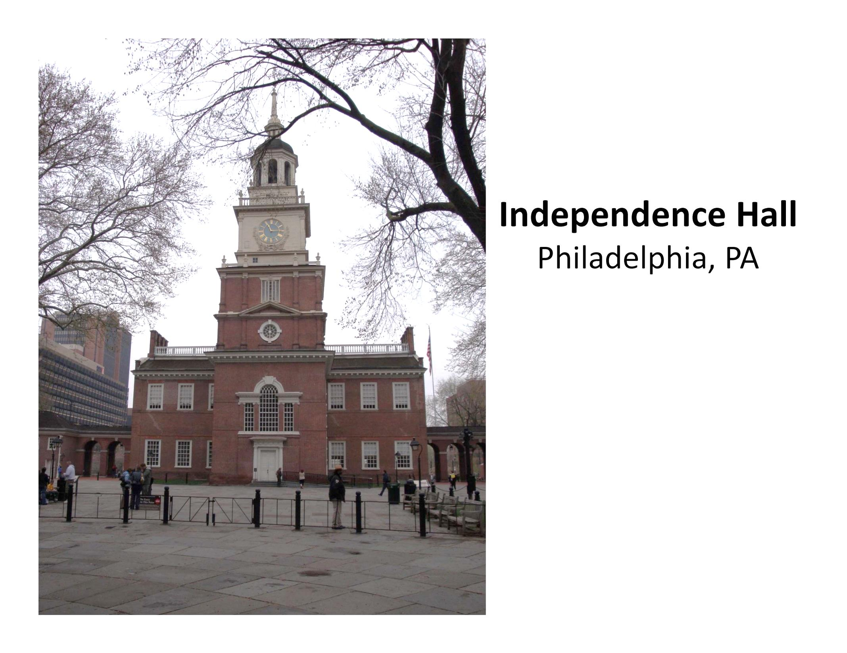

Slide 3
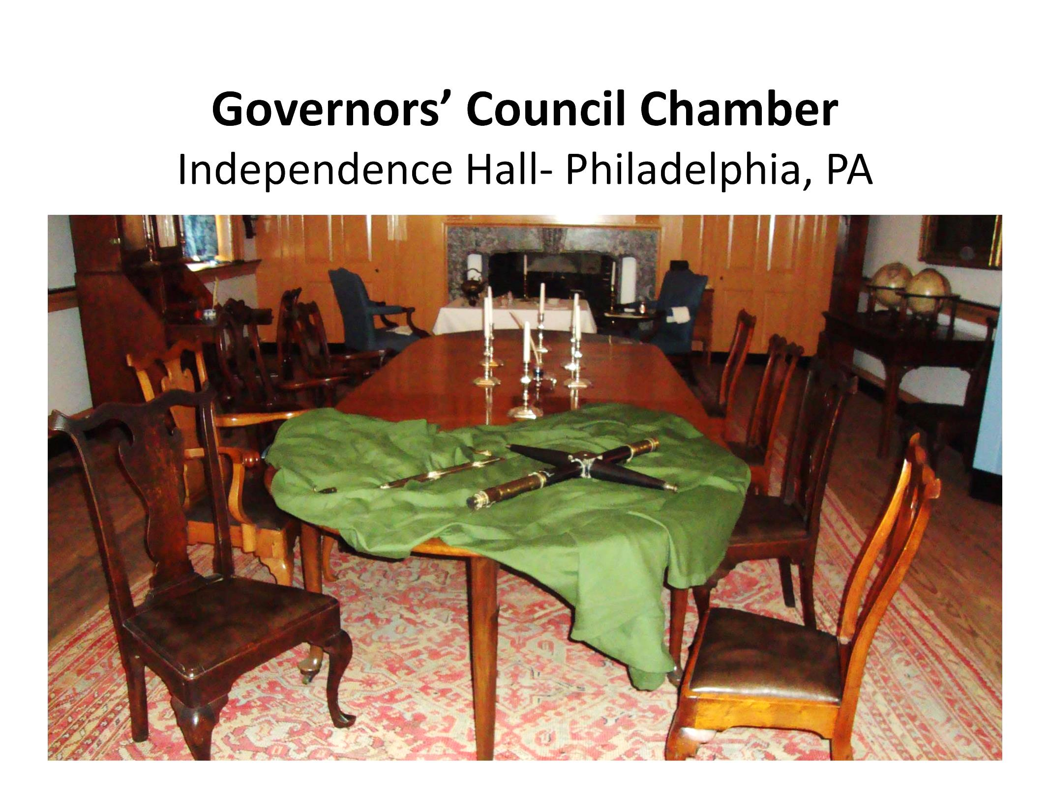

Slide 4
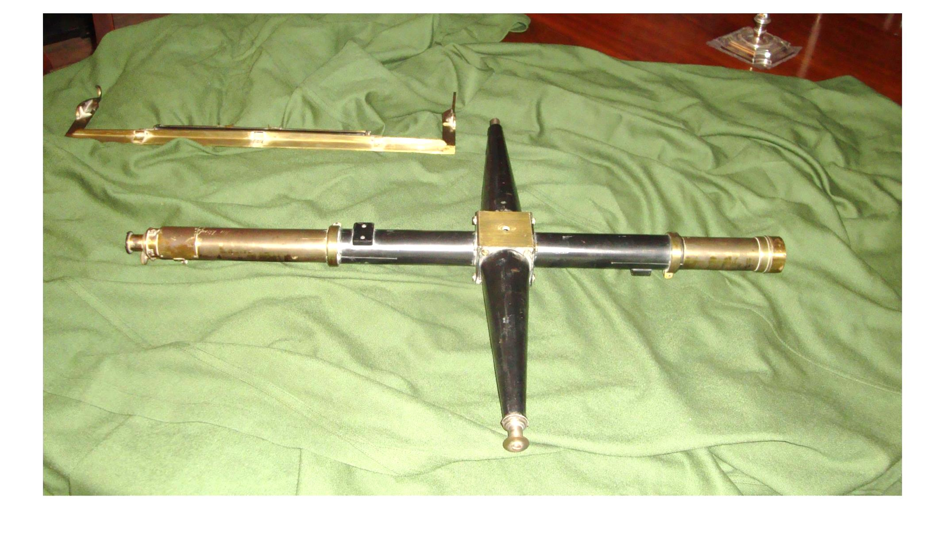
Mason & Dixon’s
Transit and Equal Altitude Instrument

Slide 5
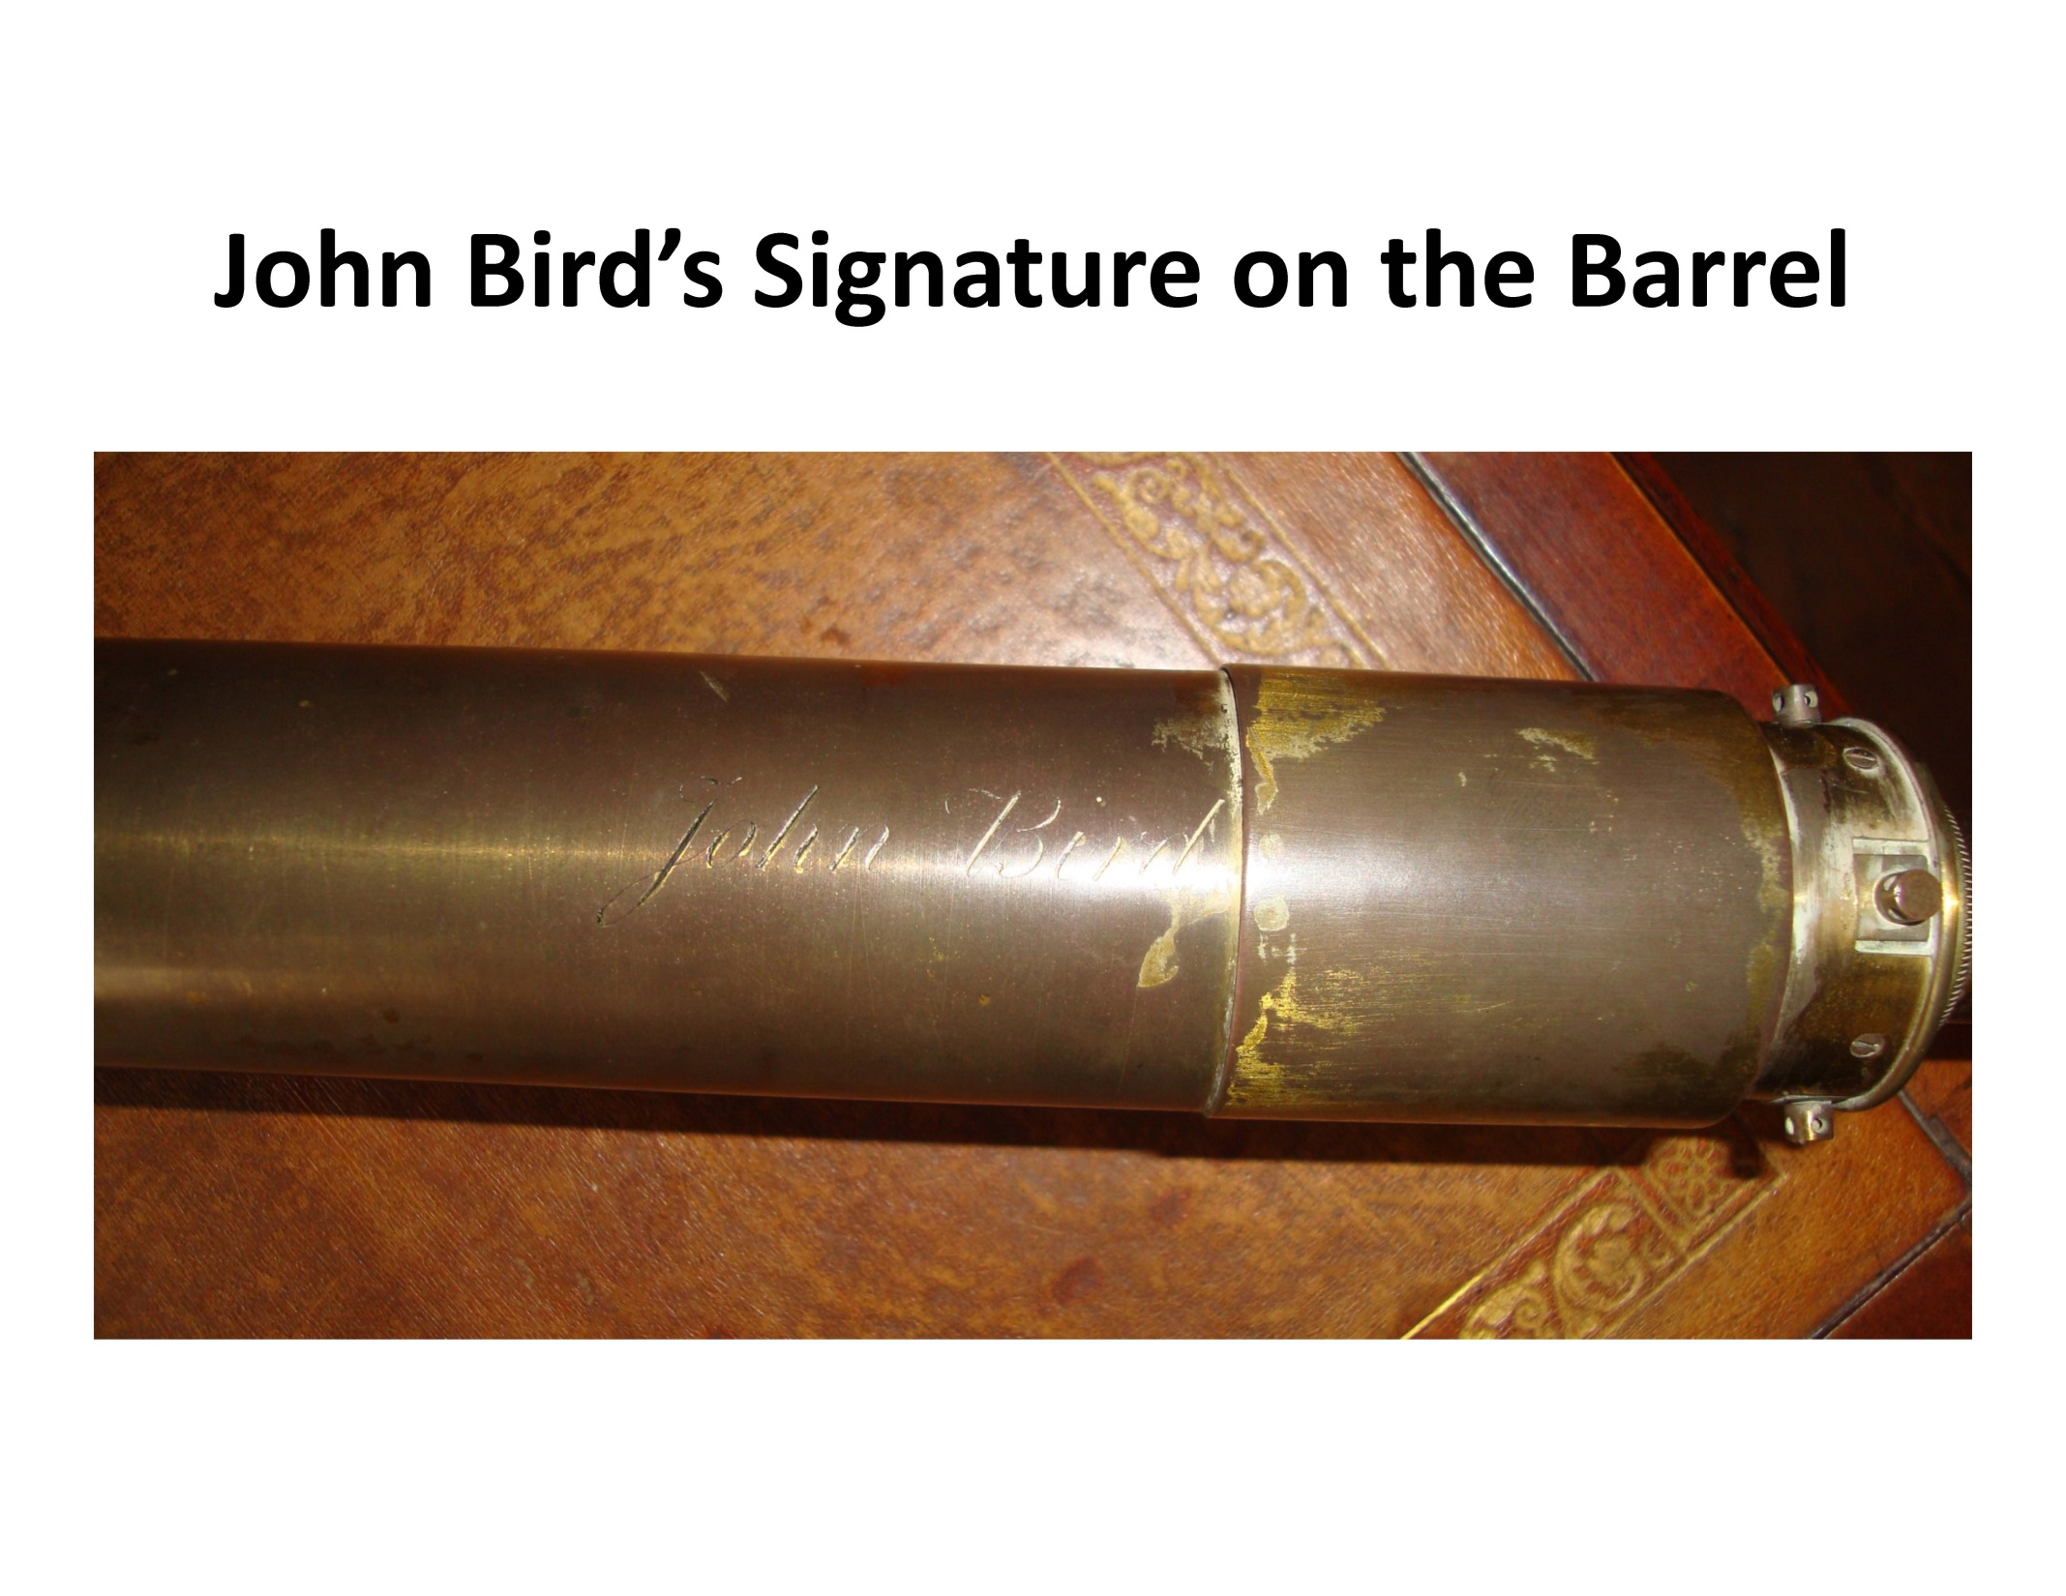

Slide 6
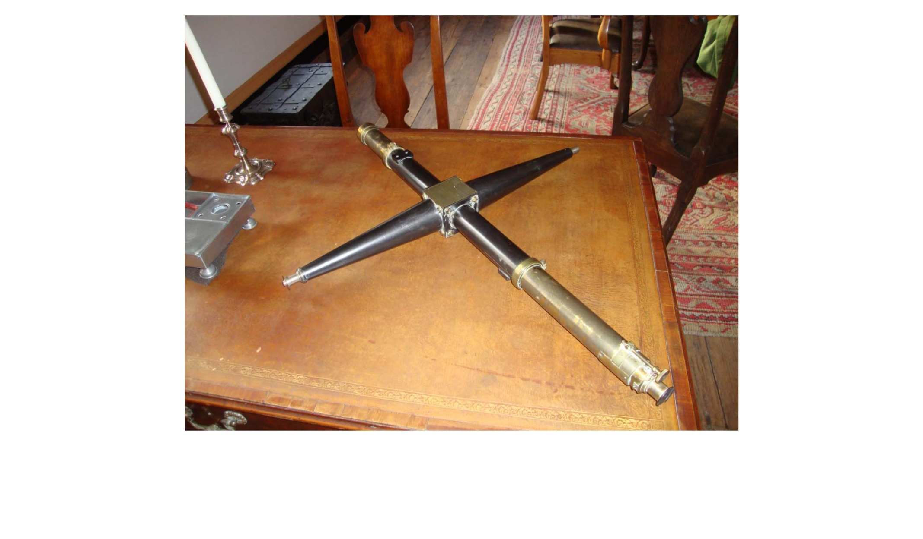
All that Remains of
Mason & Dixon’s Instrument

Slide 7
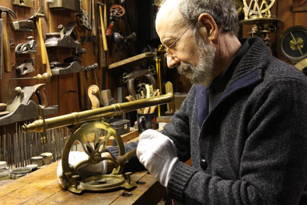

Slide 8
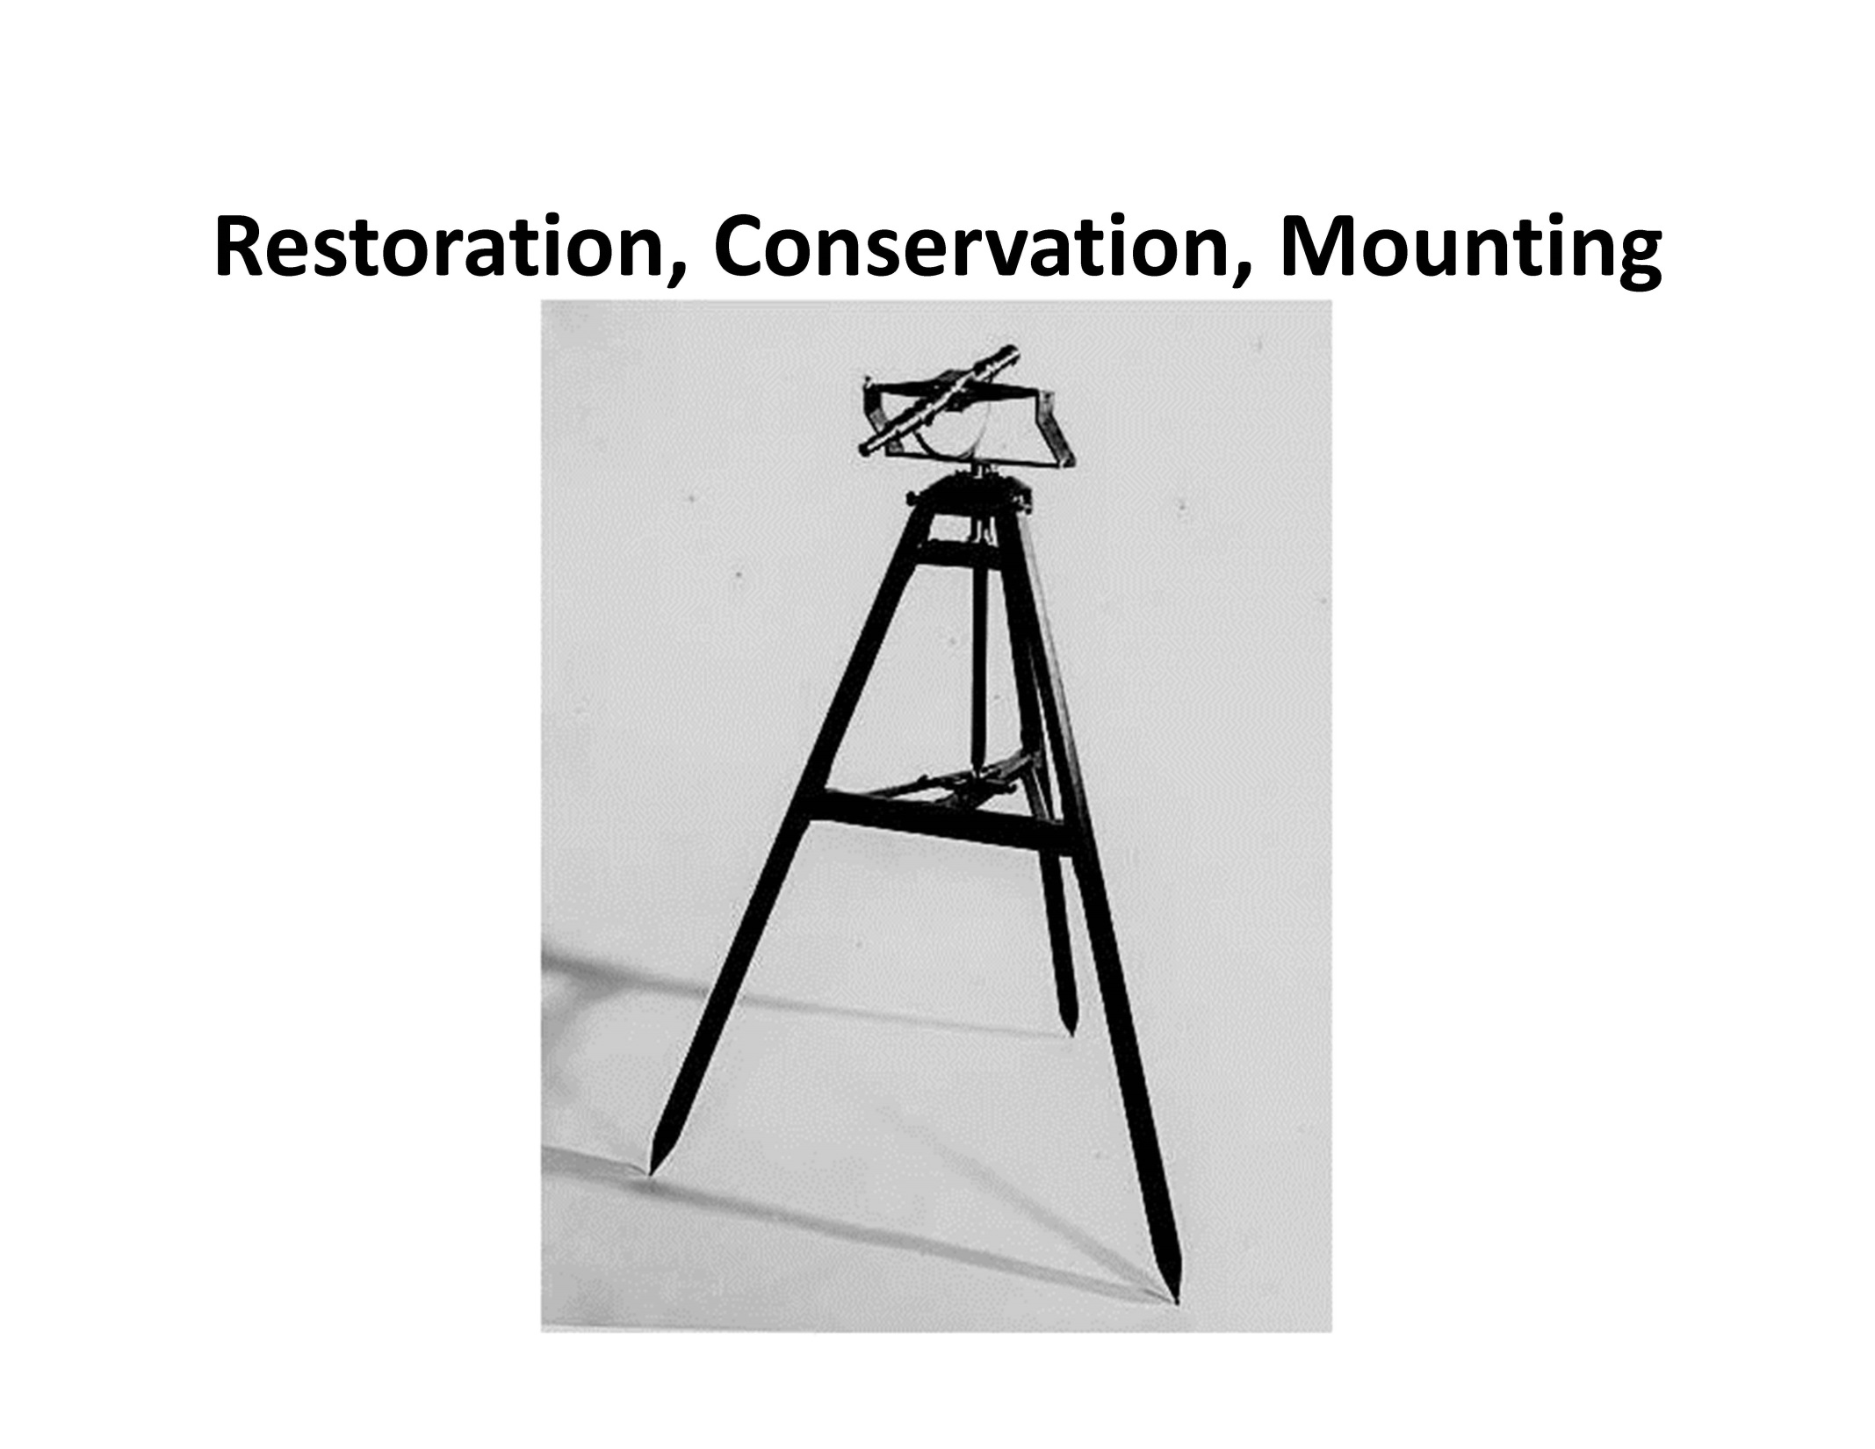

Slide 9
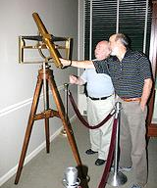

Slide 10
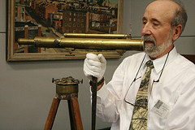

Slide 11
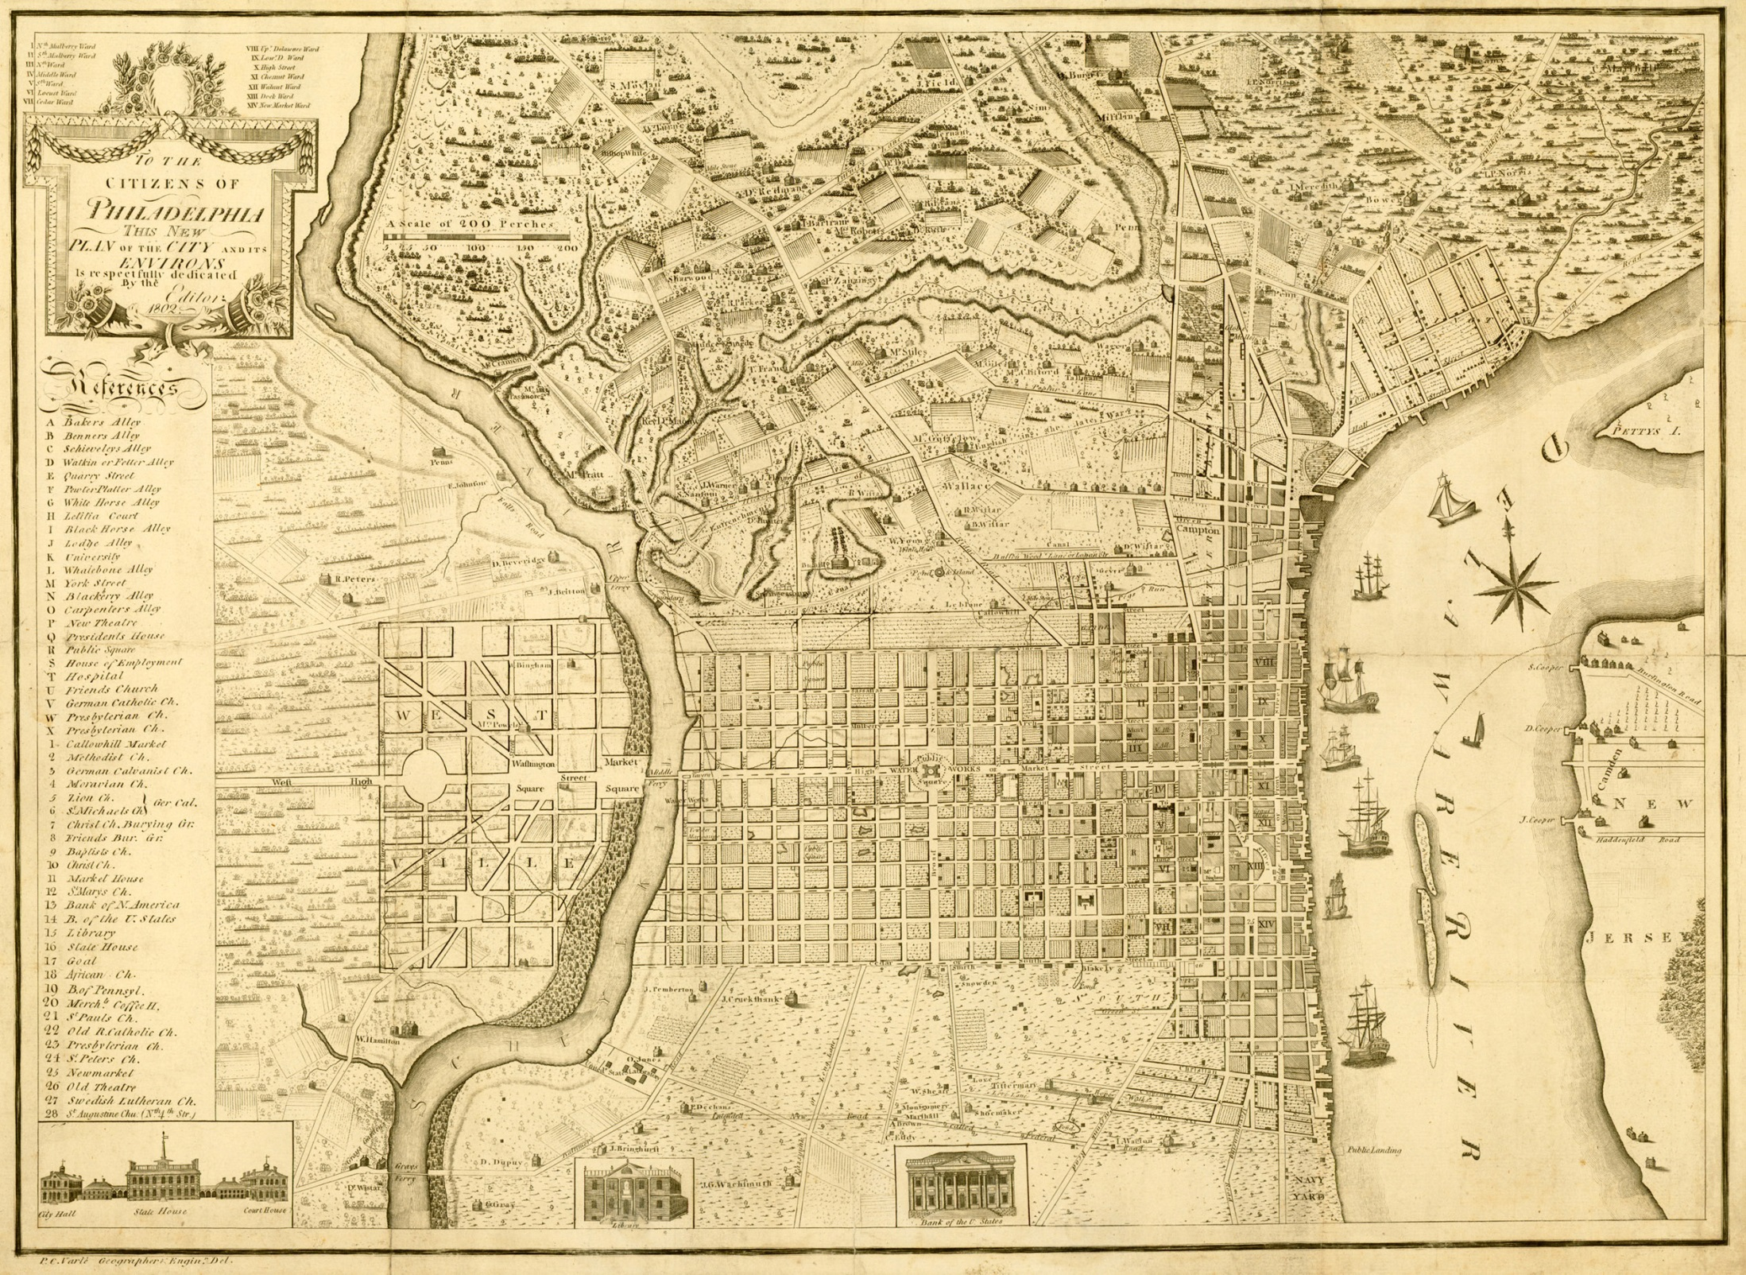

Slide 13
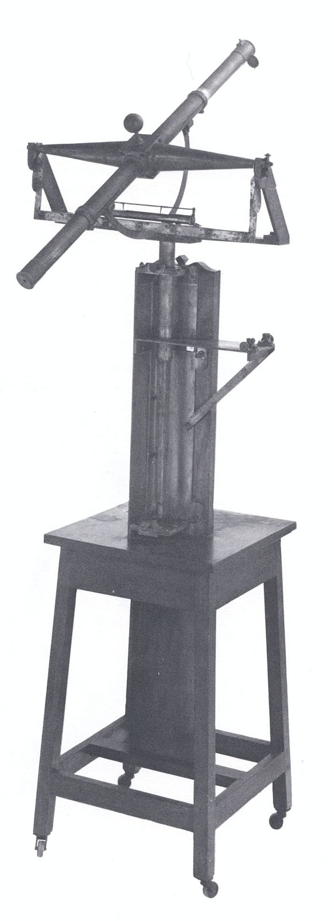

Slide 14
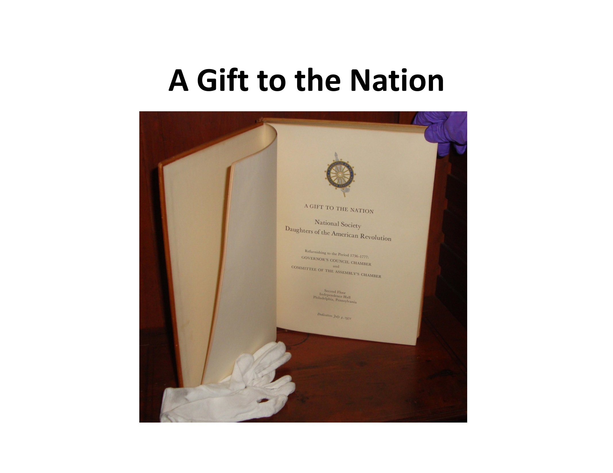

Slide 15
Maryland Society
of Surveyors
100% Member National Society
of Professional Surveyors

