Slide 1
Hydro Treatments of
Lidar-Derived DEMs
Notes:
USGS National Geospatial Program is the Federal steward for 2 main geospatial themes, Hydrography and Elevation. These are important layers on their own, but integrating them is making each layer more powerful. It’s like peanut butter and chocolate…they belong together!

Slide 2
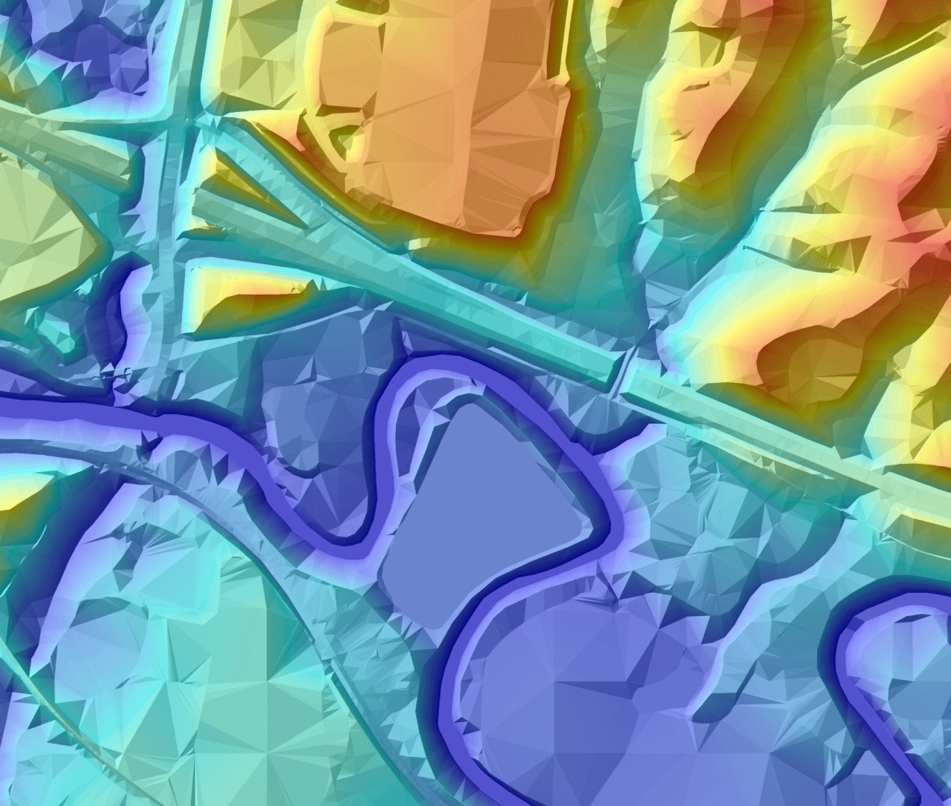
Stereo DTM
(Topographic Surface)
Reference image of the traditional stereo-compiled DTM
Built from Masspoints and Breaklines
Much coarser resolution than lidar
Demonstrates the familiar and usually expected character of a topographic DEM
Most notably, the “flat” water surfaces
Stream Waterbody
Notes:
This image roughly corresponds to a 10-meter DEM which is commensurate with 1:24,000-scale at USGS. Federal data requirements, particularly from FEMA and The Corps of Engineers identify the need for elevation data at large scale for flood studies and engineering projects.

Slide 3
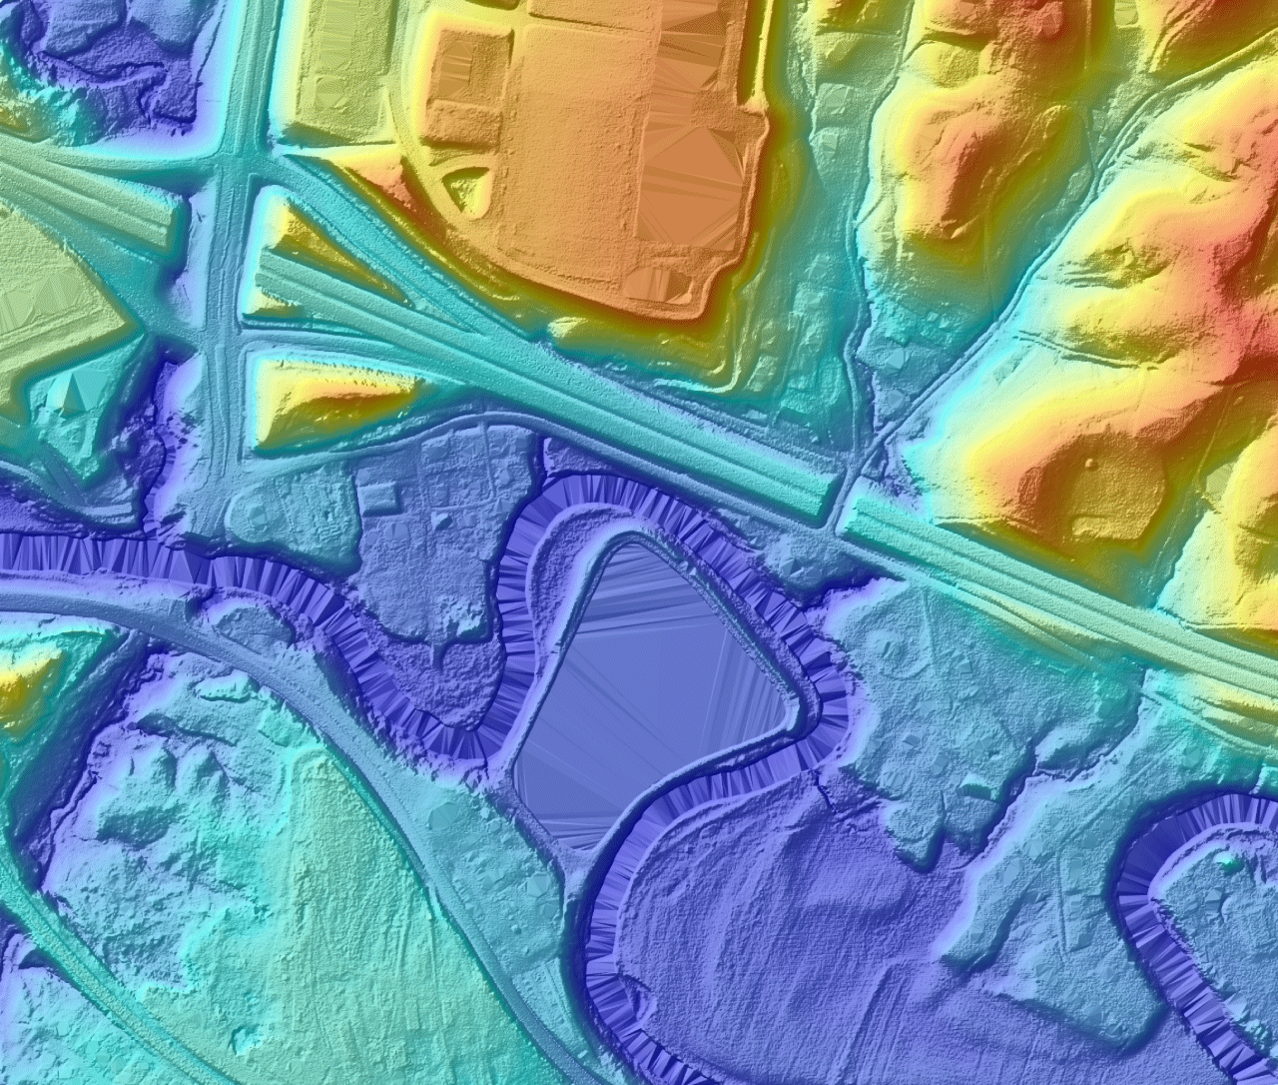
Pure LiDAR
(Topographic Surface)
DEM created only using Bare-Earth lidar points
Surface contains extensive triangulation artifacts (“tinning”).
Caused by the absence of:
  Flattening lidar returns from water
  Breakline constraints that would define buildings, water, and other features (as in the Stereo DTM).
Aesthetically and cartographically unacceptable to most users
Tinning in Water Areas
Notes:
USGS and EPA are planning in FY 2015 for the compilation of a nationwide open water database. I expect drafty standards to be publicly available later this fiscal year, including minimum water body size to be identified, most likely at 1:24,000-scale.

Slide 4
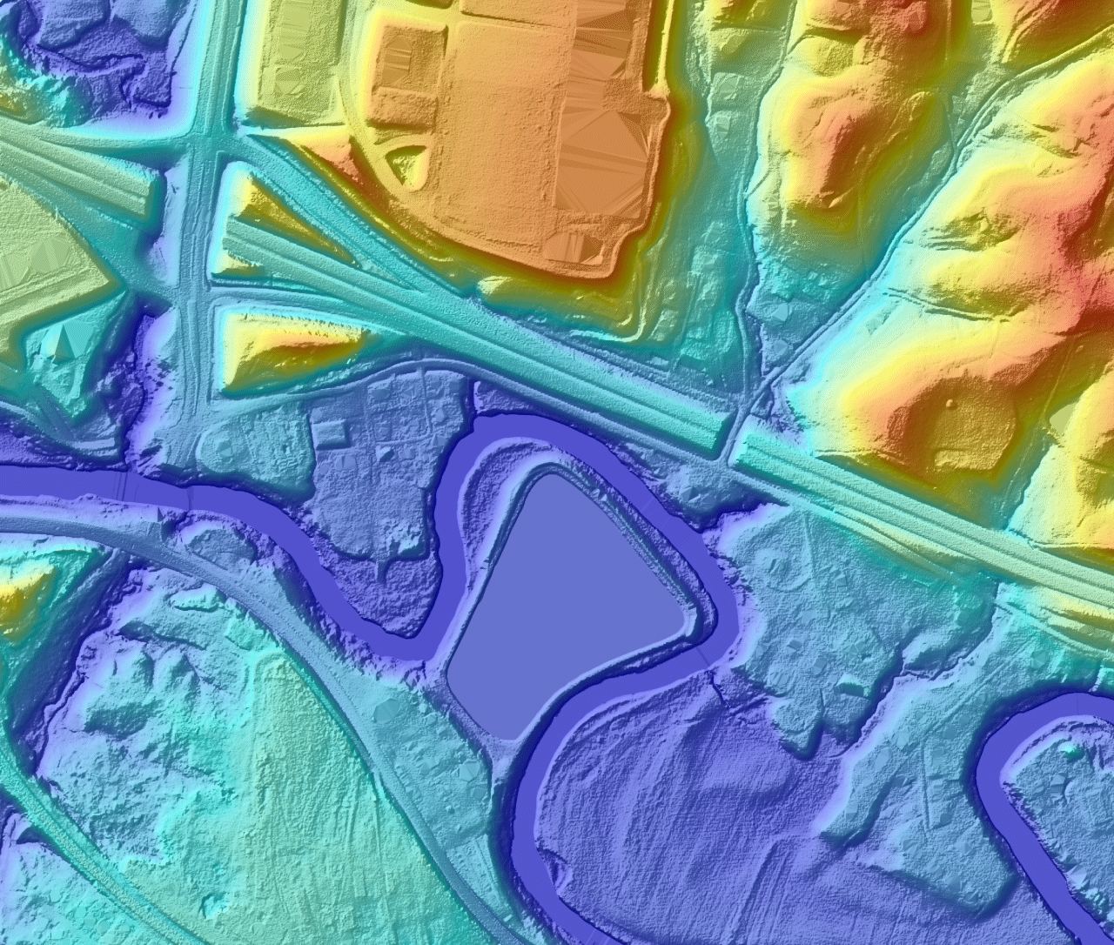
Hydro Flattened
(Topographic Surface)
The goal of the v13 Spec.
Intent is to support the development of a consistent, acceptable character within the NED, suitable for contouring.
Removes the most offensive pure lidar artifacts: those in the water.
  Constant elevation for waterbodies.
  Wide streams and rivers are flattened bank-to-bank and forced to flow downhill (monotonic).
Carries ZERO implicit or explicit accuracy with regards to the represented water surface elevations – It is ONLY a Cartographic/Aesthetic enhancement.
Building voids are too costly to correct.
Most often achieved via the development and inclusion of hard breaklines.
Stream Waterbody
Notes:
Probably the most important aspect of the hydro-flattening is that it makes water features more visually identifiable! As water elevation changes constantly unless specifically there is a specifically managed pool elevation, this is not a terrible handicap. Note that 3DEP Quality Level 2 data is still only 2 points per square meter, so building shape based on lidar alone is not recommended. QL-1 lidar at 8 points per square meter is the recommended starting point for lidar only building delineation.

Slide 5

Full Breaklines
(Topographic Surface)
A further possible refinement of the Hydro Flattened surface
Removes artifacts from building voids
Refines the delineation of roads, single-line drainages, ridges, bridge crossings, etc.
Requires the development of a large number of additional detailed breaklines
A higher quality topographic surface, but significantly more expensive.
Not cost effective for the NED.
Buildings Roads
Notes:
The newer 3DEP specification offers partial breaklines, the focus is on hydrographic features, and not building delineation for USGS. USGS is collecting landmark building information by volunteer crowd-sourcing, for inclusion on US Topo products at 1:24,000-scale.

Slide 6

Hydro Enforced
(Hydrologic Surface)
Surface used by engineers in Hydraulic and Hydrologic (H&H) modeling.
NOT to be used for traditional mapping (contours, etc.)
Similar to Hydro Flattened with the addition of Single Line Breaklines: Pipelines, Culverts, Underground Streams, etc…
Terrain is then cut away at bridges and culverts to model drain connectivity
Water Surface Elevations (WSEL) are often set to known values (surveyed or historical).
Culverts Cut Through Roads
Notes:
Hydro-enforcement requires two main adjustments to the DEM. 1. water must flow, downhill if possible. In some coastal areas water flows as much by wind or tide as it does from the lack of elevation change. 2. Connect all breaks in the watercourse that impede the flow of water such as: culverts, bridges, and dams.

Slide 7
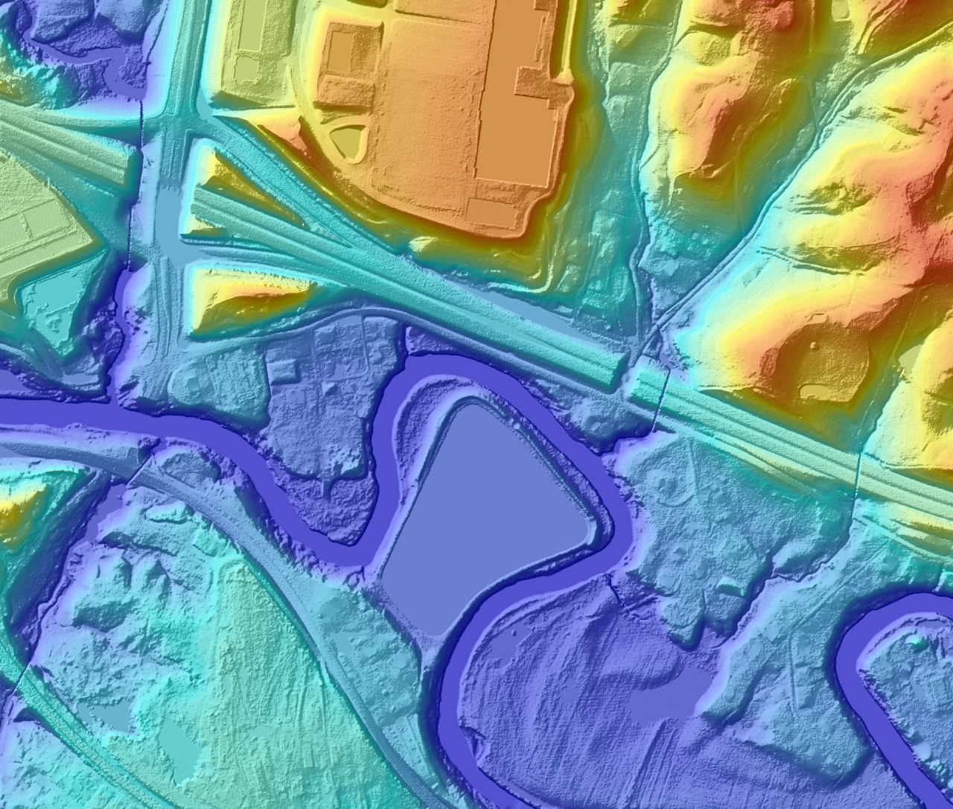
Hydro Conditioned
(Hydrologic Surface)
Another type of surface used by engineers for H&H modeling.
Similar to the Hydro Enforced surface, but with sinks filled
Flow is continuous across the entire surface – no areas of unconnected internal drainage
Often Achieved via ArcHydro or ArcGIS Spatial Analyist
Filled Sinks
Notes:
The illustration here certainly focuses on made-made sinks, which are digitally filled in to make the model work. However the same applies to a natural setting say in the Great Valley where karst features are abundant. The key is making the model work. If the karst sinks are to be mapped they would not be using this model type.

Slide 8
Active Comparison Slide (click the buttons below)
Stereo DTM
Pure
Lidar
Hydro Flattened
Full Breaklines
Hydro Enforced
Hydro Conditioned
Notes:
TA_DAAAA! A stream that flows, the highway isn’t doing so well, but they can make their own darn model if they want traffic to flow!

Slide 9
Watershed Boundary Dataset
WBD is combined with the National Hydrography Dataset, and shows watershed boundaries derived from the best available elevation data prescribed to identified drainage area ranges based on area .The number of digits in the code increases with smaller area.
Watershed area becomes important as we strive to manage nutrient sources, storm-water, and invasive species and other conservation efforts.
Particularly in areas of low relief or poor elevation data, refinements in watershed boundary will occur as new lidar is applied.
Notes:
Note that USGS and NRCS most often use 10 and 12 digit hydrologic unit codes. A 12-digit HUC describes watersheds averaging about 40 square miles, and a 10-digit HUC averages around 225 square miles. USGS is the primary manager of both the National Hydrography Dataset and the Watershed Boundary Dataset. So modeling catchment area runoff becomes more precise with new lidar data and application to large-scale mapping. DC and Fairfax County will be using the new Sandy Supplemental Lidar for stormwater management.

Slide 10
References
USGS-NGP v13 Draft LiDAR Base Specification
Special Thanks to:
  Hans Karl Heidemann
  Jeremiah Ross Vinyard-Houx
  James V Mauck
Notes:
Here are some USGS folks who assembled the graphics seen on this portion of the presentation. Note that LiDAR Base Specification 1.0 is now in use, it is quite similar to draft version 13. We do expect version 2.0 out later this fiscal year, which will add a lot of acquisition content leading to increased consistency between and within datasets.

Slide 11
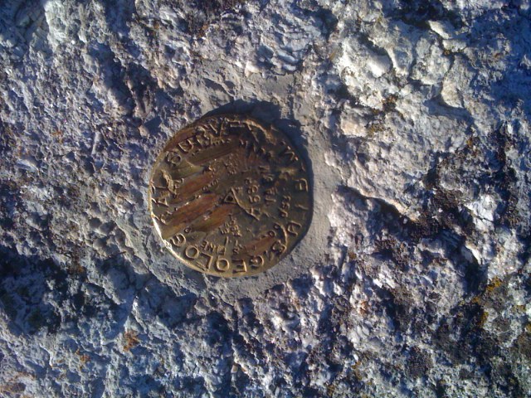
Thank you for sitting through this.
Roger Barlow (703-648-5189) rbarlow@usgs.gov
Notes:
If you want more information on topics in this presentation or any other USGS data or science, ask me or contact me.

