Slide 1
Baltimore County’s Stormwater Remediation Fee
Opportunities for surveyors & geospatial professionals
Robert Hirsch
  Natural Resource Specialist
  Baltimore County Department of Environmental Protection & Sustainability
Vince Gardina
  Director
  Baltimore County Department of Environmental Protection & Sustainability
Kevin Kamenetz
  Baltimore County Executive

Slide 2
Baltimore County’s Stormwater Remediation Fee
County perspective on fee
Baltimore County’s fee structure
Use of Geospatial Data
Opportunities for Surveyors

Slide 3
The Fee & County Governments
Stormwater runoff causes pollution

Slide 4
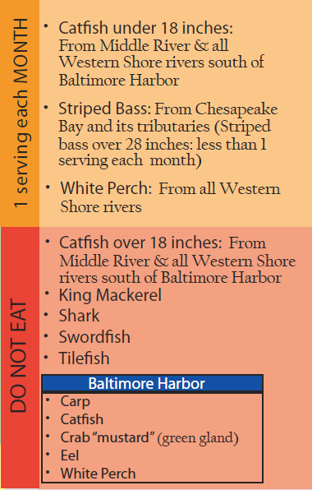
Local fish consumption hazards
www.mde.state.md.us/fishadvisory/

Slide 5
The Fee & County Governments
Stormwater runoff causes pollution
County responsible for urban runoff

Slide 6
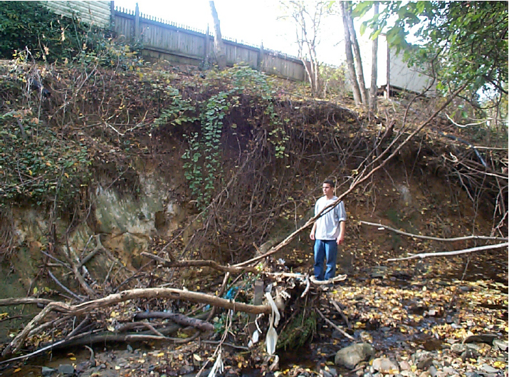
Redhouse run, before restoration
Active erosion from stormwater runoff.
Excessive sediment and nutrients into Back River and the Chesapeake Bay.
Damaged sewer mains, bridges, and habitat.
Private and public land lost .

Slide 7
The Fee & County Governments
Stormwater runoff causes pollution
County responsible for urban runoff
Water quality impairments persist
  EPA & MDE regulation ↑↑
  County compliance costs ↑↑
Stormwater Remediation Fee
  Dedicated fund
    Restore impaired water bodies
    Comply with stormwater pollution regulations

Slide 8
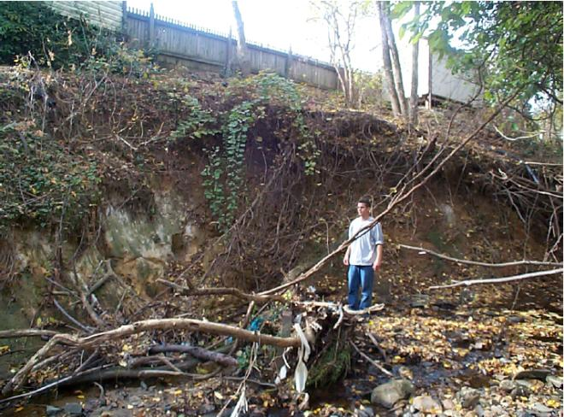
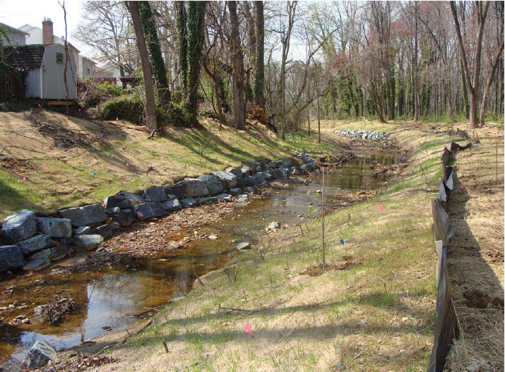
Redhouse run,
before restoration
Redhouse run,
after restoration
Notes:
With the funds from the Fee, Baltimore County will be able to do more restoration work, like what we did in Redhouse Run.

Slide 9
Fee Structure: assessment mechanism
Impervious Surface (IS) based fees
  Science supports
  Courts uphold
Concrete and simple
IS maps + cadastral maps
=
objective, fair, easily explained assessments
+
easily resolved disputes
Notes:
GIS screen shot?
State law:
Sets some limits, but gives lots of flexibility to local governments.
Fee must be "based on the share of stormwater management services related to the property"
Fee can be "graduated, based on the amount of impervious surface on each property"
Defines impervious surface: "includes rooftops, driveways, sidewalks, or pavement."
Baltimore County chose to base their fee on impervious surface cover.
Countless studies have documented that impervious surfaces cause increased stormwater runoff and associated pollution.
In most places where stormwater fees have been challenged in court, fees based on the amount of impervious surface have held up.
We have impervious surface maps depicting rooftops, driveways, pavement, etc.
We have property maps.
We can measure impervious surfaces objectively and fairly.
Disputes can be settled objectively by measuring impervious surfaces, and checking parcel maps against the property boundaries recorded in the land records.

Slide 10
Fee Structure: limiting potential problems
296,990 property accounts!
More calculations, more problems
KISS
  Single family residences get flat fee
    155,710 detached homes
    65,405 townhouses and duplexes
    19,952 residential condo units
  Agriculture & Vacant are exempt:
    39,560 agricultural and vacant
16,363 (5.5%) get ‘geospatial’ fee

Slide 11
Fee Structure:
Stormwater BMP Credits
Adapt existing SWM BMP program
    Geodatabase and monitoring program exist
    Bay Program guides credit calculations
    Fee Credits ∝ MDE Credits to County

Slide 12
Fee Structure:
Stormwater BMP Credits
Adapt existing SWM BMP program
    Geodatabase and monitoring program exist
    Bay Program guides credit calculations
    Fee Credits ∝ MDE Credits to County
KISS: credits not applied to residential
Maximum credit: 74%
  26% of impervious surfaces are owned by Baltimore County

Slide 13
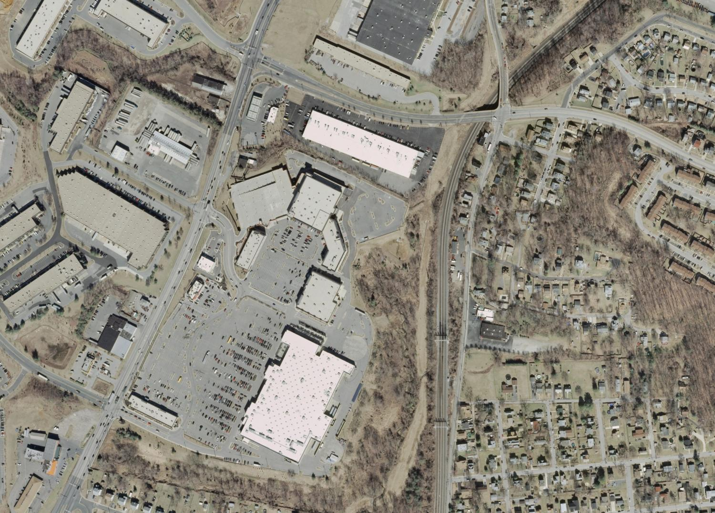

Slide 14
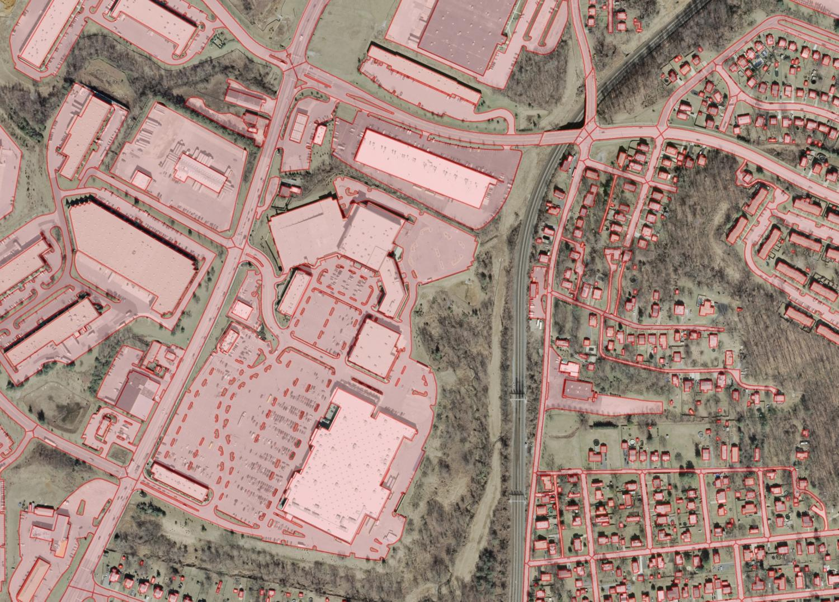

Slide 15
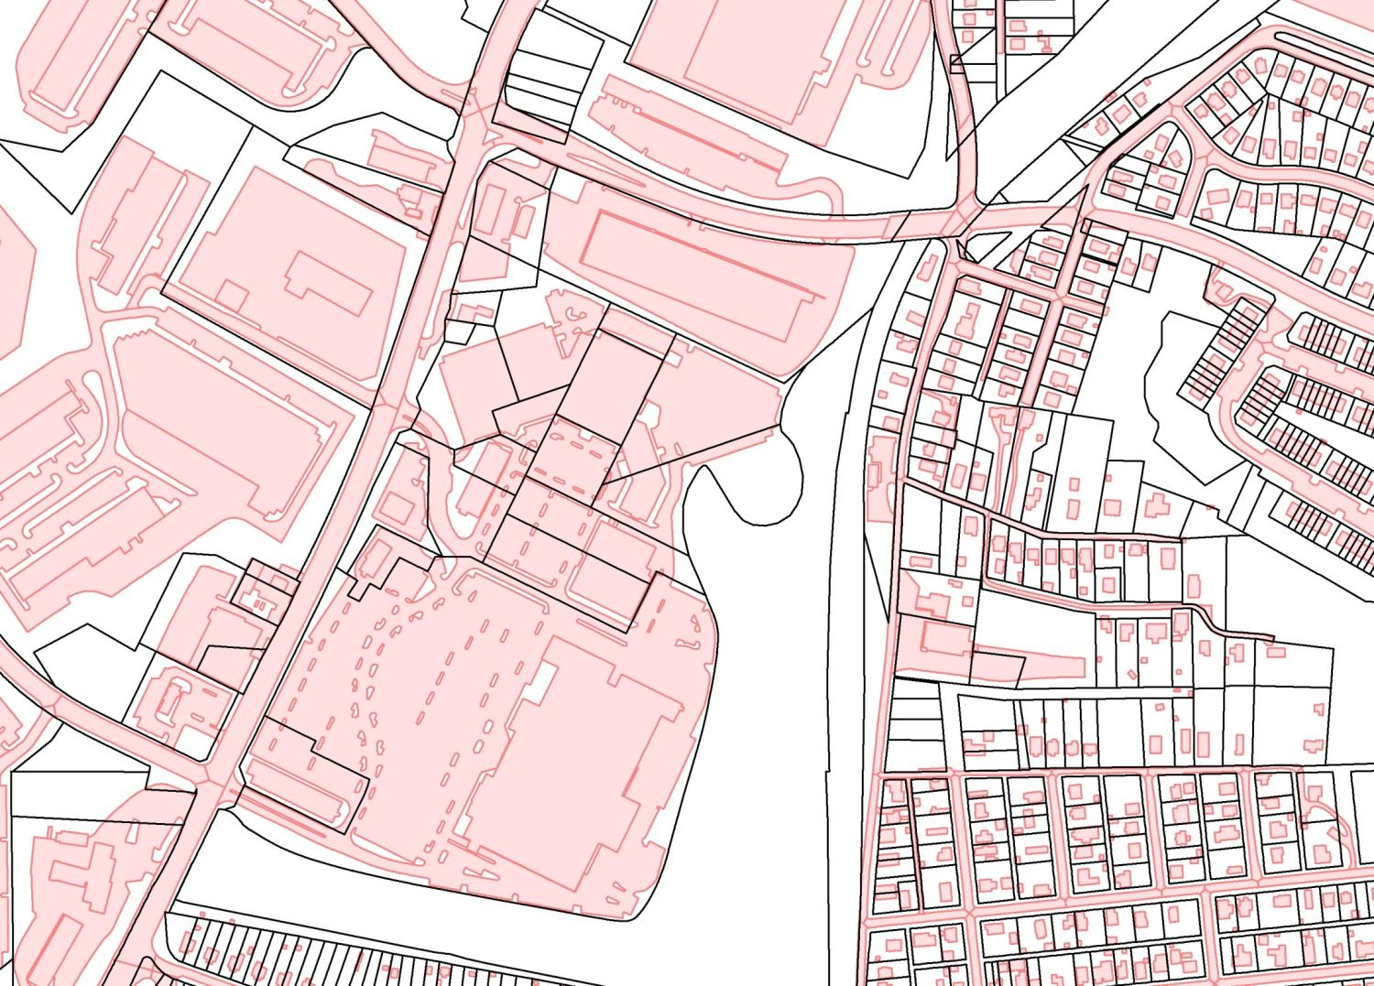

Slide 16
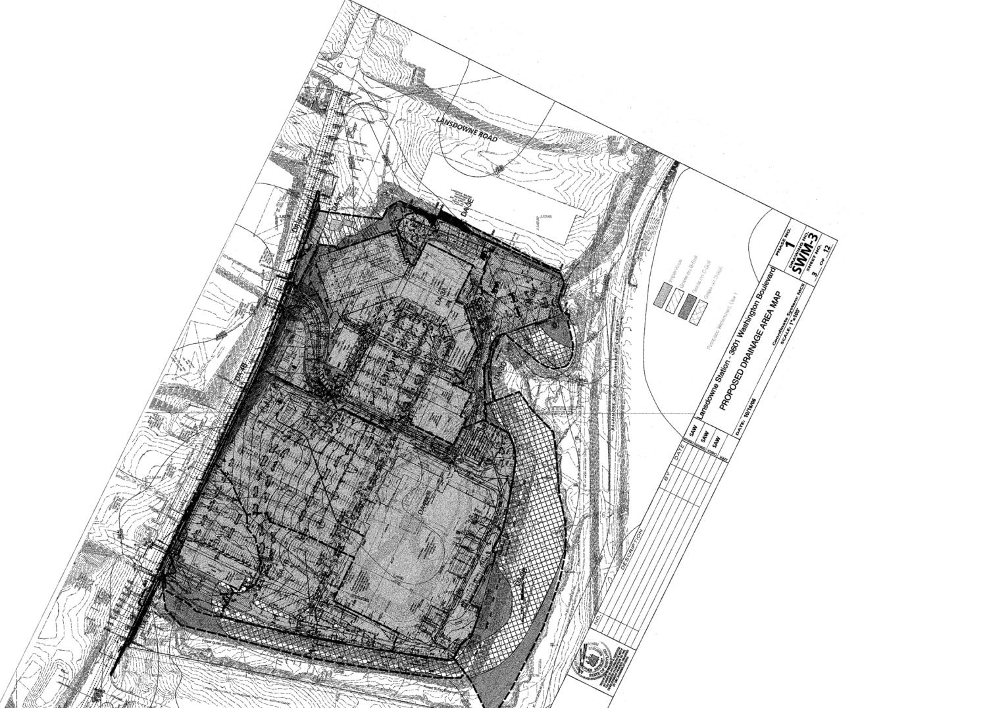

Slide 17
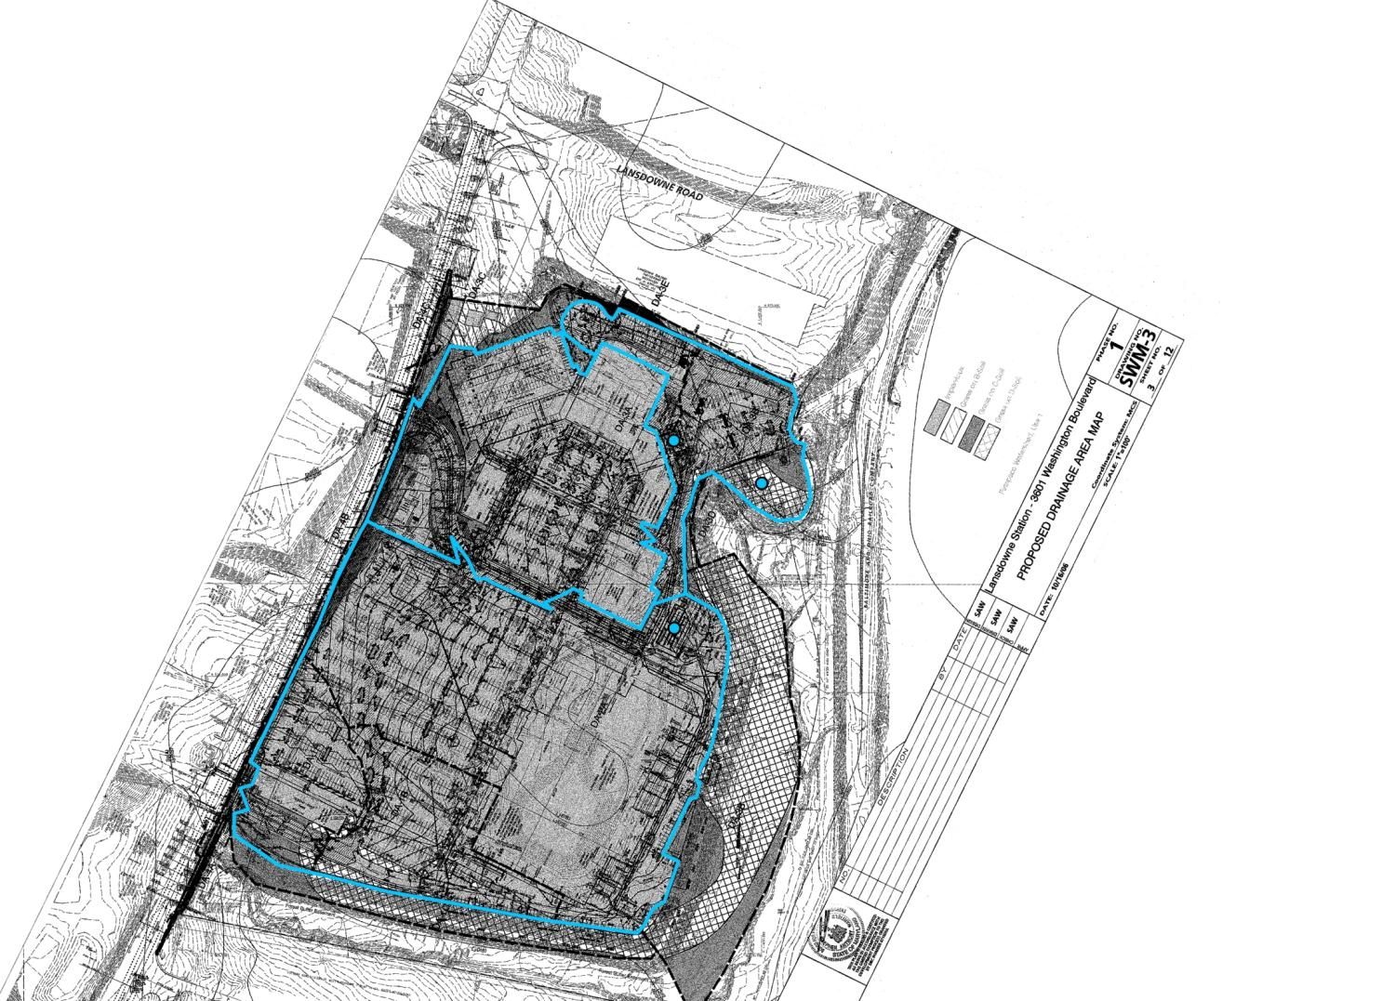

Slide 18
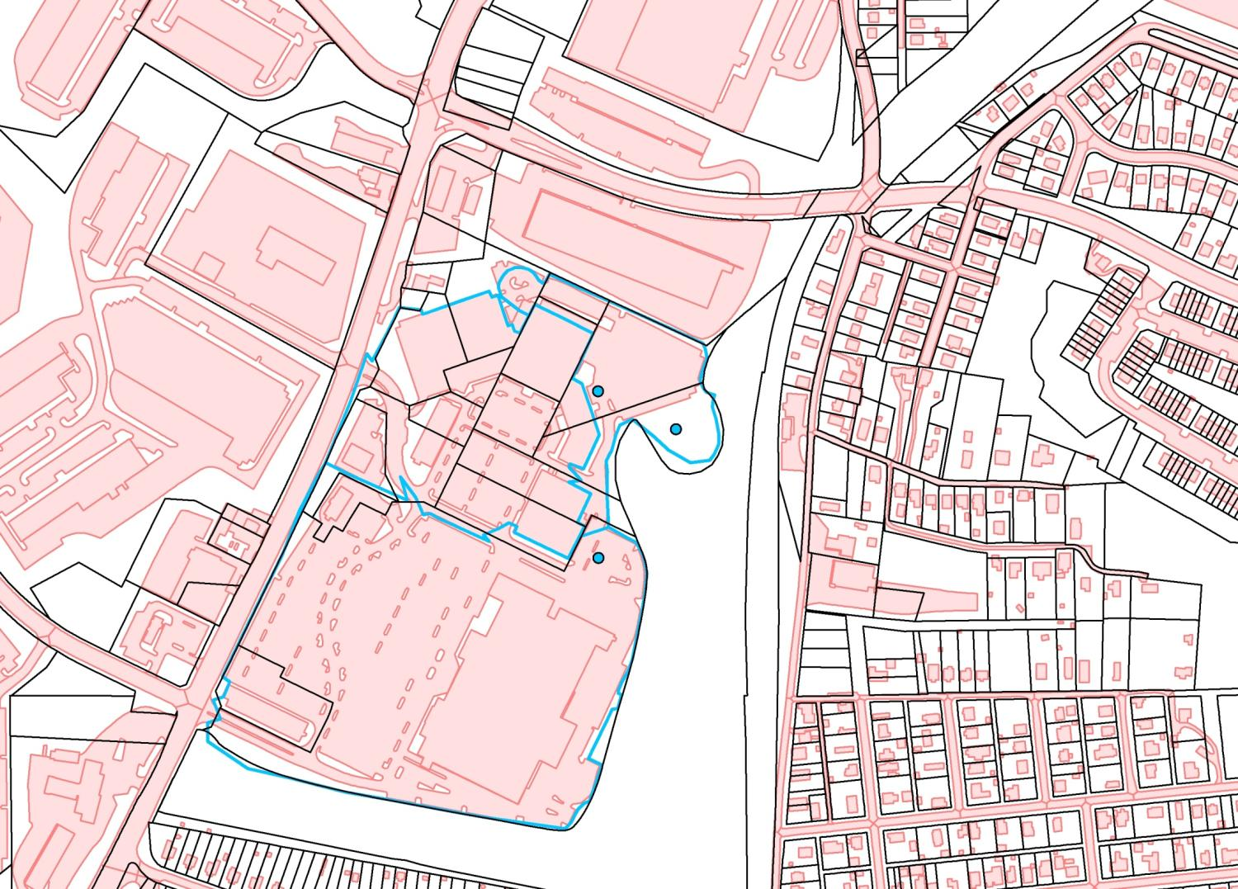

Slide 19
Fee Structure:
Setting the Rates
Bay TMDL annualized cost
Fee must:
  Cover Bay TMDL costs
    Including SWM BMP credits
  Be Proportional to ISA
  Avoid hardships on non-profits
    SFD: $39 / dwelling
    SFA: $21 / dwelling
    Condo: $32 / dwelling
    Non-profit Institutional: $20 / 2000 sq ft IS
    Commercial: $69 / 2000 sq ft IS

Slide 20
Fee Structure:
Results of geospatial fees
Commercial
  14,791 accounts
  13,109 with ISA
    $780,169 - max
    $ 873 - 3rd quartile
    $ 263 - median
    $ 49 - 1st quartile
    $ 0.36 - min
Non-Profits Institutions
  1,754 accounts
  352 with ISA
    $21,511 - max
    $ 359 - 3rd quartile
    $ 124 - median
    $ 42 - 1st quartile
    $ 1.04 - min

Slide 21
Use of geospatial data:
Fee Assessment
Impervious Surfaces
  aerial photography
Cadastre
  plats, metes & bounds, etc.
Stormwater BMP geodatabase
  engineering and construction plans
Updating & Maintaining Data
  $500,000 from fund in first year

Slide 22
Use of geospatial data:
Appeals
Successful appeal requires evidence
    Property owners often used an engineering firm to prepare the evidence or the whole appeal
791 fees appealed in first year
  613 related to geospatial data
    203 of these were successful
    $253,302.94 total fee reduction
    $ 1,247.80 average per successful appeal
    $ 413.22 average per appeal filed
Totals should ↓ each year

Slide 23
Use of geospatial data:
Stormwater Remediation Projects
County Remediation Program
  planning, design, and construction
    Field surveys
    Photogrammetry
    Desktop GIS/CADD work
  $20,000,000 per year
Landowner BMPs
  planning, design, and construction
  Typically, fee << cost of SWM BMP
  $ ???

Slide 24
Opportunities for Surveyors and Geospatial Professionals
Appeal assistance
  $ ↓
Landowner SWM BMP
  ???
Maintaining GIS data used for fees
  $$
County Restoration Projects
  $$$

Slide 25
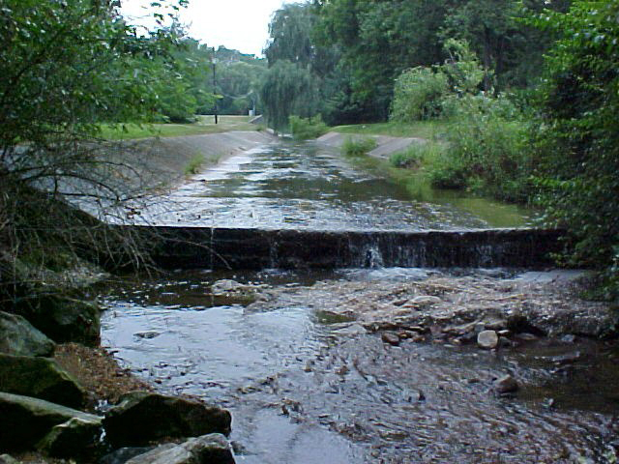
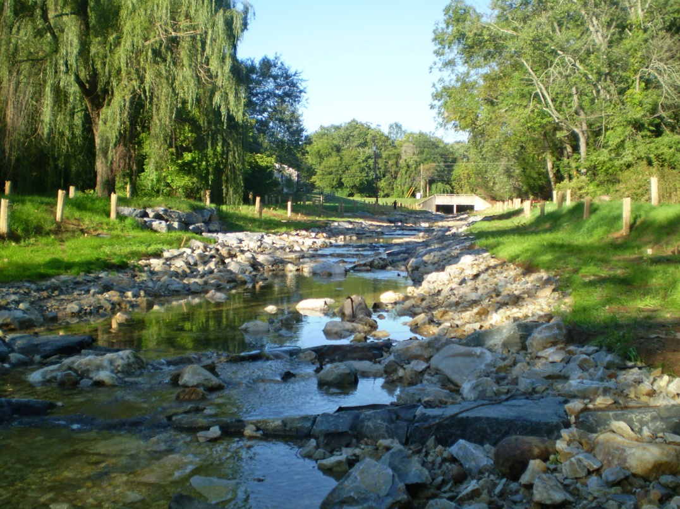
Thank you!
For more information, visit:
www.baltimorecountymd.gov/stormwaterfee.html
“Baltimore County: 200 Miles of Waterfront”
Lower Spring Branch restoration: Tributary to Loch Raven and Baltimore metro drinking water

