Slide 1
sUAS for Survey & Mapping
MD Society of Surveyors
Fall Conference 2014
by Richard Crouse, Jr.

Slide 2
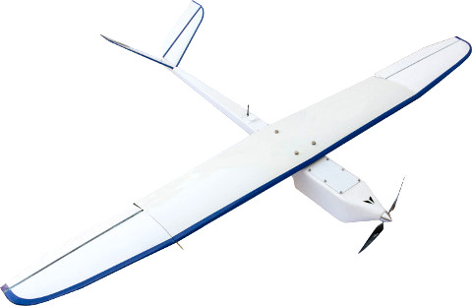
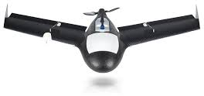
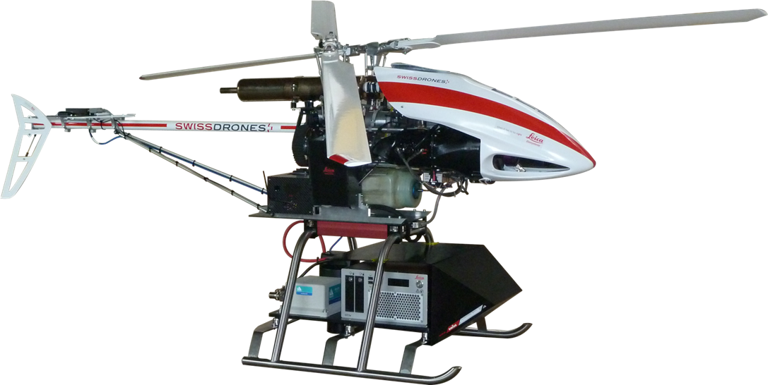
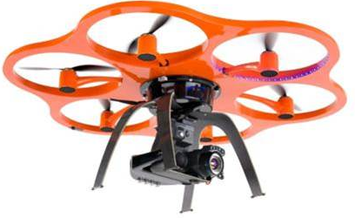
UAS Come in Many Types & Sizes

Slide 3
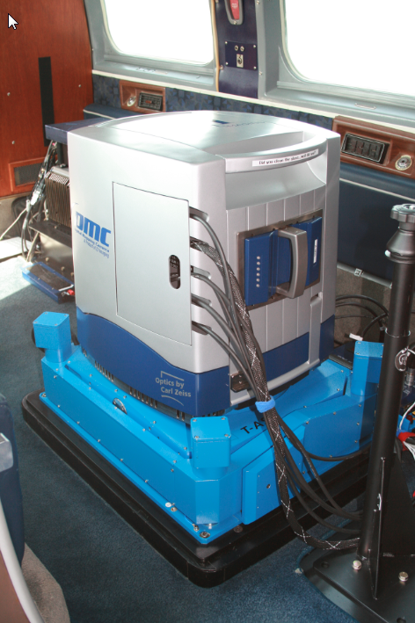
Typical Large Format Sensor
Would Require Large UAS
Fully Integrated into the National Airspace System
Seek & Avoid Capable

Slide 4
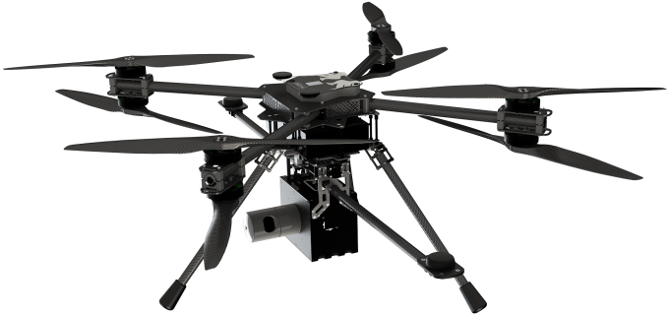
Typical Mid-Size Systems
Still Exceeds Estimated Size Limit of an sUAS

Slide 5
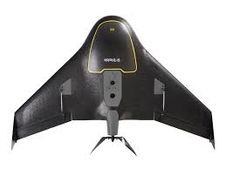
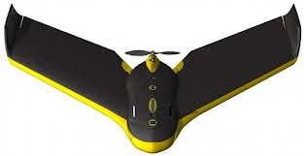
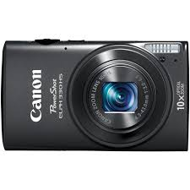
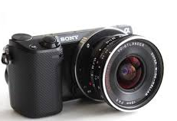
Typical Cameras Used in sUAS
Non Metric, Consumer Grade

Slide 6
How is it Possible to Map from Non-Metric, Consumer Grade Cameras?
Fly Lower
Use High Degree of Sidelap / Overlap
Process Imagery with Feature-Matching Software (Pix4d, Agisoft PhotoScan, etc.)
Typical Products: Orthophotos, Digital Surface Models, Point Clouds

Slide 7
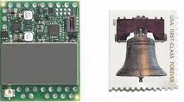
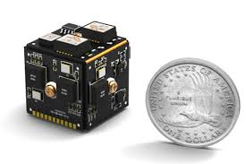
Enabling Technologies
Micro GPS Receivers
Advanced Batteries
Miniaturized Aircraft Control
Digital Storage
MEMs IMU (Micro Electromechanical)
Image Processing Software

Slide 8
sUAS Flight Mission Challenges
Weather Forecasting
Wind
Sunlight or Overcast
Obstacles
Avoidance of Other Aircraft
Logistics
Public Perception / Cooperation
FAA Rules & Regulations

Slide 9
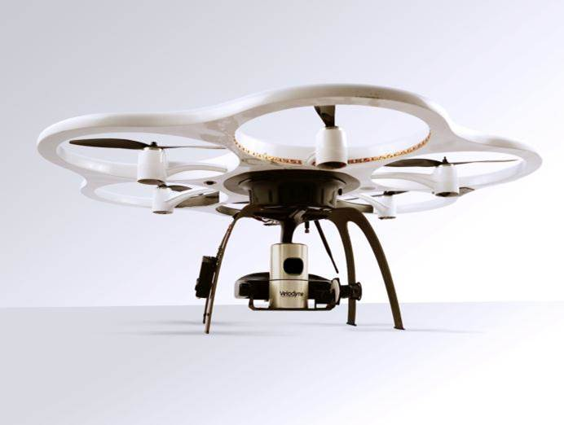
Rotary Wing sUAS
Shorter Flight Duration
Autonomous & Manual Mission Flight
Vertical Take-off & Landing (VTOL)
Well Suited for Inspections or Confined Areas
Gimbal Mounts
Can Remove Crab

Slide 10
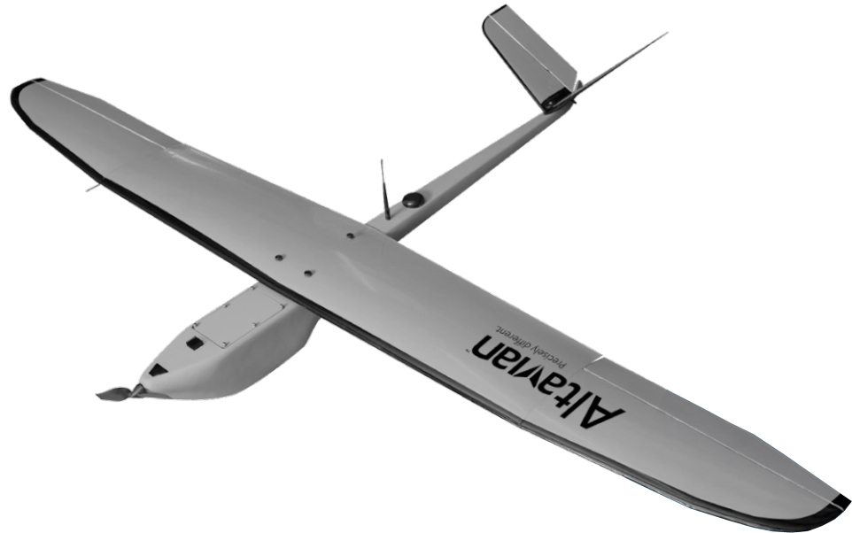
Fixed-Wing sUAS
Longer Flight Duration
Requires Landing Area
Autonomous Mission Only
Requires More Sidelap to Compensate for Crab

Slide 11
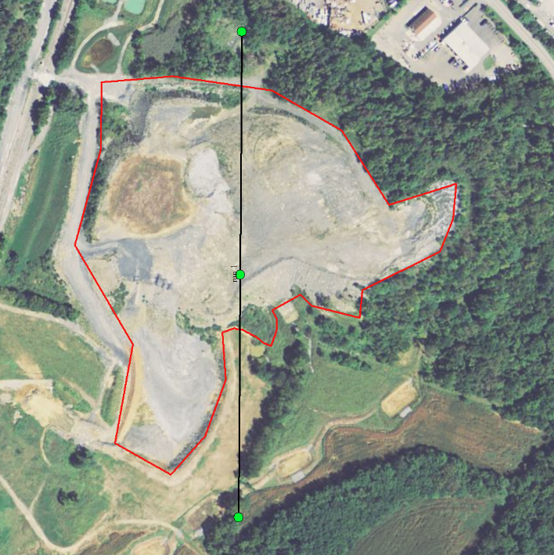
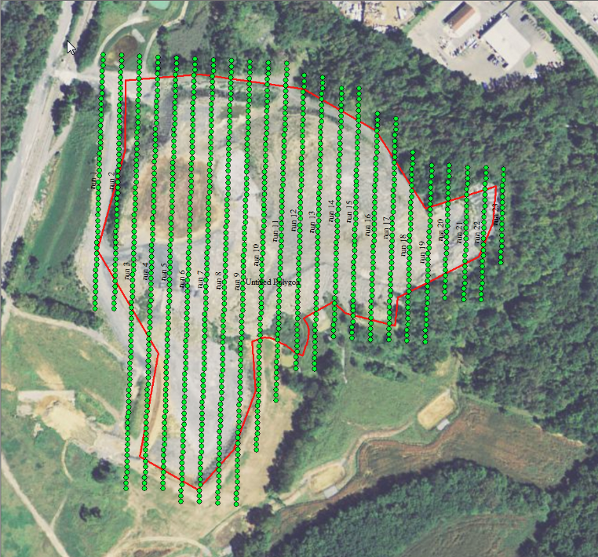
Flight Plan Comparison
Film Camera, 1200’
1 Line, 3 Exposures
sUAS, 400’
23 Lines, 1235 Exposures

Slide 12
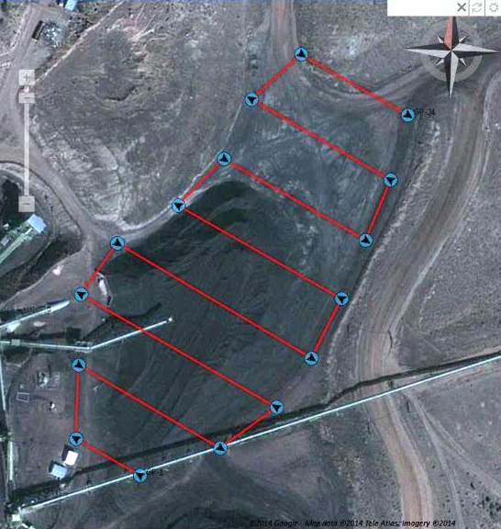
sUAS Flight Plan
Determination of Flight Parameters
Automated Planning of Coverage Area
Ground Control Necessary for Survey Accuracy
Courtesy Hexagon

Slide 13
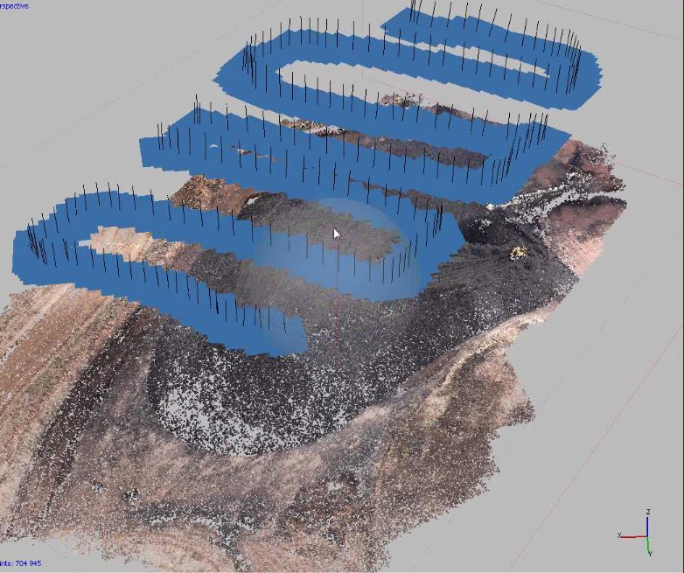
sUAS Flight Mission
Courtesy Hexagon

Slide 14
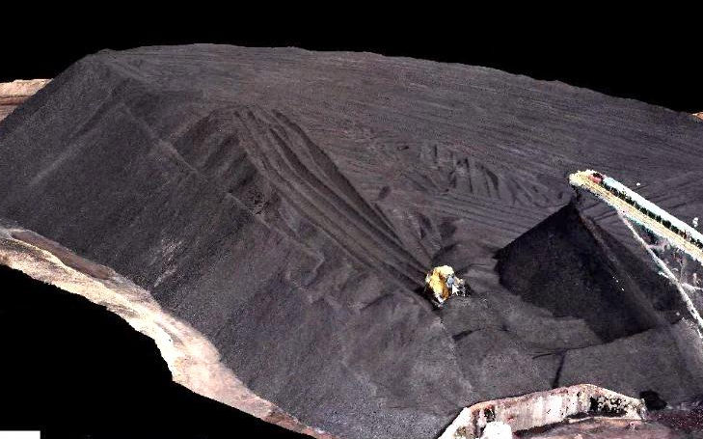
Colorized Point Clouds
Courtesy Hexagon

Slide 15
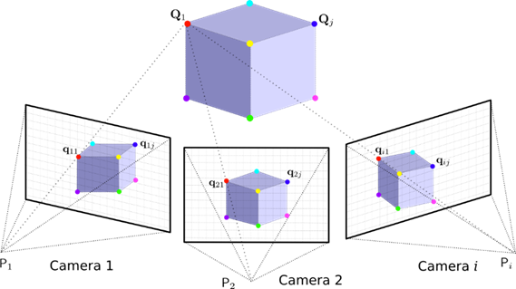
Automated Photo Feature Correlation
Uses Structure-from-Motion (SfM) Algorithms, Originating in the Fields of Computer Vision and Visual Perception
Courtesy GeoCue

Slide 16
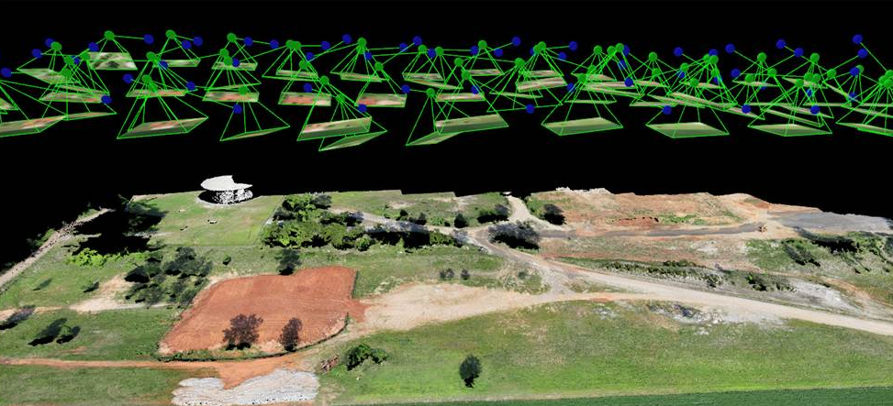
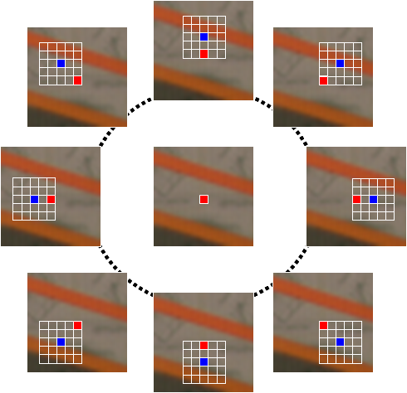
Processing Mission Data
Feature / Pixel Matching
Courtesy GeoCue
Notes:
Computer Time Consuming for Processing, Best on Hard Surfaces, Little Data Derived thru Tree Canopy, Microsoft has done work on artificial intelligence

Slide 17
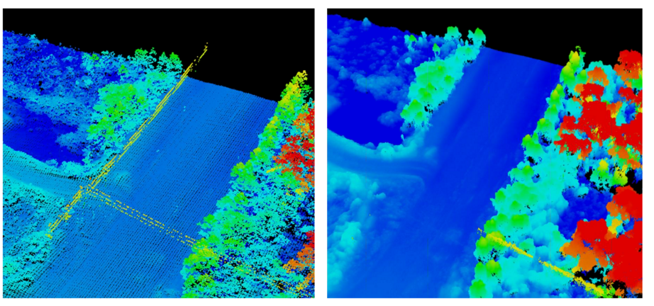
Results Comparison – Lidar vs Photo Derived Point Clouds
LiDAR
Photos
Courtesy Altavian

Slide 18
FAA Model Guidelines
Recreational Purposes Only
Within Line of Natural Sight
UAS not to exceed 55lbs
Cannot Interfere with Manned Aircraft
Must Adhere to Model Community Guidelines
Cannot be Flown Within 5 Miles of Airport Without Permission
Notes:
Amazon shipping 18,000 units per month worldwide

Slide 19
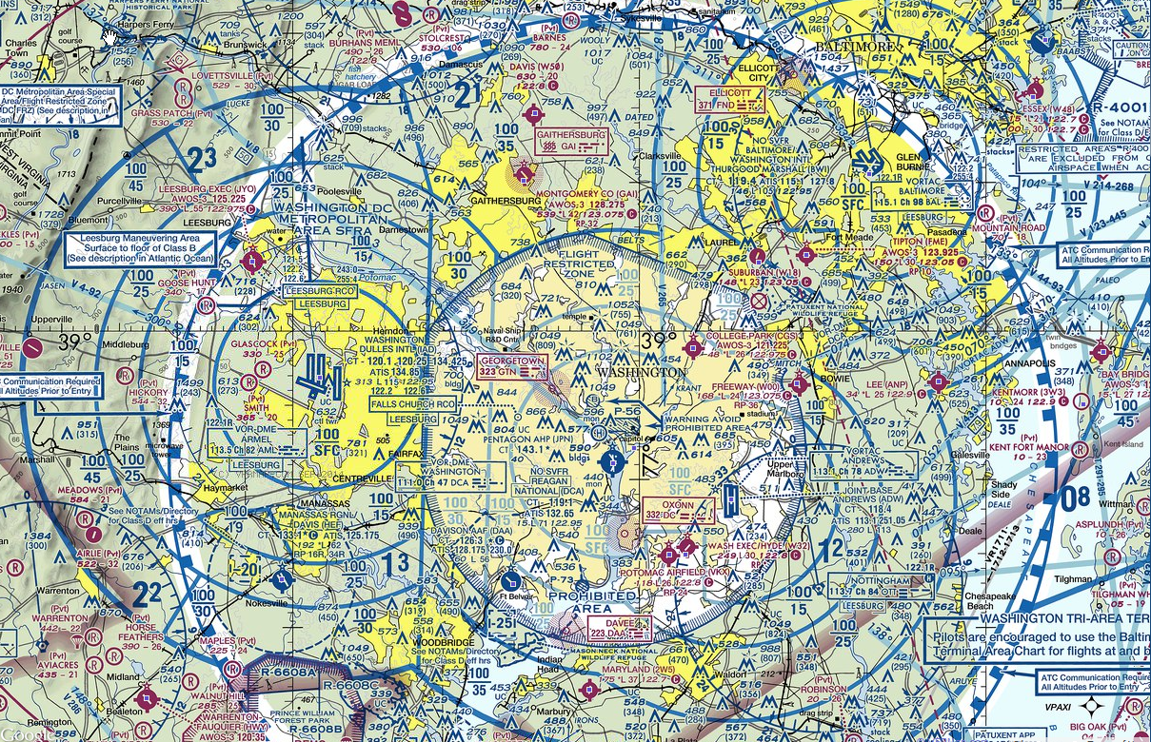
FAA’s Dilemma – sUAS Airspace Integration
Notes:
Look up – blue skies – minefield of boundaries
Congress mandates FAA is responsible for all navigable airspace
To their credit we have a safe system

Slide 20
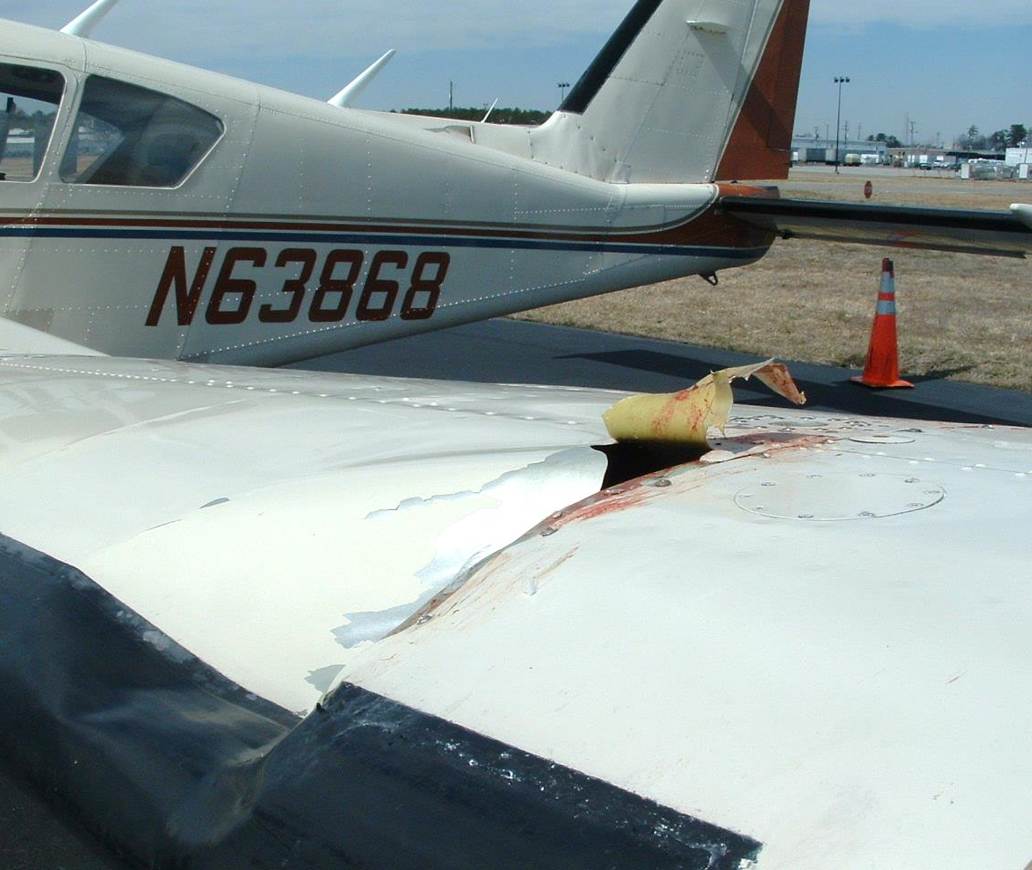
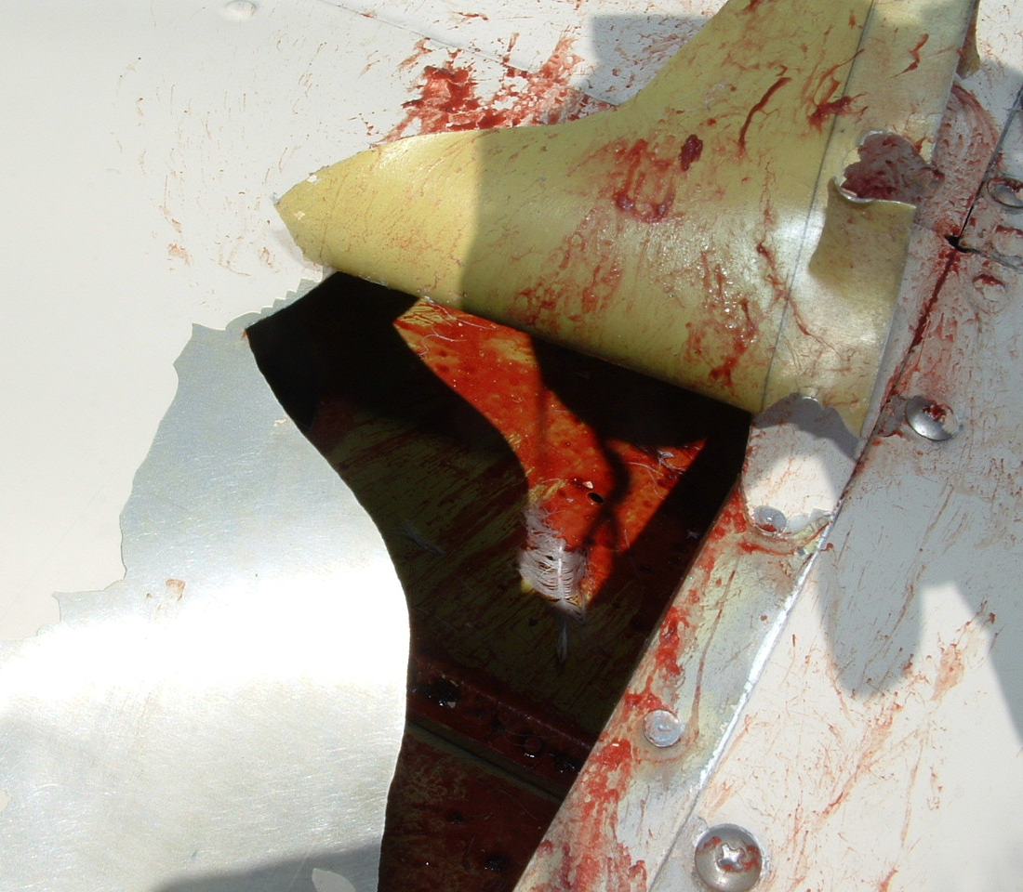
Fly Safe – Even sUAS Can Be Dangerous!
Collision with Red Tailed Hawk - approx 1.5 - 3.3 lbs
Notes:
Helicopter flights 300 ft.

Slide 21
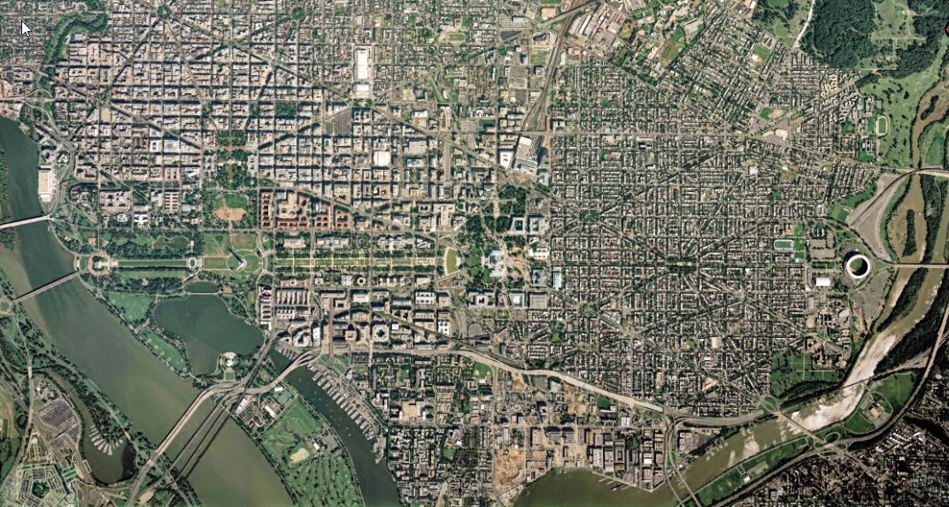
Thank You!

