Slide 1

MASSACHUSETTS COLLECTOR TREASURERS ASSOCIATION
ANNUAL FALL MEETING
Chapter 115 Veterans' Benefits
Veterans' Service Officer and Treasurer Reconciliation & Responsibilities
Tracey Brown
System Administrator & Trainer, Chapter 115 and Annuity Programs
Massachusetts Executive Office of Veterans' Services

Slide 2
TODAY'S SESSION
What We'll Cover
1
The Basics
What Chapter 115 is, and how it works in your community
2
Roles & Responsibilities
What belongs to the Veterans' Service Officer (VSO), EOVS, and the Treasurer
3
The Certification Process
Step by step, from data entry to certification
4
The Reports
Reading the VS-5, VS-6, and VS-7 before you sign
5
Reimbursement
How and when the Commonwealth pays your city or town
Massachusetts Executive Office of Veterans Services
2

Slide 3
SECTION 1
The Basics: Chapter 115 in Your Community
Massachusetts Executive Office of Veterans Services
3

Slide 4
SECTION 1 · THE BASICS
A Little History First
Massachusetts has offered state aid to veterans and their families since the Civil War era, making it one of the oldest programs of its kind in the country.
Since
1861
That legacy carries forward today in M.G.L. Chapter 115: the same basic commitment, that a veteran or their family shouldn't go without food, shelter, fuel, or medical care, now runs through your city or town's VSO and Treasurer, backed by the Commonwealth.
Massachusetts has been providing state aid to veterans and their families
You're not just running a benefits program. You're carrying on one of the Commonwealth's oldest promises to its veterans.
Massachusetts Executive Office of Veterans Services
4

Slide 5
SECTION 1 · THE BASICS
VSOs and Admins Across the Commonwealth
Every city and town relies on trained people to run Chapter 115. Here's the picture statewide.
173
VSOs statewide
(counted once per person)
137
Admins statewide
(counted once per person)
Massachusetts Executive Office of Veterans Services
5

Slide 6
SECTION 1 · THE BASICS
What a VSO Does in Your Community
Before we get into Chapter 115 certification specifically, it helps to know the full scope of what your city or town's VSO already handles.
Outreach & Referrals
Benefits Applications
Federal VA Assistance
Educates veterans on available benefits and connects them and their dependents to relevant programs and services.
Takes applications for Chapter 115 financial benefits and the annuity program.
Assists veterans in obtaining VA compensation and pension, per 108 CMR 12.04, alongside state benefits.
Employment & Community
Certification (108 CMR 14.00)
Connects veterans to employment assistance through career centers, and coordinates observances like Memorial Day and Veterans Day.
Appointed under M.G.L. c. 115 §3, trained within 6 months, retrained annually, and re-examined every 3 years at a 70% minimum passing grade.
Massachusetts Executive Office of Veterans Services
6

Slide 7
SECTION 1 · THE BASICS
The VA Accreditation Advantage
A VA-accredited VSO isn't limited to Chapter 115. They can also file for federal VA compensation, pension, and other benefits on a veteran's behalf, benefits paid entirely by the federal government.
1,000+
VA Accreditation Status
hours worked in a year
VSOs
Admins
is the general benchmark at which many VSOs pursue VA accreditation, qualifying them to file federal VA claims directly for the veterans they serve.
EOVS-Accredited: 102 VSOs (59%), 39 Admins (28%)
Accredited Elsewhere: 14 VSOs (8%), 6 Admins (4%)
Not Yet Accredited: 57 VSOs (33%), 92 Admins (67%)
A Chapter 115 benefit costs the city or town 25% after the Commonwealth's 75% reimbursement. A successful VA claim costs nothing, since it's paid entirely by the federal government, a real break for local budgets.
Massachusetts Executive Office of Veterans Services
7

Slide 8
SECTION 1 · THE BASICS
What Is Chapter 115?
Chapter 115 is a means-tested state veterans' benefit program. It provides financial, medical, and dental assistance to eligible veterans and their dependents, covering necessities such as food, shelter, fuel, and medical care.
75%
of properly certified benefits paid by a city or town are reimbursed by the Commonwealth
It's administered locally by Veterans' Service Officers (VSOs) in accordance with M.G.L. Chapter 115 and 108 CMR, with oversight and reimbursement from the Massachusetts Executive Office of Veterans' Services (EOVS).
Certified monthly
by the VSO and Treasurer, jointly
Paid to cities and towns
quarterly, on the Commonwealth's schedule
Massachusetts Executive Office of Veterans Services
8

Slide 9
SECTION 1 · THE BASICS
Chapter 115 in Your Community
The Veteran & Dependents
The VSO
The Treasurer
Veterans and their dependents have the right to file an application for aid through their local Veterans' Service Officer (VSO).
Your city or town's certified Veterans' Service Officer takes the application and determines eligibility, reviewing assets, income, shelter, and any other documentation the investigation requires. Every benefit paid must be entered in OnBase for the community to receive its 75% reimbursement.
Certifies each month's expenditures alongside the VSO, under oath that benefits were paid according to M.G.L. c. 115. Resolves any discrepancy with the VSO before certifying. OnBase should never show more than what the community actually paid out, even though the community may choose to pay more than EOVS allows.
Massachusetts Executive Office of Veterans Services
9

Slide 10
SECTION 2
Roles & Responsibilities
Massachusetts Executive Office of Veterans Services
10

Slide 11
SECTION 2 · ROLES & RESPONSIBILITIES
The VSO's Responsibilities
1
Outreach & Referrals
Educates veterans and dependents on available benefits, and refers them to alternative resources, like Medicaid, SSI, SSDI, and federal benefits. EOVS requires this referral so costs are offloaded from the city, town, and state wherever possible.
2
Benefits Applications
Takes applications for Chapter 115 financial benefits and the annuity program.
3
Case Entry in OnBase
Enters every case into the OnBase system. EOVS reviews all cases, and once the VSO closes the month, the Treasurer certifies against what was actually paid out.
4
Certification (108 CMR 14.00)
Must be certified: appointed under M.G.L. c. 115 §3, trained within 6 months, retrained annually, and re-examined every 3 years at a 70% minimum passing grade.
Massachusetts Executive Office of Veterans Services
11

Slide 12
SECTION 2 · ROLES & RESPONSIBILITIES
The Treasurer's Role
Once the VSO closes the month, OnBase notifies the Treasurer that a period is ready to certify. The Treasurer logs in, reviews the reports for accuracy, and certifies, the same review and certification step the VSO completes on their end before closing. Current law, M.G.L. c. 115 §§2 & 6, c. 30A §3, and 108 CMR 13.00, sets a 30-day window from the month of expenditure to get this done.
1
2
3
Reconcile
Certify
Resolve
Review the VS-5, VS-6, and VS-7 reports for accuracy.
Electronically sign the certification of expenditure in OnBase, under oath and penalty of perjury.
If discrepancies turn up, work with the local VSO to sort them out before certifying.
Massachusetts Executive Office of Veterans Services
12

Slide 13
SECTION 3
The Certification Process, Step by Step
Massachusetts Executive Office of Veterans Services
13

Slide 14
SECTION 3 · STEP BY STEP
The Workflow at a Glance
1
2
3
4
5
VSO Enters Cases
▶
EOVS Reviews
▶
VSO Closes the Month
▶
Treasurer Reconciles
▶
Treasurer Certifies
Chapter 115 cases go into OnBase throughout the month.
EOVS reviews and approves entries as they're made.
Once the month is complete, the VSO closes the period.
The Treasurer reviews the VS-5 and VS-6 reports for accuracy.
The Treasurer signs off in OnBase, within 30 days of month end.
Every case follows this exact path. The Treasurer's certification is the last checkpoint before EOVS audits and reimburses the city or town.
Massachusetts Executive Office of Veterans Services
14

Slide 15
SECTION 3 · STEP BY STEP
Steps 1 & 2: Case Entry and Approval
1
The VSO Enters the Case
2
EOVS Reviews and Approves
As Chapter 115 cases come in during the month, the VSO records them in OnBase for EOVS to review: the recipient, the relationship to the veteran, the benefit category, and the amount paid.
EOVS reviews and approves each case as it comes in. If anything is missing or required, EOVS sends it back as pending. If a case is denied, EOVS states the reason, and the VSO follows up.
Massachusetts Executive Office of Veterans Services
15

Slide 16
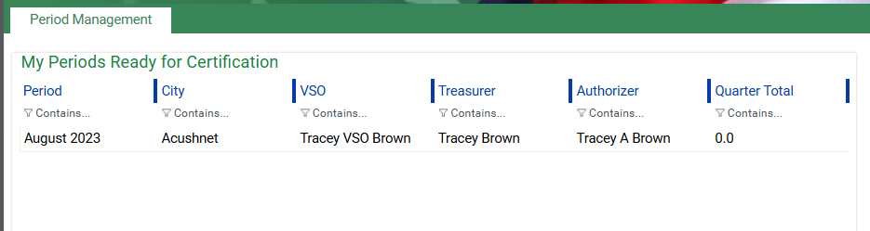
SECTION 3 · STEP BY STEP
Step 3: The VSO Closes the Month
Once every case for the month is entered and EOVS has reviewed it, the VSO closes the period in OnBase, by the end of the following month. For example, August's cases should be closed by the end of September. Once the VSO closes the month, the period appears in the Treasurer's My Periods Ready for Certification list.
Actual OnBase “My Periods Ready for Certification” screen
Why this matters to you
If a period has not yet been closed by the VSO, OnBase will not show a Certify Period button on your end, since there's nothing to reconcile yet. If a period you expect to certify is missing that button, the month likely hasn't been closed on the VSO side.
Massachusetts Executive Office of Veterans Services
16

Slide 17
SECTION 3 · STEP BY STEP
Step 4: The Treasurer Reconciles
Before you certify anything, this is where you do the real work: go through the reports and confirm the numbers tell a consistent, accurate story.
✓
Does the VS-5 total match the sum of the VS-6 detail lines?
✓
Does the VS-7 report show any disallowances to follow up on?
✓
Is the number of cases accurate and consistent with what was actually paid out that month, per person?
✓
Are flag and burial cases, your community cases, accounted for separately from individual applicant cases?
✓
If no benefits were paid this month, was there a negative entry on the VS-5, VS-6, or VS-7 due to a refund paid back?
✓
Does OnBase show no more than what the community actually paid out?
OnBase should never reflect more than the community actually paid, though a community may choose to pay more than EOVS allows. Only after reconciling should you sign. Your signature is an affidavit, under oath and penalty of perjury, that the reports are accurate.
Massachusetts Executive Office of Veterans Services
17

Slide 18
SECTION 3 · STEP BY STEP
Step 5: Certifying in OnBase
1
Open the period
From My Periods Ready for Certification, double click the period you're working on.
2
Preview the reports
Toggle Tasks to preview the VS-5, VS-6 Detail, VS-6 Summary, and VS-7 reports before deciding anything.
3
Download or print
Use the download or print icon on the report viewer to keep a copy for your files.
4
Certify the period
Once satisfied, click Certify Period. This button only appears after the VSO has closed the month.
Towns can set up two Treasurer accounts: a Primary with certification rights, and a Secondary with view-only access who cannot certify. If you need access, contact me and I'll send you everything you need to get set up.
Massachusetts Executive Office of Veterans Services
18

Slide 19
SECTION 4
The Reports You'll Review
Massachusetts Executive Office of Veterans Services
19

Slide 20
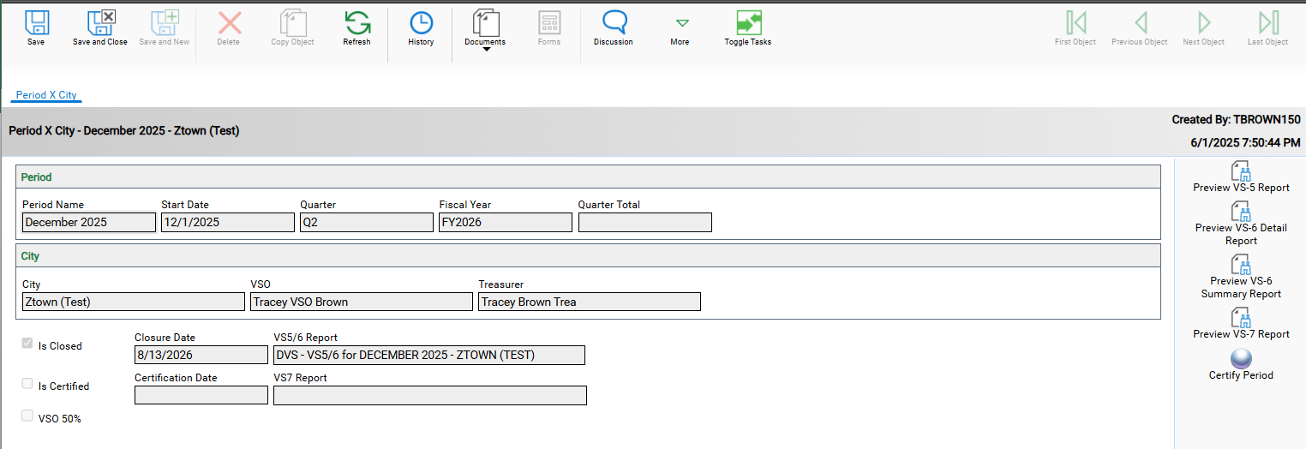
SECTION 4 · THE REPORTS
Where to Find the Reports
From My Periods Ready for Certification, double click the period you want. That opens the period record, with every report one click away on the right.
The VS5/6 Report link next to Closure Date opens the combined VS-5 and VS-6 Summary report, not the VS-6 Detail report. Use the preview buttons on the right for each report on its own.
If VSO 50% is checked, the VSO isn't in compliance with 108 CMR 14.00. Per 108 CMR 14.05, the Commonwealth reduces the city or town's reimbursement under M.G.L. c. 115, §6 to 50% until compliance is restored.
Massachusetts Executive Office of Veterans Services
20

Slide 21
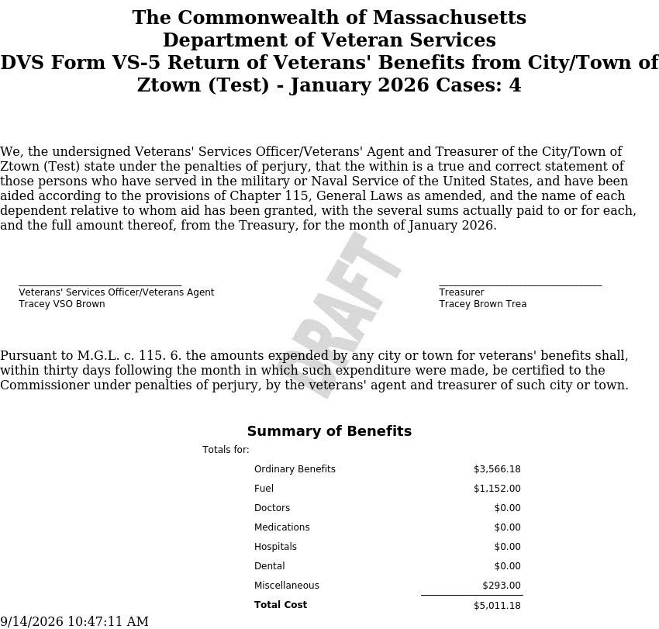
SECTION 4 · THE REPORTS
VS-5: The Summary Report
The VS-5 summarizes the month's benefits by category, signed under oath by the VSO and Treasurer. EOVS accepts electronic signatures when you close and certify the month.
Sample shown uses test data. A negative or zero VS-5 must still be submitted in months when no benefits were paid.
Massachusetts Executive Office of Veterans Services
21

Slide 22
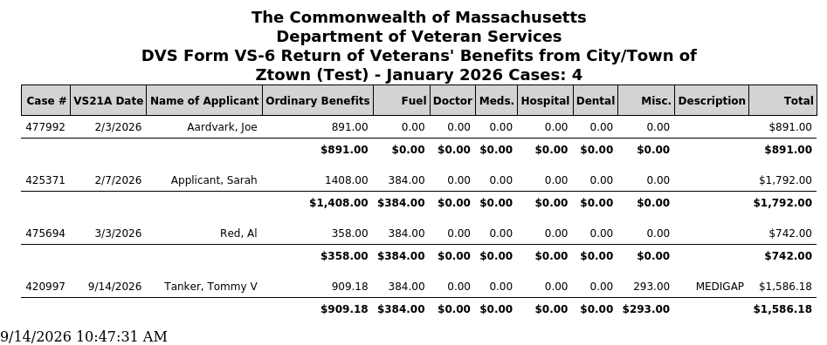
SECTION 4 · THE REPORTS
VS-6: The Detail Report
The VS-6 lists every case behind the VS-5 total, by recipient, category, and amount paid.
Sample shown uses test data. Every case here rolls up into the VS-5 total, check that the numbers match before you sign.
Massachusetts Executive Office of Veterans Services
22

Slide 23
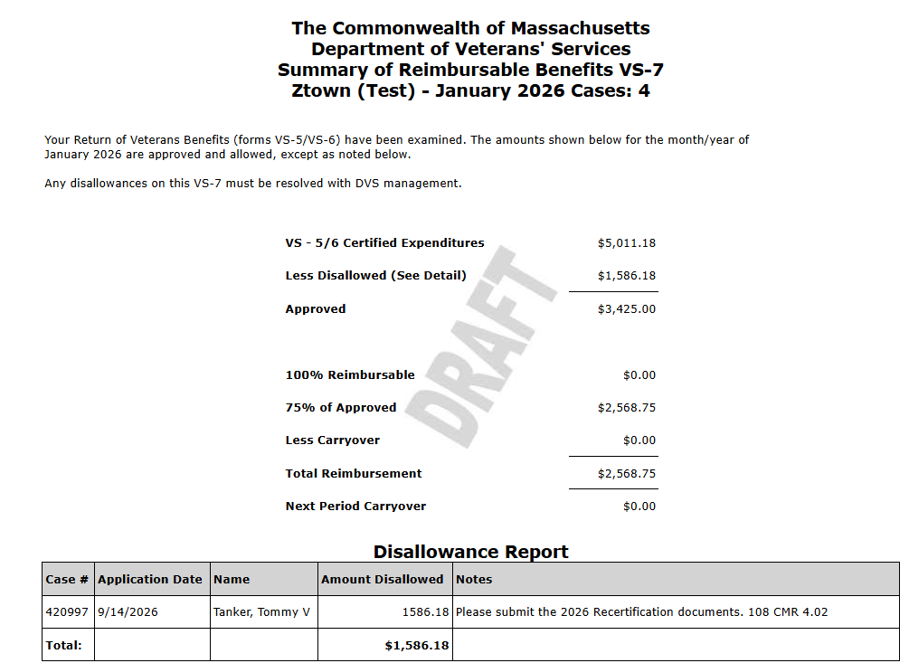
SECTION 4 · THE REPORTS
VS-7: EOVS's Audit Results
EOVS examines the VS-5/VS-6 and returns the result as the VS-7, showing what's approved and disallowed.
Sample shown uses test data. Disallowed amounts are why reconciliation matters: catch an issue before you certify, not after.
Massachusetts Executive Office of Veterans Services
23

Slide 24
SECTION 4 · THE REPORTS
Certifying the Period
Once every report checks out, certify from this same screen, the button that puts your signature on record.
Certify Period only appears once the VSO has closed the month. Clicking it is the same electronic signature as the VS-5 affidavit, made under oath.
Massachusetts Executive Office of Veterans Services
24

Slide 25
SECTION 4 · THE REPORTS
Before You Certify: A Quick Checklist
Pull the VS-5 and both VS-6 reports for the period
Watch for missing or mismatched categories
Confirm the VS-5 total matches the VS-6 detail
Confirm a negative VS-5 was filed if no benefits were paid
Check the case count against what you expect
Reach out to your VSO before certifying if anything looks off
Confirm OnBase shows no more than what the community actually paid out
Massachusetts Executive Office of Veterans Services
25

Slide 26
SECTION 5 · REIMBURSEMENT
Reimbursement: How and When
Subject to the Secretary's review, EOVS reimburses 75% of properly certified veterans' benefits paid by cities and towns. The Commonwealth pays each quarter, on the following schedule:
Q1
Q2
Q3
Q4
July, August, September
October, November, December
January, February, March
April, May, June
Paid September of the following year
Paid November of the following year
Paid March of the following year
Paid June of the following year
Reimbursement follows certification. Delays in reconciling and certifying can delay your city or town's payment.
Massachusetts Executive Office of Veterans Services
26

Slide 27
SECTION 5 · REIMBURSEMENT
If You Find a Discrepancy
If, while reconciling, you spot numbers that don't match, collaborate with your local VSO to address and resolve the issue before you certify.
Don't certify blind
Loop in your VSO first
Compliance carries weight
A certification you're not confident in is a bigger problem than a certification that's a day late.
They own the case data and can correct an entry before you sign anything.
Repeated non-compliance risks reduced reimbursement for your city or town.
Questions or concerns? Reach out to Tracey Brown first (Tracey.J.Brown@mass.gov, 857-202-9314). She'll loop in Patrick George, Director of Benefits, if needed.
Massachusetts Executive Office of Veterans Services
27

Slide 28
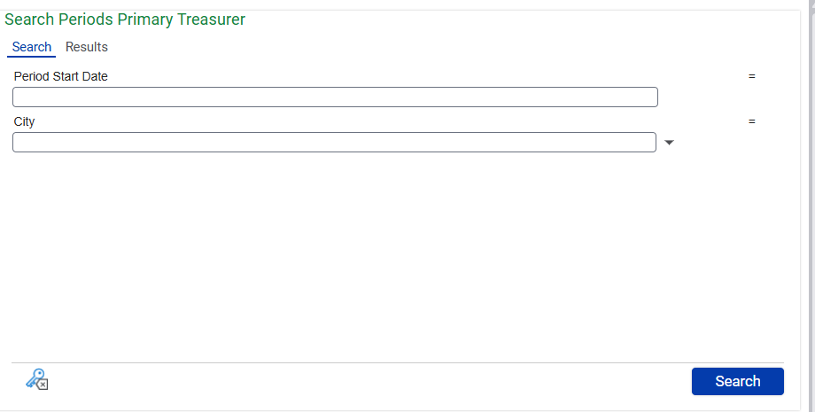
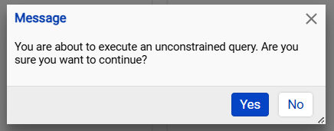
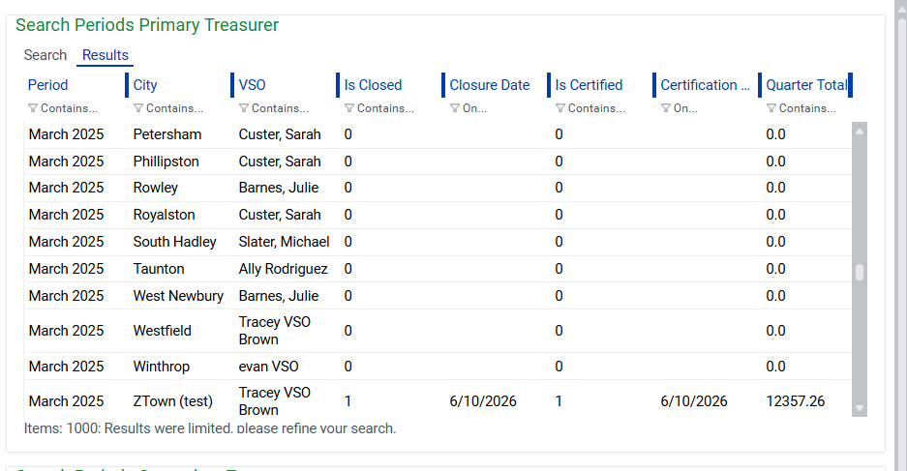
SECTION 5 · REIMBURSEMENT
Quick Tip: Search Every Period at Once
Need to check on a period from any month, closed or not? Use Search Periods Primary Treasurer instead of scrolling your queue.
1
Leave it blank
2
Click Yes
3
Scroll and open
Leave Period Start Date and City blank, then click Search.
Confirm the “unconstrained query” warning that pops up.
Scroll the full list and double click any period, closed or not, to review it.
This works for periods from years past too, handy for pulling up a historical report on the spot.
Massachusetts Executive Office of Veterans Services
28

Slide 29
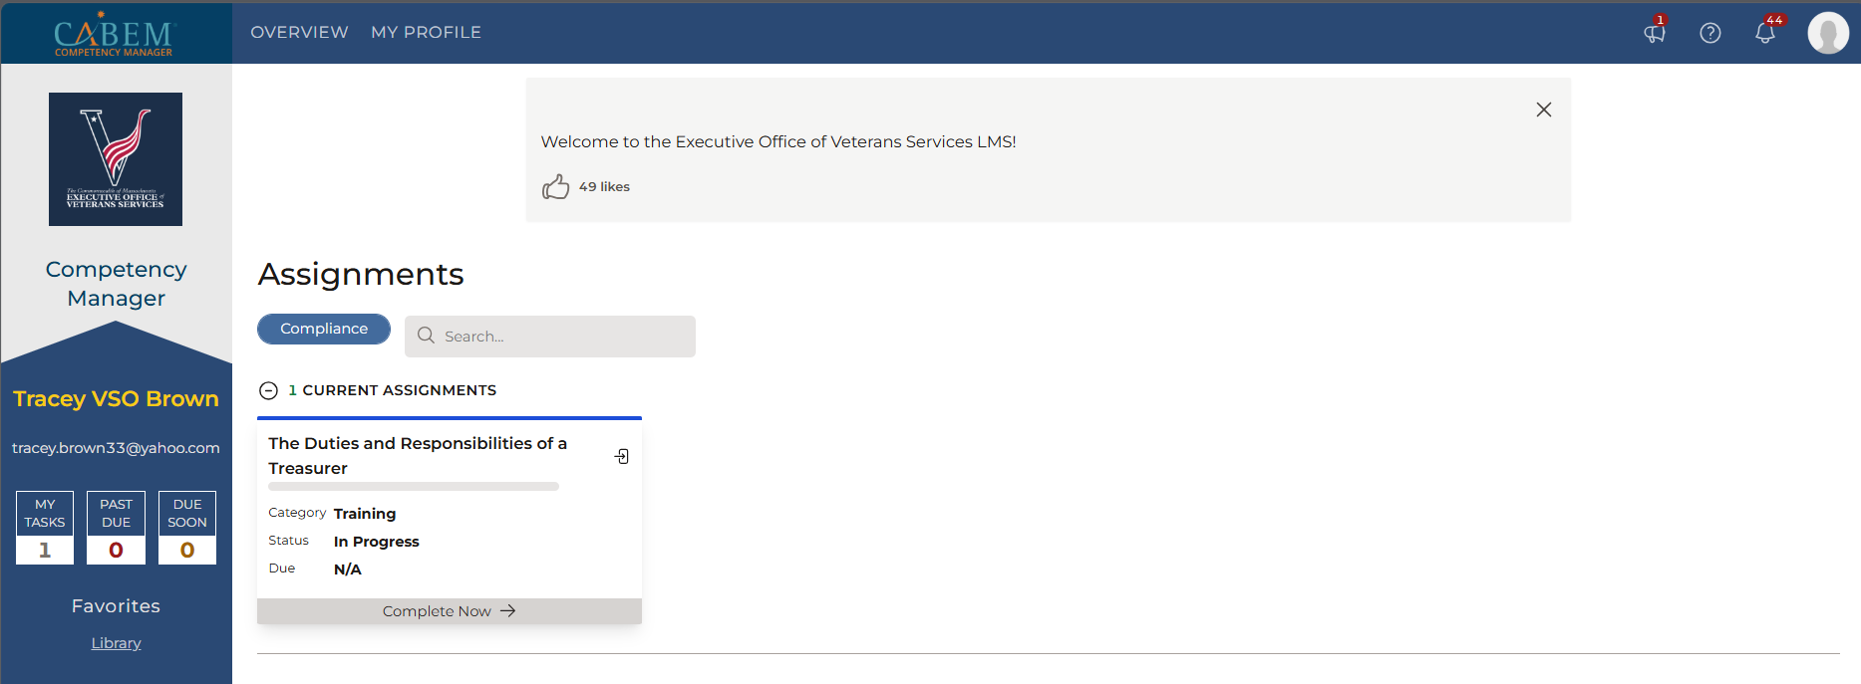
WRAPPING UP
Find These Materials Anytime: The LMS
Everything we covered today, plus the OnBase guide and reimbursement schedule, lives in the LMS. Your dashboard shows any current assignments; nothing further is required unless something appears there.
Click Library on the left, then scroll to Treasurer Training for the OnBase guide, the reimbursement schedule, and Treasurer duties, and now this presentation too.
Massachusetts Executive Office of Veterans Services
29

Slide 30
WRAPPING UP
Key Takeaways
1
Chapter 115 is a partnership between the veteran, the VSO, and you, the Treasurer
2
The VSO enters and closes each month; the Treasurer reconciles and certifies it
3
Reconciliation means checking the VS-5, VS-6, and VS-7, plus flag and burial cases
4
Your certification is an affidavit under oath, accepted electronically at closing
5
75% reimbursement flows quarterly
6
Many VSOs and Admins statewide hold VA accreditation, easing the cost on your budget
7
When something looks off, your VSO is your first call, or reach out to Tracey directly
Massachusetts Executive Office of Veterans Services
30

Slide 31
Questions?
Reach out any time, before or after today's session.
Tracey Brown
System Administrator & Trainer, Chapter 115 and Annuity Programs
Tracey.J.Brown@mass.gov · 857-202-9314
Patrick George
Director of Benefits
Patrick.George2@mass.gov
Massachusetts Executive Office of Veterans' Services
15 New Chardon Street, One Bowdoin Square, Suite 400, Boston, MA 02114
Massachusetts Executive Office of Veterans Services
31

