Slide 1
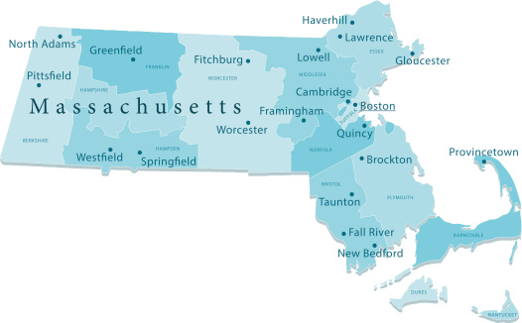
Legislation Committee Proposals
Presented by Lisa Clark

Slide 2

Agenda
An Act to Update Certain Changes to Property Tax Collection Laws
An Act to Repeal Obsolete Provisions of Collection of Property Taxes
An Act to Address the Elimination of Pennies on Municipal Collections
An Act to increase the Certification Stipend Chapter 41 Sec 108P

Slide 3


Amendment of the Acts of 2024
Builds upon Chapter 140 of the Acts of 2024 property tax tilte reforms by making practical, common-sense technical adjustments that improve efficiency, promote fairness, and protect municipal resources.

Slide 4

This bill makes four common-sense changes:
Establishes consistent notice requirements for residential and non-residential properties.
Allow municipalities to recover the actual out-of-pocket costs of required delinquency notices from the delinquent taxpayer.
Establishes the municipal chief executive as the authority that determines whether tax-foreclosed property should be retained for municipal use or sold.
Eliminates an unnecessary real estate broker requirement, allowing municipalities to continue using their established and effective auction process.

Slide 5
The Four Main Provisions:
1: Consistent Notice Requirements for All Property Types
Current notice provisions created different requirements for residential and non-residential properties. This proposal extends the updated notice requirements to both residential and non-residential properties.
Municipal collectors should be able to follow one consistent notice process regardless of a property's classification.
Maintaining separate procedures creates unnecessary administrative complexity and increases the potential for confusion and errors.
A uniform process is more efficient for municipal staff and easier to administer consistently.
Notes:
One property tax collection process should apply to all property types. Consistent notice requirements simplify administration without compromising taxpayer protections.

Slide 6
2: Recovering the Actual Cost of Required Notices
Recent legislative changes have established additional notice requirements for delinquent taxpayers.
Those requirements create actual, out-of-pocket expenses for municipalities.
This proposal allows communities to add the actual cost of posting required notices to the delinquent taxpayer's outstanding balance.
Without this provision, those costs must be absorbed by the municipality and ultimately borne collectively by all taxpayers, including those who pay their property taxes on time.
It is reasonable and fair that the taxpayer whose delinquent account generates the expense should be responsible for the actual cost.
Notes:
Taxpayers who meet their obligations should not have to subsidize the additional expenses created by someone else's delinquent property tax account.

Slide 7
3: Establish that the municipal chief executive makes the decision on swelling or retaining Tax-Foreclosed Properties
Establishes that the community's chief executive authority (Mayor or Select Board) makes the affirmative decision to retain a tax-foreclosed property for municipal use within 120 days of the final judgment.
Many communities have local charter provisions, bylaws, and ordinances requiring lengthy review processes before municipally owned property can be sold.
Those procedures are often appropriate for historically or culturally significant properties that warrant extensive community discussion.
However, most tax-foreclosed properties are not historically or culturally significant and are generally intended to be sold promptly.
Applying lengthy municipal disposition procedures to these properties can unnecessarily delay sales, prolong the process, and delay the return of equity to former property owners.
This provision allows the chief executive to make a timely decision to sell a tax-foreclosed property without having to navigate lengthy local disposition procedures.
Importantly, the community retains the ability to keep a tax-foreclosed property when there is a legitimate municipal purpose, including historical or cultural significance, provided funds are appropriated to compensate the former owner for their equity.
Notes:
The goal is to distinguish ordinary tax-foreclosed properties from historically or culturally significant municipal properties, allowing routine properties to be sold efficiently while preserving local discretion to retain properties that have genuine community value.

Slide 8
4: Eliminating the Real Estate Broker Requirement
Eliminates the requirement to procure a licensed real estate broker or agent when selling tax-foreclosed properties.
Municipal auctions have successfully served this purpose for decades.
Tax-foreclosed properties are frequently distressed, vacant, abandoned, or otherwise in need of investment.
The existing auction process has a proven track record of connecting these properties with investors who can return them to productive use.
Requiring a broker adds another layer of administration, expense, and potential delay without necessarily improving the outcome.
Eliminating this requirement allows municipalities to continue using an established and effective process.
A more efficient sale process also helps ensure that former property owners receive their remaining equity as promptly as possible.
Notes:
Municipal auctions work. There is no compelling reason to add an additional broker requirement to a process that has successfully returned tax-foreclosed properties to productive use for decades.

Slide 9

Municipal Tax Collections
Proposes how to manage through the elimination of the penny.

Slide 10

This legislation updates Massachusetts General Laws to address the elimination of the penny and its impact on municipal payment and collection practices.
It provides municipalities with the flexibility to round certain payments down to the nearest five-cent increment.
It helps ensure municipal billing and collection practices remain practical, efficient, and consistent with changes in the nation's currency system.
It also gives municipal collectors discretion to write off very small outstanding balances when the cost of further collection efforts outweighs the amount owed.

Slide 11

An Act to Repeal Obsolete Provisions of Collection of Property Taxes
This legislation seeks to modernize Chapter 60 of the Massachusetts General Laws by repealing outdated and obsolete provisions relating to the collection of property taxes.
The bill removes statutory language that is no longer necessary or consistent with current property tax collection practices, including provisions about arresting taxpayers and “distraining” their goods.
The intent is to simplify the law, eliminate antiquated procedures, and make Chapter 60 more straightforward to administer.

Slide 12

Simplification: Reduces unnecessary statutory language and makes the law easier to navigate.
Administrative clarity: Removes references to outdated collection procedures, including imprisoning taxpayers and distraint of personal property.
Focused statutory framework: Preserves the identified provision concerning special warrants for acceptance of early payments while eliminating specified obsolete sections.
Transition period: Provides an effective date of July 1, 2027.

Slide 13
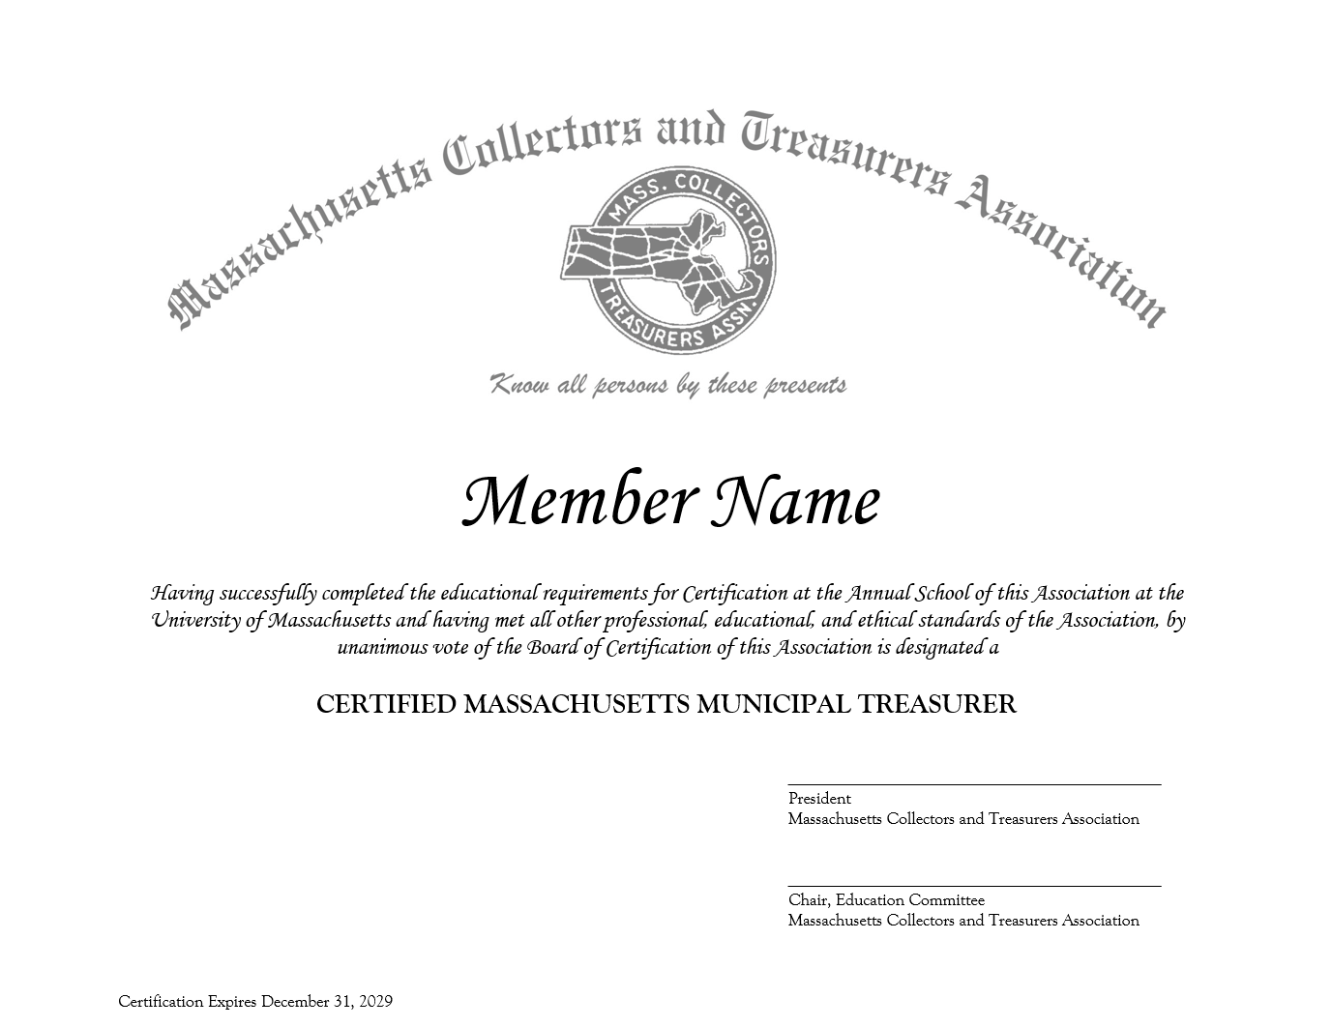
An Act to Increase certification stipend Ch 41 Sec 108P
Proposal for an Increase in Stipend
This proposal is to request an increase of the current stipend from $1,000.00 to $2,000.00.
The proposed increase if approved will require local acceptance before it can be implemented.

Slide 14

Thank you
Lisa Clark

