Slide 1



Safety Leadership
Introduction to the Foundation of effective
Safety Leadership
Presented by
Jacquelyn Seth, CSP
SHE³ Capabilities
www.she3cap.com

Slide 2

Today’s Goal
Learning Objectives
Explain why Safety Leadership is important
Describe 5 critical Safety Leadership skills
Discuss how an effective leader can apply them on the workplace
To introduce the 5 critical Safety Leadership skills that can be used to improve safety climate and safety outcomes in the workplace.
By the end of the presentation, you will understand the costs of ineffective safety leadership, the benefits and importance of effective safety leadership, and presented the
5 Safety Leadership skills.

Slide 3
How is a Safety Leader defined?
courage
A safety leader has the courage to demonstrate that s/he values safety by working and communicating with team members to identify and limit hazardous situations even in the presence of other job pressures, such as scheduling and costs.
“I learned that courage was not the absence of fear, but the triumph over it…”

Slide 4

There are basic characteristics of Ineffective and Effective Leaders
What are some the types of actions...
For an Ineffective Leader?
For an Effective Leader?

Slide 5

Ineffective Leader…
Lies to protect themselves
Blames
superiors or workers
Withholds information
Reacts angrily to a problem without addressing the problem and seeking solutions

Slide 6
Ineffective Leader…
Effective Leader…
Never goes back on their word
Lies to protect themselves
Works hard
Blames
superiors or workers
Withholds information
Tells the truth
Reacts angrily to a problem without addressing the problem and seeking solutions
Listens to hear vs. listens to speak

Slide 7

Who are the safety leaders in the workplace?
Anyone, regardless of their title or role, who values their safety and well-being and that of their fellow workers, is responsible for being an effective safety leader.
Safety Leaders
“Leadership is an action not a position”
Leaders at the highest level develop the safety programs and policies
Everyone in the workplace is a leader when it comes to reducing safety incidents
But it is the Frontline supervisors and foremen who make sure programs and policies are implemented and enforced which creates a strong jobsite safety climate

Slide 8
What about that Easter eggs??
“I learned that courage was not the absence of fear, but the triumph over it. The brave man is not he who does not feel afraid, but he who conquers that fear.”
—Nelson Mandela

Slide 9


Slide 10
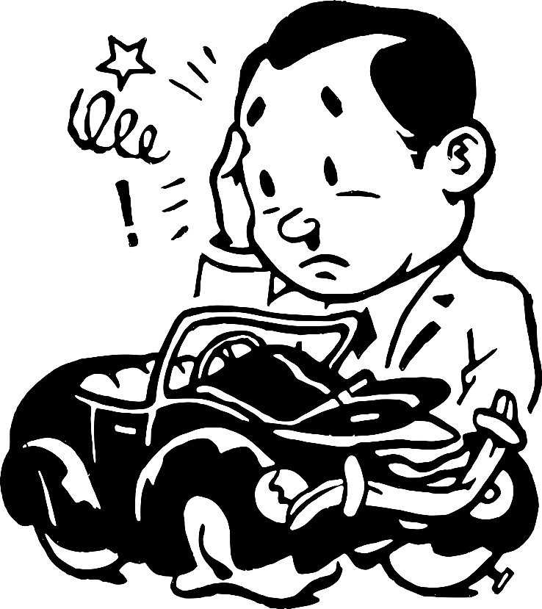

There is a cost to poor Safety Leadership
Direct Costs
Indirect Costs
Direct Costs
Indirect Costs
True Costs of an accident
Medical treatment
Lost wages
Sick pay
Damage to work product or equipment
Increase insurance premiums
Family & co-worker suffering
Lost productivity related to incident investigations and work stoppage
Hiring costs to replace an injured worker
Company’s diminished public reputation

Slide 11

Benefits of Effective Safety Leadership
Increased morale
Increased teamwork
Positive safety culture
Reduced safety hazards
Safe work practices
Fewer injuries & fatalities
Better business reputation
More productive &
better quality

Slide 12
What about those Easter eggs??
“I learned that courage was not the absence of fear, but the triumph over it. The brave man is not he who does not feel afraid, but he who conquers that fear.”
—Nelson Mandela
“Leadership is an action, not a position”
— Donald McGannon

Slide 13

5 Skills & Actions of an Effective Safety Leader
Lead by Example
Establishes safety expectations as a core value
Shares safety vision with team members
Demonstrates a positive attitude about safety
‘Walks the Talk’
Leads up!
Engages & Empowers Team Members
Engages, encourages, and empowers team members to identify and act upon unsafe situations by…
Reporting hazards and safety concerns
Providing solutions
Reporting near misses
Stopping work if necessary
Actively Listens & Practices 3-way Communication
Actively listens to hear what team members are saying
Practices 3-way communication by having person repeat the message they heard
DEvelops Team Members Through Teaching, Coaching, and Feedback
Respectfully teaches and coaches workers
Watches the learner fix the hazardous situation or perform the task to make sure it's done correctly
Focuses on potential consequences rather than on the team member
Uses the FIST principle: Facts, Impact, Suggestions, Timely
Recognizes Team Members for a Job Well Done
Privately and/or publicly acknowledges team members for going above and beyond when it comes to safety
“Start where you are. Use what you have. Do what you can.”

Slide 14
Key Takeaways
It takes COURAGE to be a leader
It takes COURAGE to be a speak up
These skills can easily be inserted into the daily workflow and productivity will not be affected.

Slide 15
Key Takeaways
LEADERS
Lead by Example
Engage and Empower team members
Actively listen and Practice 3-way communication
DEvelop team members by teaching, coaching, and knowing how to give constructive feedback
Recognize team members for going above and beyond for safety

Slide 16
What about those Easter eggs??
“I learned that courage was not the absence of fear, but the triumph over it. The brave man is not he who does not feel afraid, but he who conquers that fear.”
—Nelson Mandela
“Leadership is an action, not a position”
“Start where you are. Use what you have. Do what you can.”
— Donald McGannon
— Arthur Ashe

Slide 17



THANK YOU
GOAL!
Questions…
Thoughts?

Slide 18
Safety Leadership
Introduction to the Foundation of effective
Safety Leadership
Presented by
Jacquelyn Seth, CSP
SHE³ Capabilities
www.she3cap.com

