Slide 1
The Premium Resilience
An Outlook on OCTG and Line Pipe
October 2026
Arda Serhat Yelkenci
Argus Media
© 2026 Argus Media group. All rights reserved.
1

Slide 2
Argus Media group notices
      The Argus Media group (referred to herein as “Argus”) makes no representations or warranties or other assurance, express or implied, about the accuracy or suitability of any information in this presentation and related materials (such as handouts, other presentation documents and recordings and any other materials or information distributed at or in connection with this presentation).
      The information or opinions contained in this presentation are provided on an “as is” basis without any warranty, condition or other representation as to its accuracy, completeness, or suitability for any particular purpose and shall not confer rights or remedies upon the recipients of this presentation or any other person. Data and information contained in the presentation come from a variety of sources, some of which are third parties outside Argus’ control and some of which may not have been veriﬁed.
      All analysis and opinions, data, projections and forecasts provided may be based on assumptions that are not correct or which change, being dependent upon fundamentals and other factors and events subject to change and uncertainty; future results or values could be materially diﬀerent from any forecast or estimates described in the presentation.
      To the maximum extent permitted by law, Argus expressly disclaims any and all liability for any direct, indirect or consequential loss or damage, claims, costs and expenses, whether arising in negligence or otherwise, in connection with access to, use or application of these materials or suﬀered by any person as a result of relying on any information included in, or omission from, this presentation and related materials or otherwise in connection therewith.
      The information contained in this presentation and related materials is provided for general information purposes only and should not be construed as legal, tax, accounting or investment advice or the rendering of legal, consulting, or other professional services of any kind. Users of these materials should not in any manner rely upon or construe the information or resource materials in these materials as legal, or other professional advice and should not act or fail to act based upon the information in these materials.
      Copyright notice: Copyright © 2026 Argus Media group. All rights reserved. All intellectual property rights in this presentation and the information herein are the exclusive property of Argus and and/or its licensors and may only be used under licence from Argus. Without limiting the foregoing, you will not copy or reproduce any part of its contents (including, but not limited to, single prices or any other individual items of data) in any form or for any purpose whatsoever without the prior written consent of Argus.
      Trademark notice: ARGUS, the ARGUS logo, Argus publication titles, the tagline “illuminating the markets®”, and Argus index names are trademarks of Argus Media Limited. For additional information, including details of our other trademarks, visit argusmedia.com/trademarks.
© 2026 Argus Media group. All rights reserved.
2

Slide 3
Argus Analytics Services
Oil & Gas
Pricing & Outlook
Pipe Logix
OCTG & Line Pipe Outlook
Non-ferrous & Ferrous Metals Pricing & Outlook
© 2026 Argus Media group. All rights reserved.
3

Slide 4
Agenda
Market Overview
Oil & Gas Markets
Drilling Activity
Manufacturing Cost Components
OCTG Market & Outlook
Line Pipe Market & Outlook
Summary
© 2026 Argus Media group. All rights reserved.
4

Slide 5
The supply crunch collided with recovering demand
© 2026 Argus Media group. All rights reserved.
5

Slide 6
WTI trends lower as market balances improve
© 2026 Argus Media group. All rights reserved.
6

Slide 7
US natural gas stays soft near-term, but demand outlook firms
--> Forecast
© 2026 Argus Media group. All rights reserved.
7
Notes:
\

Slide 8
US drilling activity remains strong through 2027
© 2026 Argus Media group. All rights reserved.
8

Slide 9
HRC trends differ from previous cycles
© 2026 Argus Media group. All rights reserved.
9

Slide 10
Plate market remains tight as the spread to HRC narrows
© 2026 Argus Media group. All rights reserved.
10

Slide 11
Ample supply capped scrap prices despite growth
© 2026 Argus Media group. All rights reserved.
11

Slide 12
Duty exposure can keep OCTG supply on hold
© 2026 Argus Media group. All rights reserved.
12

Slide 13
Supply will need to address the accumulated stock deficit
© 2026 Argus Media group. All rights reserved.
13

Slide 14
Sentiment remains near-term bullish
© 2026 Argus Media group. All rights reserved.
14

Slide 15
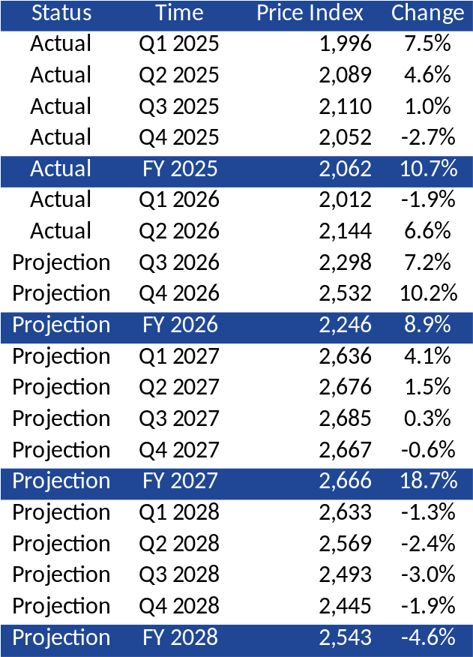
The price upcycle is expected to extend into 2027
© 2026 Argus Media group. All rights reserved.
15

Slide 16
Large-diameter pipeline approvals are accelerating
© 2026 Argus Media group. All rights reserved.
16

Slide 17
Imports continue to drive US line pipe supply
© 2026 Argus Media group. All rights reserved.
17

Slide 18
Line pipe market momentum continues to build
© 2026 Argus Media group. All rights reserved.
18

Slide 19
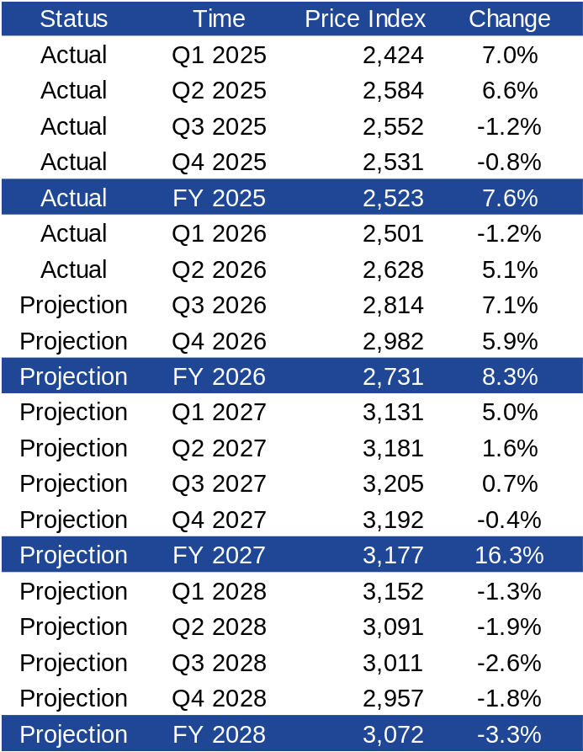
The line pipe price outlook remains firm
© 2026 Argus Media group. All rights reserved.
19

Slide 20
Summary
Demand: Positive but disciplined.
Supply: Built-up backlog, duty exposure could limit recovery.
Cost: Steady climb, not boom-bust.
Price: Upcycle has further to run.
© 2026 Argus Media group. All rights reserved.
20

Slide 21
Thank You
Arda Serhat Yelkenci
Metals Manager • Analytics & Consulting
arda.yelkenci@argusmedia.com

