Slide 1
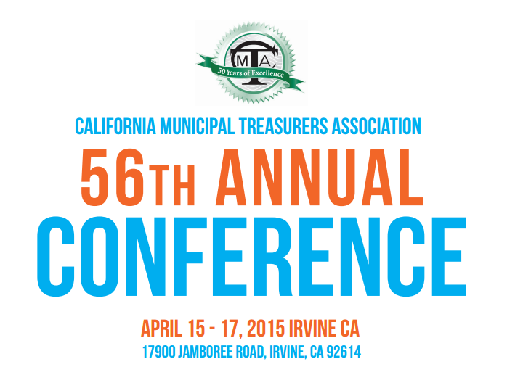
Emergency Readiness: Protecting Lives, Communities, and Dollars

Slide 2

South Napa Earthquake
August 24, 2014

Slide 3
Are you prepared
At 3:20 a.m. on Sunday, August 24, 2014, a
6.0 magnitude earthquake struck Napa County.
The Napa earthquake claimed the life of one victim and injured nearly 300 people. Thousands of homes and businesses have sustained major damage.
Estimated structural damages are $362.4 million and $80.3 million in economic impact to the wine industry.
Napa’s two U.S. Post Offices, several Government buildings, including Courthouse, schools, hotels and adult care facilities sustained major damage. One Post Office remains closed.

Slide 4
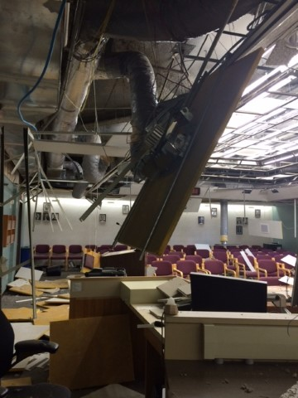
Napa county Emergency Operation Center
Do you have an alternate site?

Slide 5
Are you prepared
Direction from the Board of Supervisors was to bring County services back on line as quickly as possible.
Significant damage to several County buildings and infrastructure. One County administration building still remains closed, part of the Hall of Justice and Historic Courthouse are closed to the public.
Relocating about 400 employees from the Board of Supervisors, County Assessor-Recorder, Elections, District Attorney, Public Defender, County Executive Office, County Counsel, Child Support Services, and several HHSA Departments/Agencies and Probation.

Slide 6
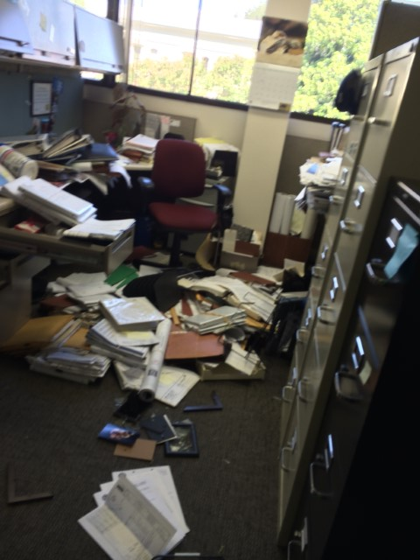
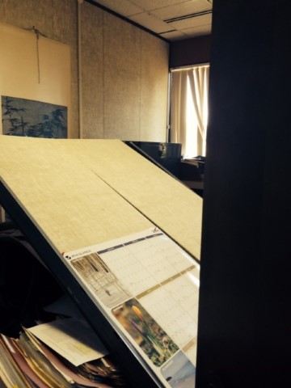
County offices

Slide 7
Are you ready to move
What would happen if your office was uninhabitable?
What if you could not remove any files, records, equipment, or supplies?
What resources would staff need to continue operations?
Are you prepared to have staff working only earthquake related projects?
Do you have partnerships with other agencies for services?

Slide 8
Eight months later
Starting in May 2015 several departments will begin to move back into their original office space.
Estimated County earthquake-related expenses for
FY 2014-15 exceed $20 million.
Pursuing both FEMA and insurance avenues for reimbursement of the damages. We are still in the preliminary stages of recovery.
Local businesses have suffered an estimated $110 million in damages and lost revenue, resulting in lower revenues, Sales Tax and Transient Occupancy Tax.

Slide 9
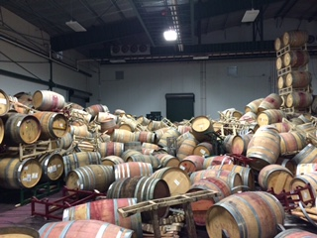
Wine Storage
August 24, 2014

Slide 10
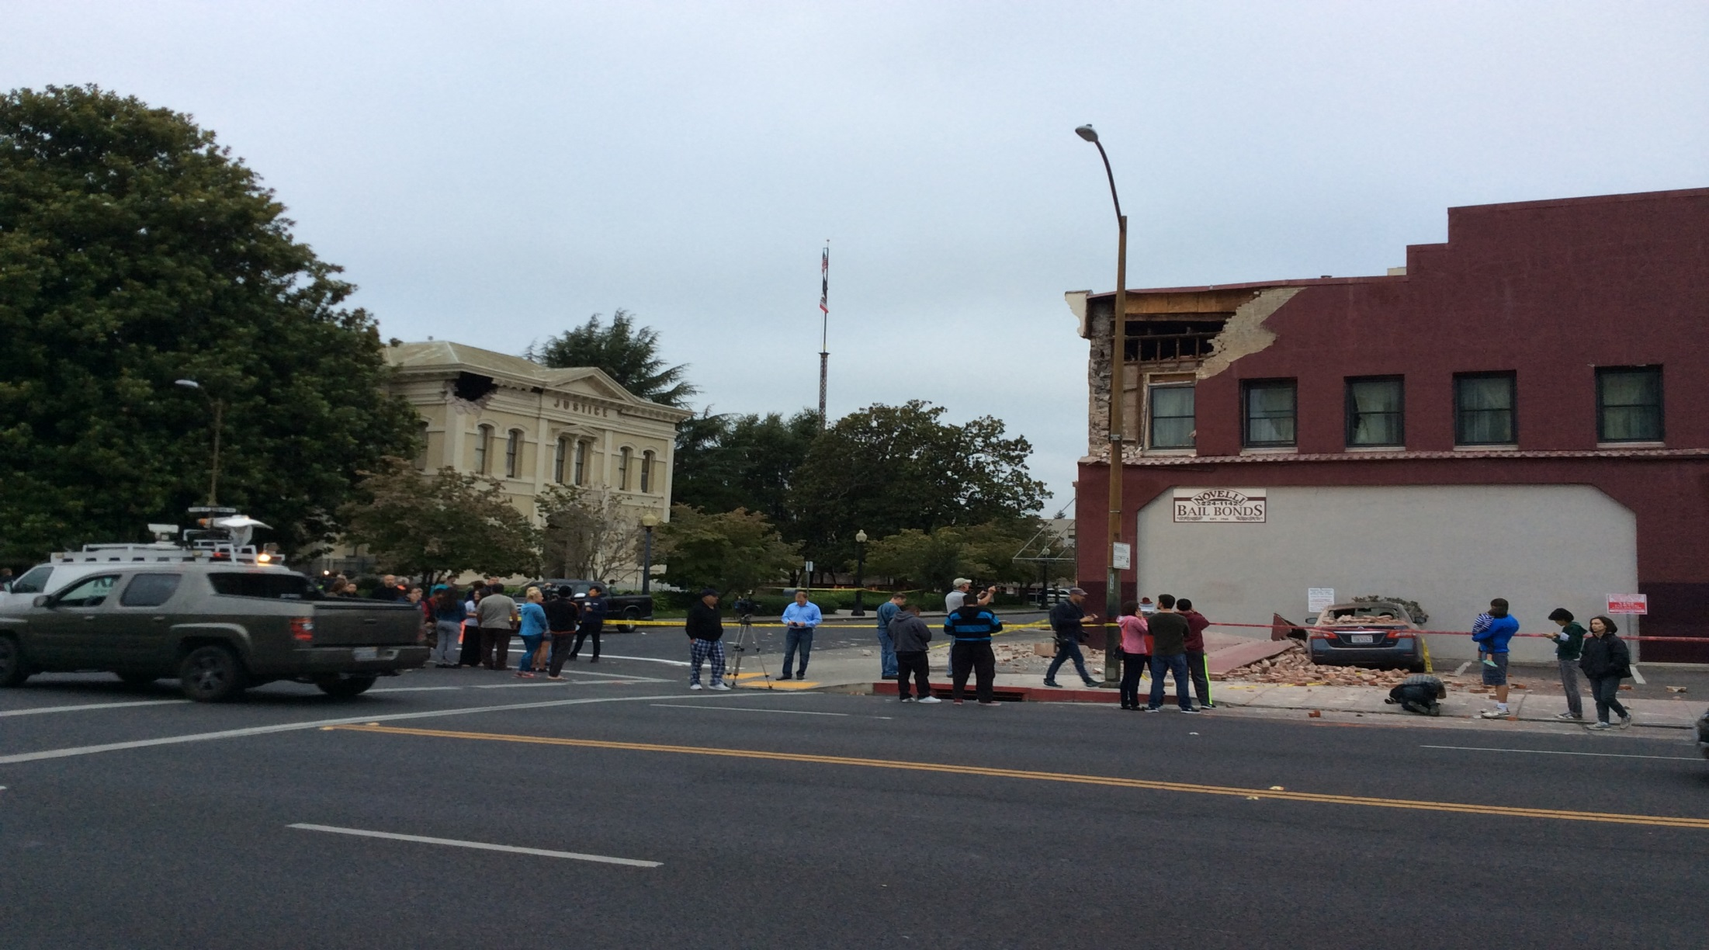
Third and Brown Street
August 24, 2014

Slide 11
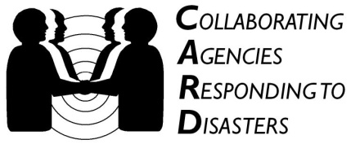

Emergency Readiness: Protecting Lives, Communities, and Dollars
Presented by: CARD - Collaborating Agencies Responding to Disasters
By request of the California Municipal Treasurers Association (CMTA)
April 16, 2015

Slide 12

Today
Requests:
Be courageous and answer ALL questions
Be confident that YOU can transform preparedness in your domain.
OWN the CMTA mission:
To lead in promoting and enhancing the fiduciary responsibility
and integrity of individuals responsible for public funds.
Goals:
You leave here more prepared and able to make a meaningful contribution to readiness* and resilience
Learn how CARD can help you to help your jurisdiction:
    Save money (lower costs, stop waste, etc.)
    Stretch money (share resources, leverage assets, etc.)
    Attract money (community grants, financial resources, donations, etc.)
    *make it better, faster, easier, more beneficial, more fun, less creepy…

Slide 13
CARD History
24/7 Media Attention – 1989 Loma Prieta Earthquake pre-empted the World Series.
Despite great effort – government, Red Cross and traditional response organizations could not address immediate, short-term or long-term needs for the most vulnerable residents. This has always been true.
CARD was created BY local community agencies, FOR local community agencies, and works WITH community agencies and committed partners to fulfill on a vision of a prepared, inclusive, resilient, humane society.
CARD’s philosophy = Prepare to Prosper!
Have everyday brilliance be your disaster resilience.
Lessons Learned:
The traditional approach to readiness has left over 90% of US residents unprepared. Businesses also remain unprepared. Local governments…?
Cities and counties are unprepared to deal with this lack of preparedness.

Slide 14
The “Why” is most important
Traditional Message
Your Message
It’s part of our mission
To keep our businesses and economy strong
To make our community more fundable
Protect/empower our residents and investors
To be stronger/more effective EVERY DAY
Be a more valued partner for our neighbors and friends
To be leaders in an international movement
Because we love our families, homes, and communities
Because We Can!
Prepare for disasters
Get ready for the “big one!”
What
Take classes/trainings
Get kits, store supplies
Do exercises and drills
How
Why
Because disasters
happen! Our lives,
homes and families are
at risk. Terrorists want to kill us. It’s not a matter of “if” a disaster will happen, it’s “when”…
Color and heart shape added by CARD, based on the model created by Simon Sinek,
author of ‘Start with Why’. Modified by CARD, 1-2012.

Slide 15

The Resilience/Optimism Framework
Desired Action: | More Pessimistic | More Optimistic
Earthquakes, floods, fires, terrorism, diseases – they are coming. You could die.
Health, wellness, financial gain, brilliant teamwork, efficiency, love of family, OPPORTUNITY!
Be prepared!
Avoid being mugged, raped, beaten, violated. To not become a victim.
Build strength, confidence, flexibility, mental calmness, agility, fun, social interaction.
Learn martial arts
We are poor. It’s all we can afford. We must cut corners.
It’s a complete protein and a healthy choice. Learn about other cultures and their cuisines.
Feed your family rice and beans
Be kind and loving toward your partner
Divorce is expensive. You’ll be ruined. Dating is hard, scary, and expensive.
Love. Affection. Desire for a happy, intimate and caring relationship. Because you can.
Bureaucracy! Acronym hell. Costs. Time. Too abstract. Kills trees. We won’t use it.
Deepen understanding of daily ops, build cross-trained teams, build stronger relationships, achieve long-range goals.
Create a Continuity of Operations Plan

Slide 16

: The 2014 Napa Earthquake
Becoming Independent is based in Santa Rosa. They serve over 200 developmentally challenged adults living independently in multiple communities.
Within 30 minutes of the earthquake, Becoming Independent staff had secured their own households.
8 Staffers deployed to respond to the needs of their clients in the impact area.
Clients were located in Napa, Vallejo, American Canyon, and Sonoma.
Staff made contact with all clients living independently -- either face-to-face or by phone.
Home visits included clearing broken glass, picking up toppled furniture, and ensuring that client homes were safe to stay in.
One person had to be removed from her house, as it was deemed unsafe to stay.
They went from ZERO preparedness, to having readiness as part of their culture, and they have woven preparedness into how they empower their staff and clients.

Slide 17


Practice Divergent Thinking
Convergent:
Name the eating utensil that goes with a spoon and a knife
What do you call the pointy parts?
How many prongs/tines are on a standard dinner fork?
In a standard place setting on what side of the plate is the fork?
Divergent:
What’s one way to use a fork to make money?
What’s one way to use a fork to be safe?
What’s a funny/entertaining way to use a fork?
In a disaster, which way of thinking and learning will be more helpful?

Slide 18
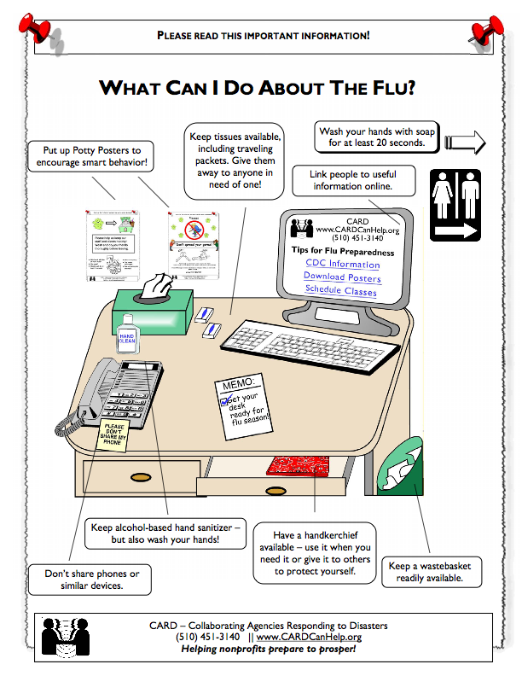
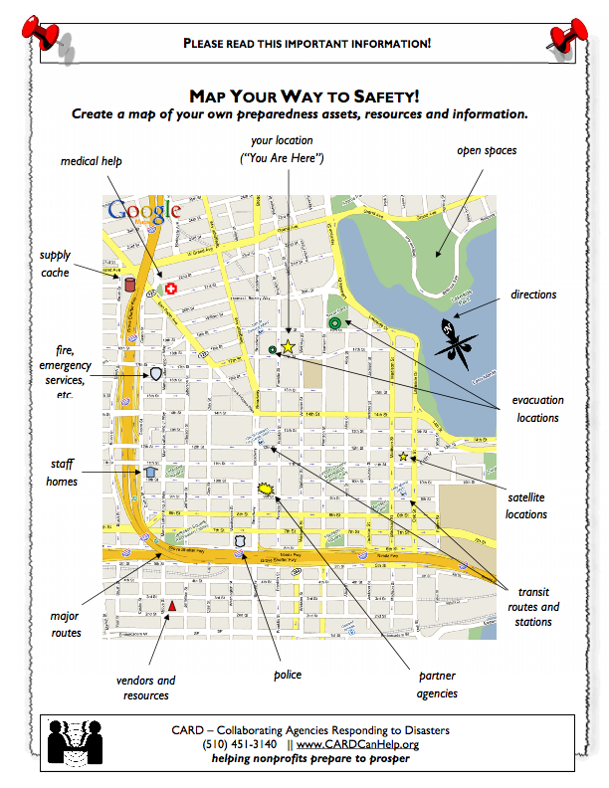
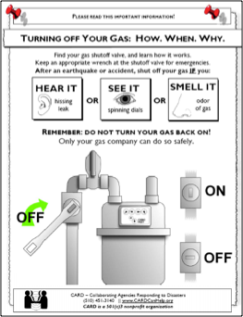
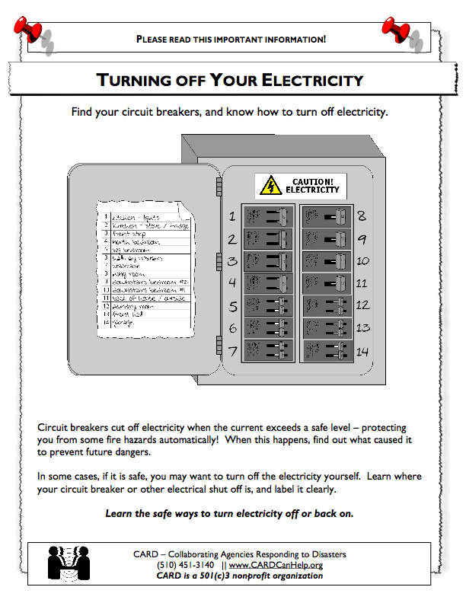
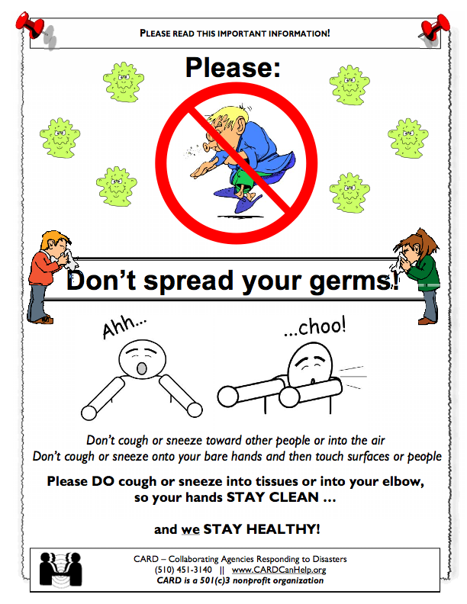
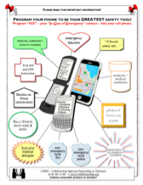
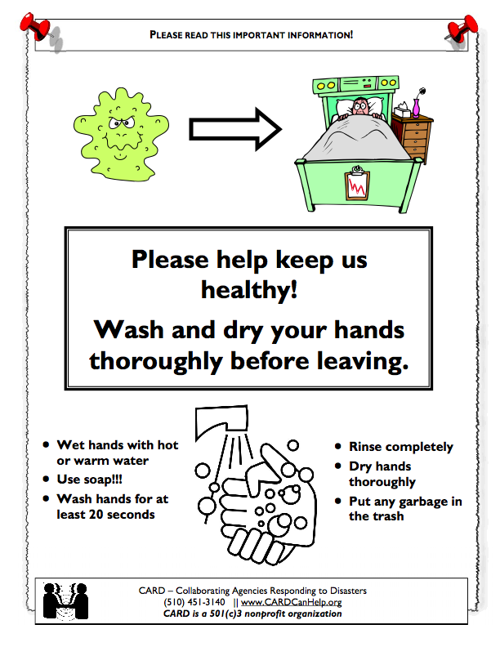
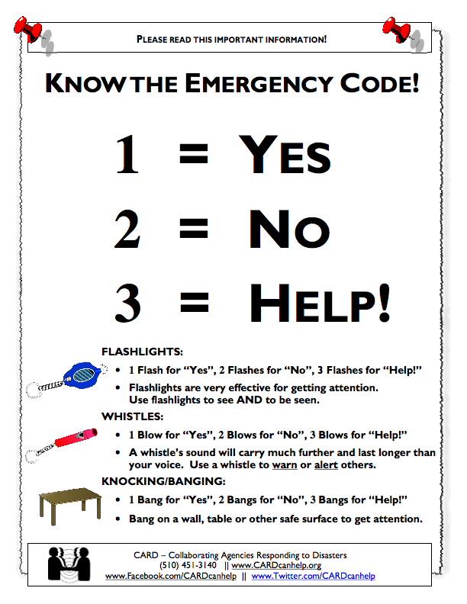
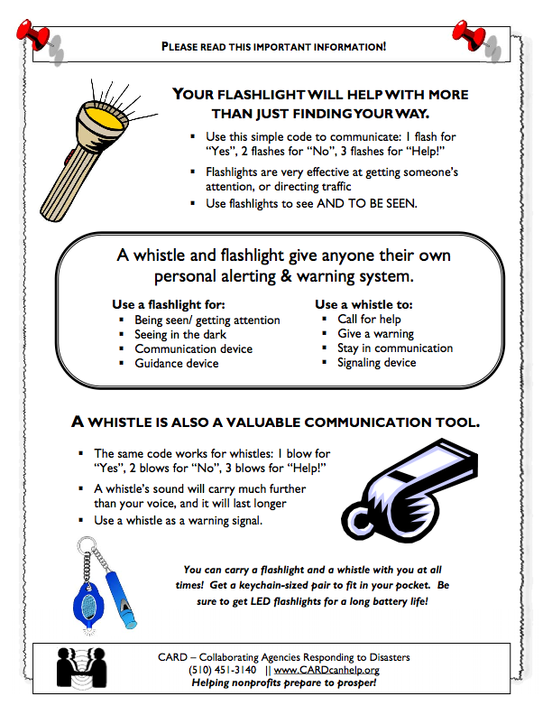
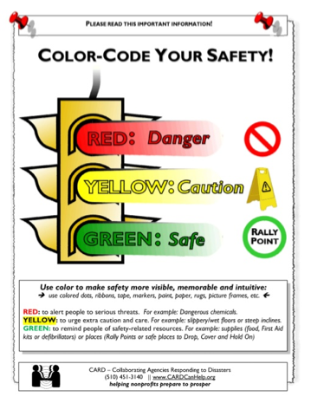
Captive Audience Education
(aka “Potty Posters”)

Slide 19
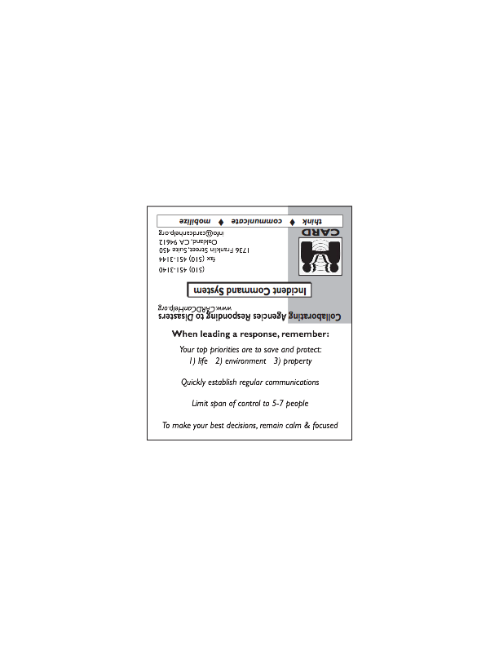
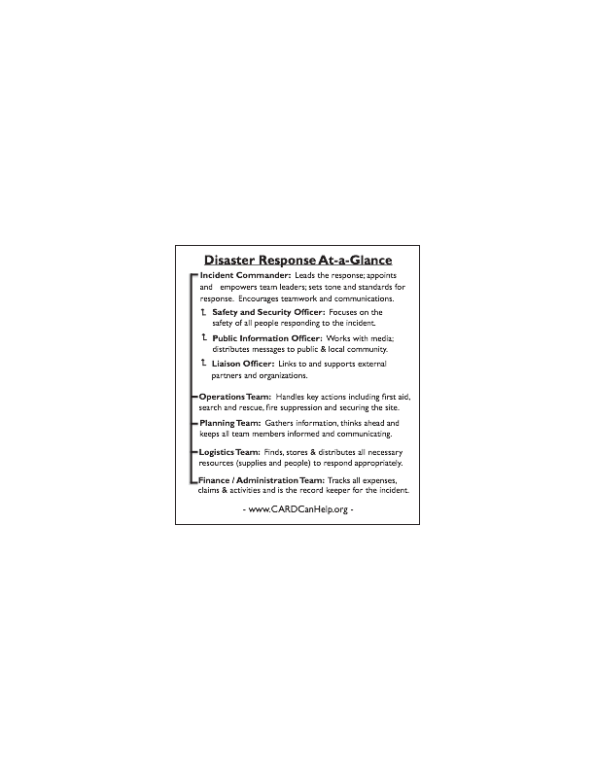

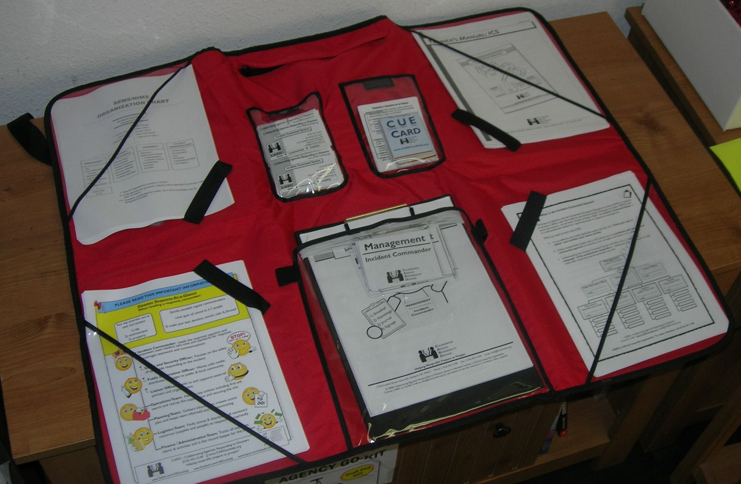
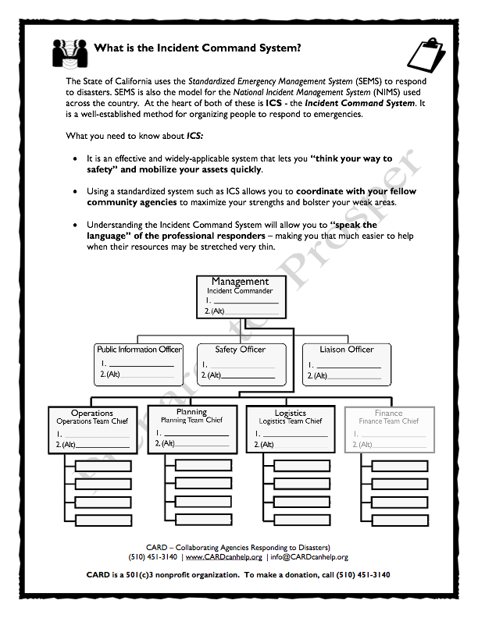
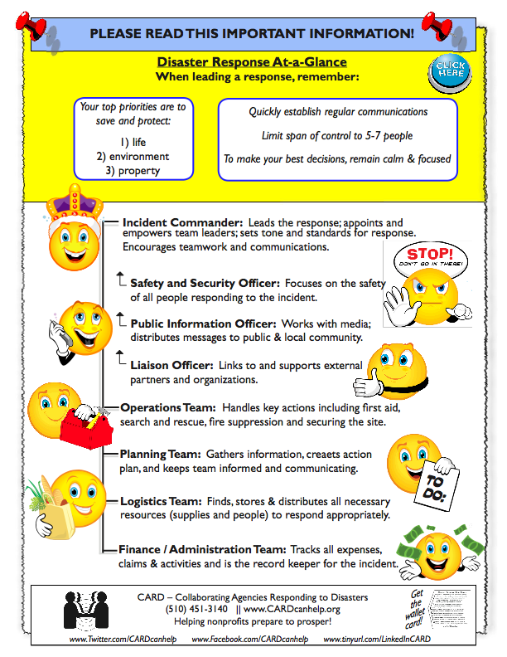
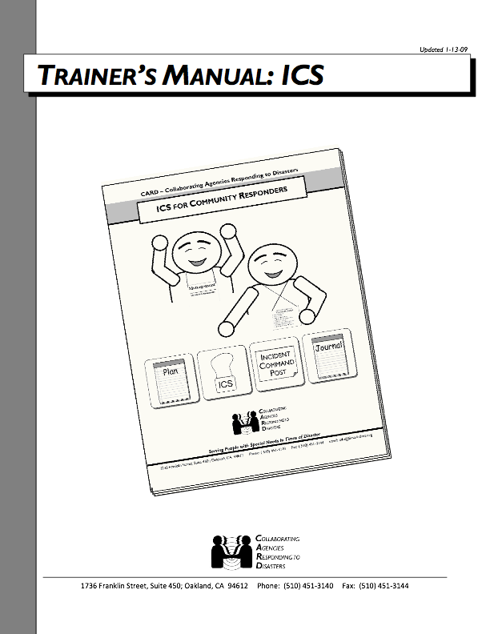
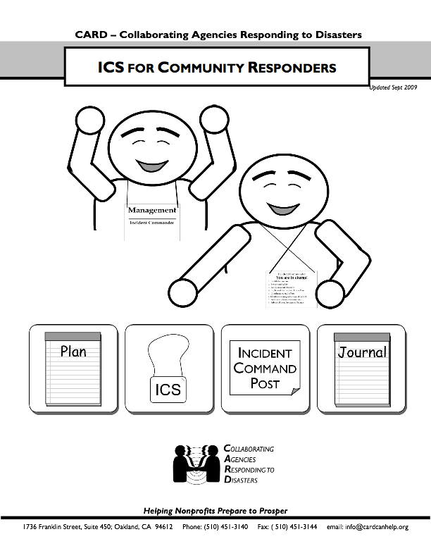
ICS for EVERYONE!
ICS Wonderfile

Slide 20
CARD’s Trainings, Facilitations, Presentations
SKIP Kits and Everyday Preparedness Tools
Incident Command System (ICS) for Community Responders
Social Media, Technology, and Community Readiness
Shelter-in-Place – training and hands-on exercise
Agency Emergency Planning
Personal Emergency Preparedness
Disaster Exercise Scenario / hands-on practice
COOP - Continuity of Operations Planning
Train-the-Trainer
Other: Seniors, Parents / Childcare Providers, Homeless, People with Disabilities, Limited English Proficiency (LEP), LGBT
Other Networking and Facilitation services and exercises provided upon request

Slide 21

Questions? Thoughts? Ideas?
The behind-the-scenes money people are the unsung heroes of many events.
Disaster management is a multi-billion dollar growth industry. Shouldn’t we be ready to be powerful in the face of this conversation?

Slide 22
Thank You to Our Supporters!
CARD’s work to make this a positive, accessible, and sustainable pursuit for all communities is made possible by:
United Way of the Bay Area
Alameda County Operational Area
Alameda County Public Health Dept.
Pacific Gas and Electric Company
The Walter and Elise Haas Fund
The San Francisco Foundation
Community Bank of the Bay
PHD City of Berkeley
City of Oakland
YOU!
CARD is online at:
www.CARDcanhelp.org
http://CARDcanhelp.org/Blog
www.Facebook.com/CARDcanhelp
www.Twitter.com/CARDcanhelp
Ana-Marie is online at:
www.LinkedIn.com/in/MsDuctTape
www.Facebook.com/MsDuctTape

