Slide 1
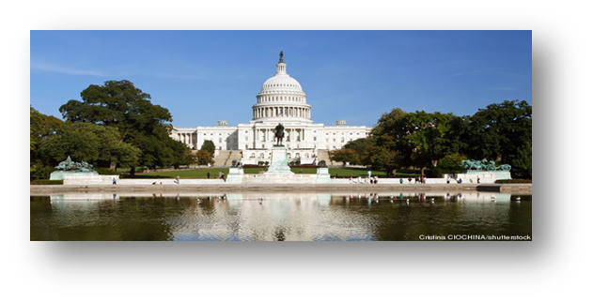
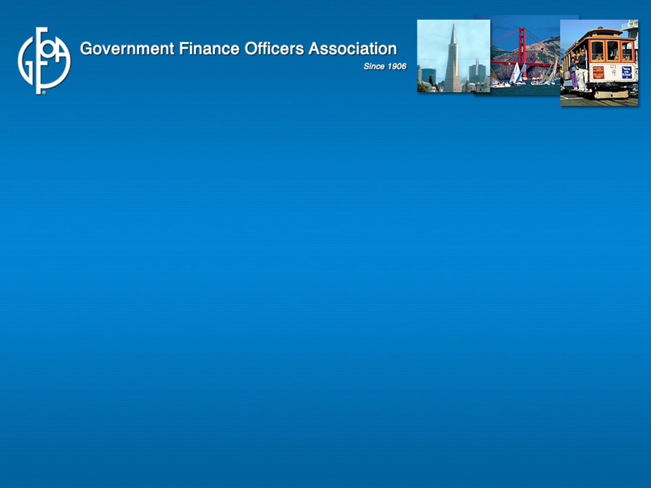


2015 Federal Update
April 16, 2015
Dustin McDonald Susan Gaffney
Director, Federal Liaison Center President, SG and Associates
Government Finance Officers Association Consultant, Government Finance Officers Association

Slide 2


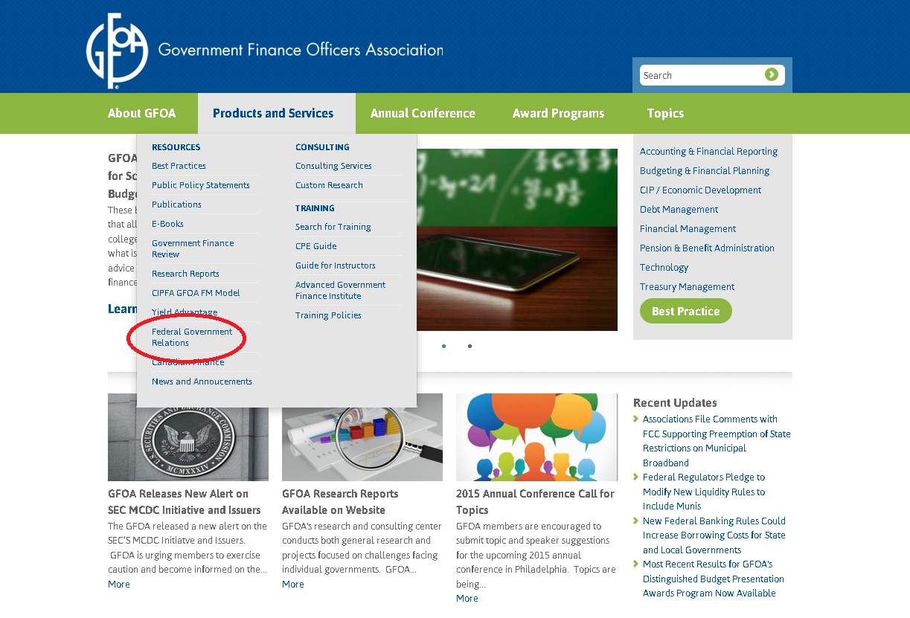
GFOA Federal Liaison Center

Slide 3
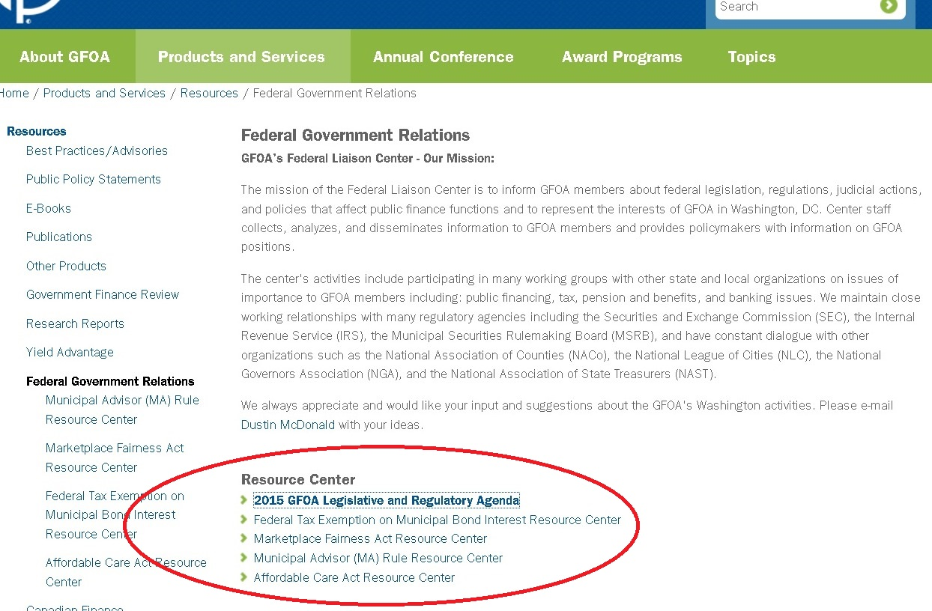
GFOA Federal Liaison Center

Slide 4

Money Market Mutual Fund (MMMF) Reform
7/23/14 – SEC Approves Final MMMFs Reform Rule
Impetus – 2008 Financial Crisis
  Heavy redemptions following announcement of Lehman Bros bankruptcy (primarily in prime institutional funds).
  Short-term financing froze, access to credit was constrained.
  Short-term Fix – Treasury Department Provides Temporary Backstop MMMFs

Slide 5

Money Market Mutual Fund (MMMF) Reform
    New SEC Rules Will -
      Require Institutional Prime and Institutional Municipal (Tax-exempt) Funds To Maintain A Floating Net Asset Value (NAV).
        Increase government cash management costs
        Force governments out of funds
      Permits MMMF Boards To Impose Liquidity Fees And Redemption Gates During Times Of Fiscal Stress.
        Increased debt management costs by driving investors away from the funds.

Slide 6
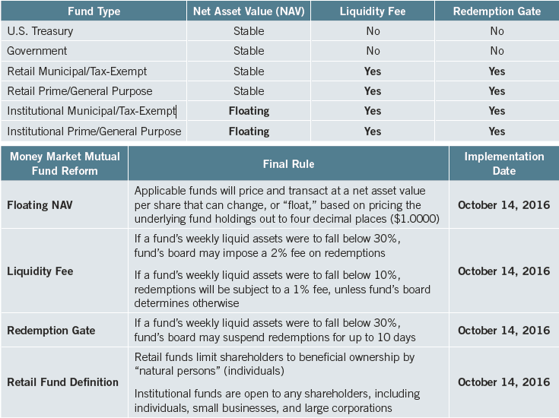
Money Market Mutual Fund (MMMF) Reform

Slide 7
Money Market Mutual Fund (MMMF) Reform
    New SEC Rules Could Also -
      Impact State And Local Government Investment Pools (LGIPs)
        New rules modifies SEC Rule 2a-7, and GASB requires LGIPs to operate in a manner consistent with this Rule.
        GASB considering new Rule to determine whether or not LGIPs would also now have to use a floating NAV.
        Key Concern: Close relationship of state and local governments and MMMFs

Slide 8
Money Market Mutual Fund (MMMF) Reform
  What’s Next?
GASB To Consider Impact Of New Rule On LGIPs
MMMFs Must Comply With The New Rule By October 16, 2016
Legislative Proposal Emerging That Would Undo Much Of The 2014 Rule.
New Reference Materials
GFOA Debt And Treasury Investment Committees Developed Issue Brief For State And Local Governments Providing Summary Of The New Rule And Potential Impact Of The New Rule.

Slide 9

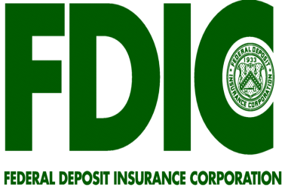

Basel III – Liquidity Coverage Ratio
  9/3/14 - Federal Reserve, FDIC, and Comptroller Of Currency approved new liquidity standards for banks.
  New rules are a response to the 2008 financial crisis and will require banks with at least $250b in total assets to maintain designated levels of high-quality liquid assets (HQLA - assets that can easily be converted to cash) during a 30-day fiscal stress scenario.
  Rules exclude municipal bonds from HQLA, meaning banks could not use municipal securities to satisfy the liquidity coverage requirement of the new rules.
  1/1/15 - Rules went into effect.

Slide 10

Basel III – Liquidity Coverage Ratio
  So Munis Aren’t HQLA. What Does This Mean?
    Not Classifying Muni Securities As HQLA Could:
    appeal of muni securities for banks to underwrite them.
    borrowing costs for state and local governments to finance desperately needed infrastructure projects during times of national economic crisis.
    Note: Bank Holding Of Municipal Securities And Loans Have Increased From $224B In 2009 To $416B In 2013 (86% Increase).

Slide 11
Basel III – Liquidity Coverage Ratio
    Impact On Your Jurisdiction Will Depend On Asset Holding Size Of Your Bank:
      Banks with at least $250B in total assets with largest muni holdings –
      A modified LCR rule will apply to bank holding companies with at least $50 billion of assets.
        However most of these banks do not hold significant levels of muni securities.
        Wells Fargo
        JP Morgan/Chase
        Citi
        Bank of America

Slide 12
Basel III – Liquidity Coverage Ratio
  WHAT HAPPENS NOW?
  Rule Went Into Effect On January 1, 2015.
  Federal Reserve Has Publicly Proclaimed Their Interest In Classifying Some Classes Of Munis As HQLA, While OCC and FDIC Are Still Pushing Back.
  GFOA Working With State And Local Partners And Banking Associations To Engage Congress In Effort To Pressure Regulators Into Including Munis As HQLA.
    New House legislation being introduced this week (Rep Messer – R – Indiana) that would admit all investment grade muni securities as HQLA.

Slide 13

Municipal Advisor (MA) Rule
9/18/2013 – SEC Approved
    7/1/2014 – Rule Implemented
    Key Concepts
    Revised MA Definition Excludes State And
    Local Employees And Appointed Board Members.
    Rule Changes Traditional Communication Between Issuers And Underwriters.
      Specifically – How issuers solicit and receive information from underwriters.

Slide 14
MA Rule – Key Points
  Municipal Advisors Have An Explicit Fiduciary Duty To Their Government Clients.
  Underwriters And Other Professionals That Do Not Have A Fiduciary Duty To Issuers Will Not Be Able To Provide Advice To Governments Unless Certain Exceptions Are Met.
  Underwriters Will Be Able To Communicate With Issuers About General Market Issues, Facts And Ideas, However, Unless An Exemption Is Met, They Can Not Advise A Government To Take A Specific Action.

Slide 15
MA Rule – Exemptions
    IRMA Exemption - Issuer Has An Independent MA.
    RFP Exemption - Issuer Has A RFP Out For Underwriting Services Related To A Specific Transaction.
    Underwriter Exemption – Underwriters May Provide Advice On The Structure, Timing, Terms Of A Transaction Using This Exemption Only During The Period Beginning With When They Are Engaged For A Particular Transaction And Ending At The End Of The Underwriting Period (Letter Of Engagement).
    GFOA & SIFMA Developed Model MA And Underwriter Exemption Language For Issuers To Use In Order To Ensure Compliance With The Rule.

Slide 16
MA Rule – GFOA Best Practices & Resources
  GFOA Existing Best Practices Strongly Recommend That Governments Hire a MA For Bond Transactions.
  GFOA Revised Three Of These Best Practices In 2014 –
    Selecting and Managing the Engagement of Municipal Advisors
    Selecting and Managing the Engagement of Underwriters for Negotiated Bond Sales
    Selecting and Managing the Method of Sale of State and Local Government Bonds
    Additional Resources
    SEC issued FAQ clarification document on January 10, 2014
    GFOA issue brief and MA Rule Alert on Rule and related issues

Slide 17
MA Rule – Next Steps
  MSRB Developing Additional Regulations on the Rule
    Rule G-42 – Governs The Conduct Of Mas With Respect To The Fiduciary Duty Of MAs, And Would Prohibit Mas And Their Affiliates From Engaging In Any Other Transaction In A Principal Capacity With A Client.
  SEC Office of Municipal Securities
    Clearing Up Misunderstandings About MA Rule
        Issuers Hiring “Token” MAs Using IRMA Exemption Solely to Talk to Underwriters
      Working To Finalize Regulations On Fiduciary Duty, Pay-to-play And Professional Qualifications.

Slide 18
Municipalities Continuing
Disclosure Cooperation (MCDC)
March 10, 2014 – Program Launch
    Goals – (1) Compelling Government Bond Issuers To Self-report Violations Of Federal Securities Laws.
    (2) Improve Continuing Disclosure Compliance.
    SEC - Will Offer “Standardized, Favorable Settlement Terms To Municipal Issuers And Underwriters Who Self-report That They Have Made Inaccurate Statements In Bond Offerings About Their Prior Compliance With Continuing Disclosure Obligations.”
    September 10, 2014 – Underwriters Deadline To Submit Findings.
    December 1, 2014 – Issuers Deadline To Submit Findings.

Slide 19
SEC – MCDC Initiative
    Legal Authority – (SEC Rule 15c2-12)
    Prohibits Underwriters From Buying Or Selling Your Bonds Unless You Have Committed To Providing Annual Updates About Your Financial Condition, Related Data And Disclosing Material Events.
    Requires That Any Final Official Statement Prepared In Connection With Your Bond Offering Contain Any Instances In The Previous Five Years In Which You Failed To Comply With Your Disclosure Obligations Under The Rule.
    SEC Can File Actions Against Issuers And Underwriters For Inaccurately Stating In Final Official Statements That They Have Complied With Their Prior Continuing Disclosure Undertakings, Or Omitted Instances Of Non-compliance—if Such Misstatements Or Omissions Are “Material.”

Slide 20

SEC – MCDC Initiative
So, like...What’s material anyway?!
    GREAT QUESTION
    SEC is NOT providing clarity on what is or is not material.
    National Association of Bond Lawyers (NABL) issued guide in August to assist issuers navigate this territory.

Slide 21
SEC – MCDC Initiative: GFOA Concerns
      Initiative Asks Issuers To Look Back 5-10 Years To Determine Whether Or Not They Have Made Materially Inaccurate Statements In Offering Documents Regarding Prior Continuing Disclosure Compliance.
      Concerns
        EMMA only came online in 2009.
        (2) Previous system (NRMSIR) contains many inaccuracies.
            Result - Underwriters sought to uncover examples of materially inaccurate statements using data from the NRMSIR and may report inaccurate findings to SEC.
            (3) SEC not imposing monetary fines on participating issuers, but reserves right to pursue separate enforcements against individuals within a government responsible for misstatements.
            (4) Issuer self-investigation to identify material misstatements will be costly.

Slide 22
SEC – MCDC Initiative
      MCDC Incentivized Banks to Report Issuers
        Initiative Imposes A Civil Penalty For Each Official Statement Containing A Materially False Statement:
          $20,000 per offering for offerings of $30M or less
          $60,000 per offering for offerings of more than $30M
          Could add up fast.
        Offers Self-reporting Underwriters A Maximum Penalty Of $500,000.

Slide 23
SEC – MCDC Initiative
    GFOA Resources and Recommendations
    MCDC Alerts – Provide Background Info And Recommendations.
    SEC Enforcement – Next Steps
    Reviewing Underwriter And Issuer Submissions And Organizing And Prosecuting Cases Against:
      Bond issuers
      Underwriters
      Individuals
    7/8/14 – SEC Announced First Cease-and-desist Order Under MCDC - Kings Canyon Joint USD (CA).
          SEC alleged the District failed to comply with continuing disclosure agreements from past 5 yrs.

Slide 24
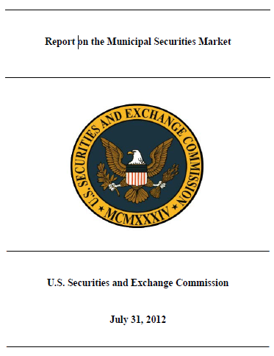
SEC 2012 Muni Market Report
    Culmination Of 2 Years Of Work, 3 Field Hearings And Meetings With Market Participants
    Cites SEC’s Desire To Seek Improvements In The Timing, Content And Frequency Of Disclosure Information

Slide 25

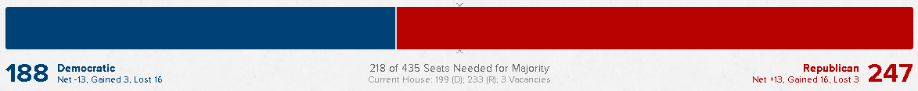
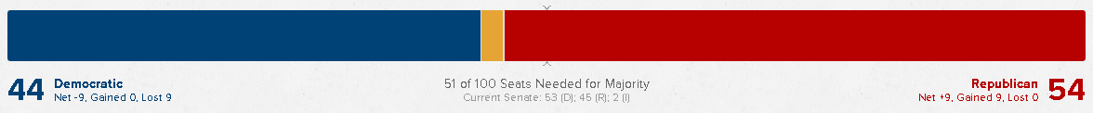
2014 Midterm Election Results
HOUSE RESULTS
SENATE RESULTS

Slide 26
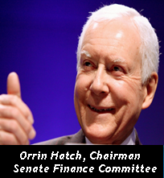


2015 Comprehensive Tax Reform
“Our tax code is far too long and complicated for most Americans to comprehend. Its administration alone saps hundreds of billions of dollars each year.”
“If I could make just one change in Washington, it would be to fix the tax code.”
“Our corporate tax system is outdated, unfair, and inefficient. It forces America's small businesses to spend countless hours and dollars filing their taxes. It's not right, and it needs to change.”

Slide 27

Paul Ryan on Tax Reform in 2015
Recognizes The Obstacles In Advancing A Corporate AND Individual Tax Reform Package In Current Political Environment
Tax Reform Phase I - Corporate Tax Reform
Willing To Consider Using A Portion Of Corporate Tax
Reform Proceeds To Finance Infrastructure Projects
Tax Reform Phase II – Individual Tax Reform
May Have To Wait Until A New President Is Sworn In
Outstanding Issue: Somewhere In Phase I Or II
Reform Needs To Address Small Businesses
Paul Ryan, Chairman
House Ways & Means Committee

Slide 28

Paul Ryan on Tax Reform in 2015
Tax Reform Goals
Simplifying the Tax Code
Closing Loopholes
Reducing Overall Rates to 25%
  (Cost = $5T over 10 years)
Tax Reform Targets
Cap Mortgage Interest Deduction at $500,000
Eliminate State & Local Income Tax Deduction
(Estimated to generate $500B over 10 years)
Paul Ryan, Chairman
House Ways & Means Committee

Slide 29
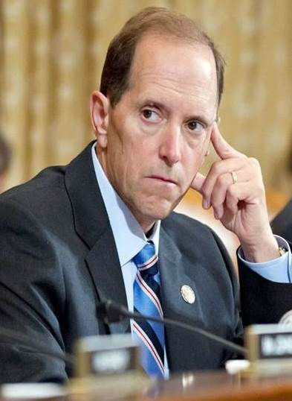
2014 Plan (Outgoing Chair Dave Camp)
How to Reduce Tax Rates to Maximum of 25%
(In 980 Easy Pages!)
Eliminate 228 Sections of the Tax Code
Modify the Tax Exemption on Muni Bond Interest
  Impose a 10% tax on currently tax-exempt
  muni bond interest for:
  Individual income earners - $400,000 +
  Married couples earning – $450,000 +
  Tax would apply to interest earned on new
  issues and outstanding bonds
Dave Camp, Previous Chairman
House Ways & Means Cmte

Slide 30
2014 Plan (Outgoing Chair Dave Camp)
How to Reduce Tax Rates to Maximum of 25%
(In 980 Easy Pages!)
  Eliminate State & Local Tax Deduction
($500B over 10 years)
Prohibit Future Advance Refundings
Caps Mortgage Interest Deduction at $500,000
Prohibit Future Issuance of Tax-exempt PABs
Prohibit Future Issuance of TCBs
(QZABs, CREBs, BABs, etc)
Dave Camp, Previous Chairman
House Ways & Means Cmte

Slide 31

Senate Tax Reform Objectives
Chairman Hatch’s Priorities:
We Must Do Corporate AND Individual
Simplifying the Tax Code
Closing Loopholes
Reducing Overall Rates to 25%
Revenue Neutral
5 Working Groups
Orrin Hatch, Chairman
Senate Finance Committee

Slide 32

White House Tax Reform Plan
Focused on Corporate Tax Reform to:
  Reduce Corporate Rates from 39.6% to 28%
  Generate Revenue
  Fund Transportation Infrastructure Through
    Closing of Corporate Loopholes
    Reducing Appeal of Corporate Inversions

Slide 33
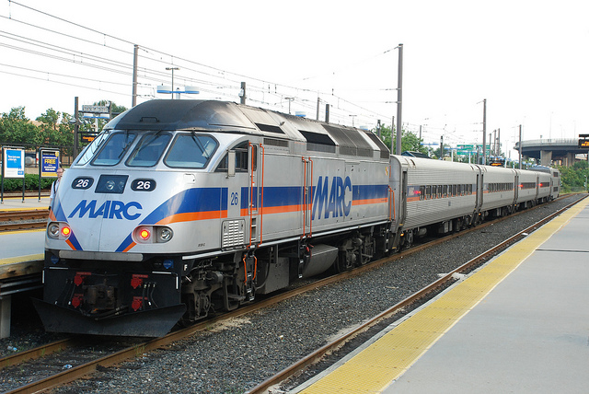

Transportation Reauthorization
    Current Federal Transportation Funding Law (MAP-21) Is Being Funding Through A Short-term Extension That Expires In May 2015
    Congress At Impasse On How To Generate Consistent Future Funding
      Considering deriving some funding from corporate tax reform
      Considering modifications to existing programs (TIFIA, New Starts, PABs) to encourage use of P3s

Slide 34

White House Transportation Initiatives
America Fast Forward (AFF) Bonds
Proposed Permanent Direct-pay Bond Program
Oriented Toward Transportation Projects
(Modeled After BABs)
Subsidy Rate = 28%
Eligible Issuers – State & Local Governments
Designed To Expand Investor Base & Attract:
  Pension funds
  Overseas investors

Slide 35
White House Transportation Initiatives
America Fast Forward (AFF) Bonds
Would Require Congressional Authorization
  Congress is opposed to BAB-type products
No Issuer Appetite For Bab-type Products
  Budget Control Act of 2011 –
  Subsidy payment cuts through 2024
  (2015 – 7.3%; 2014 – 7.2%; 2013 – 8.7%)
Not Revenue Neutral As Claimed By White House
  AFF would impose costs on taxpayers (foreign investors don’t pay U.S. taxes)

Slide 36

Other White House Initiatives
National Infrastructure Bank
Proposed Government Entity That Would Support Large National/Regional Infrastructure Projects
Invest In Transportation, Energy And Water Projects Through Loans And Loan Guarantees
Concerns –
  Reliability of capitalization
  Federal determination of approval for state and local projects (and related project delivery delays)
  Impact on existing state infrastructure banks (33 currently operating nationwide)

Slide 37
Other White House Initiatives
Qualified Public Infrastructure Bonds (QPIBs)
Proposed Bond Program That Would Augment Private Activity Bonds (PABs) By Expanding Them To Include Financing For:
  Airports
  Ports
  Mass Transit
  Solid Waste Disposal
  Water and Sewer
  Surface Transportation
As proposed QPIBs Would:
  Have no expiration date or issuance caps
  Not be subject to the private business use test currently used to determine if bonds are governmental bonds are PABs, and
  the interest on the bonds would not be subject to the Alternative Minimum Tax (AMT)

Slide 38
Other White House Initiatives
Replace FULL Tax Exemption On Municipal Bond Interest With A 28% Cap On Investor Deductions
  Would make a previously tax-exempt product taxable
  Would cause muni bond investors to demand higher returns from bond issuers to cover the taxes they now have to pay
  Would impose greatest costs on small, less frequent issuers

Slide 39

Cost of Exemption Cap and Repeal
  Independent studies estimate that:
  Capping The Exemption At 28% - 70 Basis Points
  Eliminating The Exemption - 200 basis points
  So Why is the White House Proposing This?
Proposal Would Generate ~$50B In Budget Savings
Over 10 Years. About 80% Of That Is Would Come From Applying The Provision To Outstanding Bonds And The Other 20% Is Associated With New Issues.

Slide 40
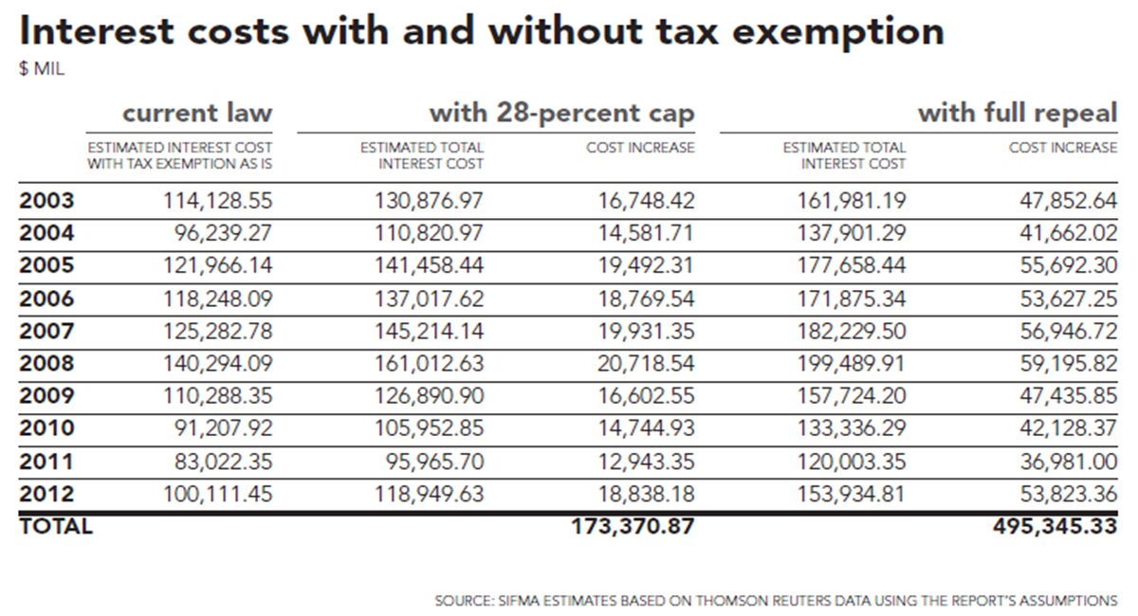

Cost of Cap and Repeal

Slide 41
Tax Exemption - 2015 Advocacy
Collaboration with Public Finance Network Partners
  Direct Lobbying – House and Senate Committees, Congressional Offices, White House
  Joint Advocacy Letters to Congressional and White House Leaders
  Reports, Testimony, Letters, Recommendations – Shared with Tax Writing Committees
  What You Can Do To Help – GET ENGAGED!!!!
  Draft Advocacy Letters, Resolutions, Talking Points for Your Use
  Timeline – 4 months before momentum shifts to 2016 Presidential Election.

Slide 42
Bank Qualified (BQ) Debt Legislation
  Working To Reintroduce Bipartisan Legislation (Municipal Bond Market Support Act) That Would Permanently Increase BQ Debt Limit From $10M To $30M And Index For Inflation.
  BQ Bonds Enable Smaller, Less Frequent Issuers To Finance Infrastructure At Lower Costs Than Traditional Bond Financing.
    For example: BQ issuers save 25 - 40 basis points on an average. On an average 15-year, $3.89M BQ financing, an issuer could expect to save between $146,000 and $233,000.
  BQ – Cap created in 1986 at $10M, where it has remained except for 2009 and 2010 during ARRA.
  Unfortunately, $10M is worth alot less today due to inflation.

Slide 43
GFOA TIM Committee
Newly Updated
BP: Using Mutual Funds for Cash Management Purposes
BP: Using Benchmarks to Assess Portfolio Risk and Returns
2015 Workplan
Update – BP: Creating Revenue Controls
Update – ADV: Use of Derivatives
NEW – BP: Data Breeches
NEW – BP: Identifying Risks
NEW – Checklist: Requirements for Treasury Mgmt Systems
NEW – Sample 3rd Party Safekeeping Agreement
NEW – Sample Custodial Trust Agreement

Slide 44
Treasury/Cash Management Training
Treasury Management and Banking Relations
Portland, OR April 29-30
Advanced Treasury Management
Phoenix, AZ October 8-9
Treasury Management Best Practices
Orange County!!!! January 11-12, 2016
WEBINAR: Risk Management in Treasury Operations
October 14

Slide 45
Debt Management Training
Debt Management for Frequent Issuers
Minneapolis, MN August 19
Best Practices in Debt Management
San Antonio December 7-8
WEBINAR: Types of Debt Instruments and Refundings
April 22 11-1 PT
WEBINAR: Update on Bond Disclosure
August 12 11-1 PT
WEBINAR: Rating Agency Outlook for the Year
January 20 11-1 PT

Slide 46
GFOA Debt Committee
Newly Updated
ADV: Use of Debt Related Derivative Products
ADV: Pension Obligation Bonds
New
BP: Selecting and Managing Credit Rating Agencies
Issue Brief: Green Bonds
2015 Workplan
Update – BP: Debt Management Policy
Update – BP: Understanding Your Continuing Disclosure Responsibilities
Update – BP: Using Technology for Disclosure

Slide 47





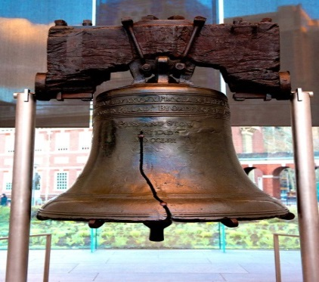
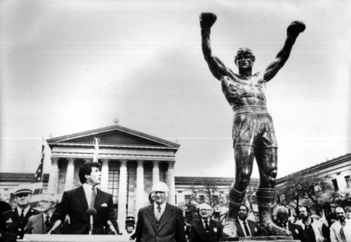



M
2015 GFOA Annual Conference
  109th Annual Conference
    May 31 – June 3, 2015
  Philadelphia Convention Center

Slide 48

Federal Government Update
Federal Tax Reform and Revenue Legislation - 113th Congress
  QUESTIONS?

