Slide 1
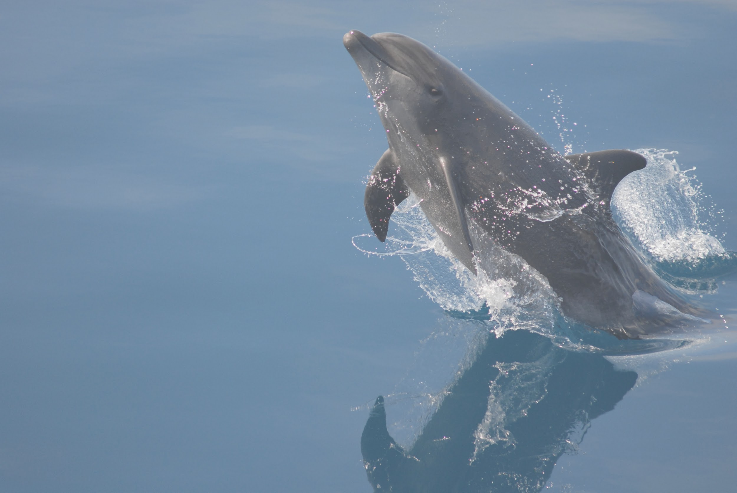


Features For Developers
Dave Stokes
MySQL Community Manager
David.Stokes@Oracle.com @Stoker
Slides -> https://slideshare.net/davidmstokes
Blog -> https://elephantdolphin.blogspot.com

Slide 2
Safe Harbor Agreement
THE FOLLOWING IS INTENDED TO OUTLINE OUR GENERAL PRODUCT DIRECTION. IT IS INTENDED FOR INFORMATION PURPOSES ONLY, AND MAY NOT BE INCORPORATED INTO ANY CONTRACT. IT IS NOT A COMMITMENT TO DELIVER ANY MATERIAL, CODE, OR FUNCTIONALITY, AND SHOULD NOT BE RELIED UPON IN MAKING PURCHASING DECISIONS. THE DEVELOPMENT, RELEASE, AND TIMING OF ANY FEATURES OR FUNCTIONALITY DESCRIBED FOR ORACLE'S PRODUCTS REMAINS AT THE SOLE DISCRETION OF ORACLE.

Slide 3
Community Edition!!

Slide 4
MySQL News
24 years old! Oracle owned for nine years!
MySQL 8.0 is the current Generally Available release
Document Store
Group Replication
We’re Hiring

Slide 5
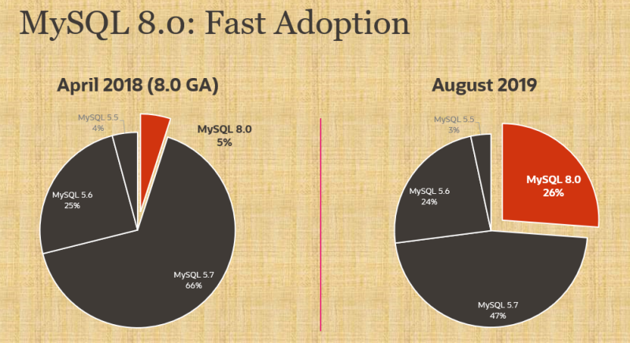
Thank You!

Slide 6
MySQL 8?
What happened to
MySQL 6 and MySQL 7??

Slide 7
Well..
Previous GA is 5.7 (October 2015)
MySQL Cluster is 7.6.11 (8.0.17 release candidate available)
There was a MySQL 6 in the pre-Sun days, kinda like the PHP version six that nobody really talks about except in hushed tones and with great sadness Engineering thought the new data dictionary and other new features justified the new major release number.

Slide 8
Data Dictionary
Before MySQL 8 -- Meta Data Stored in files!
You have had a plethora of files out there -- .FRM .MYD .MYI .OPT and many more just waiting for something to go bad -- now store relevant information in data dictionary!
This means you are no longer dependent in the number of inodes on your system, somebody rm-ing the files at just the wrong time, and a whole host of other problems.
Innodb is robust enough to rebuild all information to a point in time in case of problems. So keep EVERYTHING in internal data structures. And that leads to transactional ALTER TABLE commands.

Slide 9
System Tables are now InnoDB
Previously, these were MyISAM (non transactional) tables. This change applies to these tables: user, db, tables_priv, columns_priv, procs_priv, proxies_priv.

Slide 10
Good News!?
So now you can have millions of tables within a schema.
The bad news is that you can have millions of tables within a schema.

Slide 11
2.CTEs & Windowing Functions
Long requested, Common Table Expression and Windowing Functions have a wide variety of uses.
CTEs are handy subquery-like statements often used in quick calculations
Windowing Functions are great for iterating over a selected set of rows for things like statistical calculations

Slide 12
Windowing Function
SELECT name,
department_id,
salary,
SUM(salary) OVER
(PARTITION BY department_id) AS department_total FROM employee ORDER BY department_id, name
The key word is OVER

Slide 13
Another Example
SELECT date, amount, sum(amount)
OVER w AS ‘sum’ FROM payments WINDOW w AS (ORDER BY date RANGE BETWEEN INTERVAL 1 WEEK PRECEDING AND CURRENT ROW) ORDER BY date;
Windowing functions are great when dealing with dates

Slide 14
CTEs
WITH qn AS (SELECT t1 FROM mytable)
SELECT * FROM qn.
..are like derived tables but the declaration is BEFORE the query

Slide 15
WITH cte1 AS (SELECT a, b FROM table1), cte2 AS (SELECT c, d FROM table2) SELECT b, d FROM cte1 JOIN cte2 WHERE cte1.a = cte2.c;
JOINing two CTEs

Slide 16
Common
Table
Expression -
recursive
WITH RECURSIVE my_cte AS ( SELECT 1 AS n UNION ALL SELECT 1+n FROM my_cte WHERE n<10 ) SELECT * FROM my_cte;
+------+ | n | +------+ | 1 | | 2 | | 3 | | 4 | | 5 | | 6 | | 7 | | 8 | | 9 | | 10 | +------+ 10 rows in set (0,00 sec)

Slide 17
Lateral Derived Tables
SELECT Name, Population, District, x.cc FROM city, LATERAL (SELECT Code AS cc FROM country WHERE city.CountryCode = Code) AS x WHERE District = 'Texas' ORDER BY name;
Easier to write sub queries!

Slide 18
3. Optimizer & Parser
Descending indexes
Optimizer trace output now includes more information about filesort operations, such as key and payload size and why addon fields are not packed.
The optimizer now supports hints that enable specifying the order in which to join tables.
New sys variable to include estimates for delete marked records includes delete marked records in calculation of table and index statistics. This work was done to overcome a problem with "wrong" statistics where an uncommitted transaction has deleted all rows in the table.
Index and Join Order Hints -- User controls order
NOWAIT and SKIPPED LOCKED to bypass locked records

Slide 19
EXPLAIN FORMAT=JSON <query>
{
"query_block": {
"select_id": 1,
"cost_info": {
"query_cost": "443.80"
},
"table": {
"table_name": "city",
"access_type": "ALL",
"rows_examined_per_scan": 4188,
"rows_produced_per_join": 418,
"filtered": "10.00",
"cost_info": {
"read_cost": "401.92",
"eval_cost": "41.88",
"prefix_cost": "443.80",
"data_read_per_join": "29K"
},
"used_columns": [
"ID",
"Name",
"CountryCode",
"District",
"Population"
],
"attached_condition": "(`world`.`city`.`Name` = 'Dallas')"
}
}
}

Slide 20
How SKIP LOCKED or NOWAIT look
START TRANSACTION; SELECT * FROM seats WHERE seat_rows.row_no BETWEEN 2 AND 3 AND booked = 'NO' FOR UPDATE SKIP LOCKED;
...
COMMIT;
START TRANSACTION
SELECT seat_no FROM seats JOIN seat_rows USING ( row_no ) WHERE seat_no IN (3,4) AND seat_rows.row_no IN (12) AND booked = 'NO' FOR UPDATE OF seats SKIP LOCKED FOR SHARE OF seat_rows NOWAIT;

Slide 21

Contention-Aware Transaction Scheduling CATS
The CATS algorithm is based on a simple intuition: not all transactions are equal, and not all objects are equal. When a transaction already has a lock on many popular objects, it should get priority when it requests a new lock. In other words, unblocking such a transaction will indirectly contribute to unblocking many more transactions in the system, which means higher throughput and lower latency overall.

Slide 22
Multi Valued Index
SELECT _id, data->>"$.nbr"
FROM a1
WHERE 99999 MEMBER OF (data->"$.nbr");
Very useful in cases where you multiple phone numbers, postal codes, part numbers within an JSON array!
Getting past the 1:1 Index Ratio

Slide 23
4. Roles
MySQL now supports roles, which are named collections of privileges. Roles can be created and dropped. Roles can have privileges granted to and revoked from them. Roles can be granted to and revoked from user accounts. The active applicable roles for an account can be selected from among those granted to the account, and can be changed during sessions for that account.
Set up and account for a certain function and then assign users who need that function.

Slide 24
5. Character Sets
MySQL 8
IS by default
UTF8MB4!

Slide 25
Not all UTf8 equal
Previously UTF8 was actually UTF8MB3
3 bytes, no emojis
Supplementary multilingual plane support limited
No CJK Unified Ideographs Extension B are in supplementary ideographic plane
Upgrade problem expected!
Also supports GB18030 character set!
utf8mb4_0900_ai_ci: 0900 refers to Unicode Collation Algorithm version.
ai refers to accent insensitive.
ci refers to case insensitive.

Slide 26


Slide 27
6. Invisible Indexes
An invisible index is not used by the optimizer at all, but is otherwise maintained normally. Indexes are visible by default. Invisible indexes make it possible to test the effect of removing an index on query performance, without making a destructive change that must be undone should the index turn out to be required

Slide 28
Setting/Unsetting Invisible Indexes
ALTER TABLE t1 ALTER INDEX i_idx INVISIBLE;
ALTER TABLE t1 ALTER INDEX i_idx VISIBLE;

Slide 29
Functional Indexes
CREATE TABLE t1 (
col1 INT, col2 INT,
INDEX func_index ((ABS(col1)))
);
CREATE INDEX idx1 ON t1 ((col1 + col2));
ALTER TABLE t1 ADD INDEX ((col1 * 40) DESC);

Slide 30
7. SET PERSIST
mysql> SET PERSIST innodb_buffer_pool_size = 512 * 1024 * 1024;
Query OK, 0 rows affected (0.01 sec)

Slide 31
Why SET PERSIST (pronounced Docker)
A MySQL server can be configured and managed over a SQL connection thus removing manual file operations (on configuration files) to be done by DBAs. This feature addresses the usability issues described above, and allows MySQL to be more easily deployed and configured on cloud platforms.
The file mysqld-auto.cnf is created the first time a SET PERSIST statement is executed. Further SET PERSIST statement executions will append the contents to this file. This file is in JSON format and can be parsed using json parser.
Timestamp & User recorded

Slide 32
Other new features not dependant on server GA
Decoupling features like Group Replication and Document Store from release cycle to make updates easier
Add new features via a plug-in
Make upgrades less onerous
Easier management of features
Yes, we know that servers can be hard to manage and get harder when they are in the cloud and out of reach of ‘percussive maintenance’ techniques.

Slide 33
8. 3G Geometry
“GIS is a form of digital mapping technology. Kind of like Google Earth but better.”
-- Arnold Schwarzenegger
Governor of California

Slide 34
8. 3D Geometry
World can now be flat or ellipsoidal
Coordinate system wrap around
Boot.Geometry & Open GID
Code related to geometry parsing, computing bounding boxes and operations on them, from the InnoDB layer to the Server layer so that geographic R-trees can be supported easily in the future without having to change anything in InnoDB

Slide 35
9. JSON -- A big change in Databases
We can use a JSON field to eliminate one of the issues of traditional database solutions: many-to-many-joins
This allows more freedom to store unstructured data (data with pieces missing)
You still use SQL to work with the data via a database connector but the JSON documents in the table can be manipulated directly in code.
Joins can be expensive. Reducing how many places you need to join data can help speed up your queries. Removing joins may result in some level of denormalization but can result in fast access to the data.

Slide 36
Plan for Mutability
Schemaless designs are focused on mutability. Build your applications with the ability to modify the document as needed (and within reason)

Slide 37
Remove Many-to-Many Relationships
Use embedded arrays and lists to store relationships among documents. This can be as simple as embedding the data in the document or embedding an array of document ids in the document.
In the first case data is available as soon as you can read the document and in the second it only takes one additional step to retrieve the data. In cases of seldom read (used) relationships, having the data linked with an array of ids can be more efficient (less data to read on the first pass)

Slide 38
->> Operator
MySQL 8 adds a new unquoting extraction operator ->>, sometimes also referred to as an inline path operator, for use with JSON documents stored in MySQL. The new operator is similar to the -> operator, but performs JSON unquoting of the value as well.
The following three expressions are equivalent:
JSON_UNQUOTE( JSON_EXTRACT(mycol, "$.mypath") )
JSON_UNQUOTE(mycol->"$.mypath")
mycol->>"$.mypath"
Can be used with (but is not limited to) SELECT lists, WHERE and HAVING clauses, and ORDER BY and GROUP BY clauses.

Slide 39
JSON_PRETTY
mysql> SELECT JSON_PRETTY(doc) FROM countryinfo LIMIT 1; { "GNP": 828, "_id": "ABW", "Name": "Aruba", "IndepYear": null, "geography": { "Region": "Caribbean", "Continent": "North America", "SurfaceArea": 193 }, "government": { "HeadOfState": "Beatrix", "GovernmentForm": "Nonmetropolitan Territory of The Netherlands" }, "demographics": { "Population": 103000, "LifeExpectancy": 78.4000015258789 } }

Slide 40
JSON_ARRAYAGG
mysql> SELECT col FROM t1; +--------------------------------------+ | col | +--------------------------------------+ | {"key1": "value1", "key2": "value2"} | | {"keyA": "valueA", "keyB": "valueB"} | +--------------------------------------+ 2 rows in set (0.00 sec) mysql> SELECT JSON_ARRAYAGG(col) FROM t1; +------------------------------------------------------------------------------+ | JSON_ARRAYAGG(col) | +------------------------------------------------------------------------------+ | [{"key1": "value1", "key2": "value2"}, {"keyA": "valueA", "keyB": "valueB"}] | +------------------------------------------------------------------------------+

Slide 41
JSON_OBJECTAGG()
mysql> SELECT id, col FROM t1; +------+--------------------------------------+ | id | col | +------+--------------------------------------+ | 1 | {"key1": "value1", "key2": "value2"} | | 2 | {"keyA": "valueA", "keyB": "valueB"} | +------+--------------------------------------+ 2 rows in set (0.00 sec) mysql> SELECT JSON_OBJECTAGG(id, col) FROM t1; +----------------------------------------------------------------------------------------+ | JSON_OBJECTAGG(id, col) | +----------------------------------------------------------------------------------------+ | {"1": {"key1": "value1", "key2": "value2"}, "2": {"keyA": "valueA", "keyB": "valueB"}} | +----------------------------------------------------------------------------------------+ 1 row in set (0.00 sec)
Both JSON_ARRAY_AGG and
JSON_OBJECTAGG() work with both JSON and non JSON COLUMNS!

Slide 42
JSON_STORAGE_SIZE &
JSON_STORAGE_FREE
mysql> CREATE TABLE jtable (jcol JSON); Query OK, 0 rows affected (0.42 sec) mysql> INSERT INTO jtable VALUES -> ('{"a": 1000, "b": "wxyz", "c": "[1, 3, 5, 7]"}'); Query OK, 1 row affected (0.04 sec) mysql> SELECT -> jcol, -> JSON_STORAGE_SIZE(jcol) AS Size, -> JSON_STORAGE_FREE(jcol) AS Free -> FROM jtable; +-----------------------------------------------+------+------+ | jcol | Size | Free | +-----------------------------------------------+------+------+ | {"a": 1000, "b": "wxyz", "c": "[1, 3, 5, 7]"} | 47 | 0 | +-----------------------------------------------+------+------+ 1 row in set (0.00 sec)

Slide 43
JSON_TABLE - Structure your unstructured data
mysql> select country_name, IndyYear
from countryinfo,
json_table(doc,"$" columns (
country_name char(20) path "$.Name",
IndyYear int path "$.IndepYear")
) as stuff
where IndyYear > 1992;
+----------------+----------+
| country_name | IndyYear |
+----------------+----------+
| Czech Republic | 1993 |
| Eritrea | 1993 |
| Palau | 1994 |
| Slovakia | 1993 |
+----------------+----------+
JSON_TABLE is used for making JSON data a temporary relational data, which is especially useful when creating relational views over JSON data,

Slide 44
mysql> select aaaa.name, aaaa.ordinal, aaaa.Grading
FROM restaurants,
json_table(doc, "$" COLUMNS(
name char(50) path "$.name",
style varchar(50) path "$.cuisine",
NESTED PATH '$.grades[*]'
COLUMNS (
ordinal FOR ORDINALITY,
Grading char(10) path "$.grade",
Score INT path "$.score"))
)
as aaaa limit 5;
+--------------------------------+---------+---------+
| name | ordinal | Grading |
+--------------------------------+---------+---------+
| Morris Park Bake Shop | 1 | A |
| Morris Park Bake Shop | 2 | A |
| Morris Park Bake Shop | 3 | A |
| Morris Park Bake Shop | 4 | A |
| Morris Park Bake Shop | 5 | B |
JSON Table -- a Deeper Look

Slide 45
CREATE TABLE `testx` (
`col` JSON,
CONSTRAINT `myage_inRange`
CHECK (JSON_SCHEMA_VALID('{"type": "object",
"properties": {
"myage": {
"type" : "number",
"minimum": 28,
"maximum": 99
}
},"required": ["myage"]
}', `col`) = 1)
);
Validating a JSON Document - thanks JSON-schema.org

Slide 46
select JSON_PRETTY(JSON_SCHEMA_VALIDATION_REPORT(@s,@d))\G
*************************** 1. row ***************************
JSON_PRETTY(JSON_SCHEMA_VALIDATION_REPORT(@s,@d)): {
"valid": false,
"reason": "The JSON document location '#/myage' failed requirement 'minimum' at JSON Schema location '#/properties/myage'",
"schema-location": "#/properties/myage",
"document-location": "#/myage",
"schema-failed-keyword": "minimum"
}

Slide 47
MySQL Document Store
Relational databases such as MySQL usually required a document schema to be defined before documents can be stored. A new plug-in enables you to use MySQL as a document store, which is a schema-less, and therefore schema-flexible, storage system for documents.
When using MySQL as a document store, to create documents describing products you do not need to know and define all possible attributes of any products before storing them and operating with them.

Slide 48
MySQL Document Store
This differs from working with a relational database and storing products in a table, when all columns of the table must be known and defined before adding any products to the database.
This allows you to choose how you configure MySQL, using only the document store model, or combining the flexibility of the document store model with the power of the relational model.

Slide 49
#!/usr/bin/php <?PHP // Connection parameters $user = 'root'; $passwd = 'hidave'; $host = 'localhost'; $port = '33060'; $connection_uri = 'mysqlx://'.$user.':'.$passwd.'@'.$host.':'.$port; // Connect as a Node Session $nodeSession = mysql_xdevapi\getNodeSession($connection_uri); // "USE world_x" $schema = $nodeSession->getSchema("world_x"); // Specify collection to use $collection = $schema->getCollection("countryinfo"); // Query the Document Store $result = $collection->find('_id = "USA"')->fields(['Name as Country','geography as Geo','geography.Region'])->execute(); // Fetch/Display data $data = $result->fetchAll(); var_dump($data); ?>
Using the MySQL Document Store with the X DevAPI PECL Extension

Slide 50
mysql-py> db.countryinfo.find("GNP > 5000000").fields(["GNP", "Name"])
[
{
"GNP": 8510700,
"Name": "United States"
}
]
1 document in set (0.00 sec)
Python in the new MySQL Shell

Slide 51
10. Resource Groups
Groups can be established so that threads execute according to the resources available to the group. Group attributes enable control over its resources, to enable MySQL supports creation and management of resource groups, and permits assigning threads running within the server to particular group or restrict resource consumption by threads in the group. DBAs can modify these attributes as appropriate for different workloads.
For example, to manage execution of batch jobs that need not execute with high priority, a DBA can create a Batch resource group, and adjust its priority up or down depending on how busy the server is. (Perhaps batch jobs assigned to the group should run at lower priority during the day and at higher priority during the night.) The DBA can also adjust the set of CPUs available to the group.
CREATE RESOURCE GROUP Batch TYPE = USER VCPU = 2-3 -- assumes a system with at least 4 CPUs THREAD_PRIORITY = 10;
INSERT /*+ RESOURCE_GROUP(Batch) */ INTO t2 VALUES(2);

Slide 52
11. Histograms - Indexing without indexes!
A histogram is an approximation of the data distribution for a column. It can tell you with a reasonably accuray whether your data is skewed or not, which in turn will help the database server understand the nature of data it contains. Histograms comes in many different flavours, and in MySQL we have chosen to support two different types: The “singleton” histogram and the “equi-height” histogram. Common for all histogram types is that they split the data set into a set of “buckets”, and MySQL automatically divides the values into buckets, and will also automatically decide what type of histogram to create.
Note that the number of buckets must be specified, and can be in the range from 1 to 1024. How many buckets you should choose for your data set depends on several factors; how many distinct values do you have, how skewed is your data set, how high accuracy do you need etc. However, after a certain amount of buckets the increased accuracy is rather low. So we suggest to start at a lower number such as 32, and increase it if you see that it doesn’t fit your needs.

Slide 53
Histograms
mysql> ANALYZE TABLE customer UPDATE HISTOGRAM ON c_mktsegment WITH 1024 BUCKETS; +---------------+-----------+----------+---------------------------------------------------------+ | Table | Op | Msg_type | Msg_text | +---------------+-----------+----------+---------------------------------------------------------+ | dbt3.customer | histogram | status | Histogram statistics created for column 'c_mktsegment'. | +---------------+-----------+----------+---------------------------------------------------------+

Slide 54
Two reasons for why you might consider a histogram instead of an index
Maintaining an index has a cost. If you have an index, every INSERT/UPDATE/DELETE causes the index to be updated.
This is not free, and will have an impact on your performance.
A histogram on the other hand is created once and never updated unless you explicitly ask for it.
It will thus not hurt your INSERT/UPDATE/DELETE-performance.
If you have an index, the optimizer will do what we call “index dives” to estimate the number of records in a given range.
This also has a certain cost, and it might become too costly if you have for instance very long IN-lists in your query.
Histogram statistics are much cheaper in this case, and might thus be more suitable.

Slide 55
12. Bye Bye MEMORY Storage Engine
The TempTable storage engine replaces the MEMORY storage engine as the default engine for in-memory internal temporary tables. The TempTable storage engine provides efficient storage for VARCHAR and VARBINARY columns.
Performance is ten times better than 5.7!!

Slide 56
https://stackoverflow.com/questions/50505236/mysql-8-0-group-by-performance
5down vote
MySQL 8.0 uses a new storage engine, TempTable, for internal temporary tables. (See MySQL Manual for details.) This engine does not have a max memory limit per table, but a common memory pool for all internal tables. It also has its own overflow to disk mechanism, and does not overflow to InnoDB or MyISAM as earlier versions.
The profile for 5.7 contains "converting HEAP to ondisk". This means that the table reached the max table size for the MEMORY engine (default 16 MB) and the data is transferred to InnoDB. Most of the time after that is spent accessing the temporary table in InnoDB. In MySQL 8.0, the default size of the memory pool for temporary tables is 1 GB, so there will probably not be any overflow to disk in that case.

Slide 57
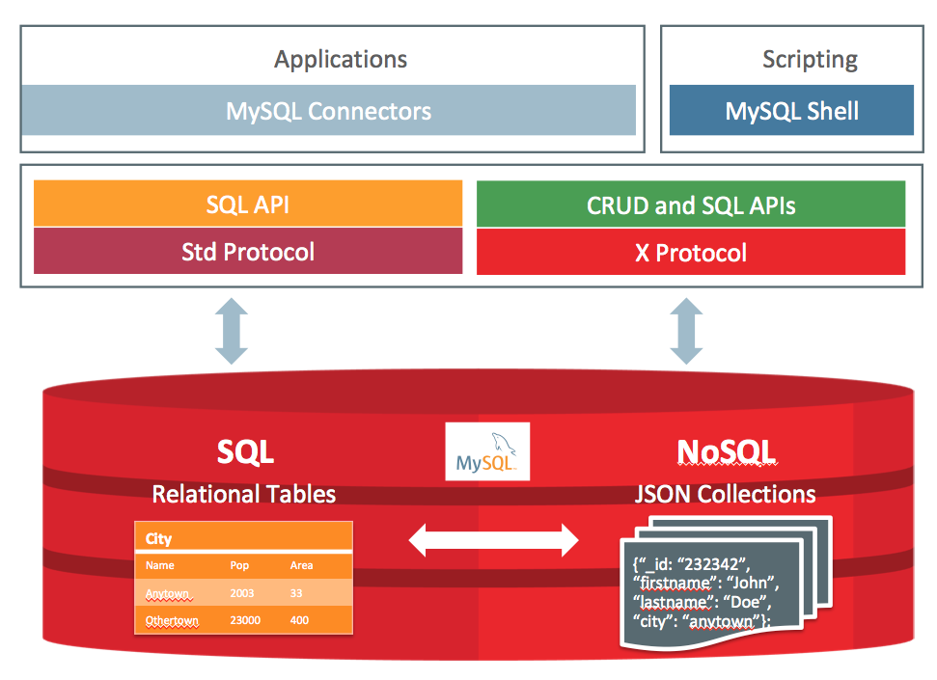
13. X DevAPI on by default on port 33060
MySQL Document Store allows developers to work with SQL relational tables and schema-less JSON collections.
To make that possible MySQL has created the X Dev API which puts a strong focus on CRUD by providing a fluent API allowing you to work with JSON documents in a natural way.
The X Protocol is a highly extensible and is optimized for CRUD as well as SQL API operations.

Slide 58
SQL + NoSQL
Schema-less NoSQL JSON Document Store with ACID compliance. And you can also access relational data!
1GB documents
versus
Mongo’s 16MB!

Slide 59
Using MySQL without SQL!
$nodeSession =
mysql_xdevapi\getNodeSession($connection_uri);
$schema = $nodeSession->getSchema("world_x");
$collection = $schema->getCollection("countryinfo");
$result = $collection->find('_id = "USA"')->execute();
$data = $result->fetchAll();
var_dump($data);

Slide 60
The 10 Best Restaurants of Different Cuisines
WITH cte1 AS (SELECT doc->>"$.name" AS name,
doc->>"$.cuisine" AS cuisine,
(SELECT AVG(score) FROM JSON_TABLE(doc, "$.grades[*]"
COLUMNS (score INT PATH "$.score")) AS r) AS avg_score
FROM restaurants)
SELECT *, RANK()
OVER (PARTITION BY cuisine ORDER BY avg_score DESC) AS `rank`
FROM cte1 ORDER BY `rank`, avg_score DESC LIMIT 10;
+-----------------------+--------------------------------+-----------+------+
| name | cuisine | avg_score | rank |
+-----------------------+--------------------------------+-----------+------+
| Juice It Health Bar | Juice, Smoothies, Fruit Salads | 75.0000 | 1 |
| Golden Dragon Cuisine | Chinese | 73.0000 | 1 |
| Palombo Pastry Shop | Bakery | 69.0000 | 1 |
| Go Go Curry | Japanese | 65.0000 | 1 |
| K & D Internet Inc | Café/Coffee/Tea | 61.0000 | 1 |
| Koyla | Middle Eastern | 61.0000 | 1 |
| Ivory D O S Inc | Other | 60.0000 | 1 |
| Espace | American | 56.0000 | 1 |
| Rose Pizza | Pizza | 52.0000 | 1 |
| Tacos Al Suadero | Mexican | 52.0000 | 1 |
+-----------------------+--------------------------------+-----------+------+
This query uses JSON_TABLE to structure the schema-less data within a CTE and then the CTE is queried to get the top 10 restaurants with a Windowing Function

Slide 61
The 10 Best Restaurants of Different Cuisines
This query uses JSON_TABLE to structure the schema-less data within a CTE and then the CTE is queried to get the top 10 restaurants with a Windowing Function
WITH cte1 AS (SELECT doc->>"$.name" AS name,
doc->>"$.cuisine" AS cuisine,
(SELECT AVG(score) FROM
JSON_TABLE(doc, "$.grades[*]"
COLUMNS (score INT PATH "$.score")) AS r)
AS avg_score FROM restaurants)
SELECT *, RANK()
OVER (PARTITION BY cuisine
ORDER BY avg_score DESC) AS `rank`
FROM cte1 ORDER BY `rank`, avg_score DESC LIMIT 10;
The JSON_TABLE, CTE, and Windowing Function

Slide 62
New Features 2019

Slide 63
1.The mysql_upgrade script runs automatically
2.Constraint checks
3.MySQL C API supports asynchronous, non blocking communications with server
4.EXPLAIN FORMAT=TREE
8.0.16 - April

Slide 64
1.Dual Passwords
2.Admin TCP/IP port (default 33062), no limit on number of connections, requires SERVICE_CONNETION_ADMIN priviledge
3.JSON_ARRAYAGG() and JSON_OBJECTAGG() added to Window Functions
4.SET PERSIST and SET PERSIST ONLY
5.LATERAL derived tables
8.0.14/15 - January/February

Slide 65
1.Multi-valued indexes
2.JSON Document Validation
3.Dual Password
4.Clone Table Space for Replication
5.New utf8mb4_900_bin (faster storts), no pad attribute
8.0.18 - October

Slide 66
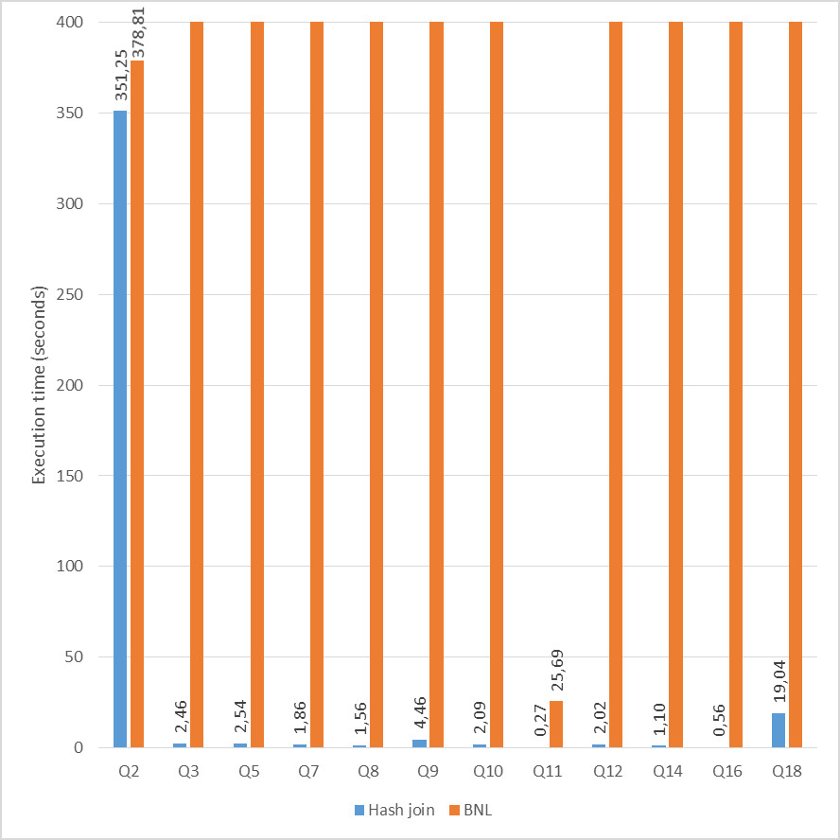
1.Random Passwords – CREATE USER, ALTER USER, and SET PASSWORD
2.EXPLAIN ANALYSE
3.HASH JOINS
4.Compression –
added ztsd (uncompresses or zlib other options)
5.Enterprise Edition supports HashCorp Vault
8.0.17 - July

Slide 67
Download Today
https://dev.mysql.com/downloads/mysql/
Or Docker images -> https://hub.docker.com/_/mysql/

Slide 68
The Unofficial MySQL 8 Optimizer Guide
http://www.unofficialmysqlguide.com/
Server Architecture
B+tree indexes
Explain
Optimizer Trace
Logical Transformations
Example Transformations
Cost-based Optimization
Hints
Comparing Plans
Composite Indexes
Covering Indexes
Visual Explain
Transient Plans
Subqueries CTEs and Views Joins Aggregation Sorting Partitioning Query Rewrite Invisible Indexes Profiling Queries JSON and Generated Columns Character Sets

Slide 69

Whew!
More features being added!

Slide 70
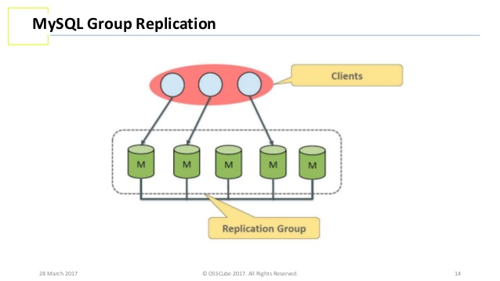
MySQL Group Replication
MySQL 5.7 or later
MySQL Group Replication is a MySQL Server plugin that enables you to create elastic, highly-available, fault-tolerant replication topologies. There is a built-in group membership service that keeps the view of the group consistent and available for all servers at any given point in time. Servers can leave and join the group and the view is updated accordingly. Sometimes servers can leave the group unexpectedly, in which case the failure detection mechanism detects this and notifies the group that the view has changed. This is all automatic.

Slide 71
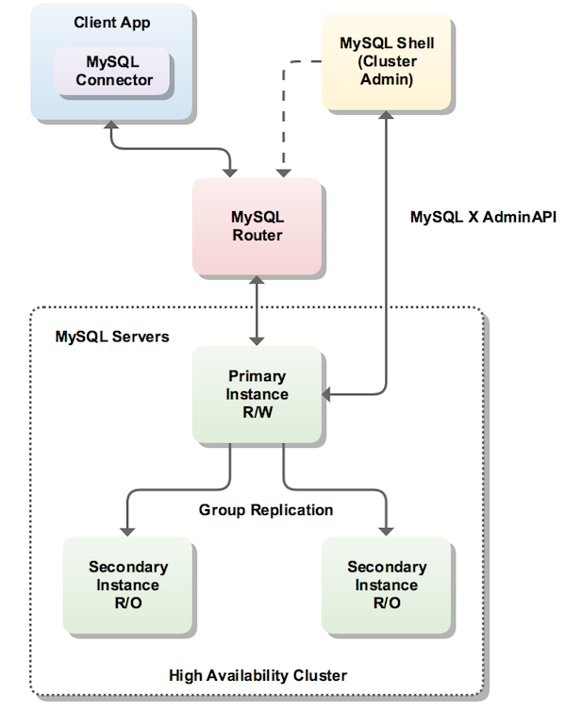
MySQL Group Replication
High Availablity MySQL Cluster

Slide 72
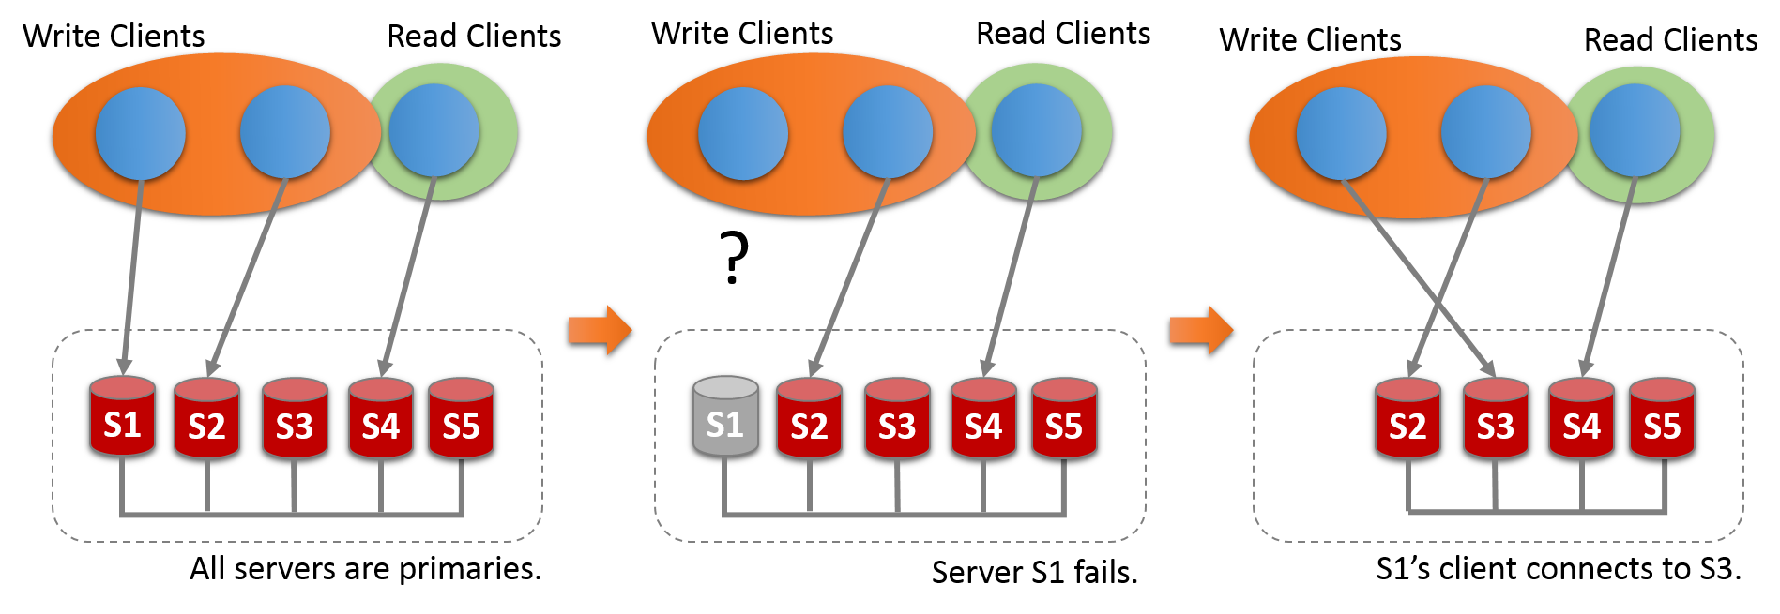
High Availablity MySQL Cluster Multi Primary Mode

Slide 73
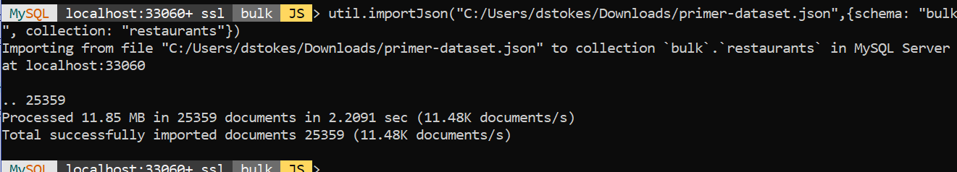
New MySQL Shell
The new MySQL Shell has three modes - JavaScript, Python, & SQL
plus admin tools -- check for upgrades, JSON bulk loader, InnoDB Cluster admin

Slide 74
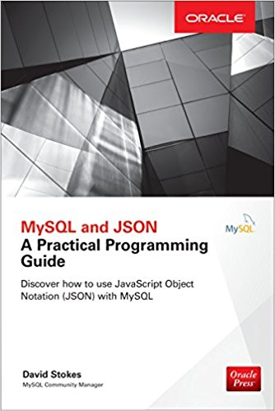
Buy My Book (please!)
What you need to know to use the MySQL JSON data type with lots of examples!

Slide 75

Thanks!
Contact me:
@stoker
david.stokes@oracle.com
slideshare.net/davidmstokes
Elephantdolphin.blogspot.com

Slide 76
WITH cte1 AS (SELECT doc->>"$.name" AS name,
doc->>"$.cuisine" AS cuisine,
(SELECT AVG(score) FROM JSON_TABLE(doc, "$.grades[*]"
COLUMNS (score INT PATH "$.score")) AS r) AS avg_score
FROM restaurants)
SELECT *, RANK()
OVER (PARTITION BY cuisine ORDER BY avg_score DESC) AS `rank`
FROM cte1 ORDER BY `rank`, avg_score DESC LIMIT 10;
+-----------------------+--------------------------------+-----------+------+
| name | cuisine | avg_score | rank |
+-----------------------+--------------------------------+-----------+------+
| Juice It Health Bar | Juice, Smoothies, Fruit Salads | 75.0000 | 1 |
| Golden Dragon Cuisine | Chinese | 73.0000 | 1 |
| Palombo Pastry Shop | Bakery | 69.0000 | 1 |
| Go Go Curry | Japanese | 65.0000 | 1 |
| K & D Internet Inc | Café/Coffee/Tea | 61.0000 | 1 |
| Koyla | Middle Eastern | 61.0000 | 1 |
| Ivory D O S Inc | Other | 60.0000 | 1 |
| Espace | American | 56.0000 | 1 |
| Rose Pizza | Pizza | 52.0000 | 1 |
| Tacos Al Suadero | Mexican | 52.0000 | 1 |
+-----------------------+--------------------------------+-----------+------+
That query by itself

