Slide 1

HOW TO CREATE A CITY CIRCLE?

Slide 2
AICI
POLICIES

Slide 3



City Circle
An AICI City Circle is a group of members that live in the same city or geographic region.

Slide 4

Participants of an AICI City Circle do whatever they want to do together: meet, talk, have dinner, study, work on certification, hold events, etc.
AICI City Circles require a minimum of four people.
City Circle

Slide 5

AICI City Circles will be recognized as an official and important part of AICI.
City Circle

Slide 6
Each City Circle will have a place on this page on the AICI Website; will be able to announce any upcoming program or event.
City Circle

Slide 7
AICI City Circles are only an organizational part of AICI. There is neither legal status, nor any financial obligation or rights between AICI International and the AICI City Circle.
City Circle

Slide 8
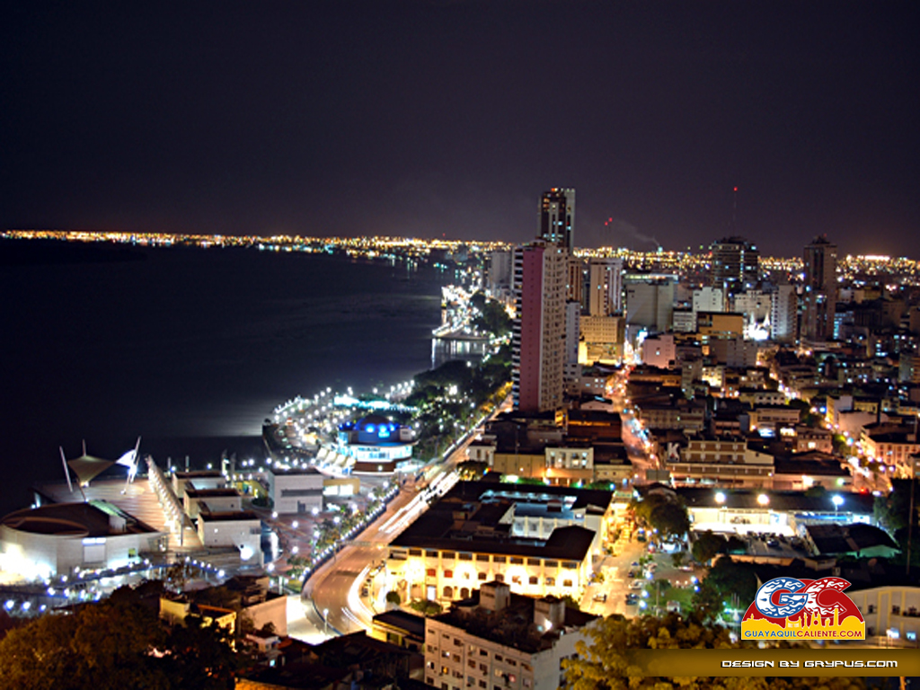
How Can I Start an AICI City Circle?
City Circle
They can make the request as soon as the number of AICI members to start an AICI City Circle is four.

Slide 9
How Can I Start an AICI City Circle?
City Circle
Existing members can choose to be affiliated with the AICI City Circle any time.
Submit all forms to VP Human Resources at vphumanresources@aici.org

Slide 10
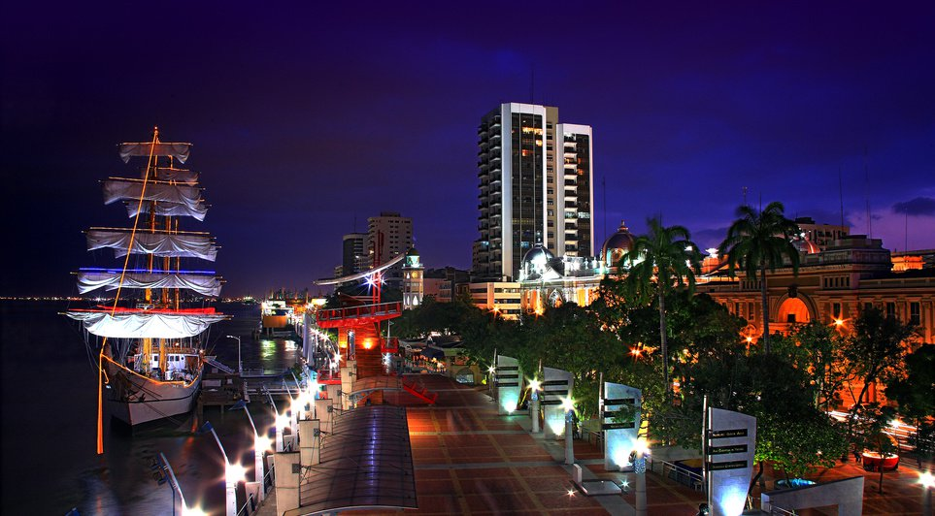
City Circle
The AICI city circles have the following obligations to be recognized by AICI:
A. An AICI City Circle is formed with a minimum of 4 AICI members.
B. The members of the City Circle of AICI are registered with an existing Chapter that is in Agreement.
C. An AICI City Circle has 1 Circle leader, the "Connector".

Slide 11
City Circle
The AICI city circles have the following obligations to be recognized by AICI:
D. The City Circle Connector signs an agreement on behalf of AICI City Circle to protect the AICI brand and logo.
E. Twice a year, the Connector sends VP Chapter Relations a written report on the activities and events carried out.
F. One of the requirements is to have a Fan Page on Facebook.

Slide 12
City Circle
WHY THE City Circles?
With the creation of AICI City Circles, we want to bring AICI closer to these members who live far away.

Slide 13
City Circle
WHY THE City Circles?
These meetings can be very simple and low budget.

Slide 14

City Circle
Circle of the city at the transition of the chapter:

Slide 15
City Circle
The AICI City Circle can be transformed into Chapters if they meet the requirements of membership, leadership and activity level, and request to be a Chapter.
They can do so by sending a Chapter Petition and the documents involved.

Slide 16


City Circle
Two or more AICI City Circles can collaborate in the construction of a Chapter.
They can share tasks and leadership and make the Chapter work.

Slide 17
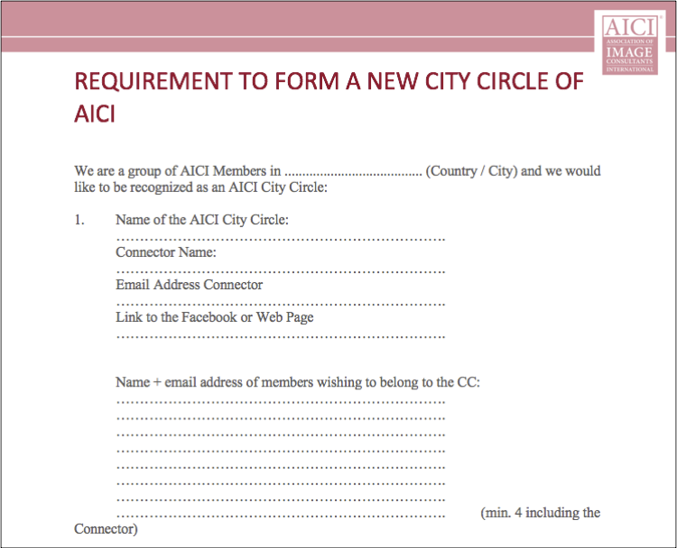
A special form for the application for recognition as City Circle of AICI is attached:

Slide 18
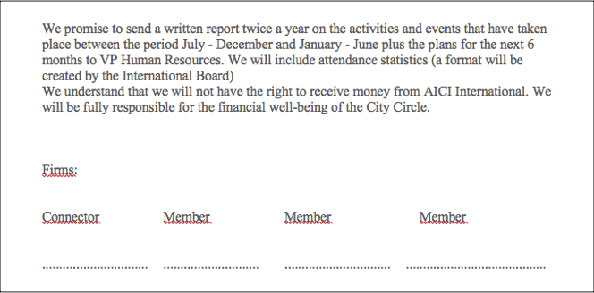
Attached the link to download the form City Circle of AICI:
http://aici.site-ym.com/?page=City_Circles

Slide 19

City Circle

