Slide 1

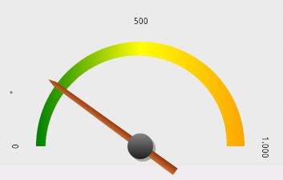
Mo Sattar
HR metrics through the prism of business planning process

Slide 2
Functional / departmental metrics should be view through multiple perspectives
  Value chain, Key stake holders , and their expectations
    Business planning process
    Business and Financial goals
  Organization structure
The “importance” of metrics will vary “depending on the business environment”.

Slide 3
Few takeaways
How is a annual business plan developed in an organization
  How does it tie in with metrics discussions ?
Steps to assess metrics
Ways to make metrics more “effective”
  Alignment
  Address relative stress
  Synergy via linkage between two metrics
This will help in becoming HR professional more sought after.

Slide 4
Is HR in your organization sought after ?
Are you sought after and why for each question ?
General Manager (GM)
Operations
Sales & marketing
Finance & accounting
Human Resources
Engineering
Other G &A departments
1. Sought after by “GM” for “tactical / compliance stuff” ?
2. Sought after by “GM” also for “strategic stuff” ?
3. Sought after by “Other departments ” for “strategic stuff” ?

Slide 5
What three things you ( HR )can do to become sought after ?
General Manager (GM)
Operations
Sales & marketing
Finance & accounting
Human Resources
Engineering
Other G &A departments
1. Actions to become sought after
2. What is holding you back?

Slide 6
How often are “HR metrics “ presented or discussed or questioned by investors during quarterly earning announcement ?

Slide 7
If business is not doing well what metrics are :
Share holders focused on ?
Banks and Lenders focused on ?
Senior Management focused on ?

Slide 8


Dominant
General Manager (GM)
Operations
Sales & marketing
Finance & accounting
Human Resources
Engineering
Other G &A departments

Slide 9
Lets take a pause
Before I start :
  Write down three “Financial level metrics” in your organization that are consistently used
  Three “HR metrics” that are also consistently used
  Identify alignment
Knowledge / Learning gaps ?

Slide 10
Bringing HR and Finance
Together with Analytics
By Jeff Higgins, Human Capital Management Institute
If the overwhelming majority of management teams
across the business world, including those at nonprofits and
in the public sector, all speak the financial language of business,
then is it the 95 percent in most organizations that
should stop and learn the language of HR? Or is it the 5 percent
in HR who need to learn the language of finance?

Slide 11
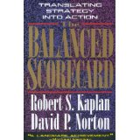
Benefits for Balanced scorecard

Slide 12
Benefits for Balanced scorecard
Themes
Strategy
Alignment
Monitoring

Slide 13
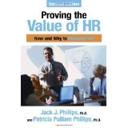
Paradigm Shift for results base approach

Slide 14
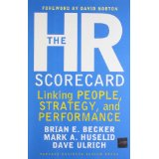

Value added ?

Slide 15
Lets take a pause
  How do you feel about the comment “ HR should be well versed in business and finance”. ?
  How do you feel about comment that financial metrics are not useful in making decisions

Slide 16
Metrics measure progress
Question : Are we are measuring the right things ?
  Alignment
  Value added
Foundation:
  Value Chain (Business process)
  Strategy
  Top level metric
  Lower level metrics

Slide 17
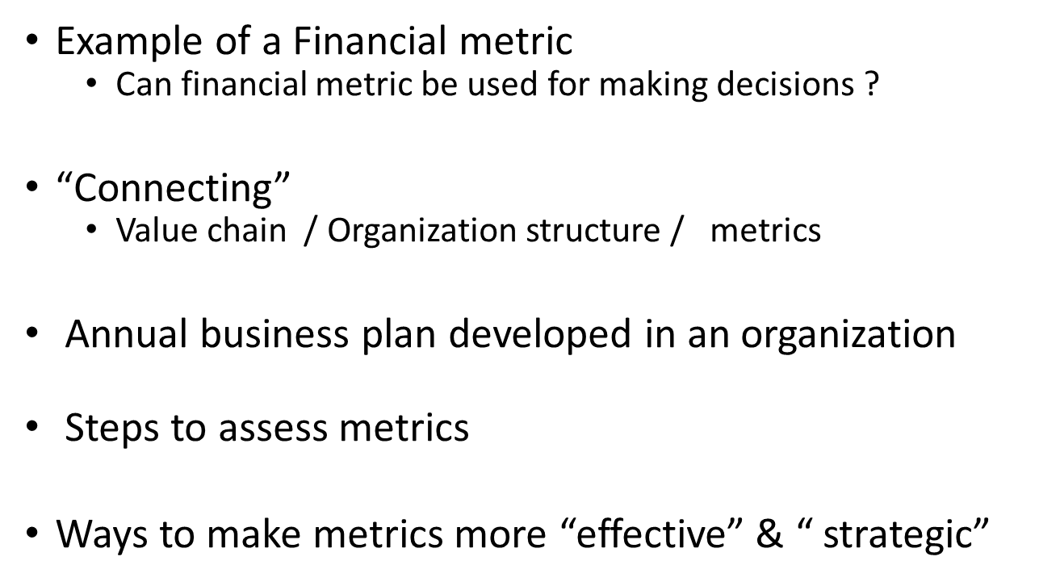
Demystifying Strategic planning
Demystifying metrics
Demystifying Finance
Effective leadership and management

Slide 18
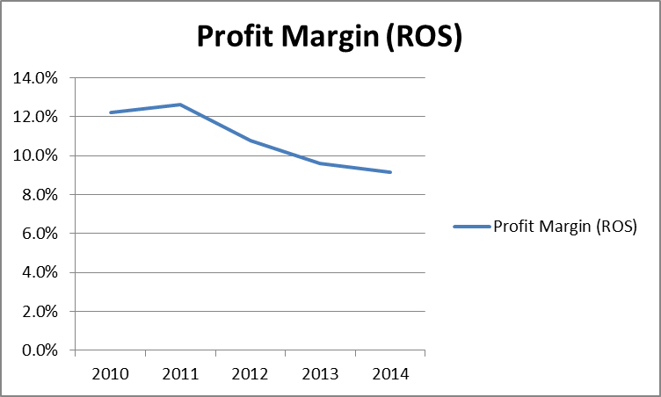
ROS : Return On Sales ( also called Profit Margin)
Examples of financial metrics
ROS, ROA, ROE
Oper. Margin, Gross margin
WC turns
Inventory turns
A.R. turns
A. P. turns
CCC

Slide 19
Value Chain

Slide 20
Harvard Business School Publishing Article : Expanding HR’s Strategic role ( Interview with Dave Ulrich)
“Successful HR professions must be business literate and customer savvy”
“For HR to deliver value, it needs to define its “receivers” and how to create value

Slide 21
HR Metrics and Analytics : Use and Impact. Lawler, Levenson, Boudreau. (Human Resources Planning)
Three functions of Metrics:
  Efficiency : How well the HR function performs its basic administrative function
  Effectiveness : Whether HR programs and practices have the intended effect .
    Example : How well “pivotal” jobs are filled
  Impact : Means demonstrating a link between what HR does and tangible effects on the organization’s ability to gain and sustain competitive advantage.
Your Metrics ???

Slide 22
Value chain concept and what is direct versus “indirect”
Design
Operations
After market support
Accounting & Finance
Human Resources

Slide 23
Important to understand the alignment between Organization structure and value chain
General Manager (GM)
Operations
Sales & marketing
Finance & accounting
Human Resources
Engineering
Other G &A departments
Value -1
Value-2
Value-3

Slide 24
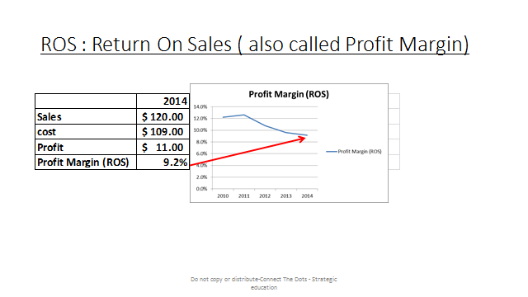
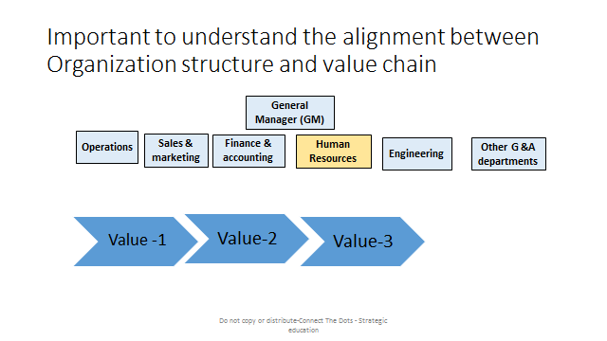
Linkage

Slide 25
Business planning process
Purpose of this review
All organization ( profit or non-profit) go through this process
Financial metrics play an important role
  Setting budgets for departments
  Reorientation during mid year
  Short term and long term
Thus “all non-financial managers and supervision” in an organization should be have some “financial literacy”
Helps in alignment of metrics and overall business performance

Slide 26
Sales
Price
Quantity
labor
EBIT
Manufacturing & quality
Cost of Good sold
Purchased
Overhead
Administration
Interest expense
SG&A
H&R
EBT
Sales and marketing
Taxes
Finance /accounting
R & D
Net Income
Engineering
EPS : EARNINGS PER SHARE

Slide 27
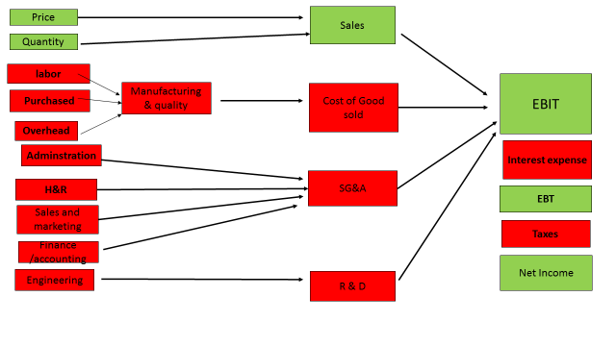
Inventory
Avoid the need to borrow
Acct . Rec.
Acct . Payable
Cash flow
Dividend
Capital exp. .
Net Income

Slide 28
If business is not doing well what metrics are :
Share holders focused on ?
Banks and Lenders focused on ?
Senior Management focused on ?

Slide 29
Organization structure
Key Financials

Slide 30

Value content effectiveness

Slide 31
HR Metrics and Analytics : Use and Impact. Lawler, Levenson, Boudreau. (Human Resources Planning)
Three functions of Metrics:
  Efficiency : How well the HR function performs its basic administrative function
  Effectiveness : Whether HR programs and practices have the intended effect .
    Example : How well “pivotal” jobs are filled
  Impact : Means demonstrating a link between what HR does and tangible effects on the organization’s ability to gain and sustain competitive advantage.

Slide 32
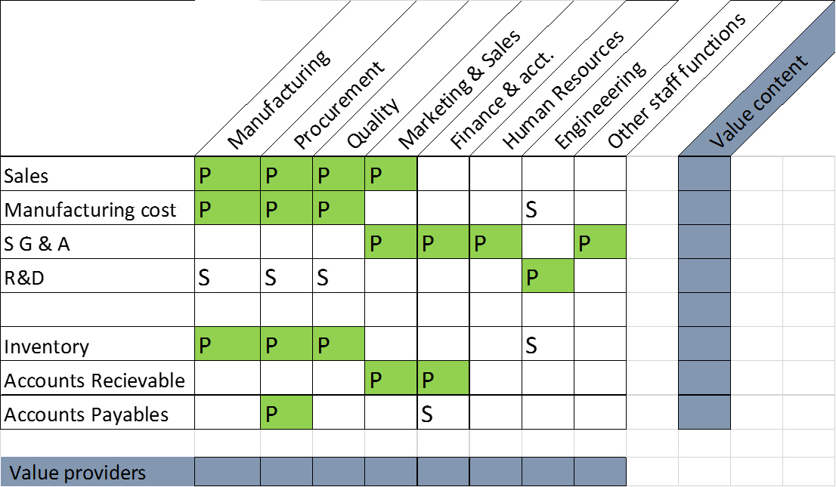

Filter the HR metrics

Slide 33

Run it through a filter process
H R cost per FTE
Benefits as %
Overtime related
H R expense %
H R cost per employee
H R FTE ratio
Diversity
Health care cost %
Average comp. ratios
Workers comp
H R cost per FTE
Span of control
Absenteeism related
Training related
OSHA
Hiring related

Slide 34
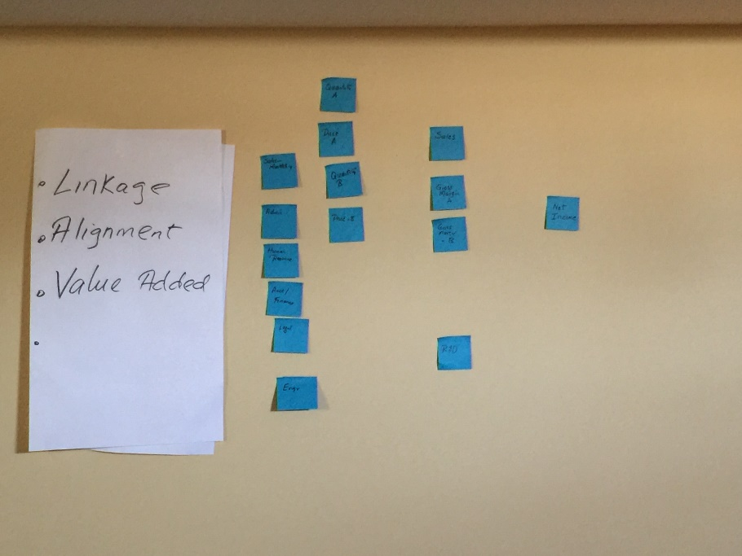
I like to test metrics for “purpose, value added, and connectivity ”
This applies to any metrics ( HR, operations, financial, procurement, etc.)
Compliance & or for “defensive purposes”.
Tactical – value added
Strategic
Connectivity – overall business goals
  Tactical, in concert with “relative risk factors”.
  Strategic
Elimination process…what will happen if we stop tracking
Gap analysis …are we missing any “gauges”.

Slide 35
Check for alignment – for near term goals

Slide 36
Address relative risk factors

Slide 37
Intersection of two metrics
Best ROI

Slide 38
Check for alignment – for longer term goals

Slide 39
Harvard Business School Publishing Article : Expanding HR’s Strategic role ( Interview with Dave Ulrich)
CF : “How do you create an outstanding strategy “.
DU : “ What are the business challenges ?”

Slide 40
This is how I test goals and strategies (business level, department level or personal)?
1. What are you trying to accomplish ( your goal) , testing for clarity ?
  We need clarity for alignment
2. Why ?
  If Why is not strong enough ( clarity and commitment) , go back to # 1.
3. “How” will you achieve your goal ( “what”)
  Fast forward, assume you can successfully implement your “how”
  Will you accomplish your “what” ?
  Test for alignment ( or misalignment)
4. What are the “measures” to monitor “progress”
  Test for alignment, clarity, ownership, leading, lagging, tactical, strategic
    Overall test for value added ( to monitor how and what)
5. Test for alignment and connectivity within the “relevant organization / system ”.

Slide 41
Closing comments / Recommendations
Re –think your training programs in your company
Add “basic management financial literacy” , across the organization
Test the metrics for “ purpose, valued added and connectivity”
Test for “relative risk factors” and “alignment”
Employee performance and compensation in line with “value added metrics”.
For HR staff/managers . Enhance your knowledge in the areas of
  Finance
  Strategic planning
  Leadership

Slide 42
Is HR (you) in your organization sought after ?
Are you sought after and why for each question ?
General Manager (GM)
Operations
Sales & marketing
Finance & accounting
Human Resources
Engineering
Other G &A departments
1. Sought after by “GM” for “tactical / compliance stuff” ?
2. Sought after by “GM” also for “strategic stuff” ?
3. Sought after by “Other departments ” for “strategic stuff” ?

Slide 43
What three things you ( HR )can do to become sought after ?
General Manager (GM)
Operations
Sales & marketing
Finance & accounting
Human Resources
Engineering
Other G &A departments
1. Actions to become sought after
2. What is holding you back?

Slide 44

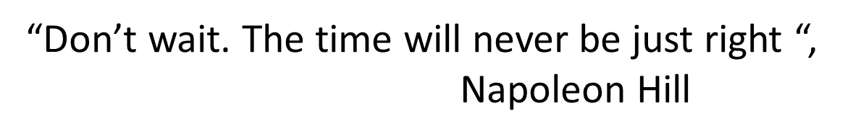
Q&A

