Slide 1

CAIVRS
Credit Alert Verification Reporting System v6 -12

Slide 2
The History Of CAIVRS
CAIVRS was implemented in 1988 as a Federal Housing Administration (FHA) loan origination aid.
In 1989, the Office of Management and Budget (OMB) mandated that Federal credit agencies prescreen all applicants to assure they were not delinquent on other Federal debt.
In 1990, CAIVRS was expanded to include delinquent Federal borrower data from agencies other than FHA, including the Department of Agriculture, Department of Veterans Affairs, Small Business Administration, Federal Deposit Insurance Corporation, Department of Education and the Department of Justice.
In 2004, CAIVRS became available through the internet.
2

Slide 3
Why Use CAIVRS
CAIVRS is used to determine if a loan applicant has a Federal debt that is currently in default or foreclosure or has had a claim paid by the reporting agency within the last three years.
Although CAIVRS may not identify all federal “delinquent debt” or “prior losses,” it is a good resource, especially for “delinquent debt.” Other sources to identify federal “delinquent debt” and/or “prior losses” include credit bureau reports as well as the borrower’s loan application.
You can use CAIVRS for all your SBA loan products.
3

Slide 4
Who Is Required To Use CAIVRS
SOP 50 10 5(D), Subpart B, Chapter 2, which became effective October 1, 2011, added the following procedure for delegated 7(a) lenders to follow:
“Delegated lenders are responsible for checking the Credit Alert Verification Reporting System (CAIVRS) to determine if any of the individuals or businesses identified in paragraph (4) immediately above has either a Delinquent Federal Debt or a Prior Loss which would result in the Small Business Applicant being ineligible for SBA financial assistance.
CAIVRS allows the lender to enter multiple tax id numbers (either SSN or EIN) to search for an outstanding Delinquent Federal Debt or Prior Loss in connection with a loan application.
Lenders may obtain general information and instructions for accessing CAIVRS at:
http://www.hud.gov/offices/hsg/sfh/sys/caivrs/caivrs_faq.cfm.”
4

Slide 5
When Do I Use CAIVRS
The following groups as being subject to a CAIVRS review:
“These rules apply to:
(a) The Small Business Applicant;
(b) Any business in which an Associate of the Small Business Applicant owned, operated or controlled a business that incurred the Delinquent Federal Debt or caused the Prior Loss;
(c) Any business controlled by the same person(s) who controls/controlled the business that incurred the Delinquent Federal Debt or caused the Prior Loss;
(d) Any Associate of the Small Business Applicant who has (or guaranteed) a Delinquent Federal Debt or caused a Prior Loss (either directly or as a guarantor); and
(e) Any guarantor who has (or guaranteed) a Delinquent Federal Debt or caused a Prior Loss (either directly or as a guarantor).”
The same procedures were added to Subpart C, Chapter 2 for PCLP-CDCs.
5

Slide 6
Who Can’t Use CAIVRS
Extension to allow lenders to receive CAIVRS access:
In order to give delegated lenders and PCLP-CDCs enough time to sign up for and include CAIVRS in their approval process, SBA is giving delegated lenders and PCLP-CDCs until September 30, 2012, to meet the SOP requirements to use CAIVRS for 7(a) and 504 loans processed under delegated authority. Instructions to sign-up for and use CAIVRS are attached to this notice.
Reminder:
Only SBA approved 7(a) lenders or Certified Development Companies (CDCs) are permitted to sign up for CAIVRS to identify possible delinquent debt associated with their 7(a) or 504 loan applications. Loan packagers are not recognized as SBA approved lenders and therefore cannot have access to CAIVRS through SBA.
6

Slide 7
How Do I Access CAIVRS
The only way to access CAIVRS is through an FHA Connection.
If the lender is FHA-approved, it can use CAIVRS for their SBA loans as well. The SOP does not state you have to have a SBA Coordinator, only that you must use CAIVRS. You may have a mortgage or other department that is or has used CAIVRS in the past. If they are willing to be your coordinator, you can register, under them, as a User.
Remember: If you register under an existing coordinator as a User, you must use the same Lender ID and Agency/Program they use. (ie. HUD-FHA Single Family, USDA Rural Development, etc).
You would only use the Small Business Administration ,as the Agency/Program, if you registered as the coordinator using the Small Business Administration as your Agency/Program.
7

Slide 8
CAIVRS - Not FHA-Approved
If the lender is not FHA-approved, the following are the steps to register:
Step 1: Coordinator User ID
First, identify a “Coordinator.” This person will be responsible for updating the system for other individuals the Lender chooses to have access to CAIVRS. Do not have other users register for a User ID until the Coordinator can successfully process a Prescreening Report.
There must be at least one, but no more than two, coordinators for each lending institution. You must register under the name of the lending institution.
You will need your Lender EIN number (tax id) to register for a User ID and password to gain Internet access to CAIVRS. Do not enter any dashes or spaces in the EIN number.
8

Slide 9
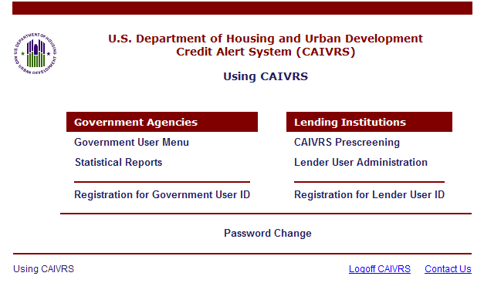
Use This Link To Get Started
Go to https://entp.hud.gov/caivrs/public/home.html (This link will direct the reader to the “USING CAIVRS” menu for non-FHA approved lenders.)
On the first page, choose “Lending Institutions.” Do NOT choose “Government Agencies.”
Select: Registration for Lender User ID.
9

Slide 10
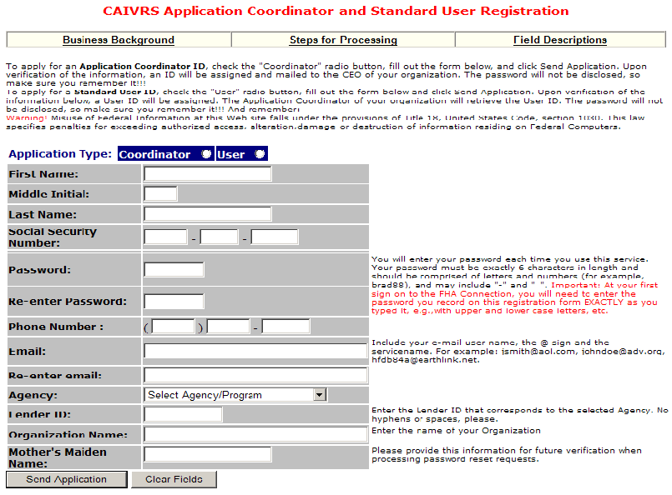
Follow The Instructions At The Top Of The Page To Obtain A Coordinator's ID.
.
Register as a Coordinator. (DO NOT register as both a coordinator and a standard user.)
Enter into the “Lender ID field” the Lender’s EIN number (tax ID).
(Do not add dashes, spaces or zeroes to either side of the EIN in an attempt to create a 10 digit number.)
For the Agency/Program field, select Small Business Administration.
10

Slide 11
If The Application Is Not Accepted
If the application is rejected and the message is “Invalid Lender ID or Agency,” you may contact kristi.harris@sba.gov. SBA may have to enter information about the Lender into the HUD CAIVRS system database in order for you to proceed further.
Please provide the following information in your e-mail:
Your name
Your phone number
The name of your lending institution
The address of your main branch and PO Box (if applicable)
Your main branch EIN number (tax ID)
Note: Please don’t send this information in a password protected format.
11

Slide 12
If The Application Is Accepted
If the application is accepted: You should receive an e-mail stating that your request for a CAIVRS User ID was processed successfully.
From: sfadmin@hud.gov [mailto:sfadmin@hud.gov]
Sent: Thursday, November 17, 2011 6:35 PM
To: Jane Doe
Subject: CAIVRS ID
This is to inform Jane Doe that your request for a CAIVRS User ID was processed successfully
Your CAIVRS Application Coordinator ID will be mailed to the CEO of your organization
As stated in Mortgagee Letters 97-14 and 98-13, each FHA Connection user must obtain their own user ID. User IDs are NOT to be shared. Passwords should never be shared, displayed online or divulged publicly. They should not be given to third parties in telephone conversations, placed on office message boards, or left written on telephone message notes on unattended workstations. Using an FHA Connection user ID assigned to another person falls under the provisions of Title 18, United States Code, section 1030. This law specifies penalties for exceeding authorized access, alteration, damage or destruction of information residing on Federal Computers.
Any person who knowingly presents materially false, fictitious or fraudulent statements in a matter within the jurisdiction of the U.S. Department of Housing and Urban Development is subject to penalties, sanctions or other regulatory actions, including but not limited to:
(i) fines and imprisonment under 18 U.S.C. sections 287, 1001, 1010 and
1012, which provide for fines of a maximum of $250,000 for individuals and $500,000 for organizations, or imprisonment for up to 5 years, or both;
(ii) civil penalties and damages under 31 U.S.C. section 3729 of not less
than $5,000 and not more than $10,000 per violation, plus 3 times the amount of damages that the government sustains; and
(iii) administrative sanctions, claims and penalties by HUD pursuant to 24 C.F.R parts 24, 28 and 30.
If you have any questions, please email us at sfadmin@hud.gov
12

Slide 13
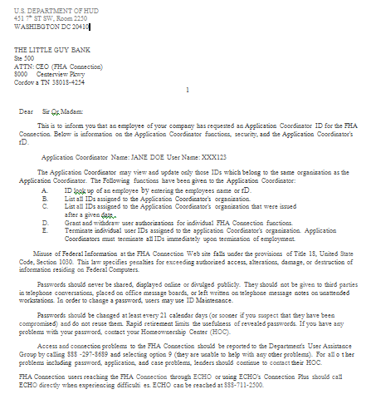
The Letter Is In The Mail
A letter containing your User ID will be sent from the FHA Connection security application to the CEO of the lender by U.S. Mail.
This may take a week to ten days.
There is no way to expedite this process.
13

Slide 14
If You Don’t Receive Your Letter
If the CEO of your company has not received a message containing your Coordinators ID in the U.S. Mail within two weeks of your registration, send an e-mail to SFADMIN@hud.gov, advising them that you have not received your "Coordinator ID."
You must include:
    Your name;
    Your social security number;
    The Lender’s EIN number (tax id);
  And they may ask for:
    Your mother’s maiden name.
The FHA Connection help desk will assist you.
14

Slide 15
Once You Receive Your Letter
Step 2: Process to Submit CAIVRS Inquiries by a Coordinator
After a Coordinator ID has been issued, the following steps are to be followed by the Coordinator:
Go to the “USING CAIVRS” page and select “Lender User Administration.”
15

Slide 16
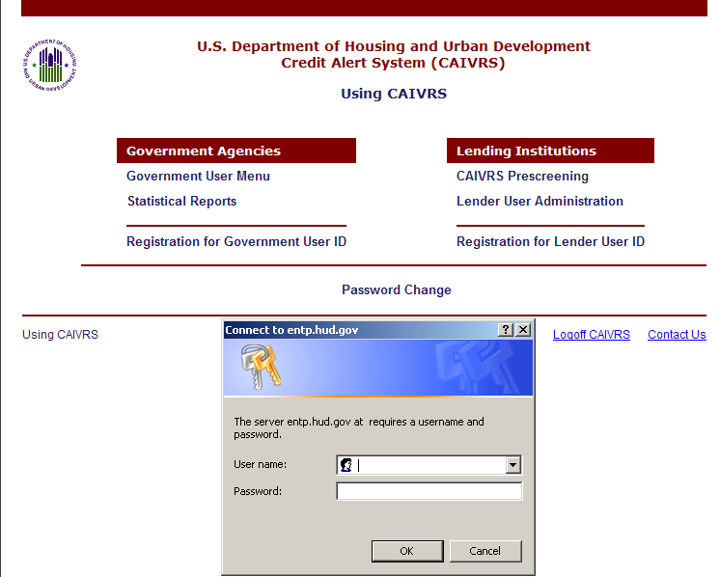
Logging Into CAIVRS
Login:
Enter your User ID found in the letter that you received from FHA Connection into the User Name window;
Enter the password that you chose when you registered into the Password window;
Press submit.
16

Slide 17
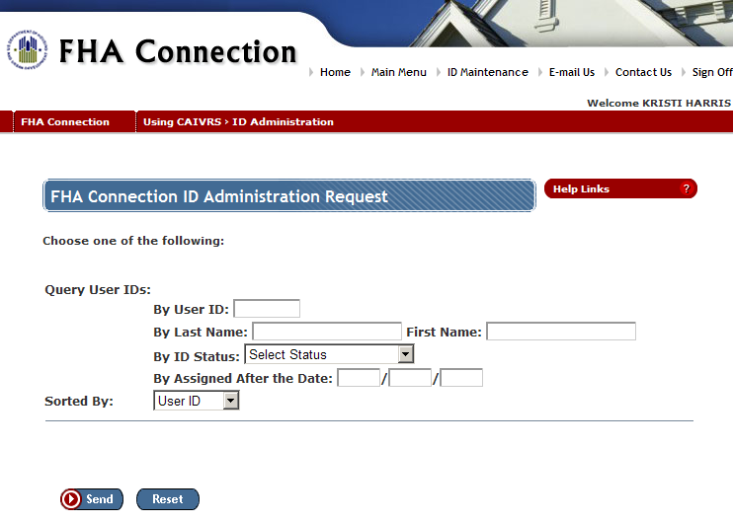
When The FHAC Lender User Administration Screen Appears:
Enter your User ID into the window “User IDs;”
Press send.
When your profile page appears, find and verify that the box for CAIVRS Prescreening Authorization has been checked. (The CAIVRS Prescreening Authorization box will need to be checked for each user, including the Coordinator, before being authorized to perform a CAIVRS Prescreening.)
*Please note: You only need to verify your user id authorization this one time.
17

Slide 18
Pulling A CAIVRS Report
Return to the USING CAIVRS menu:
Select CAIVRS Prescreening option.
18

Slide 19
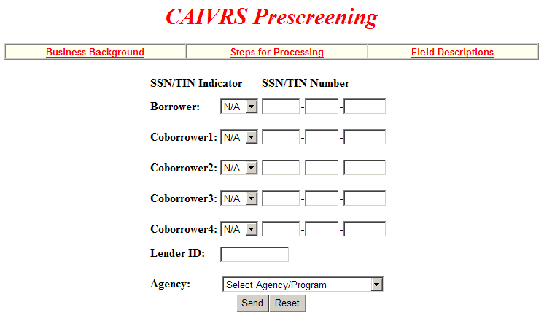
What To Enter To Receive A Report
Enter your User ID and Password into the “pop up box.”
CAIVRS Prescreening is where you enter the tax id numbers for the small businesses (EIN) and the owners/guarantors (SSN).
Limit of 5 per inquiry screen.
Enter your Lender EIN number (tax id). (Do not enter any dashes or spaces in the EIN number.)
For SBA loans, your lender ID is your company's tax ID (EIN), followed with a capital "T". Enter your company's nine digit Tax ID in the lender ID box, DO NOT USE ANY DASHES, followed immediately with a capital "T" (*********T).
For the Agency, select Small Business Administration.
Press send.
19

Slide 20
If the applicant has no delinquent federal debt:
If the applicant’s SSN or EIN is not in the database, you will receive a clear confirmation code (the Authorization number).
You will see the Authorization number on the right hand side, directly across from the SSN or EIN number you entered into the system.
The line showing the Agency reporting the default, the case number of the defaulted debt, the type of delinquency (default, claim, foreclosure, lien or judgment) and a telephone number to call for further information or assistance will be blank.
If the applicant has delinquent federal debt:
If there is a record of default for the borrower whose SSN or EIN was entered, you will be given the name of the Agency reporting the default, the case number of the defaulted debt, the type of delinquency (default, claim, foreclosure, lien or judgment) and a telephone number to call for further information or assistance.
*To avoid typo errors causing a possible loss of your guarantee, please remember to verify that the SSN or EIN number shown on the report are the correct numbers for your applicant.
How To Read The Results
20

Slide 21
What Do I Do With The CAIVRS Report (CDC)
If the report results show no delinquent federal debt:
Print/save a copy and include it in your loan application under Exhibit 11.
If the report results do show a delinquent federal debt:
Print a copy for your loan file.
Call the phone number shown on the report.
Supply the information to the applicant.
Have the applicant get the debt resolved.
Have the applicant bring you verification, from the agency in question, that the debt has been satisfied.*
Print/save a copy and include it in your loan application under Exhibit 11.
*Any delinquent federal debt that is not addressed in your application will result in an automatic decline.
21

Slide 22
How Do I Add Other Users
Step 3: Process for Coordinator to Add Additional Lender Employees
(Standard Users) to the CAIVRS System
Employee Step:
Employee(s) goes to the “Using CAIVRS” main screen and click on “Registration for Lender User ID.”
For “application type,” choose User.
Fill in all the requested information.
Again, the Lender ID is the Lender EIN Number (no spaces or other additions).
Agency:
Select Small Business Administration.
Organization Name:
Lender’s Name.
Once completed, click on “Send Application” at the bottom of the screen.
This is an overnight process.
22

Slide 23
How Do I Add Other Users
Coordinator Step:
No sooner than the following day, the coordinator must go to the USING CAIVRS page, and select Lender User Administration.
Login by entering your User ID.
Enter your password.
Press submit.
When the FHAC Lender User Administration screen appears:
Select “By ID Status”
Then select “All IDs”
Press send
A list of IDs will appear.
Select each individual by clicking on the ID number.
23

Slide 24
How Do I Add Other Users
When an individual's profile page appears:
Assign a CAIVRS role (Standard User)
Find and check the box for CAIVRS Prescreening Authorization
(The CAIVRS Prescreening Authorization box will need to be checked for each user, including the Coordinator, before being authorized to perform a CAIVRS Prescreening.)
Provide the system-issued user ID to each employee who has a registration request pending once the coordinator approves the employee to have access to CAIVRS.
Note: Coordinators must also terminate the User ID of employees who no longer need access to the FHA Connection. If a coordinator is leaving the position, it would be best for the current FHA Connection coordinator to go to “Lender User Administration” and change an existing employee's User ID from “Standard User” to “Coordinator” before the current coordinator leaves the position.
Note: When the current coordinator no longer needs access, the new coordinator must terminate the previous coordinator's User ID.
24

Slide 25
User Requests For A CAIVRS Report
Step 4: Process to Submit CAIVRS Inquiries by a Standard User
Once an FHA Connection User ID and Password has been issued to a Standard User, the Standard User then goes to:
https://entp.hud.gov/caivrs/public/home.html to submit CAIVRS inquiries.
This will bring up the USING CAIVRS menu.
Select CAIVRS Prescreening option.
Enter your User ID and Password into the “pop up box.”
Then process a CAIVRS request the same way a coordinator does.
25

Slide 26
Passwords
FHA Connection passwords are good for 21 days and must be reset before they expire.
Passwords must be exactly 6 characters, are case sensitive, and must contain at least one letter and one number.
To reset your password, go to the "Using CAIVRS" screen. Choose “Lending Institutions.”
Then click on “Password Change.”
After changing your password, reboot your PC. (PCs have a tendency to hold your old ID/Password, and the server that houses the FHA Connection security module sometimes takes 15 to 20 minutes to recycle. Make sure that you do not check the "Remember My Password" box.)
Coordinators have the authority to reset user passwords from the user id profile screen.
Coordinators can reset passwords of FHA Connection Users if the User is locked out because it has been more than 21 days.
Make your password easy to remember. Since the HUD CAIVRS website does not remember past passwords, you are allowed to switch back and forth between two choices (i.e. Eewew1, Eewew2). You are given 3 tries to log-in before you are locked out of the system, so if you type carefully you shouldn’t need to have your password reset.
Do not contact HUD or your Coordinator to ask what your password is, they don’t know.
If you are a Coordinator and need your password reset contact: sfadmin@hud.gov and they can reset your password to the last 6 digits of your SSN. You will be prompted to create a new password, once you are back in the system.
If you are a USER contact your Coordinator to reset your password. The Coordinator can reset your password to the last 6 digits of your SSN. You will be prompted to create a new password, once you are back in the system.
26

Slide 27
Some Interesting CAIVRS Facts
CAIVRS may be accessed Monday through Saturday, 8:00 a.m. to 10:00 p.m. US Eastern Standard Time. CAIVRS is not available on Federal holidays. Access to the system is during limited hours because it requires mainframe access.
Note: The “T” fix is only used on the CAIVRS Prescreening screen. Never use it to try and register as a Coordinator or User. The “T” is used as a temporary tenth digit and HUD is trying to fix this issue. If sometime in the future, the “T” fixes stop working, enter your EIN without the “T”.
Federal law prevents “delinquent Federal debtors from obtaining Federal loans or loan insurance guarantees.” CAIVRS provides a single repository of delinquent Federal debtor records with easy access through a variety of media for pre-screening applicants for Federal benefits. Most credit bureau reports do not identify insured debts as being delinquent Federal debts. By participating in CAIVRS, Federal lending agencies have ready access to an interdepartmental database of delinquent Federal debts that provide Federal financial managers with the information necessary to comply with the U.S. Code requirements.
Since 1987, over 31 million borrowers have been pre-screened through CAIVRS. As a direct result of participating in CAIVRS, HUD alone has avoided over $12 billion in potential claims and over $4 billion in potential losses. USDA and VA have also realized significant claim and loss avoidance benefits. Additionally, participating Agencies have realized cash collections of delinquent debts on an annual average in excess of $6 million.
From a report published on 11/12/2011 by the U.S. Department of Housing and Urban Development regarding the Credit Alert Interactive Voice Response System (CAIVRS) for data through 10/2011.
* Over 79,071 lenders working on behalf of HUD and participating agencies have access to the system.
* Lenders use touch tone telephones and the web to access data base containing social security numbers (SSN's) for 3,335,320 borrowers from all participating agencies.
- 469,732 borrowers currently in default on an FHA single family mortgage.
- 455,416 borrowers who have had a claim paid on an FHA single family mortgage in the last three years.
- 38,306 borrowers who have had a claim paid on a Title I loan in the last three years.
* Since implementation over 104.0 million FHA single family and Title I applicants’ SSN's have been checked using the system. Less than 4% were matched with the credit alert data bases.
* Even so, CAIVRS has to date allowed the department to avoid $193.8 billion in potential FHA single family claims and $69.9 billion in potential losses. (3,877,001 potential Title II claims have been avoided and 34,785 potential Title I losses have been avoided.)
27

Slide 28
QUESTIONS?
28

