Slide 1
ERAS
Enhanced Recovery After Surgery

Slide 2
Intro
Fast-track
Standardized
Multimodal/multispecialty approach
Goals
  Reduce surgical stress response
  Support physiological function

Slide 3
History
Idea
  Get patients out faster
1990’s – Regional
Research on different aspect
  Fluid therapy, NPO status, pain, etc

Slide 4
Combined approach
Integration of ideas
  Colorectal
  Fluid therapy + multimodal pain + early mobilization
2005 – 1st protocol by ERAS Society
2011-2016 Bulk of ERAS evidence
  Bariatric, Urologic, Ortho, etc.

Slide 5
Why now
“Show Me The Money”
  Change in reimbursement
    Value based purchasing
    Quality measures
  Cost savings in hospital
    Shorter stays
    Standardized resources
  Bundled payments
    Same pie for everyone
    Need to make more pies for less

Slide 6
Other Factors
Variability in outcomes
  Standardize
Quality of U.S. Care
  We spend more
  Outcomes

Slide 7
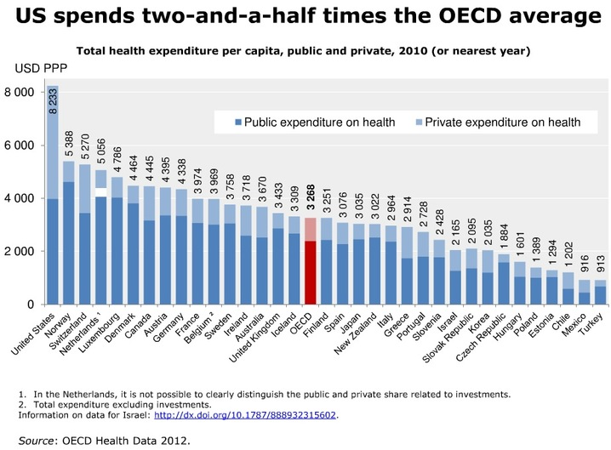
How much do we spend?

Slide 8
What the numbers say?
 | Results
Length of Stay | Decreased (3 days)
Complications (All) | Decreased (50%) or unchanged
Mortality | Decreased (50%) p=0.41
Readmission | Decreased to unchanged p=0.91
Cost | Decreased
Patient Satisfaction | Increased (Home, different difficulties)

Slide 9
Where we stand
Decreased length of stay (3 days)
Saving some money
Not compromising quality
Patients happier
Is it a good idea?
Why are we not doing this yet?

Slide 10
Building a Protocol
A Perioperative Protocol
  Multispecialty
    Buy in from everyone
  Start well before surgical day
  Lots of examples
    ASER

Slide 11
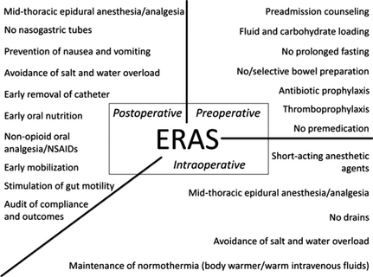
Enhanced Recovery After Surgery (ERAS) for gastrointestinal surgery, part 1: pathophysiological considerations
Acta Anaesthesiologica Scandinavica
Volume 59, Issue 10, pages 1212-1231, 8 SEP 2015 DOI: 10.1111/aas.12601
http://onlinelibrary.wiley.com/doi/10.1111/aas.12601/full#aas12601-fig-0001
Notes:
ERAS elements. Reproduced from Varadhan KK et al. with permission.
IF THIS IMAGE HAS BEEN PROVIDED BY OR IS OWNED BY A THIRD PARTY, AS INDICATED IN THE CAPTION LINE, THEN FURTHER PERMISSION MAY BE NEEDED BEFORE ANY FURTHER USE. PLEASE CONTACT WILEY'S PERMISSIONS DEPARTMENT ON PERMISSIONS@WILEY.COM OR USE THE RIGHTSLINK SERVICE BY CLICKING ON THE 'REQUEST PERMISSIONS' LINK ACCOMPANYING THIS ARTICLE. WILEY OR AUTHOR OWNED IMAGES MAY BE USED FOR NON-COMMERCIAL PURPOSES, SUBJECT TO PROPER CITATION OF THE ARTICLE, AUTHOR, AND PUBLISHER.

Slide 12
Preoperative
Not Anesthesia
  Preadmission counseling
    Educate, Educate, Educate
    Pts have to be involved
    Compliance is key
    Should include risk stratisfication
      Cardiac, renal, pulm
        STOP SMOKING
  No/selective Bowel preps

Slide 13
PreOp
Not Anesthesia
  Antibiotic prophylaxis
    Blame anesthesia if not done/correct
  Thrombopropylaxis
    Blame anesthesia if not done

Slide 14
PreOp
Anesthesia related/involved
Prehabilitation
  Boost pts health prior to surgical insult
  NO PROLONGED FASTING
    Current NPO guidelines
    Fluid and Carbohydrate loading

Slide 15
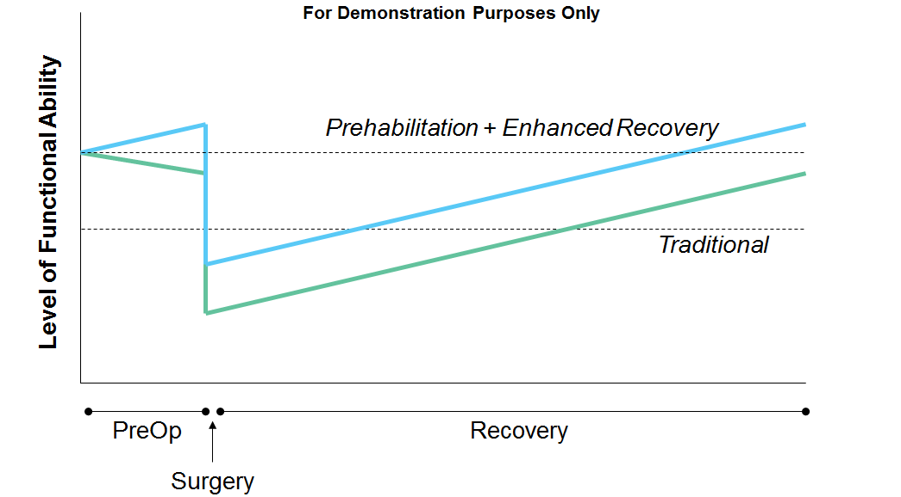
Comparison

Slide 16
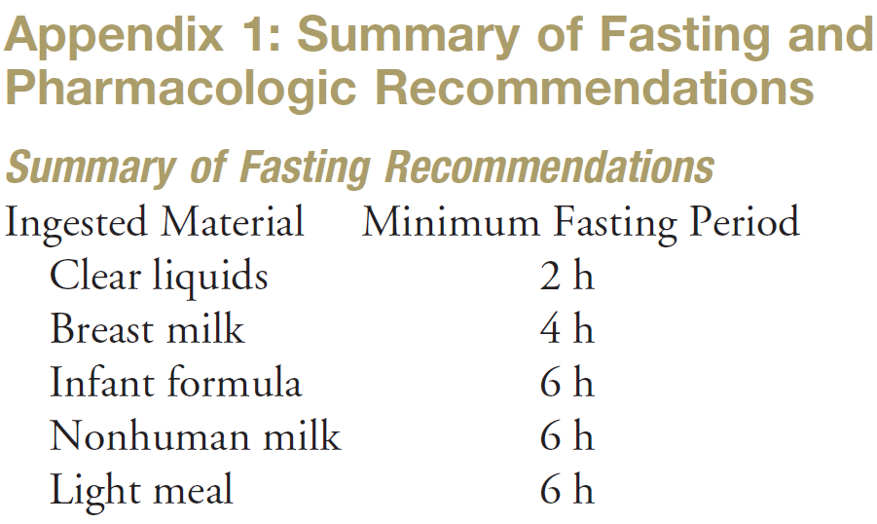
NPO Guidelines

Slide 17
Fluid and Carbohydrate Loading
Preoperative oral complex carbohydrates (maltodextrin)
  100g night before sx
  50g 2-3 hrs before induction
Free clear liquids up to 2 hrs
    Alter with known delayed gastric emptying

Slide 18
Last Preoperative Piece
No premedication
  Long acting anxyolytics/opiods
  Short acting benzodiazepine in elderly
  Note
    Anxiety does correlate with post-operative pain intensity
    Short acting anxyolytics may be beneficial

Slide 19
Intraoperative
Non-Anesthesia
  No drains
Anesthesia
  Short-acting anesthetic agents
  Mid-Thoracic Epidural anesthesia/analgesia
  Maintenance of Normothermia
  Avoidance of salt + water overload

Slide 20
Epidural
Alternative
  Intrathecal opiods
    200 mcg preservative free morphine

Slide 21
Fluid Management
Fluid Calculation
  Maint + deficit + fluid loss + EBL = tons of fluid
Goal Directed Therapy
  Stroke Volume Variability (SVV)
  Systolic Pressure Variate (SPV)
  Pulse Pressure Variation
  Pleth variability index (PVI)
  Respond to pt instead of predetermined amount

Slide 22
Which fluids?
Balanced Crystalloid
  Avoid 0.9% NS
Colloids
  Albumin
    Hespan associated with AKI

Slide 23
Postoperative
Repeat
  Mid-thoracic epidural anesthesia/analgesia
  Avoidance of salt + water overload
No nasogastric tube
  Avoid if possible
Prevention of Nausea/Vomiting
  PONV guidelines
  APFEL scoring system

Slide 24
Post-op
Non-opioid oral analgesia/NSAIDS
  Multimodal pain approach
Non-Anesthesia
  Early catheter removal
  Early oral nutrition
  Early mobilization
  Stimulate gut motility
  Audit of compliance and outcomes

Slide 25
Enhanced Recovery After Surgery (ERAS) for gastrointestinal surgery, part 1: pathophysiological considerations
Acta Anaesthesiologica Scandinavica
Volume 59, Issue 10, pages 1212-1231, 8 SEP 2015 DOI: 10.1111/aas.12601
http://onlinelibrary.wiley.com/doi/10.1111/aas.12601/full#aas12601-fig-0001
Notes:
ERAS elements. Reproduced from Varadhan KK et al. with permission.
IF THIS IMAGE HAS BEEN PROVIDED BY OR IS OWNED BY A THIRD PARTY, AS INDICATED IN THE CAPTION LINE, THEN FURTHER PERMISSION MAY BE NEEDED BEFORE ANY FURTHER USE. PLEASE CONTACT WILEY'S PERMISSIONS DEPARTMENT ON PERMISSIONS@WILEY.COM OR USE THE RIGHTSLINK SERVICE BY CLICKING ON THE 'REQUEST PERMISSIONS' LINK ACCOMPANYING THIS ARTICLE. WILEY OR AUTHOR OWNED IMAGES MAY BE USED FOR NON-COMMERCIAL PURPOSES, SUBJECT TO PROPER CITATION OF THE ARTICLE, AUTHOR, AND PUBLISHER.

Slide 26
 | Traditional | ERAS
Fasting | NPO after midnight | Clear up to 2 hrs Light meal 6 hrs
Carb Loading | Ø | 100g night before 50 gm 2-3 hrs before
Prevent PONV | Everyone gets zofran | Risk 1-2 = 2 antiemetics Risk 3-4 = 2-3 + TIVA
Anesthetics | Inhaled 1 MAC NMBD’s | ET 0.7-1.3 MAC or Bis 40-60 NMBD’s – short and completely reverse (suggamadex)
Hypothermia | Keep warm | Preop warming Active warming intraop Postop warming
NGT | Place on everyone May remove at end or leave in | Avoid prophylactic Remove after decompressing
Glycemic control | Tx as necessary | Reduce insulin resistance Maintain near normal
Hemodynamics | Tx – fluids, vasopressors, gas, etc. | Avoid high fluid (2-5 ml/kg/hr), avoid NS, Balanced cryst or colloids, vasopres/inotropes, invasive monitoring for high risk

Slide 27
Pain approach
Multimodal, Evidence-based, Procedure specific
  Optimal analgesia with minimal side effects
  Early mobilization and oral feeding
Opioid side effects
NO OPIODS for ERAS

Slide 28
Preoperative
NSAID
Cox-2
Acetaminophen
Gabapentanoids
Systemic Steroids
Notes:
Some question with NSAIDS and Cox2 for anastomotic leakage

Slide 29
Lidocaine Infusion
    Decreases opioid consumption
    Speeds recovery
    Inhibits neuropeptides chemical mediators – influences pain phenomenon
  1.5 mg/kg/hr 30min before or at induction through end of surg or to PACU
  Low risk of LAST

Slide 30
Magnesium Infusion
    Enhances analgesic action of other meds
    Blocks NMDA and calcium channels
  2 gm over 2 hr
  Low risk of toxicity

Slide 31
Ketamine gtt
  NMDA – antihyperanalgesic effect of opioids. Many other benefits
  0.4 mg/kg/hr

Slide 32
References
American Association of Nurse Anesthetists. (2016, October 17). [Image]. Retrieved from http://www.aana.com/resources2/professionalpractice/Pages/Enhanced-Recovery-After-Surgery.aspx
American Medical Association. (2015). Measure #430: Prevention of Post-Operative Nausea and Vomiting (PONV) – Combination Therapy – National Quality Strategy Domain: Patient Safety (430). Retrieved from American Association of Nurse Anesthetists website: http://www.aana.com/resources2/quality-reimbursement/Documents/2016_PQRS_Measure_430_11_17_2015.pdf
American Society of Anesthesiologists. (2011). Practice Guidelines for Preoperative Fasting and the Use of Pharmacologic Agents to Reduce the Risk of Pulmonary Aspiration: Application to Healthy Patients Undergoing Elective Procedures. Anesthesiology, 114(3), 495-511. doi:10.1097/aln.0b013e3181fcbfd9
Bernard, H., & Foss, M. (2014). Patient experiences of enhanced recovery after surgery (ERAS). British Journal of Nursing, 23(2), 100-106. doi:10.12968/bjon.2014.23.2.100
Do, S. (2013). Magnesium: a versatile drug for anesthesiologists. Korean Journal of Anesthesiology, 65(1), 4. doi:10.4097/kjae.2013.65.1.4
Feldheiser, A., Aziz, O., Baldini, G., Cox, B. P., Fearon, K. C., Feldman, L. S., … Gan, T. J. (2016). Enhanced Recovery After Surgery (ERAS) for gastrointestinal surgery, part 2: consensus statement for anaesthesia practice. Acta Anaesthesiologica Scandinavica, 60, 289-334. doi:10.1111/aas.12651
Grady, P., Clark, N., Lenahan, J., Oudekerk, C., Hawkins, R., Nezat, G., & Pelligrini, J. (2012). Effect of Intraoperative Intravenous Lidocaine on Postoperative Pain and Return of Bowel Function After Laparoscopic Abdominal Gynecologic Procedures. AANA Journal, 80(4), 282-288. Retrieved from http://www.aana.com/newsandjournal/Documents/intra-intrav-lido-postop-pain-0812-p282-288.pdf
Jaggers, J. R., Simpson, C. D., Frost, K. L., Quesada, P. M., Topp, R. V., Swank, A. M., & Nyland, J. A. (2007). Prehabilitation before knee arthroplasy increases postsurgical function: a case study. Journal of Strength and Conditioning Research, 21(2), 632-634. doi:10.1519/00124278-200705000-00059

Slide 33
Kane, J. (n.d.). Health Costs: How the U.S. Compares With Other Countries. PBS News Hour. Retrieved from http://www.pbs.org/newshour/rundown/health-costs-how-the-us-compares-with-other-countries/
Lemanu, D. P., Singh, P. P., Berridge, K., Burr, M., Birch, C., Babor, R., … Hill, A. G. (2013). Randomized clinical trial of enhanced recovery versus standard care after laparoscopic sleeve gastrectomy. British Journal of Surgery, 100(4), 482-489. doi:10.1002/bjs.9026
Lukyanova, V., & Reede, C. (2015). Perioperative care pathways for enhanced recovery and anesthesia. AANA NewsBulletin, 17-19. Retrieved from http://www.aana.com/resources2/professionalpractice/Documents/Perioperative%20Care%20Pathways%20for%20Enhanced%20Recovery%20and%20Anesthesia.pdf
Maempel, J. F., Clement, N. D., Ballantyne, J. A., & Dunstan, E. (2016). Enhanced recovery programmes after total hip arthroplasty can result in reduced length of hospital stay without compromising functional outcome. The Bone & Joint Journal, 98-B(4), 475-482. doi:10.1302/0301-620x.98b4.36243
Nanavati, A. J., & Prabhakar, S. (2016). Enhanced recovery after surgery: If you are not implementing it, why not? Practical Gastroenterology, 46-56.
OECD Health Data. (2012). Total health expenditure per capita, public and private, 2010 [Graph]. Retrieved from http://www.pbs.org/newshour/rundown/health-costs-how-the-us-compares-with-other-countries/
Ricciardi, R., & MacKay, G. (2016, June). Fast-track protocols in colorectal surgery. Retrieved August 1, 2016, from http://www.uptodate.com/contents/fast-track-protocols-in-colorectal- surgery?topicKey=SURG%2F15006&elapsedTimeMs=21&source=search_result&search..

Slide 34
Scott, M. J., Baldini, G., Fearon, C. H., Feldheiser, A., Feldman, L. S., Gan, T. J., … Ljungqvist, O. (2015). Enhanced recovery after surgery (ERAS) for gastrointestinal surgery, part 1: pathophysiological considerations. Acta Anaesthesiologica Scandinavica, 59(10), 1212-1231. doi:10.1111/aas.12601
Spanjersberg, W. R., Reurings, J., Keus, F., & Van Laarhoven, C. J. (2011). Fast track surgery versus conventional recovery strategies for colorectal surgery. Cochrane Database of Systematic Reviews, 1-47. doi:10.1002/14651858.cd007635.pub2
Stanford University. (n.d.). PONV Prophylaxis Guidelines. Retrieved from http://ether.stanford.edu/policies/PONV_prophylaxis_guidelines.htmlether.stanford.edu/policies/PONV_prophylaxis_guidelines.html
Trinooson, C., & Gold, M. (2013). Impact of Goal-Directed Perioperative Fluid Management in High-Risk Surgical Procedures: A Literature Review. AANA Journal, 81(5), 357-368. Retrieved from http://www.aana.com/newsandjournal/Documents/impact-goal-directed-1013-p357-368.pdf
Varadhan, K. K., Neal, K. R., Dejong, C. H., Fearon, K. C., Ljungqvist, O., & Lobo, D. N. (2010). The enhanced recovery after surgery (ERAS) pathway for patients undergoing major elective open colorectal surgery: A meta-analysis of randomized controlled trials. Clinical Nutrition, 29(4), 434-440. doi:10.1016/j.clnu.2010.01.004
Wanden-Berghe, C., Sanz-valero, J., Arroyo-sebastian, A., Cheikh-moussa, K., & Moya-forcen, P. (2016). Effects of a nutritional intervention in a fast-track program for a colorectal cancer surgery: systematic review. Nutrición Hospitalaria, 33(4), 983-1000. doi:10.20960/nh.402

