Slide 1
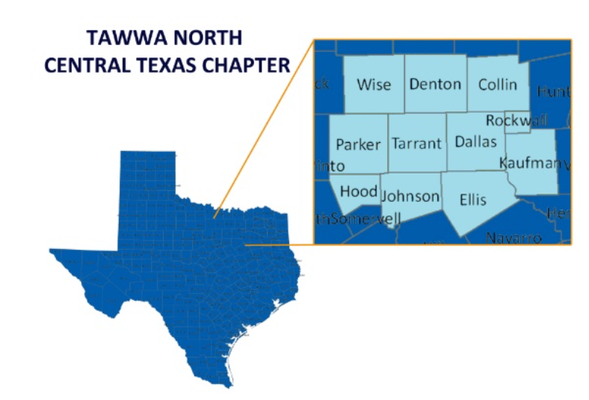
TAWWA Leadership Summit 2018
NORTH CENTRAL TEXAS TAWWA
What’s Unique About Our Chapter?
Wells Branch Community Center, Pflugerville, TX – October 5, 2018

Slide 2
What’s unique about NCT Chapter of TAWWA?
Hardworking, dedicated leadership team
Active, supportive membership
Ongoing high level of commitment to education, outreach, and industry support

Slide 3
Our Team: 2018-2019 Executive Committee
Position | Name | Organization
Section Trustee | Sally Mills-Wright | Dallas Water Utilities
Section Deputy Trustee | Theo Chan | Freese & Nichols
Past President | Sam Barraco | Carollo
President | Mia Welch | Tetra Tech
Vice-President | Katie Livas | HDR
Secretary | Steffi Massey | AECOM
Treasurer | Steve Mendoza | Carollo
Arrangements Committee Chair | Nicole Conner | Kennedy Jenks
Arrangements Co-chair | Brandy Martinez | CDM Smith
Programs Committee Chair | Valentine Sonnier | Siemens
Membership Committee Chair | Chris Bitter | JQ
Scholarship Committee Chair | Sid McCain | TRA
Seminar Committee Chair | Dustan Compton | TRWD
Communications Committee Chair | Andrea Fernandez | CDM Smith
Education and Outreach Committee Chair | Helen Dulac | Dallas Water Utilities
Young Professional Committee Co-Chair (Dallas) | Jacob Niemeier | Vera Aqua Vera Vita
Young Professional Committee Co-Chair (FW) | Michael McBee | Freese & Nichols
Young Professional Committee Co-Chair (Dallas) | Brandon Mellgren | Newman Regency
Young Professional Committee Co-Chair (FW) | Chris Boyd | Alan Plummer Assoc.

Slide 4
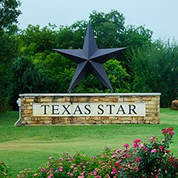
How we run Chapter Business
Executive Committee Meetings – Bi-monthly
  ~1.5 hrs over lunch
  Committee Updates
  New Business
  Financial Update
  Voting
  Planning
Separate Committee Meetings
  Seminar
  Communications
  Education/Outreach
  Pipe Tapping
  Etc.

Slide 5
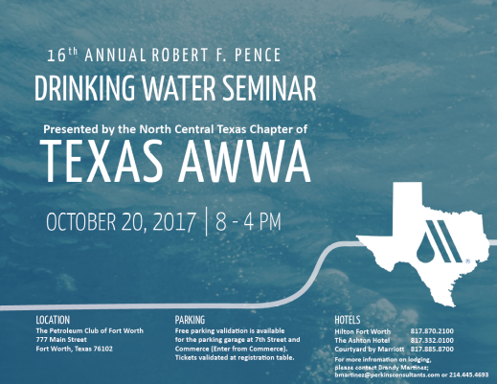
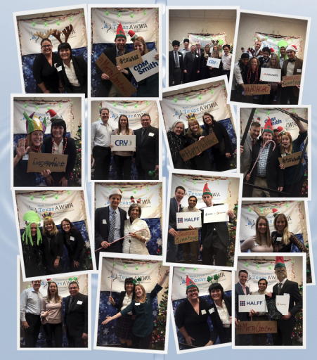
How we generate $$: Chapter Activities, Sponsorships
4 Chapter Lunch Meetings and 1 Facility Tour
  February, June, August, October; April Facility Tour
  $6,000 in sponsorships, $3,700 revenue in 2017
October Drinking Water Seminar
  $5,150 in sponsorships, $12,800 revenue in 2017
December Holiday Dinner Meeting
  $21,900 in total revenue/sponsorships in 2017 - TXWARN

Slide 6
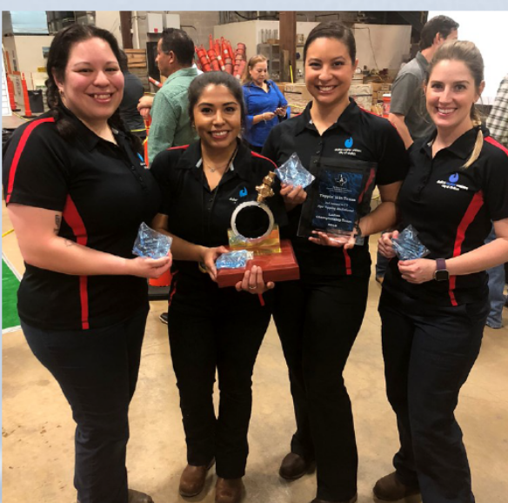
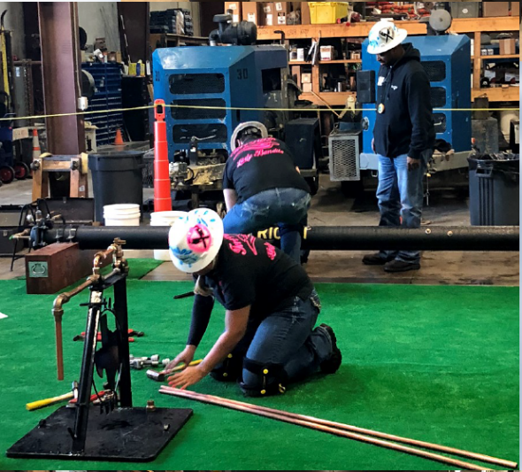

How we generate $$: Chapter Activities, Sponsorships
Pipe Tapping Competition
  $2,500 raised for One AWWA Operator Scholarship Fund in 2018 (2nd annual)
  3 men’s, 2 women’s teams
YP Events
  2017 Poker Tournament - $8,400 for Water for People
Annual sponsorship program
  4 in 2018 - $8,000

Slide 7
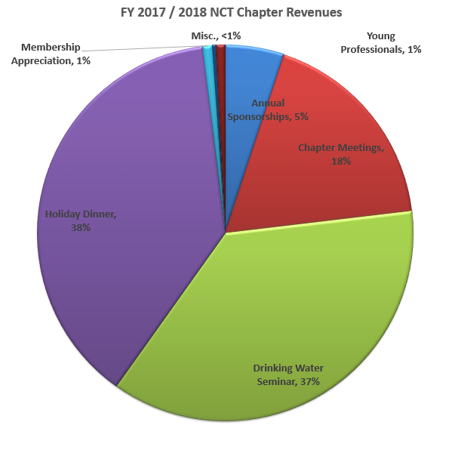
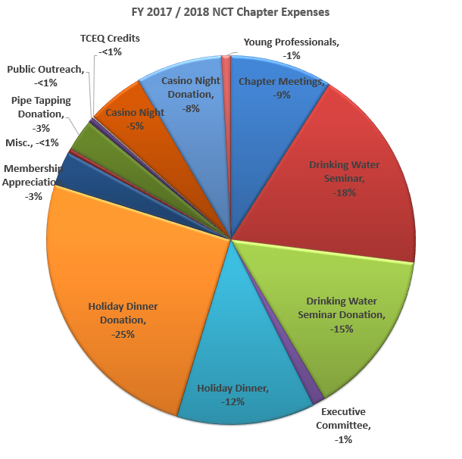
Over $45,000 raised in 2017 for scholarships and charitable donations – on track to continue this trend in 2018

Slide 8
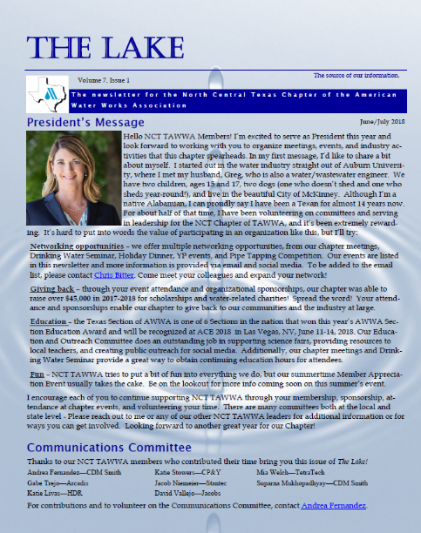
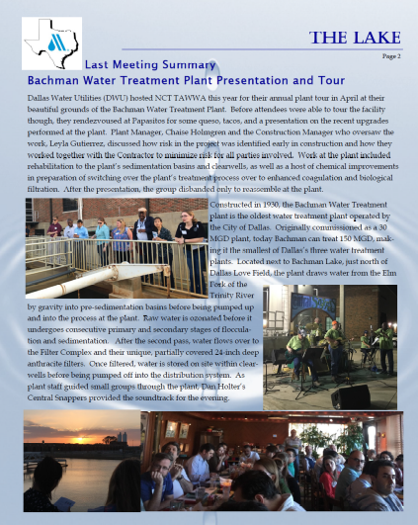

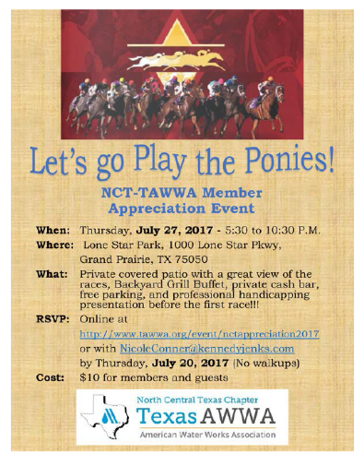
Communication/appreciation is key to our membership support
Bi-monthly Newsletter – The Lake
  Utility spotlight
  Member spotlight
  Industry news, upcoming events
Email blasts/Social Media
YP Events
Member Appreciation
Member Survey
Increased active memberships by 161 in 2017

Slide 9
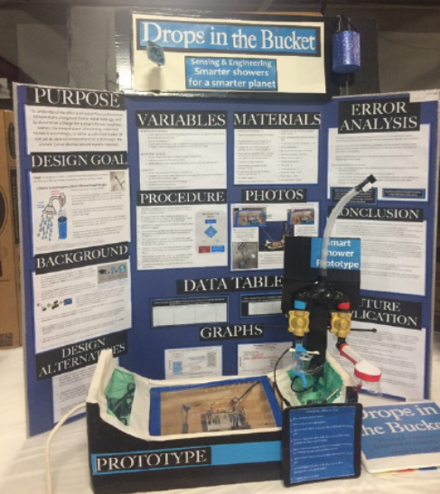
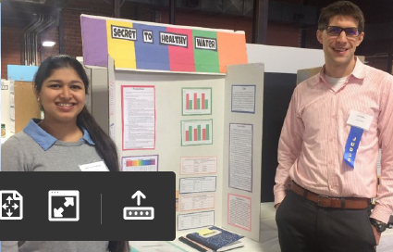
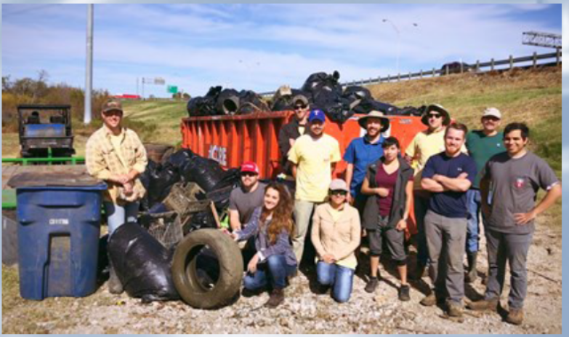
Extensive education and outreach offers value to our members and local water industry
Annual abstract process – diverse, high quality presentations
  Lunch meetings, seminar – CEUs/PDHs
External education/outreach
  SmallCon – STEM for women/young girls
  DFW MiniCAST
  Science fair judging
Volunteer Events
  Redeem the Stream, etc.
Pipe Tapping Competition
  Outreach to smaller utilities

Slide 10
Questions?

