Slide 1
EMOTIONAL INTELLIGENCE
Michele O’Connor, MBA, MSN, RN NE-BC
October 2026

Slide 2
LEARNING OBJECTIVES
The ability to analyze your own emotional triggers and apply at least two self-regulation strategies to maintain professional composure during high-stakes interactions.
Demonstrate empathetic communication by identifying verbal and non-verbal emotional cues from peers or clients and responding with a validated, constructive approach.
Implement Emotionally Intelligent Insights to Improve Personal Decision Making and Professional Contributions.
Notes:
Analyze your own emotional triggers and apply at least 2 self regulation strategies
Identify verbal and non-verbal cues=demonstrate empathy
Implement EI insights into decision making

Slide 3

WHAT IS EMOTIONAL INTELLIGENCE
DEFINITION: The capacity to be aware of, control, and express one’s emotions, and to handle interpersonal relationships judiciously and empathetically.
Notes:
EI is not about being emotional-it is about being skilled w/emotions ours and others-so we can lead, communicate and collaborate more efficiently

Slide 4

WHY DOES IT MATTER
Builds trust with Veterans and families
Improves teamwork and collaboration
Managing stress
Strengthens communication and reduces errors
Enhances outcomes and satisfaction
Supports leadership development
Notes:
Strong EI=communicating with empathy, listening deeply and picking up on verbal and nonverbal cues
Better navigate personalities, resolve conflict constructively
Emotional awareness and emotional regulation-stay composed, think clearly during crises
High quality communication=critical to safety-EI supports calm, clear and respectful information exchange
Respond to Veterans emotional appropriately, anticipate needs and advocate effectively, Veterans have a better experience
EI is a core leadership trait

Slide 5
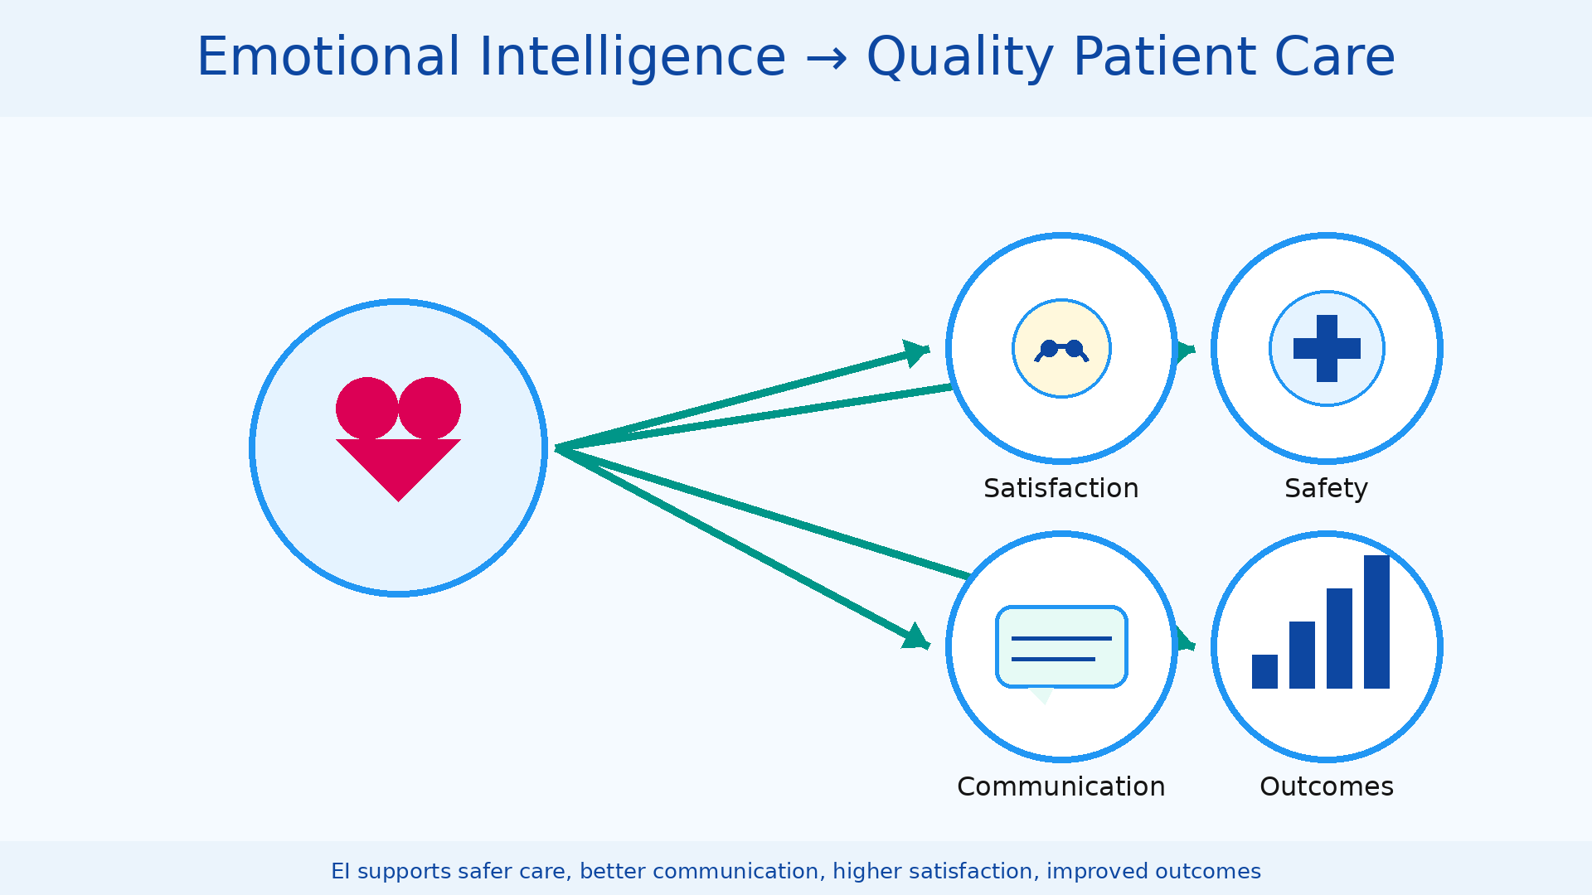
Notes:
A 2023 systematic review in BMC Primary Care analyzing 65 studies found that interprofessional collaboration consistently improved patient outcomes across cardiovascular, mental health and chronic disease care, with measurable gains in blood pressure control, glycemic management and reduced hospitalizations.

Slide 6
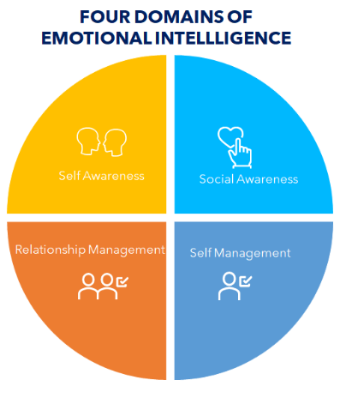

Slide 7
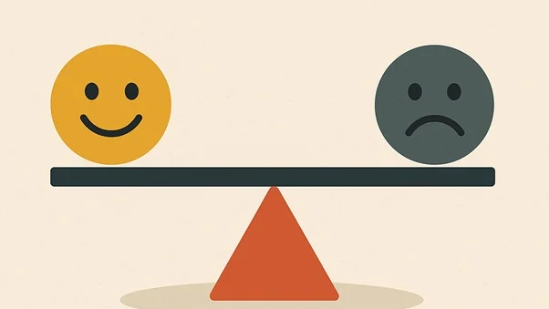
SELF AWARENESS
IF YOU DON’T SEE YOURSELF, YOU CAN’T UNDERSTAND YOUR IMPACT ON OTHERS
Notes:
Emotional intel is about your ability to not only understand yourself but others as well and your impact on others

Slide 8
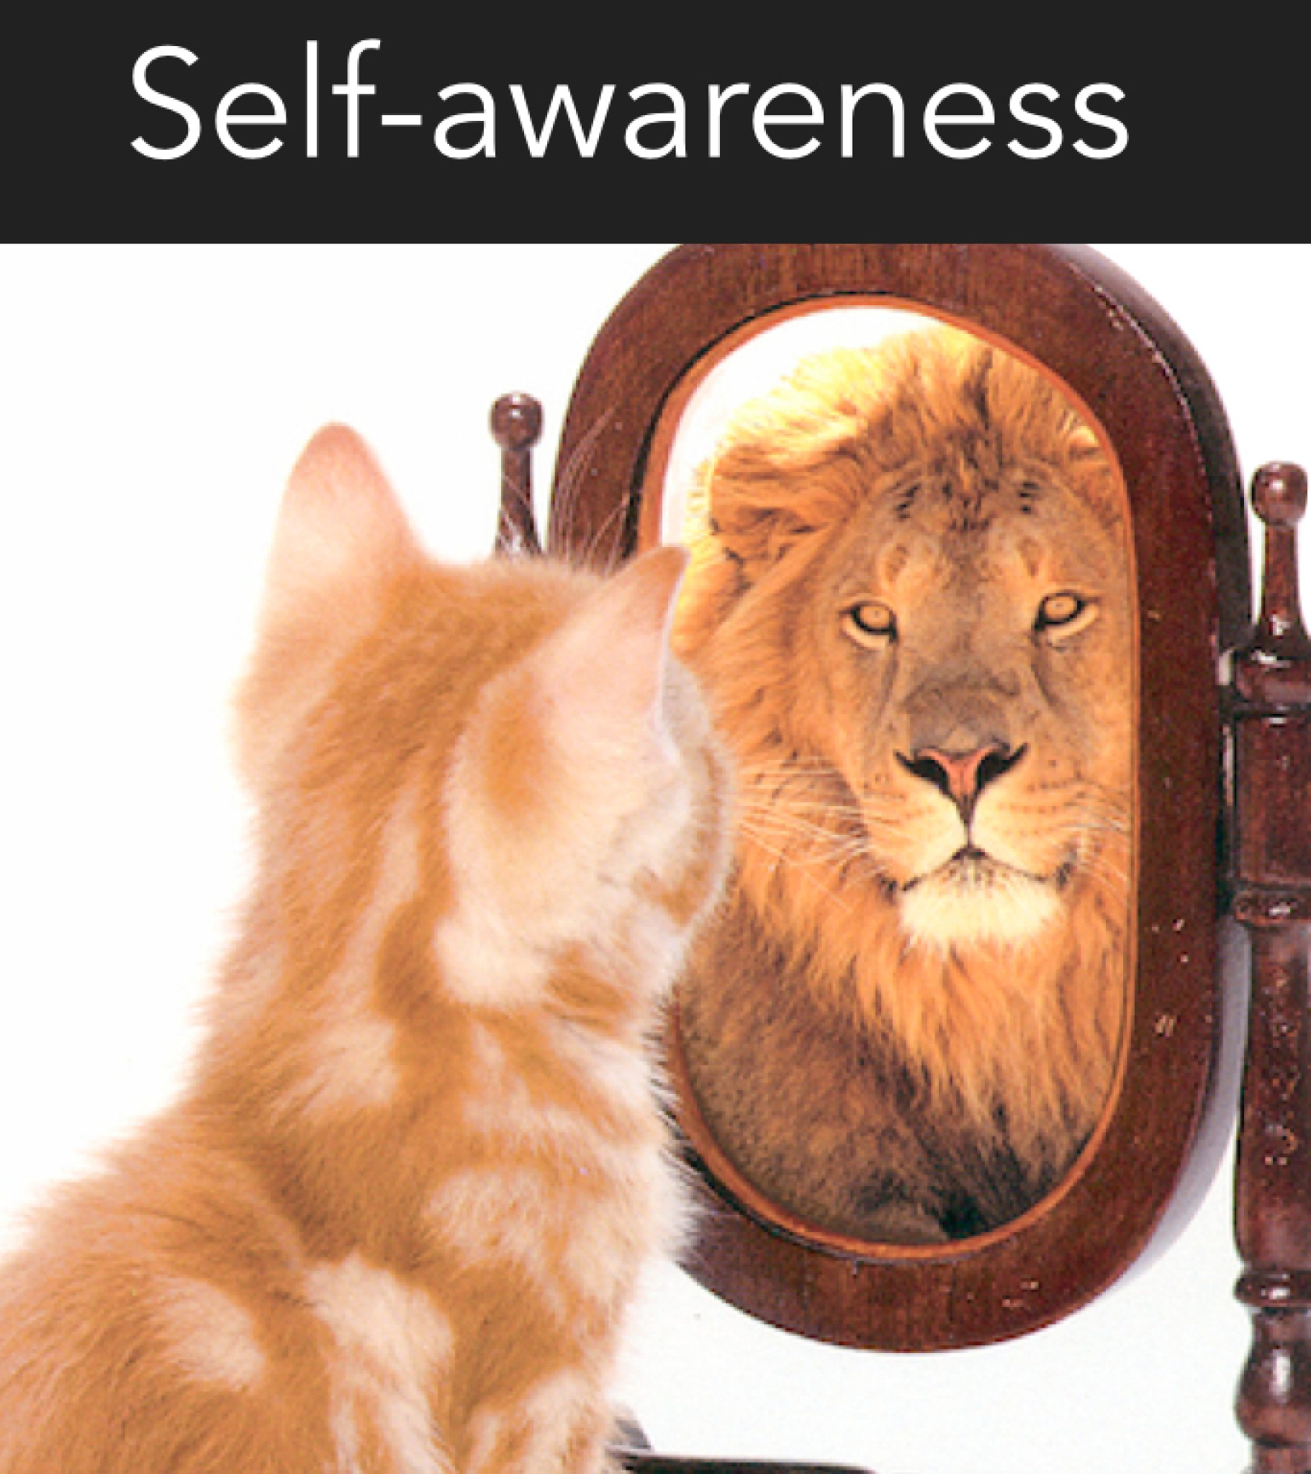
Heart of emotional intelligence.
Ability to recognize and understand:
  Your own thoughts and feelings
  How your reactions impact others
  How other people’s emotions impact you
Notes:
Core of EI
What are you triggers, why do I act this way

Slide 9
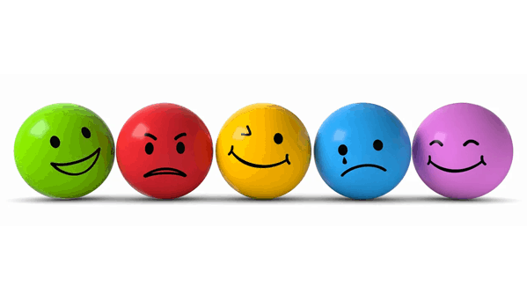
UNDERSTANDING EMOTIONS
Notes:
May confuse emotions or assume you are feeling a specific emotion but it is really not that emotion

Slide 10
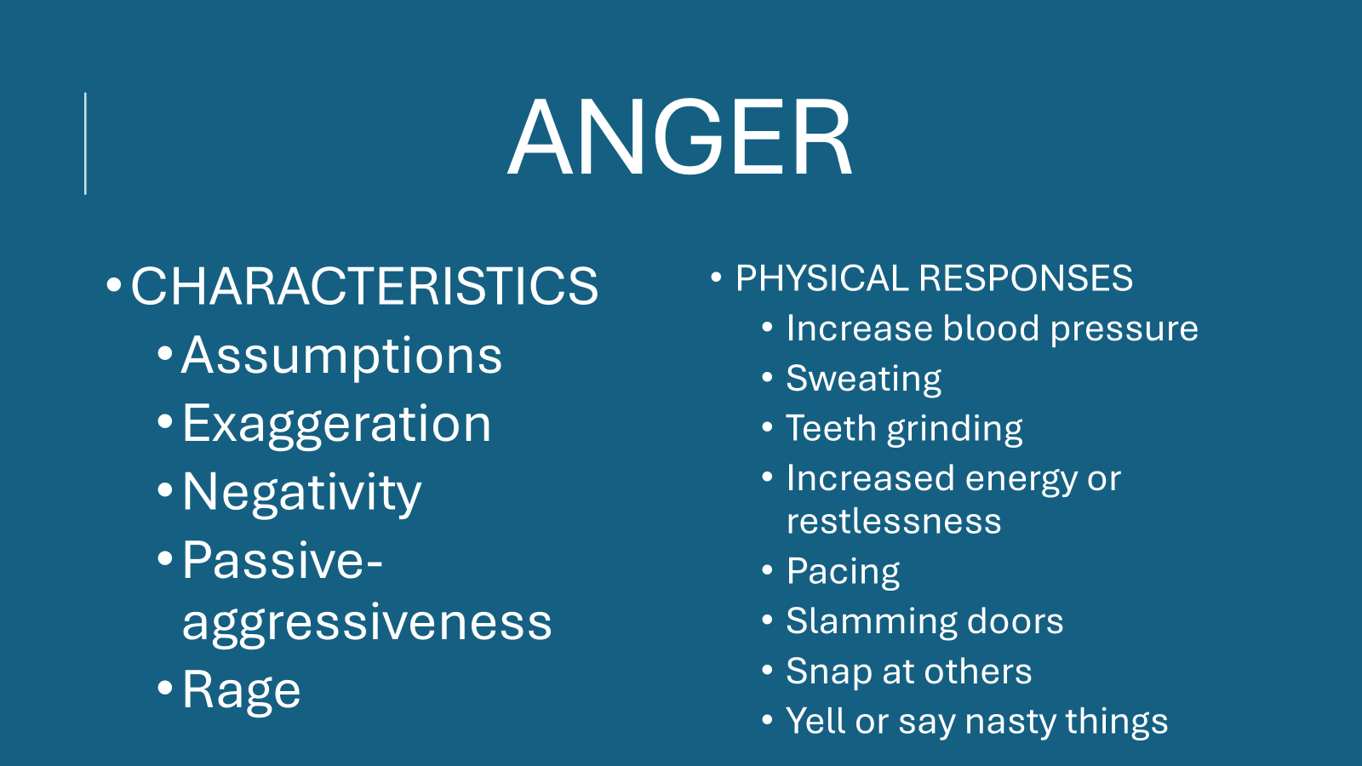
ANGER
CHARACTERISTICS
  Assumptions
  Exaggeration
  Negativity
  Passive-aggressiveness
  Rage
PHYSICAL RESPONSES
  Increase blood pressure
  Sweating
  Teeth grinding
  Increased energy or restlessness
  Pacing
  Slamming doors
  Snap at others
  Yell or say nasty things
Notes:
Exag ex: telling kids 1000 times to clean their room What is driving your anger?
Angry cleaning-increased energy or restlessness
People with high EI manage anger in a controlled, purposeful manner: Pause and reflect, take responsibility-own your emotions, Communicate and reframe-turn anger into advocacy-express concerns using “I” statements not accusations-challenge your narrative-reacting on assumption of if you have facts

Slide 11
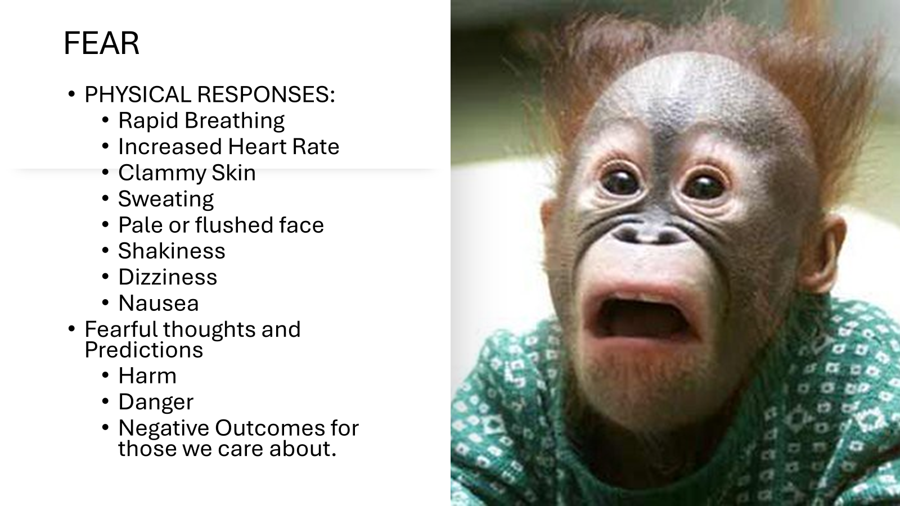

Slide 12
GUILT AND SHAME
GUILT
SHAME
Negative Self-Judgement thoughts: I should have or shouldn’t have
Sadness and Anxiety
Verbally Justify actions: Become defensive
Lead to avoidance
Sense of being flawed or unworthy
Feeling badly about ourselves
Blushing or flushed skin
Symptoms similar to anxiety
Notes:
Guilt is focused on the behavior, shame is focused on self. Understanding the difference allows to pivot from destructive self-blame to taking accountability, improving relationships. Allows for healthier emotional processing, better self-management and more empathetic interpersonal reactions

Slide 13
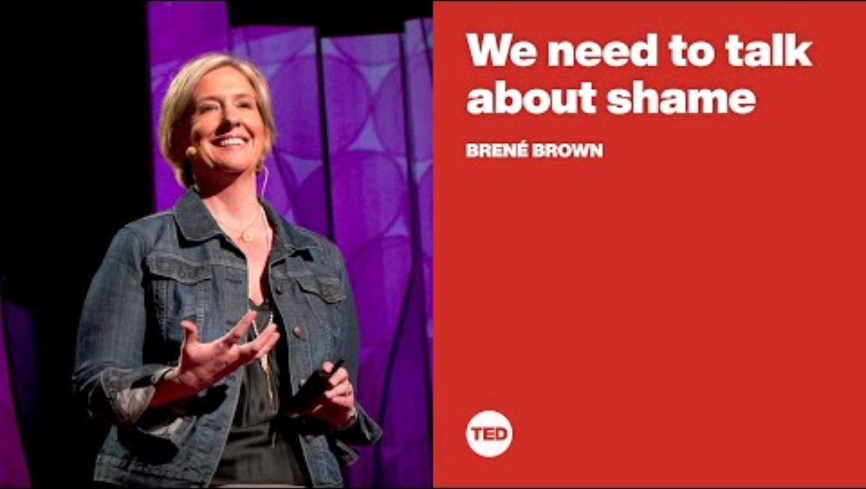

Slide 14
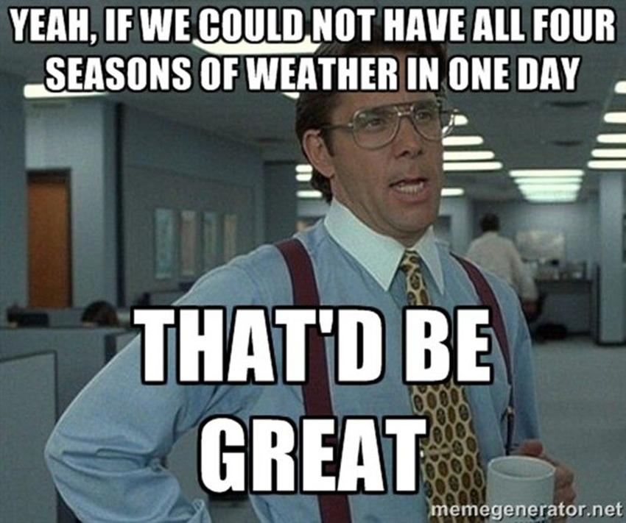
WEATHER CHECK-IN
Describe an emotion as if it were weather.
Example: When I am angry, I feel like I am in the eye of a tornado, things swirling around me.

Slide 15
SELF AWARENESS STRATEGIES
Quit
Quit funneling your feelings into anger
Turn
Turn “have to” into “get to”
Believe in
Believe in yourself
Know
Know who and what pushes your buttons
Stop and ask
Stop and ask yourself why you do the things you do
Seek
Seek feedback
Notes:
Funneling frustration into anger-recognize the anger as a second emotion-think what is this anger protecting me from,
Turn-”I have good news” story given new tasks-helps you grow as a leader
Believe-we all have days that it seems nothing is going right-take a step back, reflect and reset
Seek feedback-someone you respect or someone you would not normally ask

Slide 16

SELF MANAGEMENT
What you choose to do with your emotions
Ability to channel emotions into producing the behavior you want
Managing both positive and negative emotions
Enables you to delay short-term gratification for long-term results
Notes:
Positive emotions-allowing yourself to say yes to everything, like you can take on the world
Short versus long-term results-enhances impulse control, discipline, planning, stress management, resilience, patients and self motivation-builds a solid foundation for sustained efforts and achieving long-term objectives.

Slide 17
MOTIVATION
Emotional value and satisfaction that comes with pursuing goals with energy and persistence.
Intrinsic Motivation: Motivation to engage in a behavior because of inherent satisfaction rather than a desired reward.
Extrinsic Motivation: Motivation to perform an activity or behavior to earn a reward or avoid a punishment.
Notes:
Why is motivation important: Achieving Goals: Motivation is the driving force behind achieving personal and professional objectives.
Resilience: Motivated individuals are better equipped to handle setbacks and bounce back from failures.
Positive Outlook: Motivation fosters a positive attitude, which can improve overall well-being and relationships.
Inspiring Others: Motivated leaders can inspire and motivate their teams, creating a more productive and harmonious work environment.

Slide 18
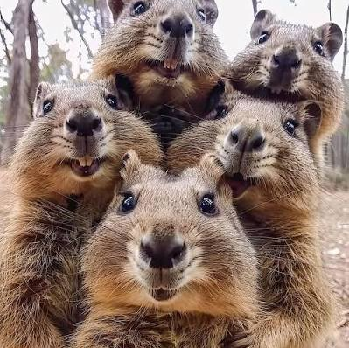
ACTVITY
Choose a person you do not know in the room
Topic: How do you get motivated on a day that it seems everything is going wrong.

Slide 19
VULNERABILITY
  Owning Limitations
  Fostering Connection
  Driving Systemic Change
Notes:
Embracing vulnerability means acknowledging knowledge gaps and clinical unknowns rather than hiding them-fosters safer practice
Listens, learns and admits when they need help creates an environment where patients feel safe and coworkers feel supported.
Recognizing vulnerability allows organizations to implement better peer support, clear communication and robust safety protocols to protect healthcare teams.

Slide 20
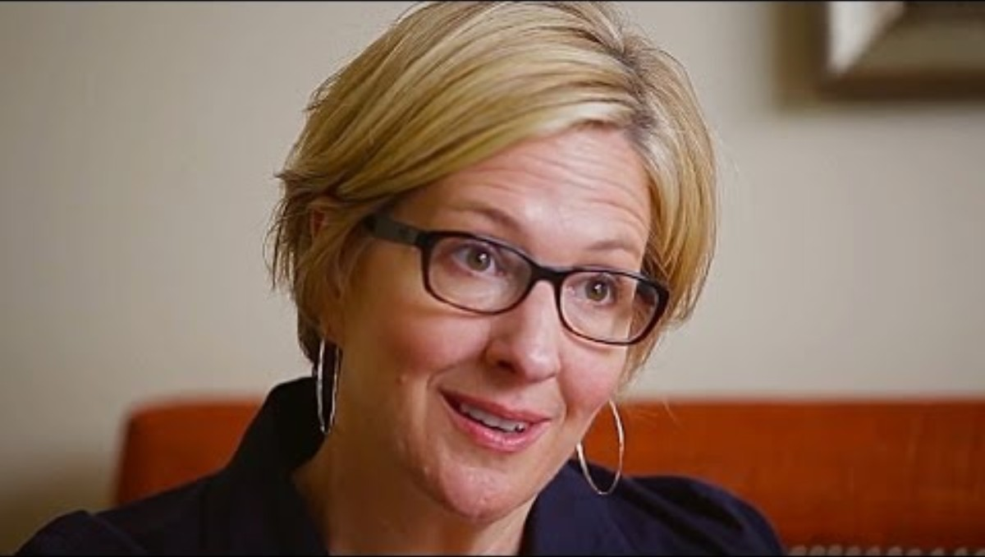

Slide 21
SELF MANAGEMENT STRATEGIES
Quit
Quit multitasking
Practice
Practice mindfulness
Say
Say no
Count
Count to ten
Speak
Speak to someone who is not emotionally invested in your problem/situation
Notes:
Mindfullness is not just a yoga class-talk to WH
Count to ten-sometimes 1000-never answer an email when you are angry

Slide 22
SOCIAL AWARENESS
Having a clear understanding of the experience of other people
Knowing what is going on with emotionally even when he/she can’t or won’t tell you
Interpreting behaviors
Accurately picking up on the emotions of others
Most difficult skill to master
Notes:
Recognizing and understanding the emotions of others, leaders create are more harmonious, supportive and productive environment
Read the room

Slide 23

EMPATHY: The greatest form of emotional intelligence.
The ability to understand and share the feelings of another person
Not judging or labeling
Place yourself “in their shoes”
Allows to connect with others on a deeper level
Empathy is not fixed; it can be learned.

Slide 24

HOW TO BUILD EMPATHY
Be willing to share your feelings
Listen to understand not to respond
Talk to new people
Step out of your comfort zone
Examine your biases
Explore the heart not the head

Slide 25
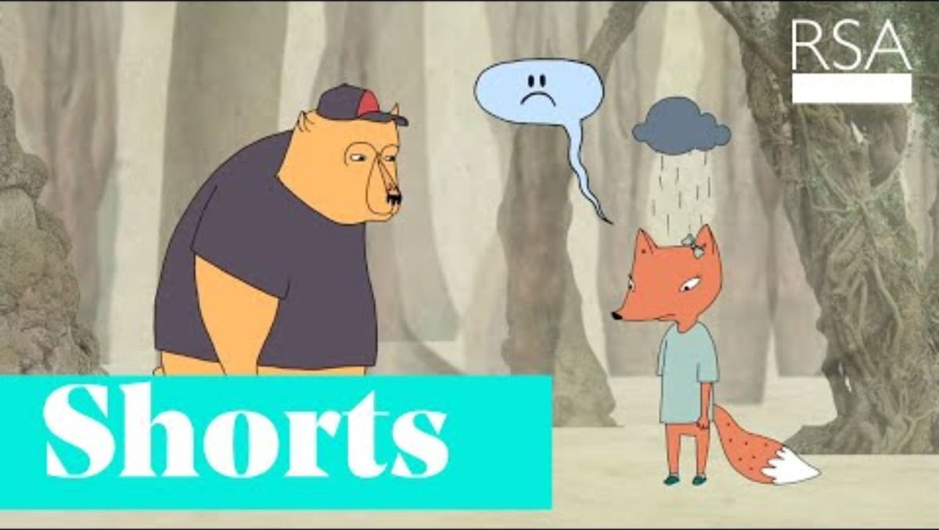
Notes:
Try to make things better-instinct for nurses

Slide 26
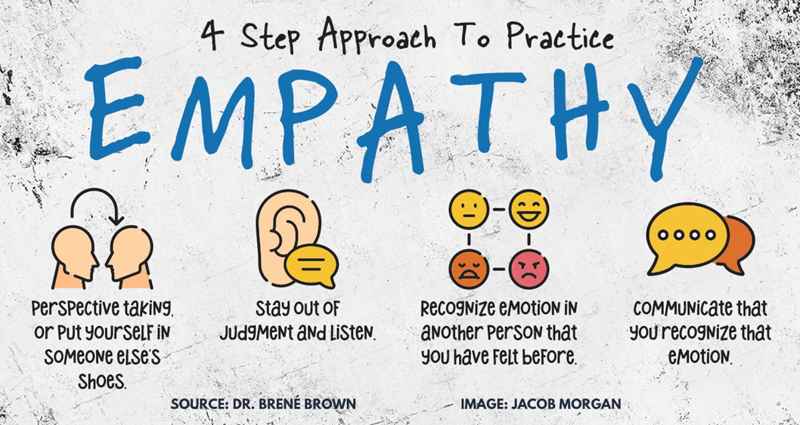

Slide 27
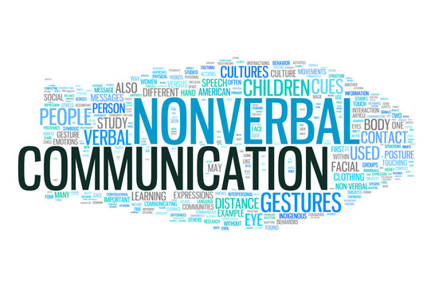
NON-VERBAL COMMUNICATION

Slide 28

NONVERBAL COMMUNICATION
Facial expressions, gestures, postures and tone of voice.
Giver and/or receiver.
Speaks the loudest and send the strongest message.
Put individuals at ease and build trust, draw others into you.
Offend, confuse and undermine what you are trying to convey.

Slide 29


Slide 30

What do you see?

Slide 31
RELATIONSHIP MANAGEMENT
Most advanced emotional intelligence skill
  Requires the use of three other emotional intelligence skills in concert
  Most subtle skill
  The ability to connect even with those you are not fond of
  Poses as the greatest challenge at times of stress

Slide 32
CONFLICT MANAGEMENT
Respect
Self-Awareness and Self-Management
Cultivating empathy
Active listening
Communicate with clarity and respect
Collaborative problem solving

Slide 33
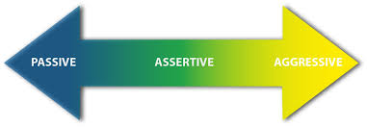
ASSERTIVELY HANDLING CONFLICT
Ask good questions
Challenge an idea but offer solutions
Say “and” instead of “but”
Use hypotheticals
Notes:
Needs are met without bullying, addresses the issue without ignoring or trivializing the needs of the other party
Challenge-demonstrates you want to work together
End-more constructive and collaborative

Slide 34

RELATIONSHIP MANAGEMENT STRATEGIES
Transparency
Set boundaries with those who need them
Form strong connections with others
Build trust
Tackle a tough conversation
Explain your decisions don’t just make them

Slide 35
TEAM BENEFITS OF EI
Improve Team Collaboration
Foster positive team culture
Encourage open communication
Build strong relationships among team members
Effective Communication
Successful project execution
Increased Empathy
Fosters better relationships
Greater sense of camaraderie
Conflict Resolution
Find constructive solutions
Increased Job Satisfaction
Positive work experience
Improved Customer Relations
Handle complaints with empathy
Contribute to Veteran satisfaction

Slide 36
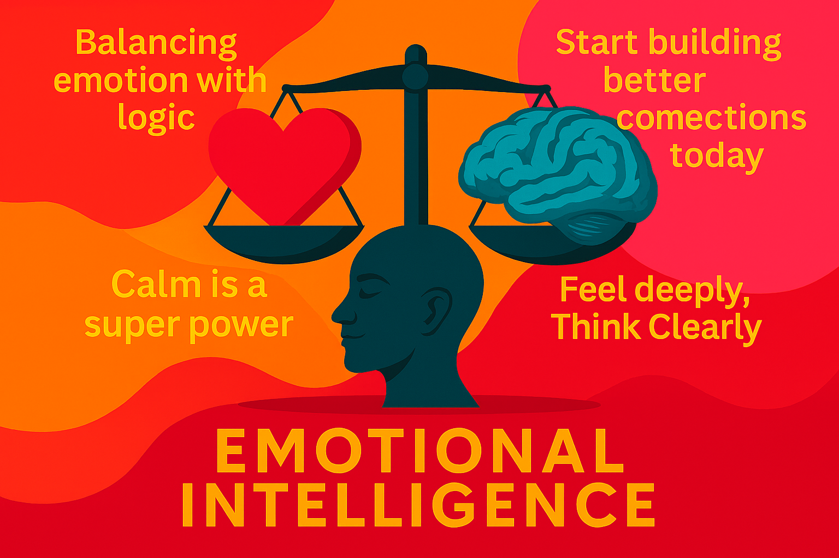
Notes:
To wrap things up, as we’ve discussed, emotional intelligence is a crucial aspect of effective leadership. Your ability to understand and manage your own emotions, as well as those of others, can significantly enhance team performance and foster a positive work environment. Remember that empathy, self-awareness, and strong interpersonal skills are essential for leading with emotional intelligence.

Slide 37

Notes:
Thank you for your time and attention today. I hope this session has provided valuable insights and practical tools that you can apply in your work. Please don't hesitate to reach out if you have any questions or need further clarification on any of the topics we've covered. Your feedback is greatly appreciated, as it helps us improve and tailor future sessions to better meet your needs.
Let's continue to strive for excellence together, leading with both our hearts and minds. Thank you once again, and have a great day!

Slide 38
References
Bradberry, T. (2025). The New Emotional Intelligence. ISBN 979-8-218-58966-0.
Bradberry, T., & Greaves, J. (2009). Emotional Intelligence 2.0. TalentSmart. ISBN 978-0-97435206-2-5.
Goleman, D. (1998). Working with Emotional Intelligence. Bantam Books. ISBN 978-0-553-37858-0.
ManageMagazine. (n.d.). The 10 Benefits of Emotional Intelligence in the Workplace. Retrieved from https://managemagazine.com/article-bank/emotions-emotional-intelligence/the-10-benefits-of-emotional-intelligence-in-the-workplace/.
Niagara Institute. (n.d.). Emotional Intelligence Statistics. Retrieved from https://www.niagarainstitute.com/blog/emotional-intelligence-statistics.
Forbes Coaches Council. (2024, July 31). Using Emotional Intelligence And Respect To Resolve Conflict In The Workplace: An Executive Coach's Perspective. Retrieved from https://www.forbes.com/councils/forbescoachescouncil/2024/07/31/using-emotional-intelligence-and-respect-to-resolve-conflict-in-the-workplace-an-executive-coachs-perspective/.

