Slide 1
Continued Readiness through SIP
Carla Spinelli, PhD, MSN, RN, GERO-BC, NPD-BC
HSA 1.1 Regional Quality Management Officer

Slide 2
Self-Inspection Program (SIP)
Transforms compliance oversight into proactive, enterprise-wide practices across all facilities
Assuring continuous readiness
Identifies risk
Improves patient safety
Accountability at all levels

Slide 3
How does it work
Three Levels
Level 1 - Facility Self Assessment
Level 2 - Enterprise Health Assessment
Level 3 - Executive Oversight

Slide 4
Level 1
EVERY 6 MONTHS
Facilities receive the standardize list of high-risk items
Facilities disperse items to correct SME
SMEs verifies compliance
  If not-compliant SME creates action plan to put facility in compliance
Second level review at facility
Medical Center Director attestation
HSA works with facilities on non-compliant items

Slide 5
Level 2
MOC group performs regular data analysis
Routine collaborative site visits – every 18 months
Look for high risk triggers and critical compliance failures
HSA works with facilities on action plans

Slide 6
Level 3 – Executive Oversight
Enterprise Integration: Level 3 Executive Oversight consolidates Level 1 and Level 2 findings
Strategic Decision Support: Focus on system-wide trends and opportunities for policy or operational improvements
Action Orientation: Governance decisions may result in policy change and/or enterprise corrective action.
Enterprise-wide Improvements: Implement 3-4 enterprise-wide strategies based on annual assessment findings

Slide 7
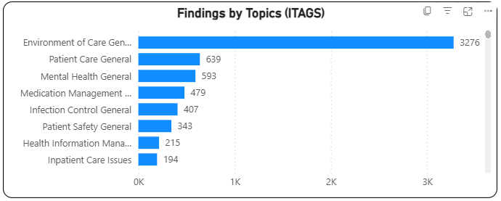
Everyone is responsible
OIG/OMI/TJC 2023-2026

Slide 8
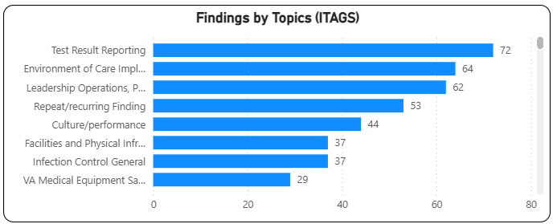
OIG - HFI recommendations
OIG-HFI 2023-2026

Slide 9
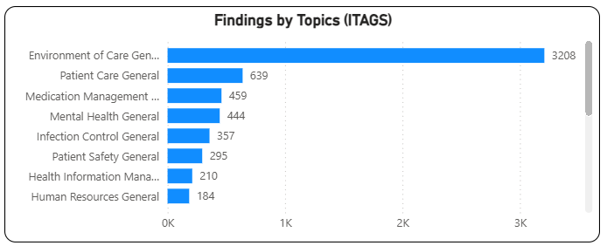
TJC 2023 - 2026

Slide 10
Sample of SIP items
Staff are responsible for the maintenance and use of medical equipment, utility systems and equipment, fire safety systems and equipment, and safe handling of hazardous materials and waste are competent and receive continuing education and training.
Check to ensure fire barriers are continuous from outside wall to outside wall or from one fire barrier to another with an equivalent or higher rating, or a combination thereof, including continuity through all concealed spaces, such as those found above a ceiling, including interstitial spaces.
Follows requirements for medication labeling during procedures.
The HCS has an established process for ensuring the proper storage of medications (outside of pharmacy) and supplies that services are following the process.
Ensure departments are aware of their responsibility related to medication and supply storage.
The HCS follows processes to correctly identify patients when providing care, treatment, or services.
Managers who are responsible for patient flow processes review measurement results and take action to improve patient flow processes when goals are not achieved.
Service Chiefs and managers are aware of and use measurement to inform success of their processes, communicate measurement to staff and use this information and data to drive continuous process improvement in the work area, with examples.
Ensure documentation for escalation of issues when medications and supplies rooms are out of temperature and humidity proper ranges.
The HCS is safe and clean for patient care.
Maintenance documentation of eyewash stations is completed fully per organizational standards.

