Slide 1
Understanding the Rural-Urban Suicide Disparity among VA Patients
Brian Shiner MD, MPH
Staff Psychiatrist and
Associate Chief of Staff for Research
White River Junction VAMC
Professor of Psychiatry and of
Health Policy & Clinical Practice
Geisel School of Medicine at Dartmouth

Slide 2
Part A
Ecological Fallacy 101: Rurality Causes Suicide

Slide 3

Restaurants and Wealth
Dining at a 5-start restaurant is associated with higher income.
Does dining at a 5-start restaurant cause you to be wealthy?

Slide 4

Walt Disney World and Children
Visiting Walt Disney World in the summer is associated with having children.
Does visiting Walt Disney World cause you to have children?

Slide 5

But what about Rurality and Suicide?
It looks bad for rural Americans:
  The CDC found that suicide rates are higher and climbing faster for rural Americans than urban Americans (Ivey-Stephenson et al., MMWR, 2017).
  The suicide rate appears to be highest in the most deprived rural enclaves (Steelesmith et al., JAMA Open, 2019).
  Rural VA patients have 20% higher suicide rates both overall (McCarthy et al., 2012), and following psychiatric discharge (Britton et al., 2017).

Slide 6
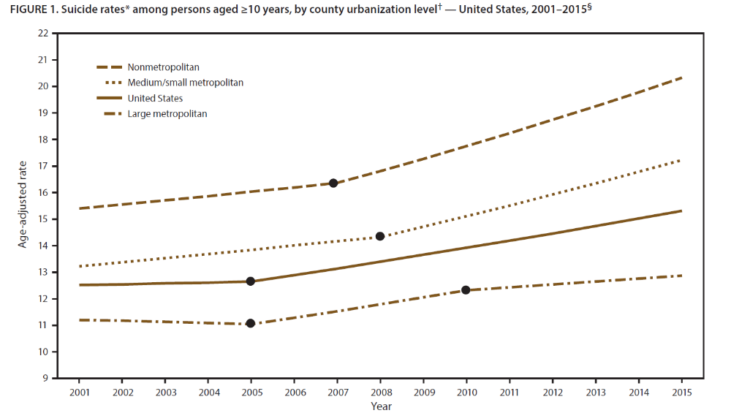
The CDC found that suicide rates are higher and climbing faster for rural Americans than urban Americans (Ivey-Stephenson et al., MMWR, 2017).
Death by Suicide Cases Age-Adjusted to Standard US Population

Slide 7
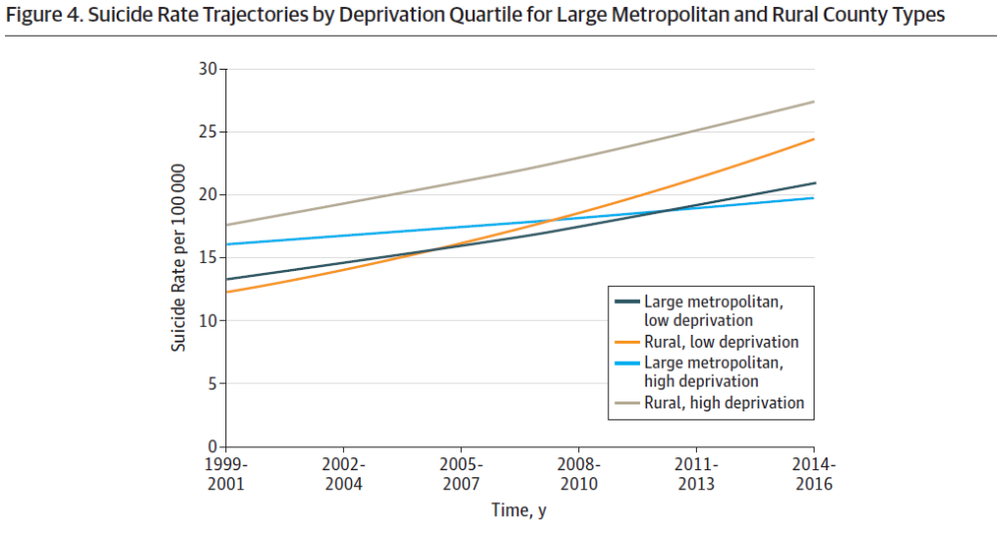
The suicide rate appears to be highest in the most deprived rural enclaves (Steelesmith et al., JAMA Open, 2019).
Based on County-Level Data

Slide 8
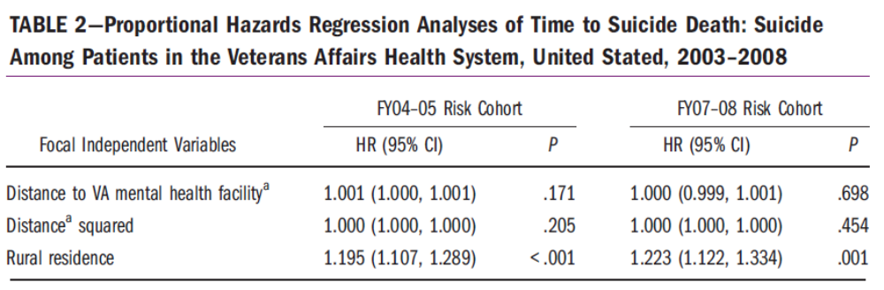
Rural VA patients have 20% higher suicide rates both overall (McCarthy et al., 2012), and following psychiatric discharge (Britton et al., 2017).
Individual-Level Data adjusted for Age, Gender, Comorbidity, and VISN

Slide 9
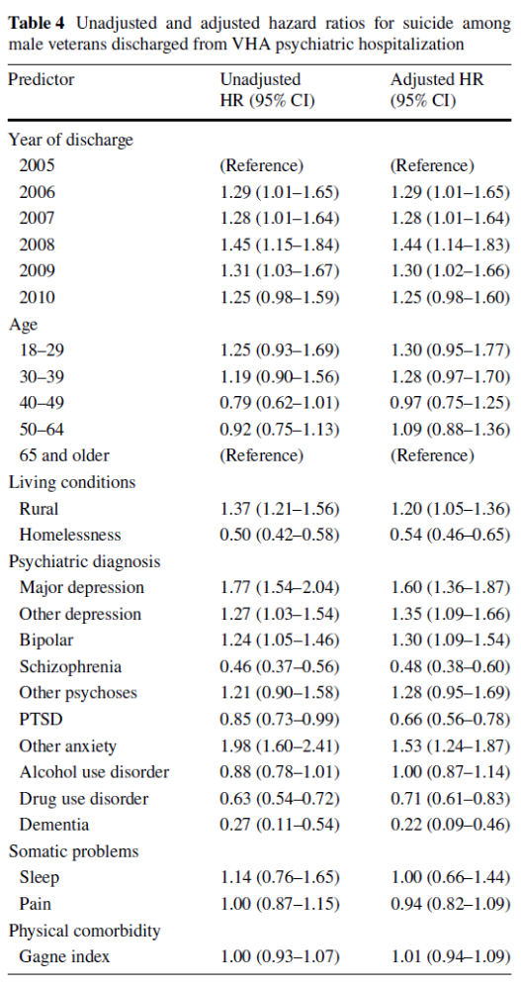
Rural VA patients have 20% higher suicide rates both overall (McCarthy et al., 2012), and following psychiatric discharge (Britton et al., 2017).
Individual-Level Data adjusted for Age, Comorbidity, and Rurality

Slide 10
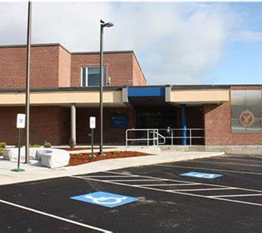
Perhaps this improved when the VA increased mental health resources at rural CBOCs
2007: The VA Creates the Office of Rural Health to address rural health disparities
  Hiring mental health providers at rural CBOCs
  Telehealth services and other programs
2008: Development of the VA Suicide Prevention Program
  National Suicide Prevention Hotline
  Suicide Prevention Coordinators and other programs
These initiatives could have been synergistic.

Slide 11
Study 1:
Did the Rural-Urban Suicide Disparity Decrease Among VA Patients Following the 2007 implementation of the Office of Rural Health and the 2008 implementation of the VA Suicide Prevention Program?
Build a cohort of all VA patients between 2003 and 2017 and link to the CDC National Death Index
Calculate Annual Suicide Rates for Urban (70%) and Rural (30%) Veterans
Standardize age, sex, and race to the 2017 VA user population using individual-level data.
Examine the Rural-Urban Disparity Each Year
Examine Trends using Joinpoint Regression

Slide 12
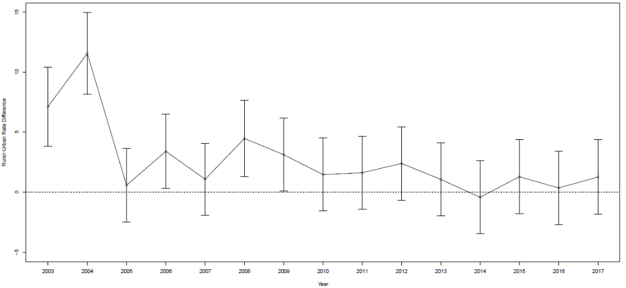
Study 1 Result A: Yearly Rural-Urban Death by Suicide Disparity
ORH
SPP
Individual-Level Data adjusted for Age, Gender, and Race

Slide 13
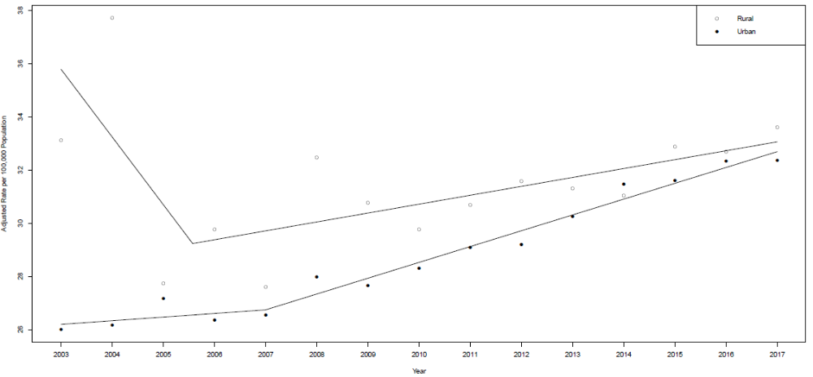
Study 1 Result B: Rural and Urban Suicide Trends
ORH
SPP
Individual-Level Data adjusted for Age, Gender, and Race

Slide 14
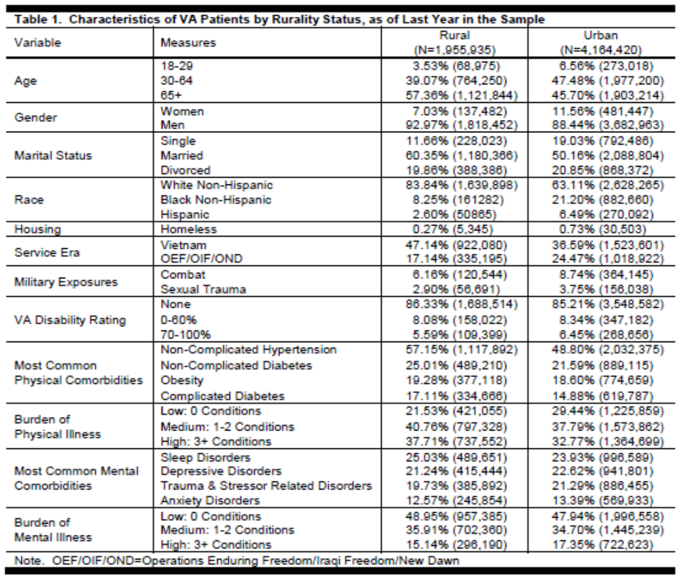
Study 1 Interpretation: That Seems Incorrect
It doesn’t look like there is a rural-urban suicide disparity among VA Patients.
  Something must be going on with the data.
Seems like Rural VA Patients are Mostly White.
Suicide Risk Per 100,000:
  White
    Rural: 34.3
    Urban: 34.7
  Black
    Rural: 9.9
    Urban: 10.5
  Hispanic
    Rural: 20.8
    Urban: 16.5

Slide 15
Study 1 Conclusion: We May Looking at an Ecological Fallacy
Prior VA Studies Controlled for Age and Sex but not Race.
White VA Patients were at Especially High Risk for Suicide.
White VA Patients Lived Disproportionally in Rural Areas.
Odds Ratio of Rural versus Urban Suicide, Adjusted for Age and Sex:
  1.18 (95% CI: 1.07-1.29; p<0.001)
  About the same as McCarthy et al. (2012), Britton et al. (2017)
Odds Ratio of Rural versus Urban Suicide, Adjusted for Age, Sex, and Race:
  1.03 (95% CI: 0.94-1.13; p=0.485)

Slide 16
Study 2:
How do suicide trends compare by race and rurality?
Split the Cohort into Six Race/Ethnicity-Rurality Strata
  White Non-Hispanic: Rural and Urban
  Black Non-Hispanic: Rural and Urban
  Hispanic: Rural and Urban
Summarized age- and sex-adjusted suicide rates across three-year periods to ensure rate stability.
Tested for significant rural-urban differences within each race/ethnicity stratum using a Z-test.

Slide 17
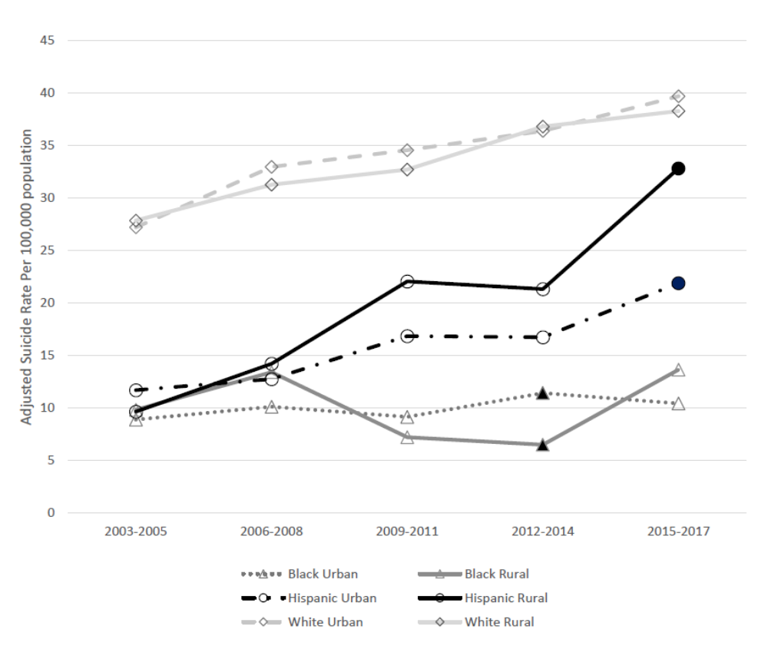
Study 2 Result: Trends in Suicide Rates Among VA Patients by Race/Ethnicity

Slide 18
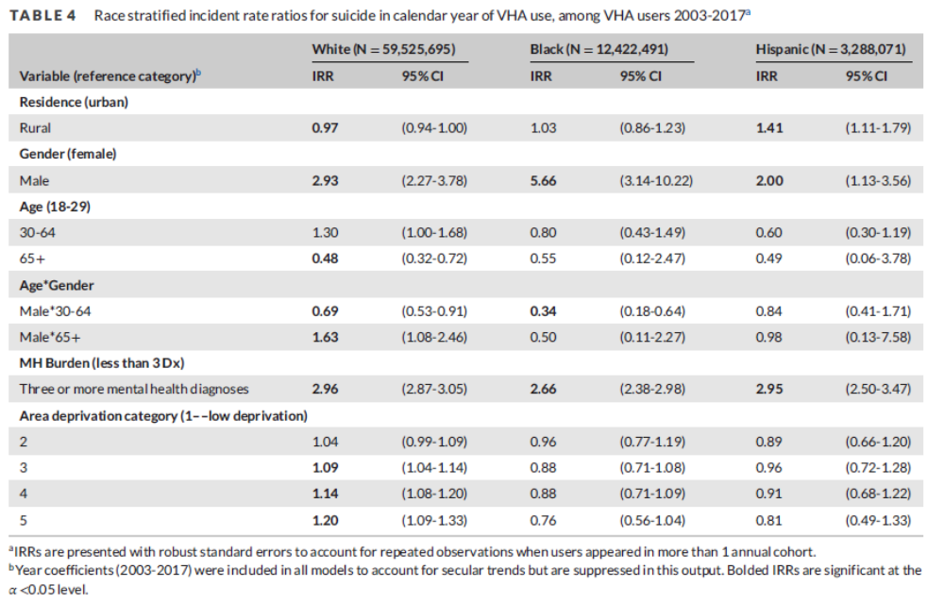
Study 2 Interpretation: Whether Rurality Is a Risk Factor for Suicide Depends on Race/Ethnicity

Slide 19
Part B
Rural Hispanic VA Patients Do Have a Higher Rate of Death by Suicide.

Slide 20
Study 3:
Are we identifying Rural Hispanic VA Patients as well as we could?
Office of Management and Budget (OMB) sets federal standards for race and ethnicity reporting.
Race Categories:
  American Indian or Alaska Native (AIAN)
  Asian
  Black or African American (“Black”)
  Native American or Other Pacific Islander (NHPI)
  White
Ethnicity Categories:
  Hispanic
  Non-Hispanic
Self-Report Preferred

Slide 21
Study 3:
Available Sources of Race and Ethnicity Data for VA Patients
Survey of Health Experiences of Patients (SHEP)
Self Reported (Preferred), but only about 20% sample.
Corporate Data Warehouse (CDW)
Continuously Updated, but sometimes clerk makes assessment.
MedSAS
Same source as CDW, but “frozen” each fiscal year.
VA-DoD Identity Repository (VADIR)
Service information, not available for many older Veterans.
Centers for Medicare and Medicaid Services (CMS)
Ongoing efforts by CMS to improve data capture, but not available for many younger Veterans.

Slide 22
Study 3:
Strategy to prioritize race and ethnicity data when missing or conflicting.
Use SHEP self-reported data as gold-standard.
Calculate PPV using other available sources for each race and ethnicity category.
Combined NHPI and Asian (NHPIA) due to coding inconsistencies across sources.
Each race and ethnicity value is filled in separately first by SHEP and by the source with highest PPV when no SHEP self-identified value is available.
Algorithm (2000-2018 VA Population):
  Race – SHEP, CMS, CDW, MedSAS, VADIR
  Ethnicity – SHEP, CDW, MedSAS, VADIR, CMS

Slide 23
Study 3 Result: Comparison of Algorithm to CDW Data
 | CDW Data Alone | Multi-Source
Frequency for Race (%)
NHPIA | 1.8 | 1.9
AIAN | 0.8 | 1.1
Black | 11.9 | 14.3
White | 56.7 | 74.3
Multiple Races | 0.6 | 3.5
Unknown | 28.8 | 8.4
Frequency for Ethnicity (%)
Hispanic | 4.5 | 5.8
Non-Hispanic | 67.9 | 78.4
Unknown | 27.6 | 15.8

Slide 24
Study 4:
What are some ways that Rural and Urban Hispanic VA Patients Differ?
Used Updated Race and Ethnicity Coding Algorithm
Categorized Rural and Urban Hispanic VA Patients into Rural and Urban, by first available VA use.
Examined geographic distribution by rural and urban counties.
Compared individual-level characteristics from CDW and area characteristics from Area Deprivation Index (ADI) and American Community Survey (ACS) between rural and urban.
Examined changes in characteristics over time 2001-2018.

Slide 25
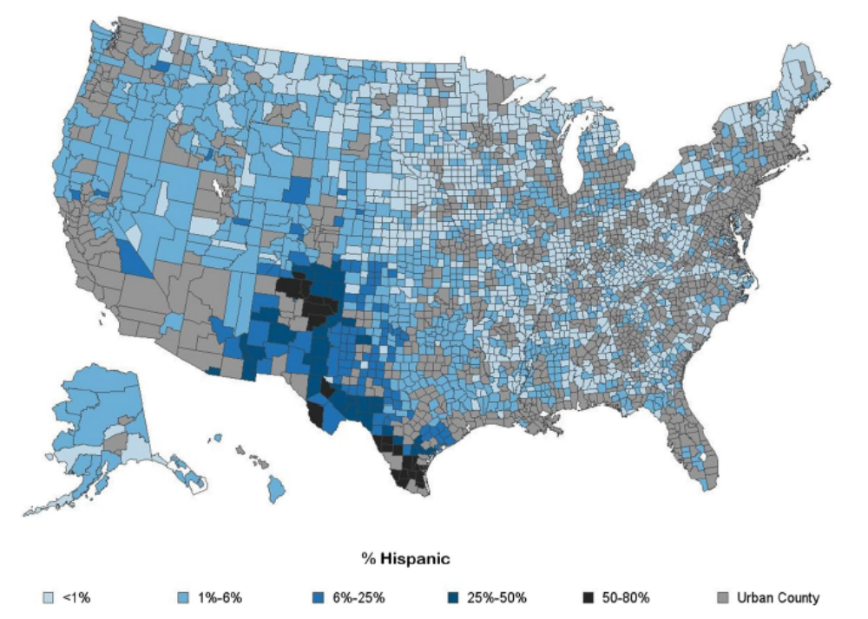
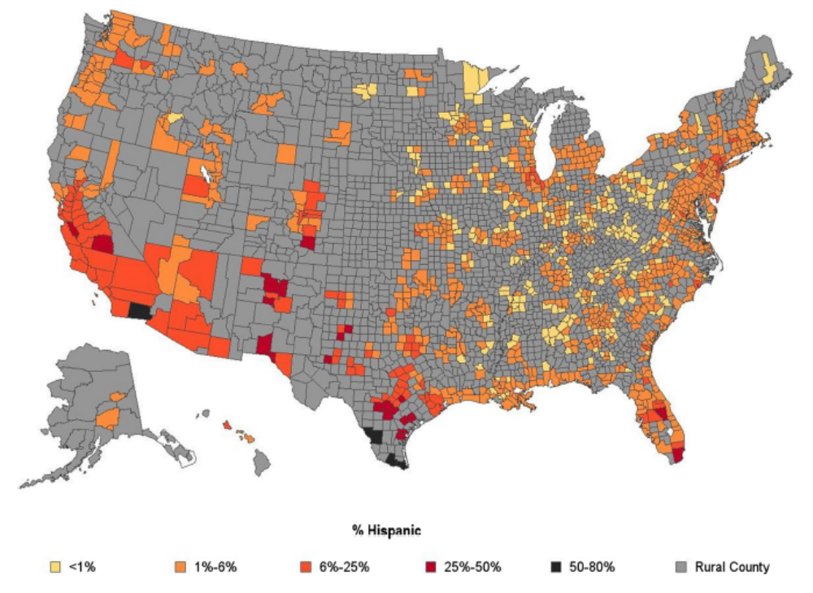
Study 4 Results: Geographic Distribution
Rural
Urban

Slide 26
Study 4 Results:
Biggest Differences Between Rural and Urban Hispanic VA Patients
Individual Differences;
Rural Hispanic VA Patients are:
More likely to be older (Age 65+: OR=1.7)
Less likely to be female (OR=0.7)
Less likely to be single (OR=0.7)
Less likely to be black (OR=0.6)
Area Differences;
Rural Hispanic VA Patients are:
More likely to live in:
Zip codes with high deprivation (OR=3.3)
Counties with large Mexican populations (OR=1.2)
Less likely to live in counties with large:
Foreign-born populations (OR=0.3)
Hispanic populations (OR=0.3)
Caribbean populations (OR=0.5)
South and Central American populations (OR=0.3)

Slide 27
Study 5 Results:
Biggest Changes over Time for Hispanic new VA Patients (2013-18 versus 2001-06)
Individual Differences;
Newer Hispanic VA Patients are:
Younger (Age 18-34: OR=3.9)
More likely to be female (OR=1.7)
Area Differences;
Newer Hispanic VA Patients are:
Less likely to live in:
A high-deprivation area (OR=0.7)
A county with a large foreign-born population (OR=0.8)
A county with a large Caribbean population (OR=0.4)
More likely to live in:
An urban area (OR=1.64)
A county with a large Hispanic population (OR=1.7)
The Midwest (OR=2.4)
The Northeast (OR=0.6)

Slide 28
Study 5:
Are any differences between rural and urban Hispanic VA Patients Driving the difference in suicide rate?
Differences in geographic distribution:
  Death by Suicide 2005-19
  Self Injury Mortality (SIM) 2005-19
Differences in characteristics of suicide decedents:
  N=771 Urban, 134 Rural
  Comparison of individual and area characteristics for rural and urban patients.
Differences in predictors of suicide:
  Stratified Random Forest Models for Rural and Urban
    1:1 Allocation over 1,000 random control populations
    Average mean decrease in accuracy for top 30 models
    70% training set, 30% testing set

Slide 29
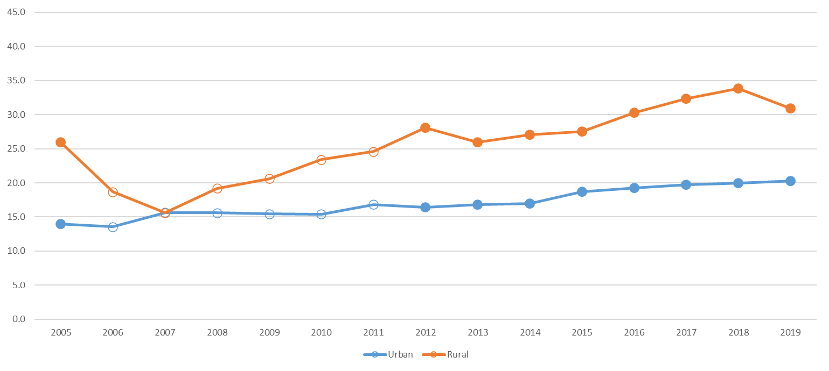
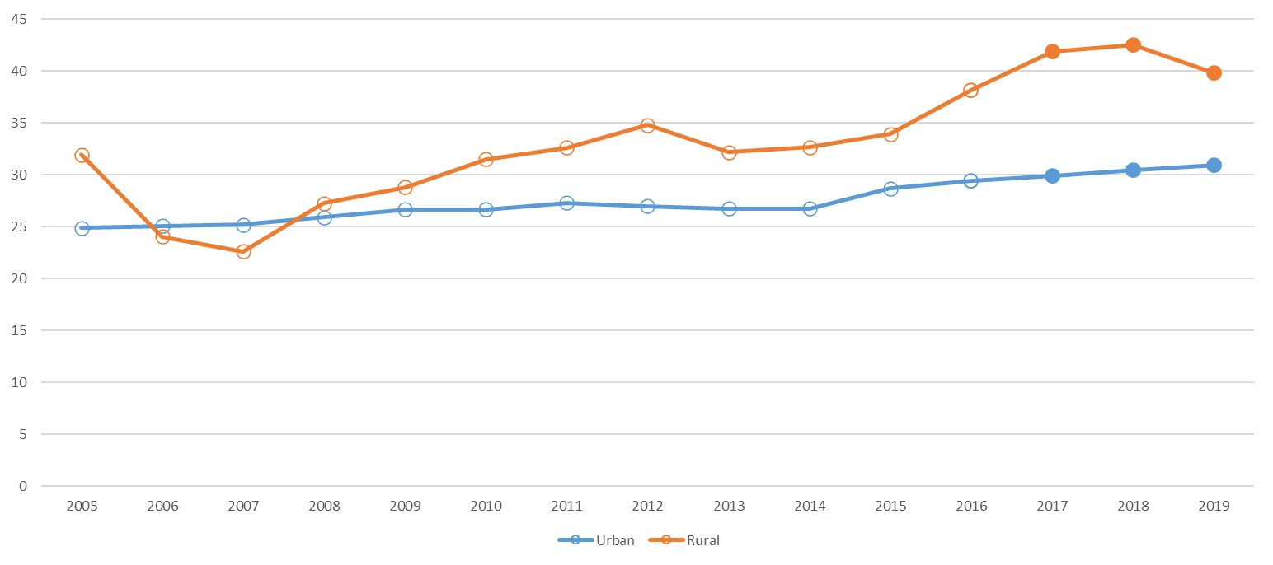
Study 5 Results: Suicide and Self Injury Mortality
Suicide
SIM

Slide 30
Study 5 Results:
Rural and Urban Hispanic VA Patients who Died by Suicide were generally similar.
Overall suicide rate higher in rural than urban.
  27.6 per 100K rural versus 19.6 per 100K urban; RR 1.4
Small numbers precluded rural versus urban reporting in several demographic subgroups.
Rural rates were higher in all subgroups we could report, but were particularly elevated for:
  Living in areas with low deprivation
    35.8 per 100K rural versus 18.5 per 100K urban; RR 1.9
  Living in the Midwest
    30.5 per 100K rural versus 16.5 per 100K urban; RR 1.9

Slide 31
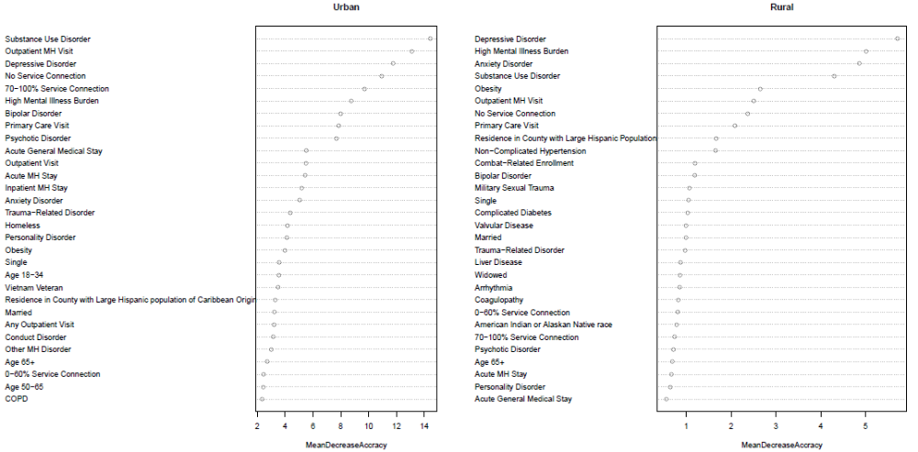
Study 5 Results: Prediction models had limited performance (Rural Accuracy: 0.62; 95% CI 0.61, 0.73, Urban Accuracy: 0.67; 95% CI 0.63, 0.70), and the most important predictors were mental health and substance use disorders for both rural and urban patients.

Slide 32
Study 6:
Can leveraging unstructured EHR help identify differences between rural and urban Hispanic VA patients that died by suicide?
Stratified sample of rural and urban Hispanic VA patients that died by suicide in 2015-18 (cases)
Age, sex, rurality, and care interval matched patients that did not die by suicide (controls); four controls per case
  Rural: Cases = 39; Controls = 148
  Urban: Cases = 273; Controls = 1090
Extraction of unstructured EHR from all clinical encounters
Semantic analysis of EHR corpus using Python-based toolkit that evaluates 500+ psychosocial variables
Dimensional reduction using LASSO, a penalized logistic regression method that is helpful for highly collinear data
Analysis of LASSO-identified variables using non-penalized logistic regression
Calculation of area under the receiver operating characteristic curve (AUC) to estimate average sensitivity and odds ratios to calculate variable directionality
Analysis of derived psychosocial variables in rural and urban models

Slide 33
Study 6 Results:
Differences Between Rural and Urban Hispanic VA Suicide risk models

Slide 34
Study 6 Results:
Differences between Rural and Urban Hispanic VA suicide risk models
Rural Hispanic Prediction Model
Very High AUC
Urban Hispanic Prediction Model
Moderate to Low AUC
Model only includes protective factors
Protective factors emphasize community and communal resources, including religion, kinship, and participation
Model includes both risk and protective factors
Protective factors emphasize communication, independence, and autonomy; Risk factors emphasize relationship difficulties and vices
Links to theoretical models that associate suicide risk with lack of communal interaction and social resources
Links to theoretical models that associate suicide risk with individual experience, deprivation
Suggests value of interventions targeting social connectedness
Suggests value of interventions targeting personal growth, mental health

Slide 35
General Thoughts
We were funded by the Office of Rural Health to Study the Rural-Urban Suicide Disparity among VA Patients so we could do something about it.
Among non-Hispanic VA patients, I am not convinced there is a Rural-Urban Suicide disparity.
  But there could still be a need for tailored rural and urban prevention.
Among Hispanic VA patients, there appears to be a Rural-Urban Suicide disparity, but the cause is not clear.
  I had not initially thought of a next “database” project in this area with the White River Junction Rural Health Resource Center.
    Examining additional demographic groups becomes challenging due to small sample size within the rural stratum.
  The NLP Work Suggest Thematic Differences in Clinical notes between Rural and Urban Hispanic Patients, but again data gets thin.

Slide 36

Team Members
White River Junction
  Epidemiologists: Talya Peltzman, Dan Gottlieb
  Statisticians: Jiang Gui, Sara Cornelius
  Psychiatrists: Natalie Riblet, Vince Watts
  Health Services Researchers: Jenna Park (Forehand), Maxwell Levis
Gainesville
  Health Services Researcher: Maggie Freytes

Slide 37
References
Shiner, B., Peltzman, T., Cornelius S.L., Gui, J., Forehand, J., Watts, B.V. (2021) Recent Trends in the Rural-Urban Suicide Disparity among Veterans using VA Health Care, Journal of Behavioral Medicine, 44(4):492-506.
Shiner, B., Peltzman, T., Cornelius, S.L., Gui, J., Jiang, T., Riblet, N., Gottlieb, D.J., Watts, B.V. (2022) Influence of Contextual Factors on Death by Suicide in Rural and Urban Settings, Journal of Rural Health, 38(2):336-45.
Peltzman, T., Gottlieb, D.J., Levis, M., Shiner, B. (2022) The Role of Race in Rural-Urban Suicide Disparities, Journal of Rural Health, 38(2):346-54.
Peltzman, T., Rice, K., Jones, K.T., Washington, D.L., Shiner, B. (2022) Optimizing Data on Race and Ethnicity for Veterans Affairs Patients. Military Medicine, 187(7-8): e955-962.
Peltzman, T., Forehand, J.A., Freytes, I.M., Shiner, B. (2022) Rural and Urban Hispanic Patients of the Veterans Health Administration, Journal of Racial and Ethnic Health Disparities, 10(5):2273-83.
Shiner, B., Peltzman, T., Forehand, J., Gui, J., Freytes, I.M., Watts, B.V. (2022). Examination of Increasing Suicide Rates Among Rural Hispanic VA Patients. Journal of Rural Health, 39(3):565-74.
Peltzman, T., Park, J., Shiner, B. (2023) Development and validation of a prognostic index for mental health and substance use disorder burden, General Hospital Psychiatry, 85:213-19.
Levis, M., Dimambro, M., Levy, J., Natalie, R., Watts., B.V., Shiner, B. (2025) Using Natural Language Processing to Inform Targeted Rural and Urban Hispanic VA Suicide Prediction Models, Journal of Rural Mental Health, 10.1037/rmh0000320.

