Slide 1
NOVA
VISN 1 RISE Update
October 22, 2026
Brett Rusch, MD; HSA 1.1 Director
Representing Ryan Lilly, VISN 1 Network Director

Slide 2
RISE (Restructure for Impact &
Sustainability Effort)
GOAL: To increase efficiency and improve the quality of care provided to Veterans by aligning with the President’s objectives stated in Executive Order 14210.
SCOPE: The restructure includes VHA Central Office for policy and governance, Operations Centers and VISNs for oversight and implementation, and 139 Health Care Systems for direct patient care.

Slide 3
RISE Will:
Enhance Veteran care by functionally aligning the organization to improve quality and safety, ensure seamless coordination between direct and community‑based services, and drive better health outcomes.

Slide 4
RISE Will:
Strengthen operational consistency by establishing a unified governance and planning framework that reduces conflicting guidance and standardizes implementation of clinical and business operations across all Department of Veterans Affairs (VA) health systems.

Slide 5
RISE Will:
Increase market‑level agility by breaking down communication and decision‑making silos so VHA can respond to regional and local needs, adapt to emerging health care trends, and integrate new technologies faster.

Slide 6
RISE Will:
Focus on care delivery by streamlining operations and eliminating unnecessary bureaucracy so resources can be redirected to frontline care – improving the quality, timeliness, and consistency of services delivered to Veterans.

Slide 7
VHA Future State
Central Office (Policy): Responsible for governance, strategy, compliance, and national programs.
Operations Centers (Implementation): Overseeing enterprise care capacity, policy execution, and operational coordination.
Health Care Systems (Execution): Delivering direct care at over 1,700 sites with greater autonomy and reduced administrative burden

Slide 8
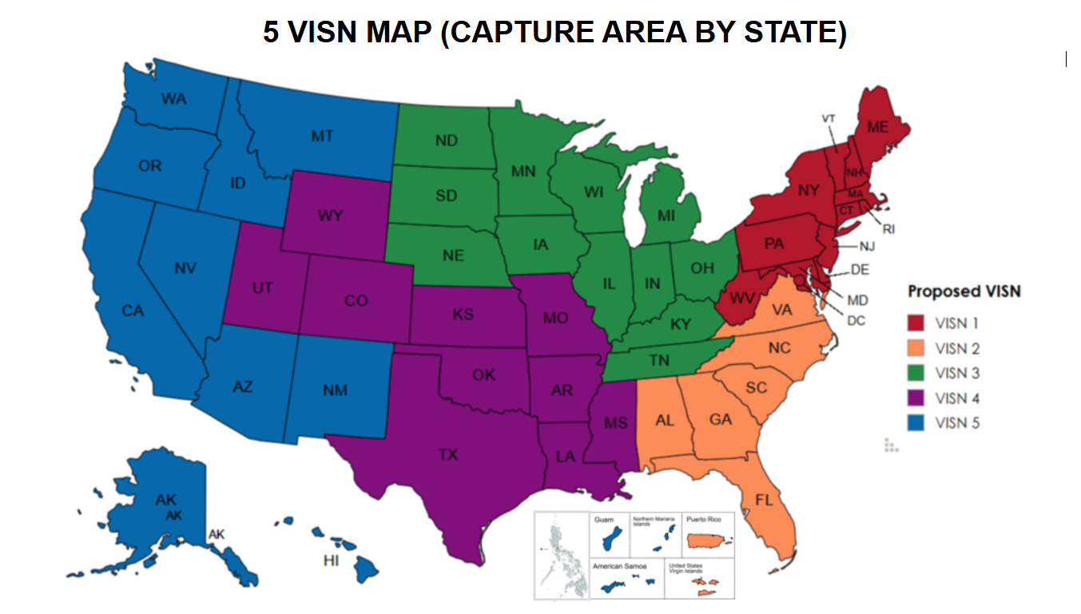
VISN Restructure

Slide 9
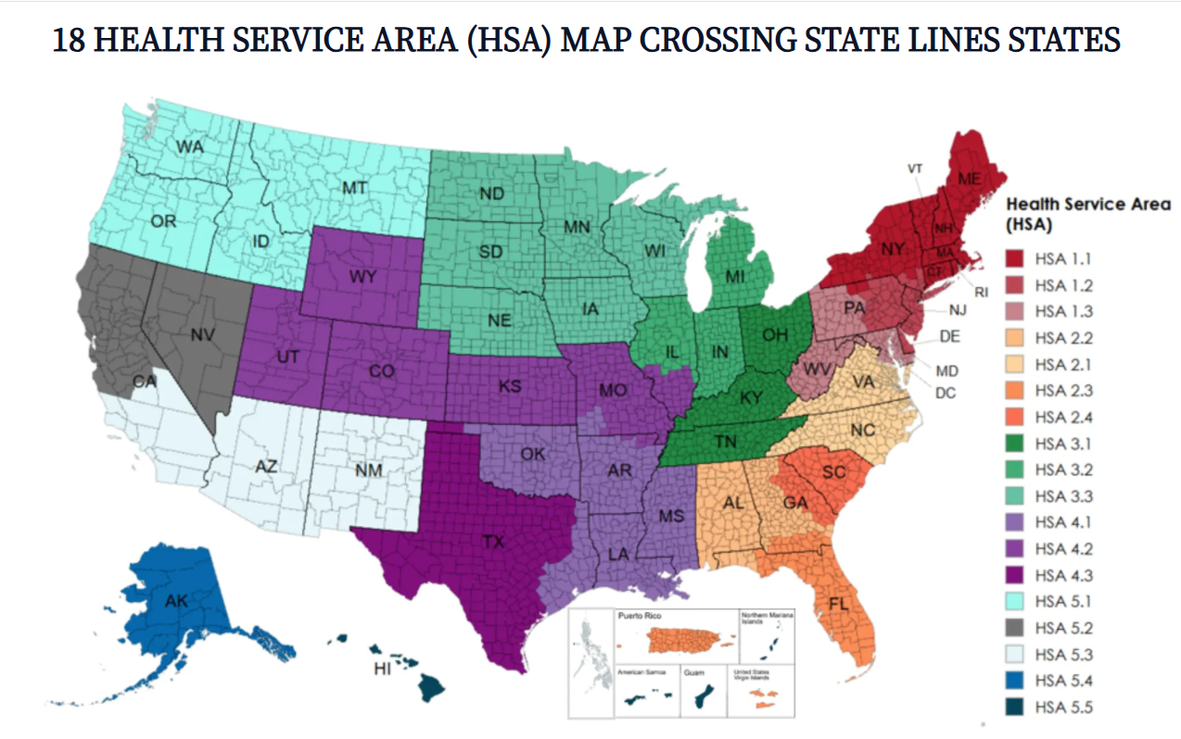
HSA Restructure

Slide 10
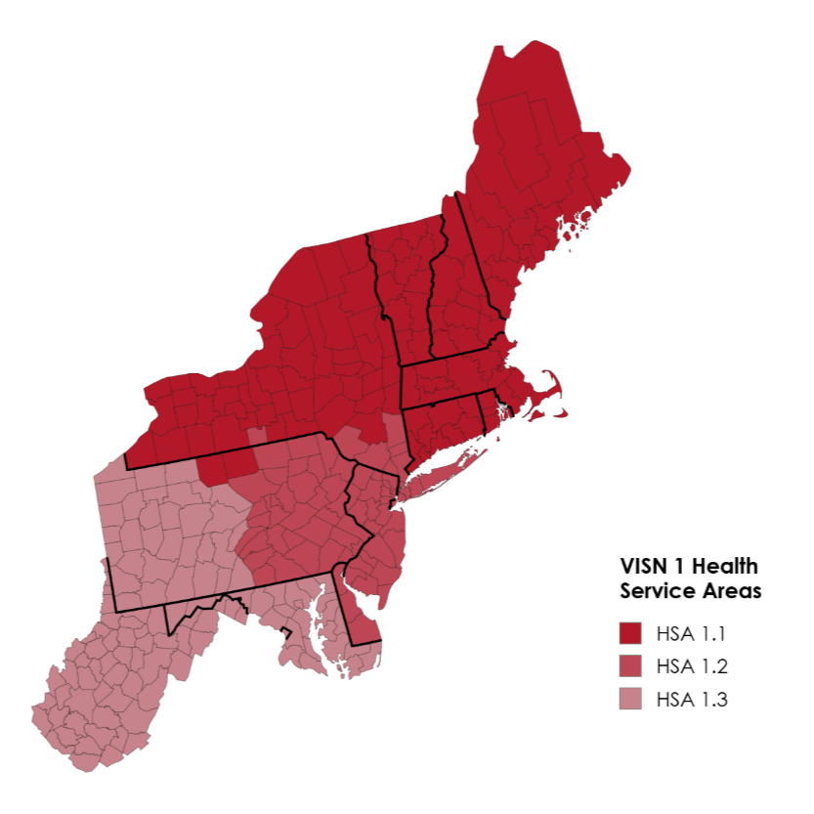
What is the new VISN 1?
Comprised of legacy VISNs
1, 2, 4, 5
Includes 12 states and DC
32 Medical Centers, 43 campuses, and 141 CBOCs
1a Facilities- 7
1b Facilities- 11
1c Facilities- 11
2 Facilities- 3
3 Facilities- 11

Slide 11
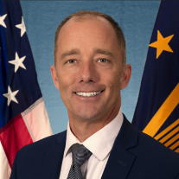
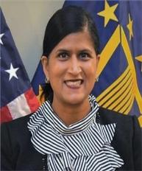
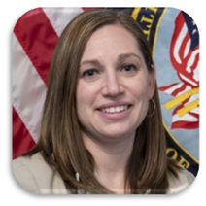
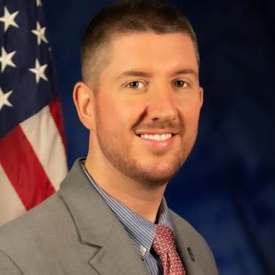
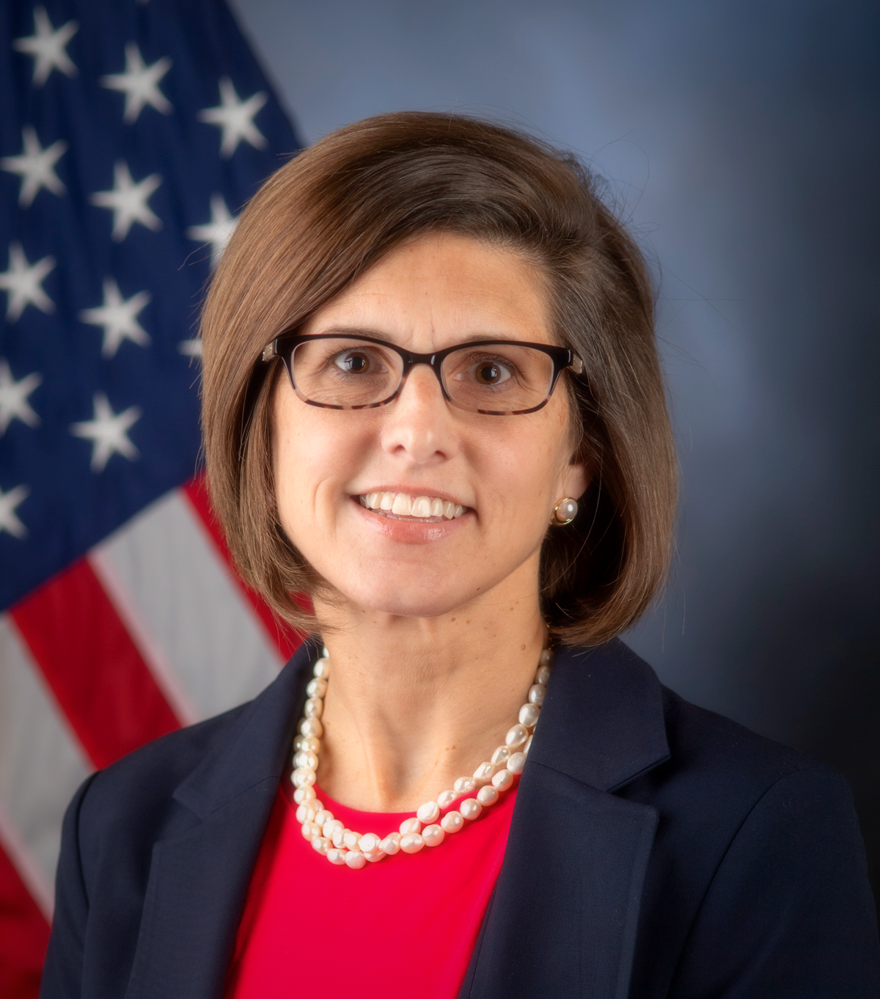
Introductions - VISN 1
VISN 1 Network Director
Ryan Lilly, MPA
VISN 1 Chief Medical Officer
Latha Sivaprasad, MD, FACP, FHM
Interim VISN 1 Chief Nursing Officer- Ashley Klick, MSN, MHA, BSN, RN
Interim VISN 1 Deputy Network Director
Joseph Scotchlas, FACHE
VISN 1 Quality Management Officer
Kelly O’Connell

Slide 12
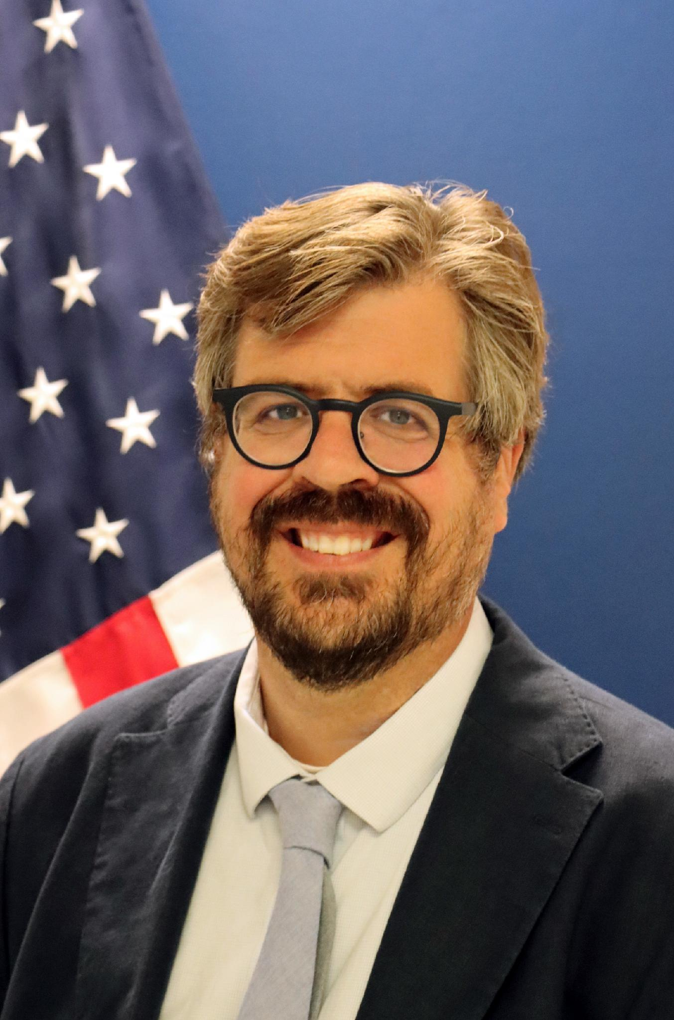
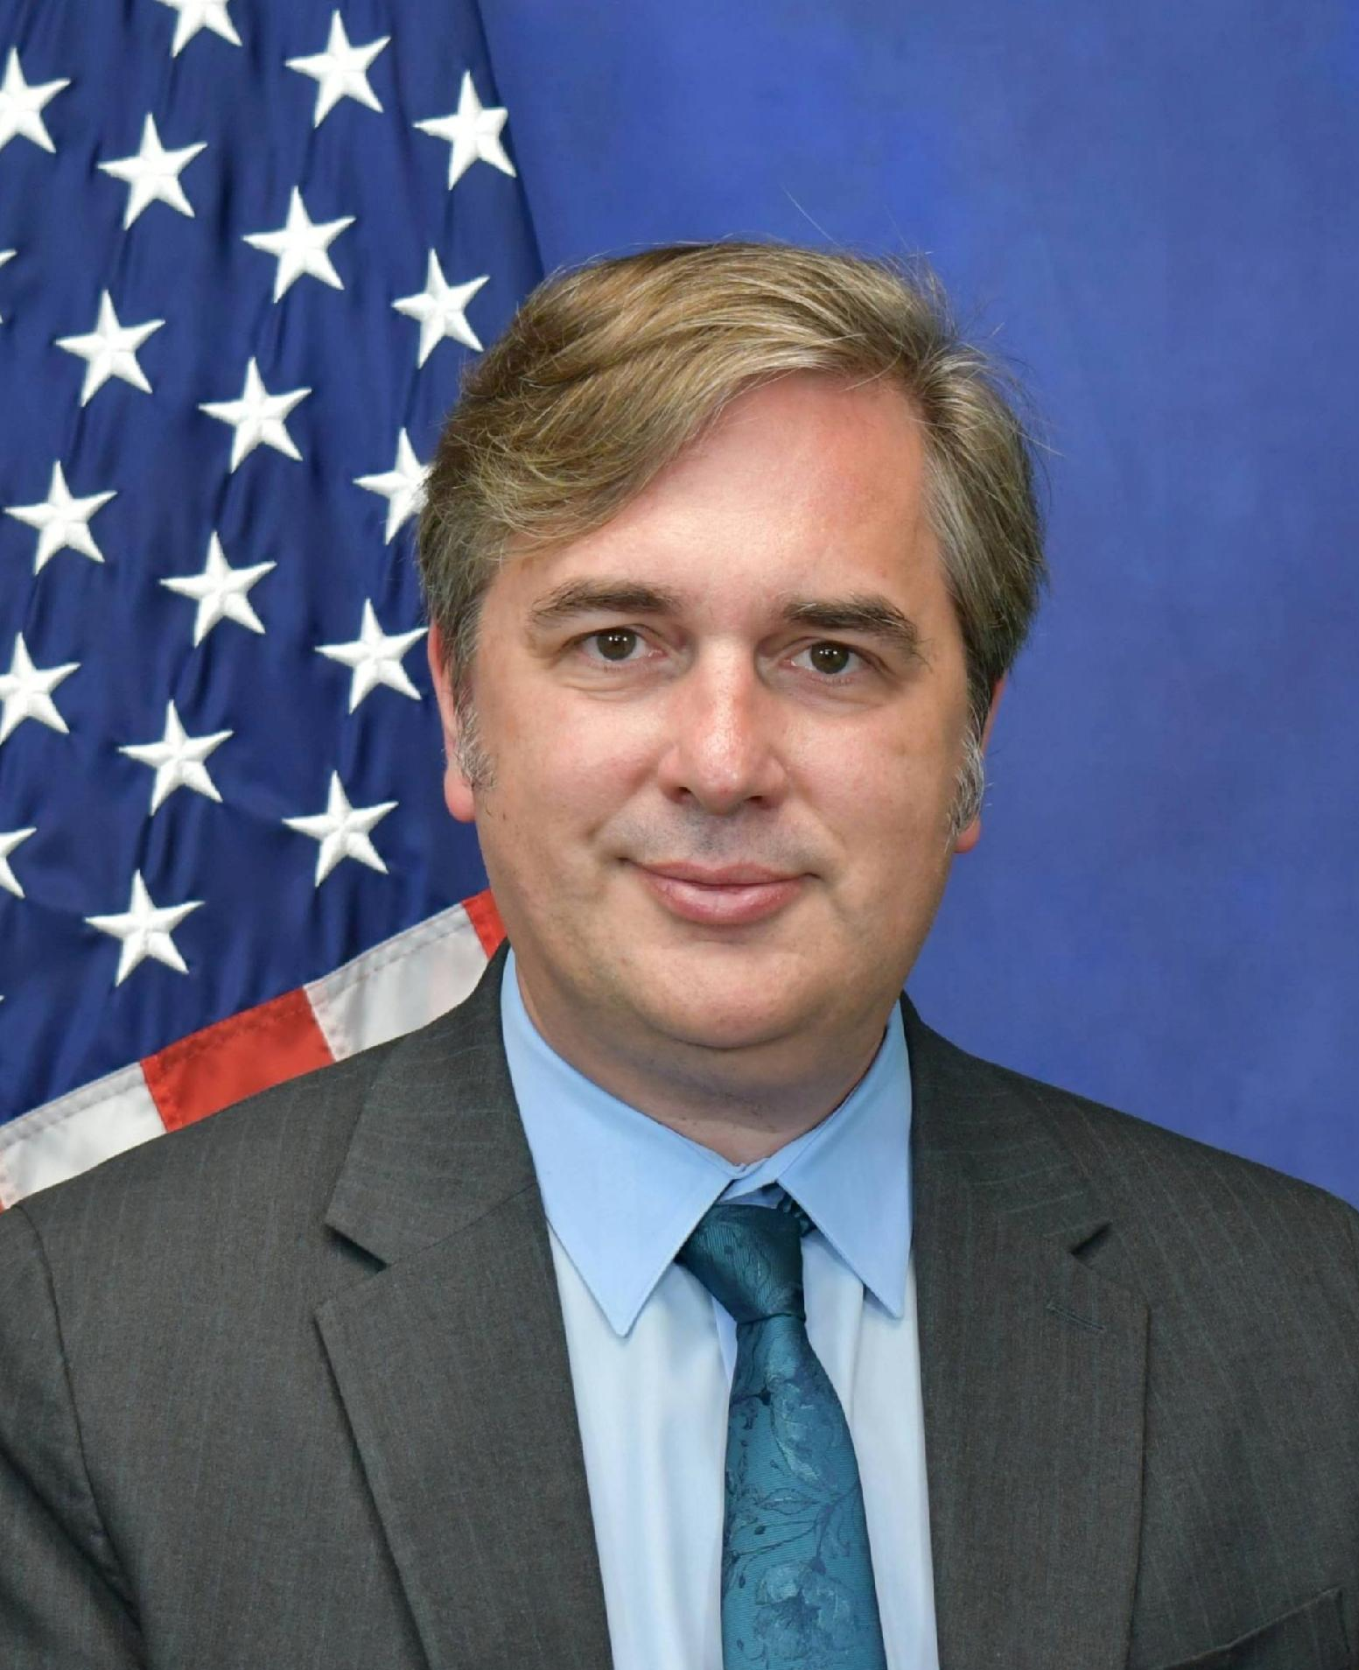
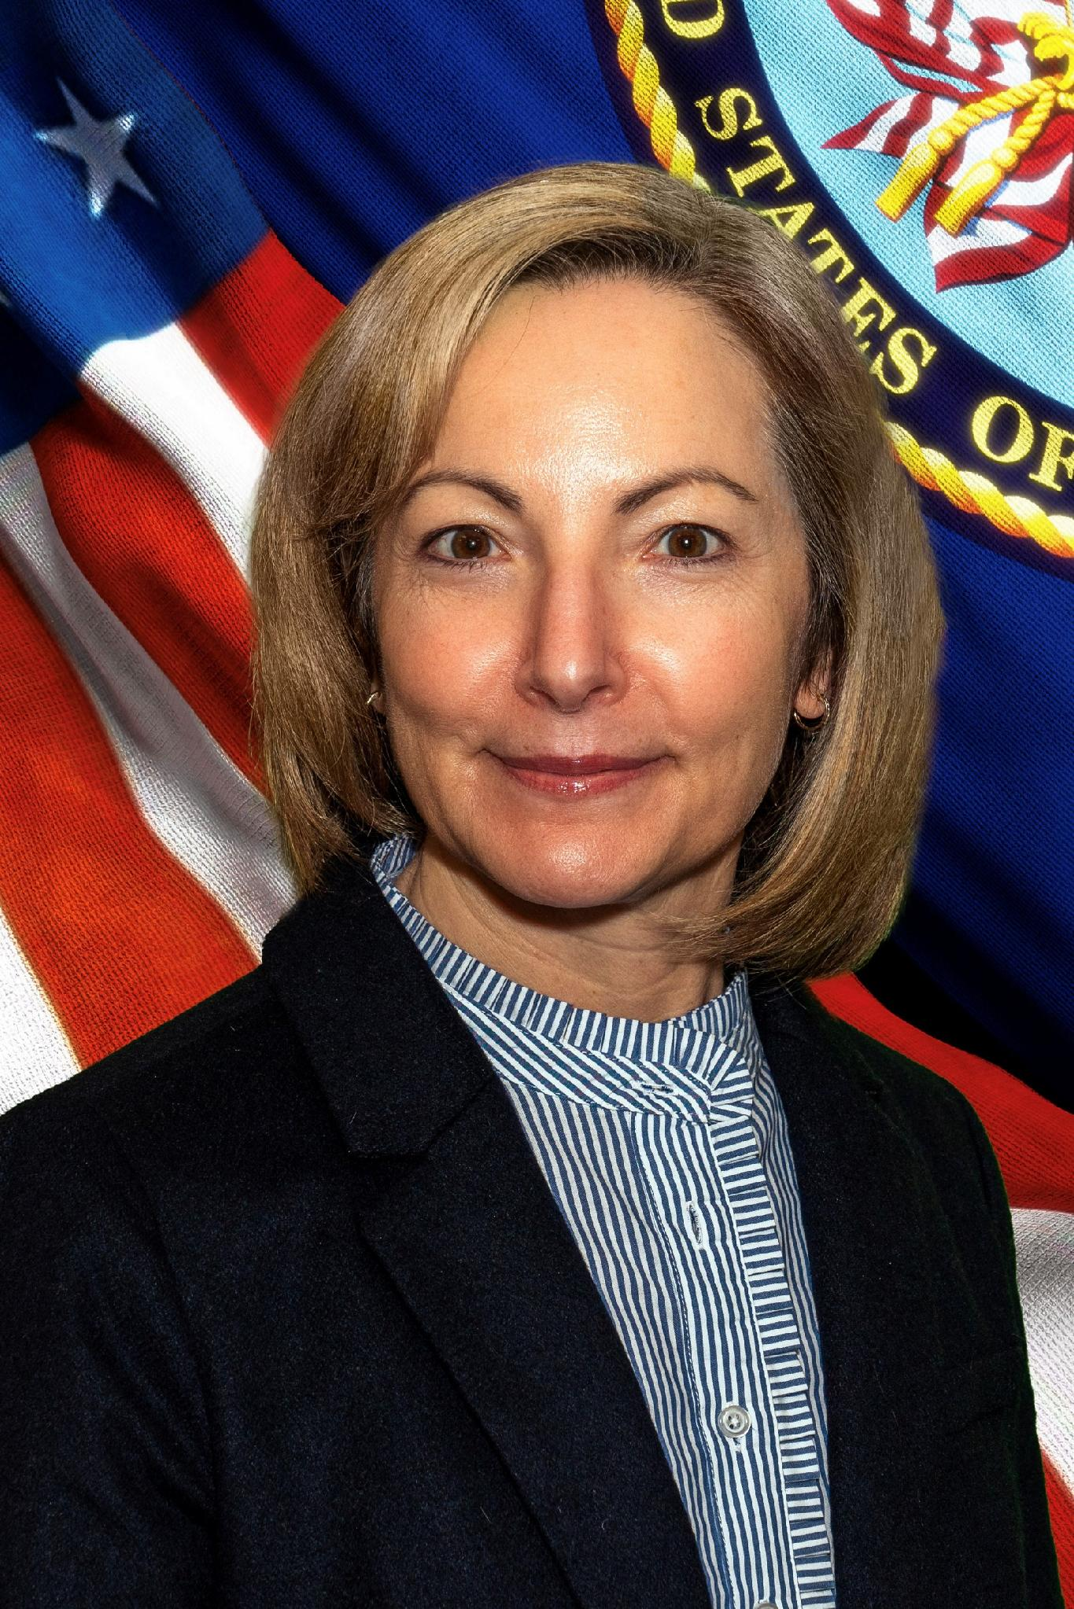
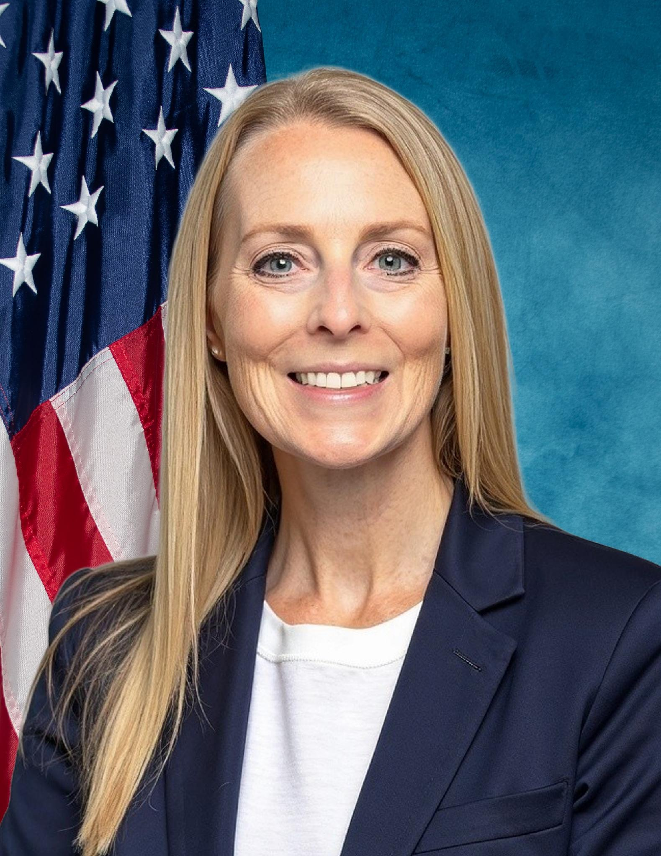
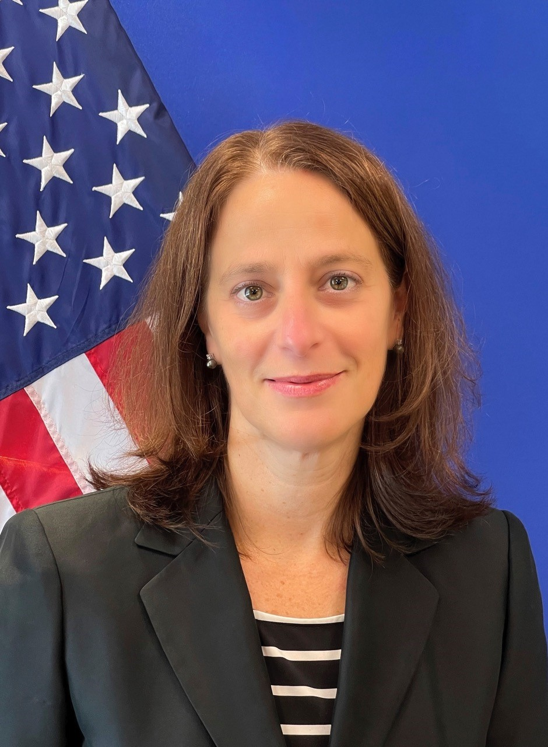
Introductions – HSA 1.1
HSA 1.1 Executive Director Brett D. Rusch, MD
Interim HSA 1.1 Regional Medical Officer
Donald A. McDonald, MD
Interim HSA 1.1 Regional Nursing Officer
Jennifer F. Winslow, MBA, MSN, APN, FNP-BC
HSA 1.1 Regional Quality Officer
Carla Spinelli, PhD, RN-BC, CPHQ

Slide 13
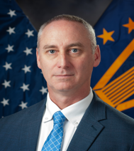
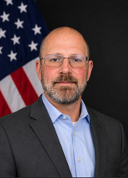
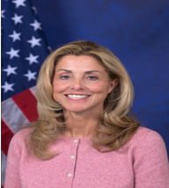
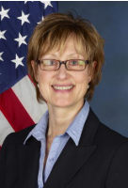
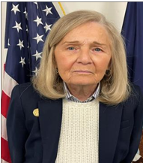
Introductions- HSA 1.2
HSA 1.2 Executive Director
Bruce Tucker, LCSW-R
Interim HSA 1.2 Regional Operating Officer
Michelle Goetz, FACHE
Interim HSA 1.2 Regional Medical Officer
Matthew Garin, MD
Interim HSA 1.2
Regional Quality Officer
Pamela Wright, RN, MSN
Interim HSA 1.2 Regional Nurse Officer - Lisa Lehning, MSN, NP

Slide 14
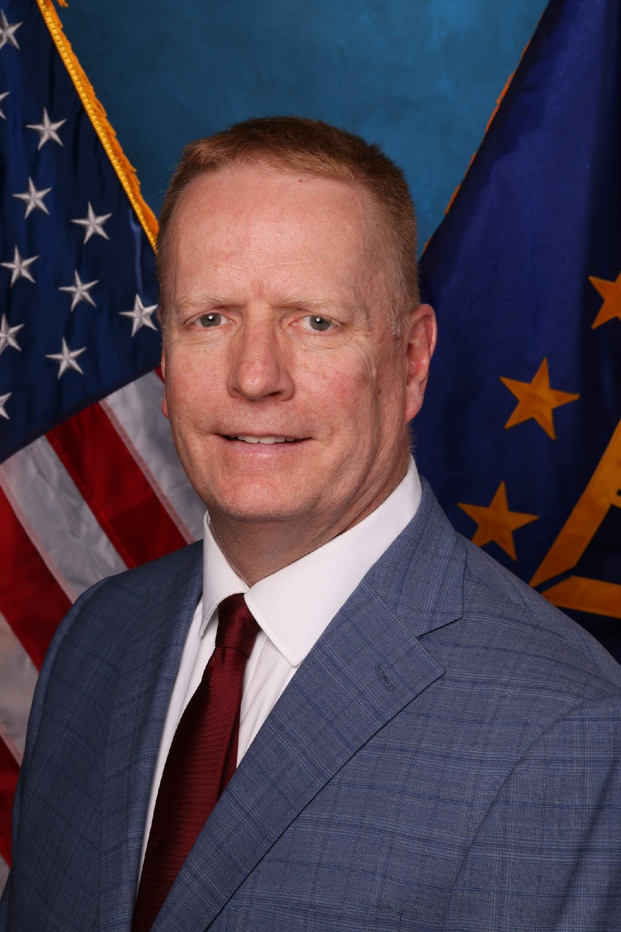
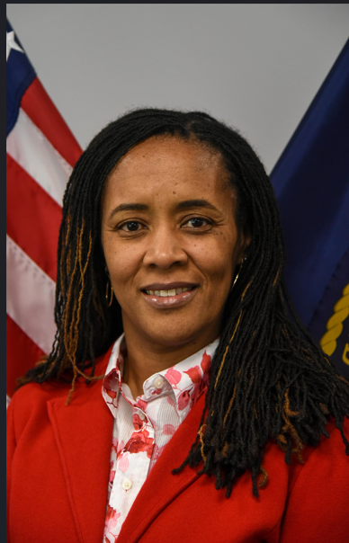
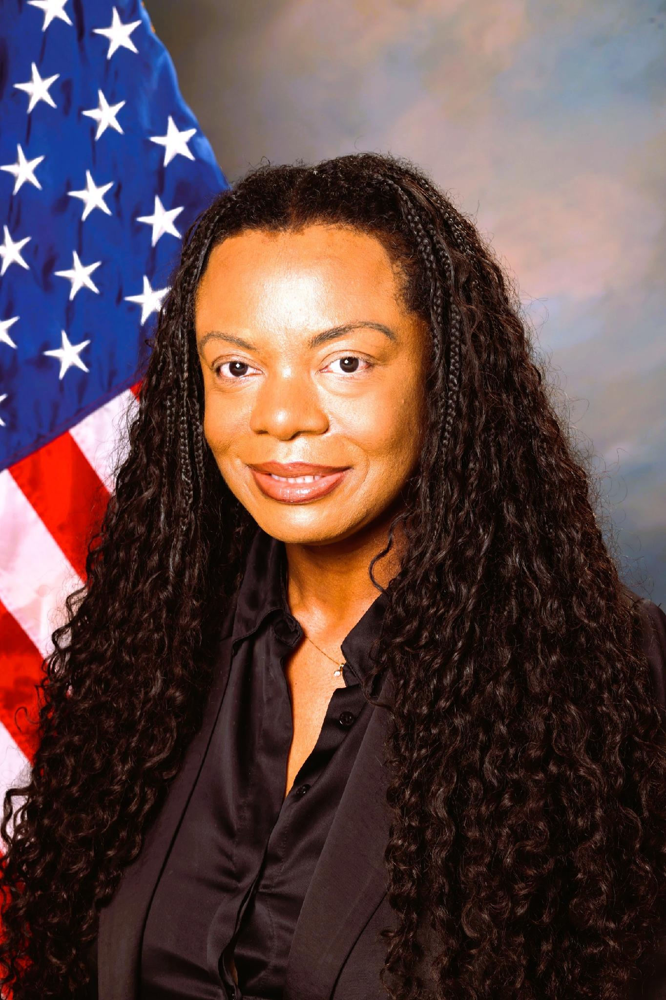
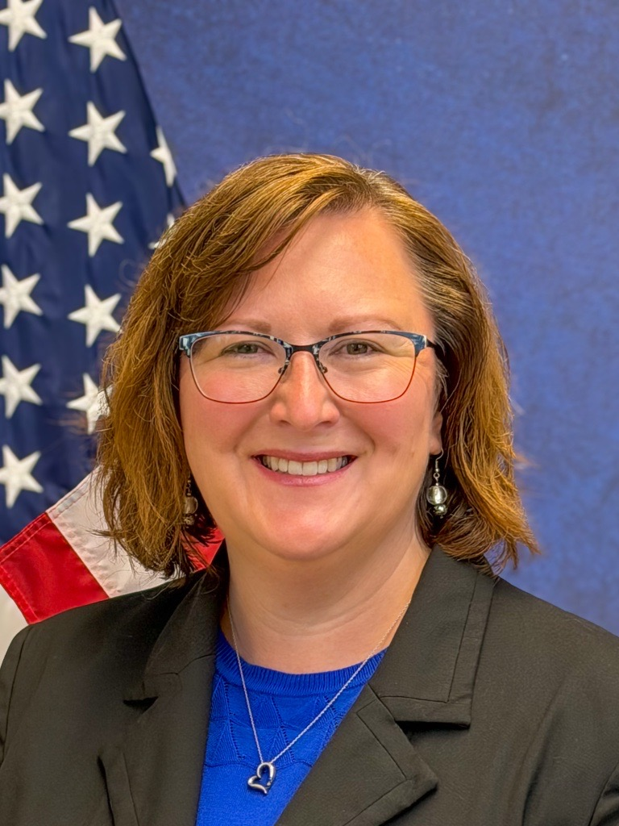
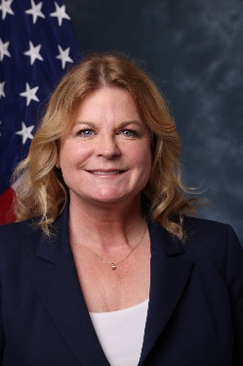
Introductions- HSA 1.3
HSA 1.3 Interim Executive Director
Dan Dücker, MSS, MEd
HSA 1.3 Interim Regional Medical Officer
Dr. Michalle Buchanan, MD, FACEP, MMM
HSA 1.3 Interim Regional Nursing Officer
La-Kenya Rushing, DHA, MSN, RN
HSA 1.3 Interim Regional Operating Officer
Bridget Brozyna, DNP, APRN, NEA-BC
HSA 1.3 Interim Regional Quality Officer
Roxanne Guadagna, BS, BSN, MHSA, CPHQ

