Slide 1
Title
Presenter Name, Credentials
Presenter Title
Presenter Contact Info
Notes:
Refrain from using commercial logos, or brand name pharmaceuticals in your presentation.
Presenters do not need to use these slides, but can use them to develop their own presentations. Presenters may change the font, and design to suit your style and subject.

Slide 2
Disclosure
<Presenter> has no actual or potential conflict of interest in relation to this program/presentation.
Or
<Presenter> has the following financial relationships to disclose: (omit those that do not apply)
  Grant/Research Support from: List all companies or emit for no disclosure.
  Speaker’s Bureau for: List all companies or emit for no disclosure.
  Consultant for: List all companies or emit for no disclosure.
  Stockholder in: List all companies or emit for no disclosure.
  Honoraria from:
  Employee of:
  Other: List all companies or emit for no disclosure.

Slide 3
Disclosure
I will not discuss off label use and/or investigational use in my presentation.
or
I will be discussing off-label uses and/or investigational use of the following medications in my presentation:
  List Medications
  List Medications
  List Medications
Notes:
You can combine this with the previous slide if space allows

Slide 4
Objectives
At the completion of this program, the participant will be able to: For Pharmacists
At the completion of this program, the participant will be able to: For Technicians (if applicable)
Notes:
Words for Objectives:
Application based learning words: analyze, compare, contrast, devise a method, differentiate, discriminate, distinguish, estimate, identify the variables, interpret, justify, reformulate, relate, etc
Knowledge based learning words: define, describe, examine, explain, identify, illustrate, imitate, measure, prepare, etc
Avoid using the words: Be familiar with, figure out, know, learn, grasp, imagine, master, realize, remember, thing, understand
See page 5 of the WSPA Speaker Packet for more information about developing objectives

Slide 5
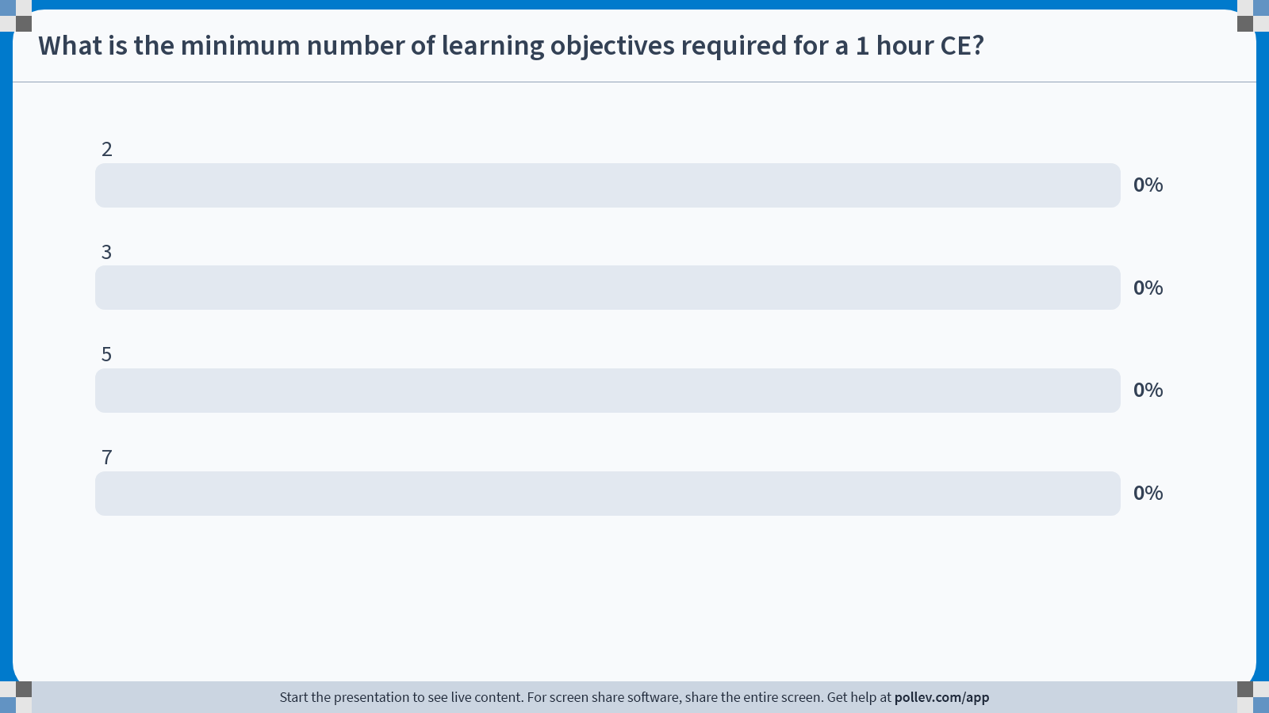
Notes:
Poll Title: Do not modify the notes in this section to avoid tampering with the Poll Everywhere activity.
More info at polleverywhere.com/support
What is the minimum number of learning objectives required for a 1 hour CE?
https://www.polleverywhere.com/multiple_choice_polls/DYPRxpFa6ELIkMW0gxYDO?state=opened&flow=Default&onscreen=persist

Slide 6
Notes:
Poll Title: Do not modify the notes in this section to avoid tampering with the Poll Everywhere activity.
More info at polleverywhere.com/support
What is the minimum number of learning objectives required for a 1 hour CE?
https://www.polleverywhere.com/multiple_choice_polls/WE1zNQSgLQzhQDoBbu2Gb?state=opened&flow=Default&onscreen=persist

Slide 7
Notes:
Poll Title: Do not modify the notes in this section to avoid tampering with the Poll Everywhere activity.
More info at polleverywhere.com/support
True or False: You need to disclose in your presentation whether or not you will be discussing non-FDA approved drugs/devices.
https://www.polleverywhere.com/multiple_choice_polls/Dmg7VZ8PtfqnfZZRQnIMg?state=opened&flow=Default&onscreen=persist

Slide 8
Notes:
Poll Title: Do not modify the notes in this section to avoid tampering with the Poll Everywhere activity.
More info at polleverywhere.com/support
True or False: You need to disclose in your presentation whether or not you will be discussing non-FDA approved drugs/devices.
https://www.polleverywhere.com/multiple_choice_polls/lgq4guRjJLsk34fqGs5gX?state=opened&flow=Default&onscreen=persist

Slide 9
Body Slide
Please limit the content of the slides to enhance the presentation, but not distract the learner from listening

Slide 10
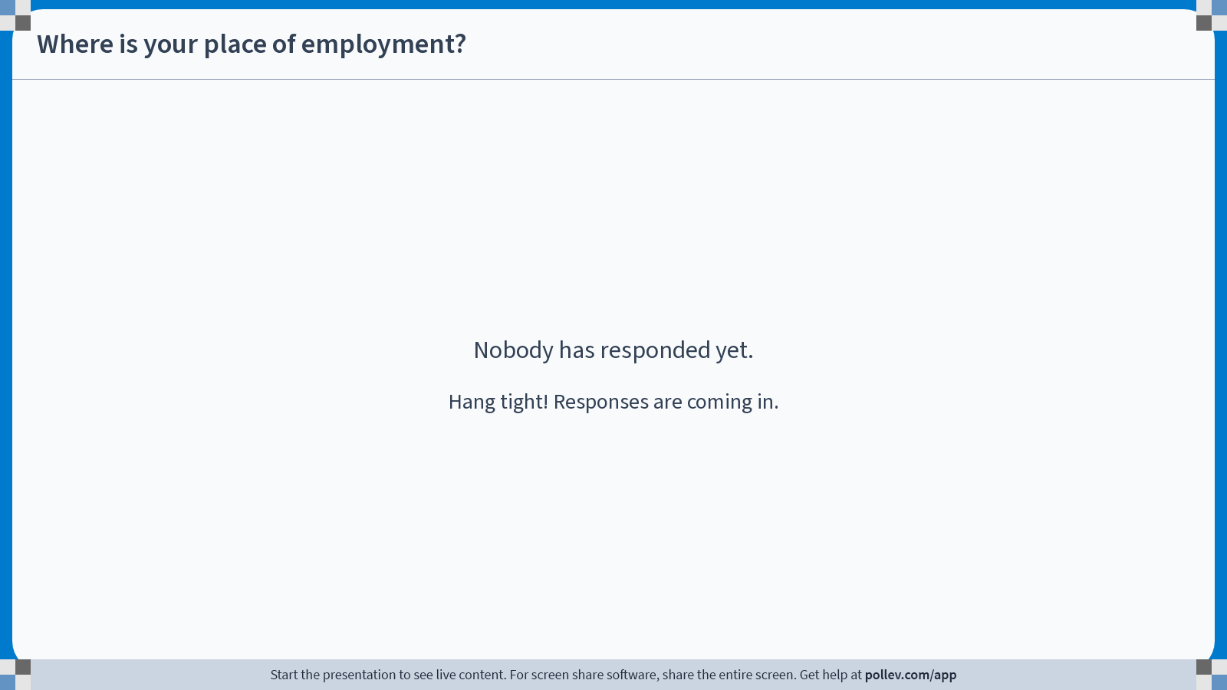
Notes:
Poll Title: Do not modify the notes in this section to avoid tampering with the Poll Everywhere activity.
More info at polleverywhere.com/support
Where is your place of employment?
https://www.polleverywhere.com/free_text_polls/xyGrFqOZZUQlxuRNaynuB

Slide 11
Questions or Case Discussion
Notes:
Adult learners appreciate opportunities to apply the knowledge they are gaining. Also, speakers do better when they assess the learner’s knowledge, and embedded questions accomplish this goal. There should be a minimum of 1 question for each learning objective during the presentation.
Software such as https://getkahoot.com or https://www.mqlicker.com are free resources to actively poll and engage the audience. Audience responses can be embedded in the slides for real time reporting. Furthermore WSPA learners give talks with case based discussions and/or polling the highest marks!

Slide 12
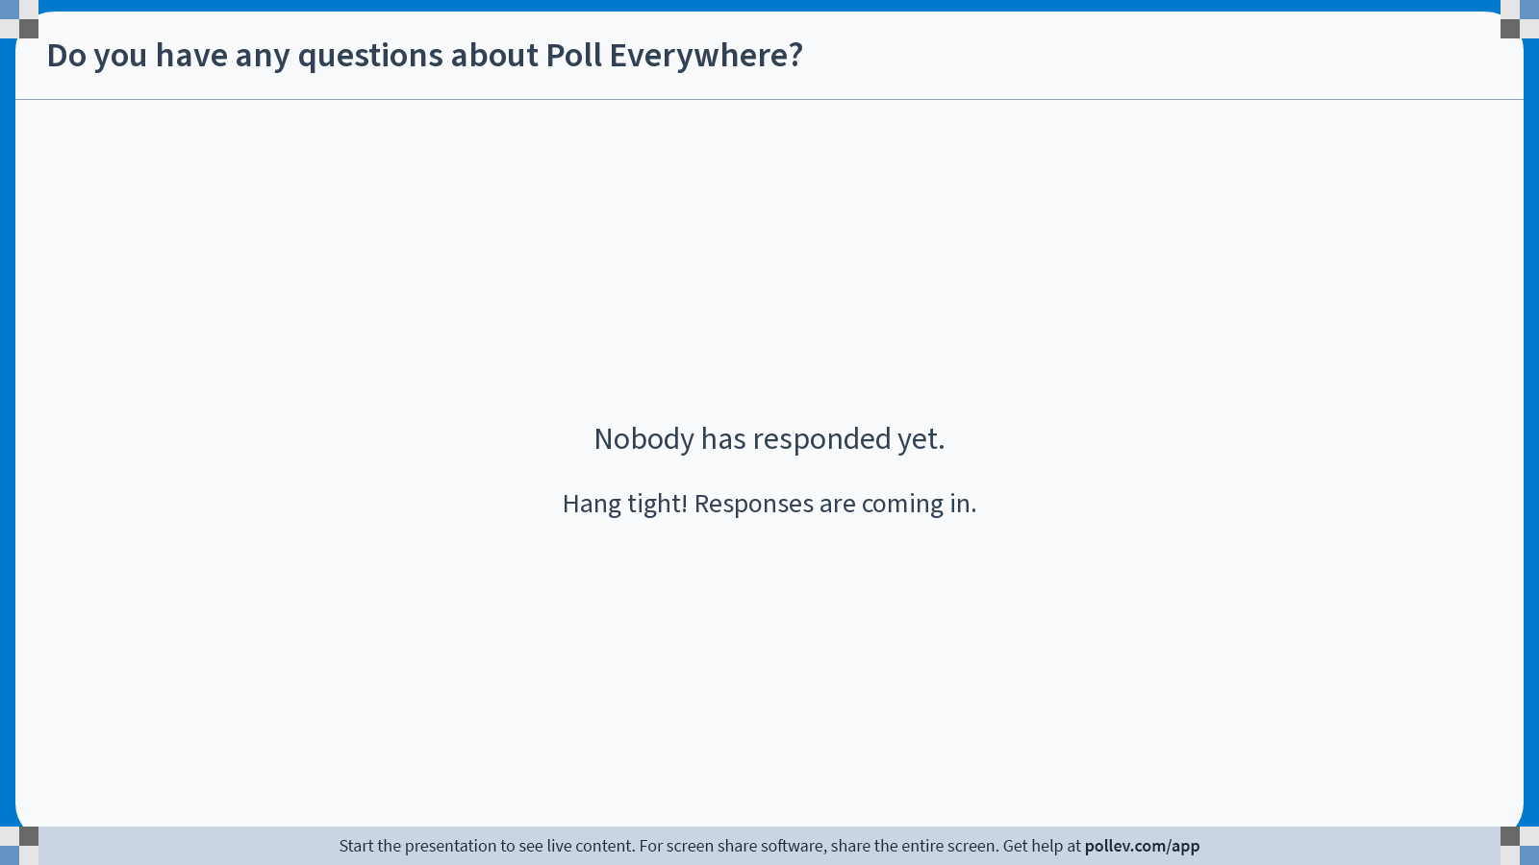
Notes:
Poll Title: Do not modify the notes in this section to avoid tampering with the Poll Everywhere activity.
More info at polleverywhere.com/support
Do you have any questions about Poll Everywhere?
https://www.polleverywhere.com/free_text_polls/wnwmjE4GaaAespDWV1ASl

Slide 13
References
Notes:
References can be included in footnotes on each slide or at the end. Referencing data and information helps learners to go back and implement what they have learned at their sites.

